Slide 1
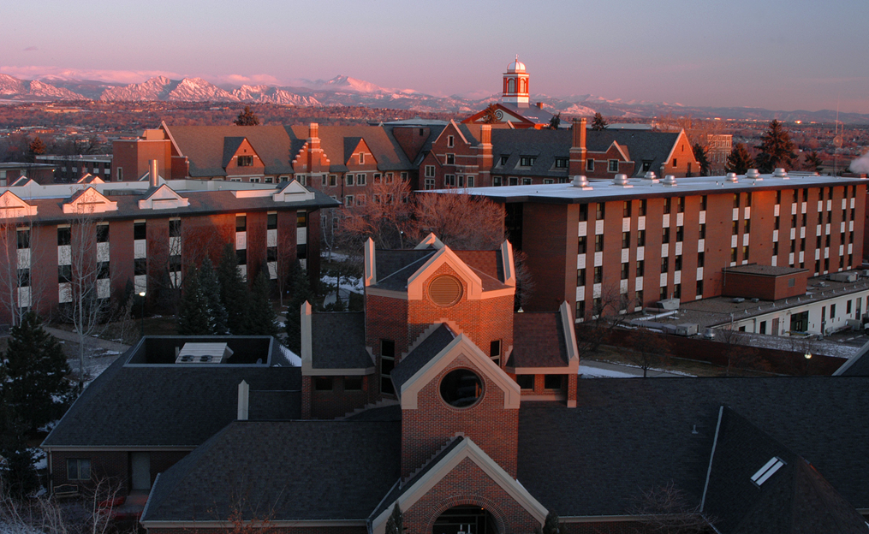
CC&IS
College of Computer & Information Sciences

Slide 2
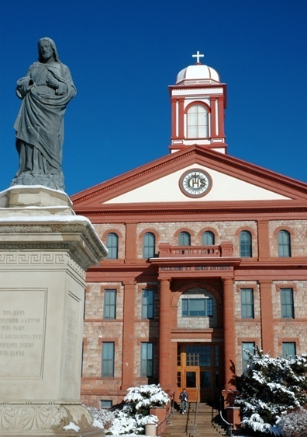
Quality and Tradition of Regis
138 year-old Jesuit, Catholic
institution (Founded 1877)
Regis is one of twenty-eight
Jesuit Universities:
Boston College
Fordham University
Georgetown University
Marquette University
Santa Clara University
University of San Francisco

Slide 3
5 Colleges → 1 Mission
College of Computer & Information Sciences (CC&IS)
College of Business & Economics
Regis College
Rueckert Hartman School for Health Care Professions
College for Professional Studies (CPS)
School of Humanities & Social Sciences
School of Teacher Education

Slide 4
College of Computer & Information Sciences
SCIS ranked 85th out of 1,265 institutions for the number of Bachelor’s degrees awarded in the computing field.
(According to the 2011 data by the National Science Foundation)
SCIS ranked 59th out of 4430 institutions for the number of Master’s degrees awarded in Computing field.
(According to the 2011 data by the National Science Foundation)

Slide 5
CC&IS Programs
Four Bachelor’s and Six Master’s programs
BS in Business Technology Management
BS in Computer Information Systems*
BS in Computer Networking *
BS in Computer Science *
* ABET CAC accredited Program
4+1 Combined Bachelor of Science and Master of Science Degrees

Slide 6
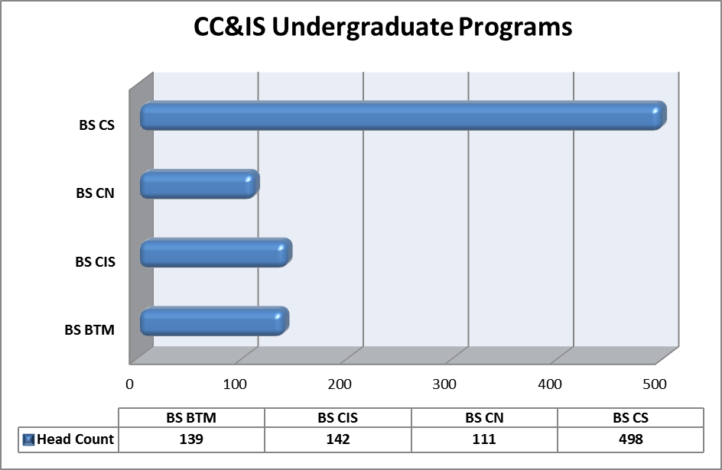
CC&IS

Slide 7
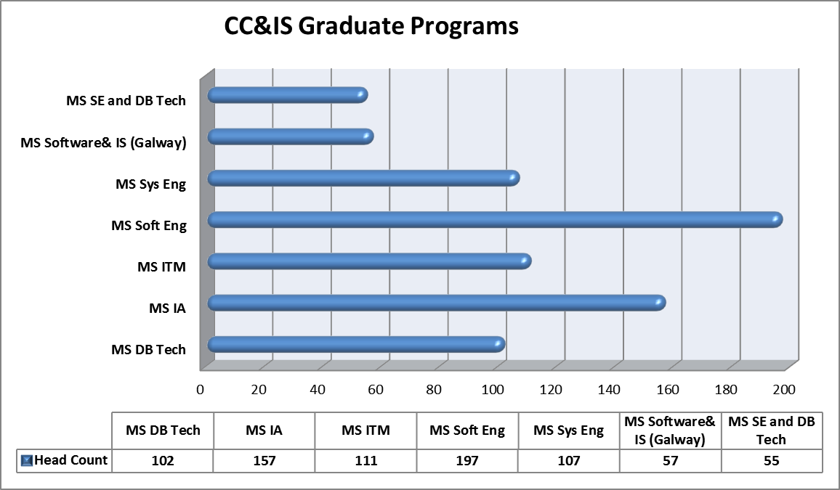
CC&IS

Slide 8
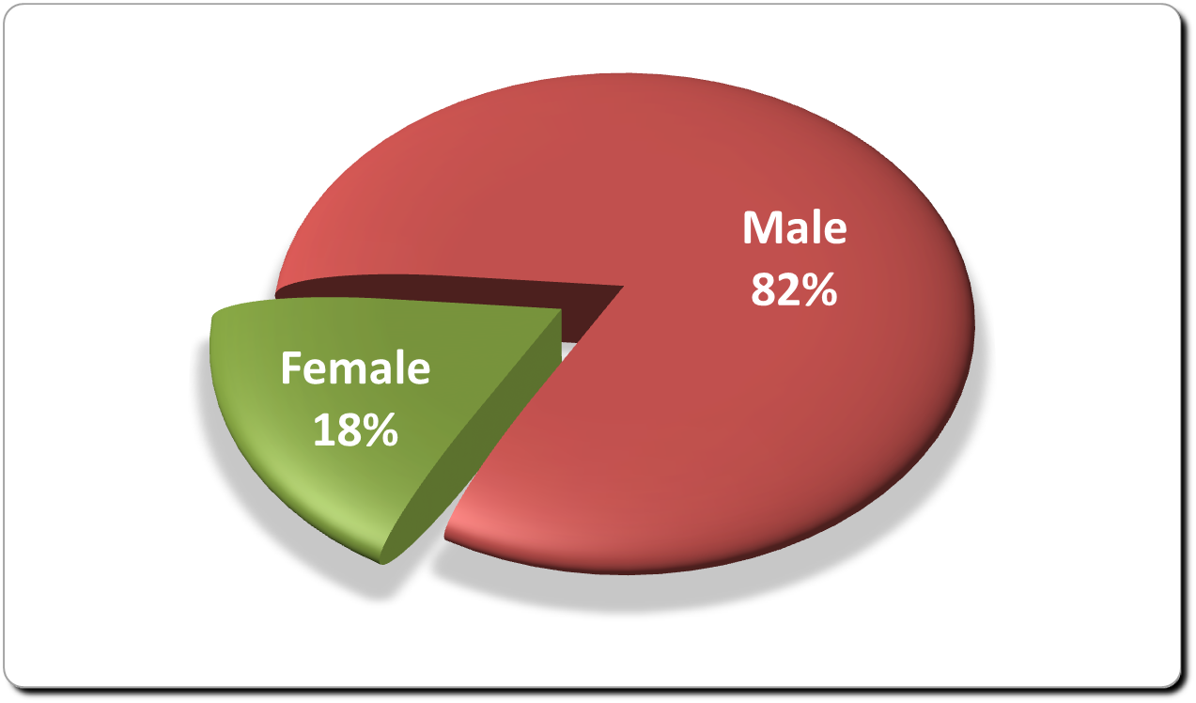
CC&IS UG Gender Distribution

Slide 9
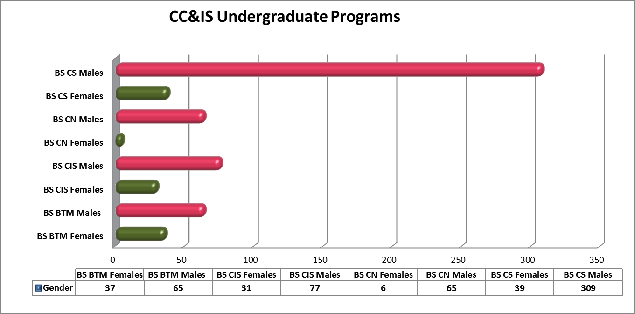
CC&IS UG Gender Distribution

Slide 10
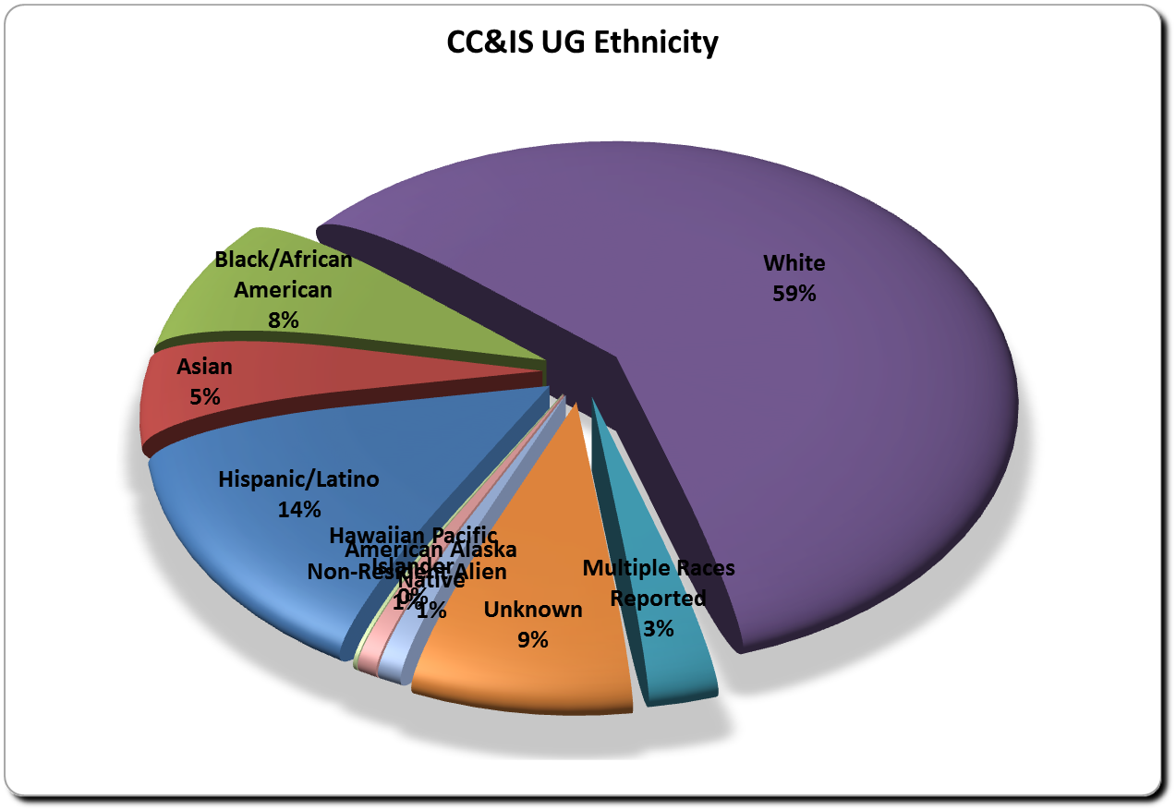
CC&IS UG Ethnic Distribution

Slide 11
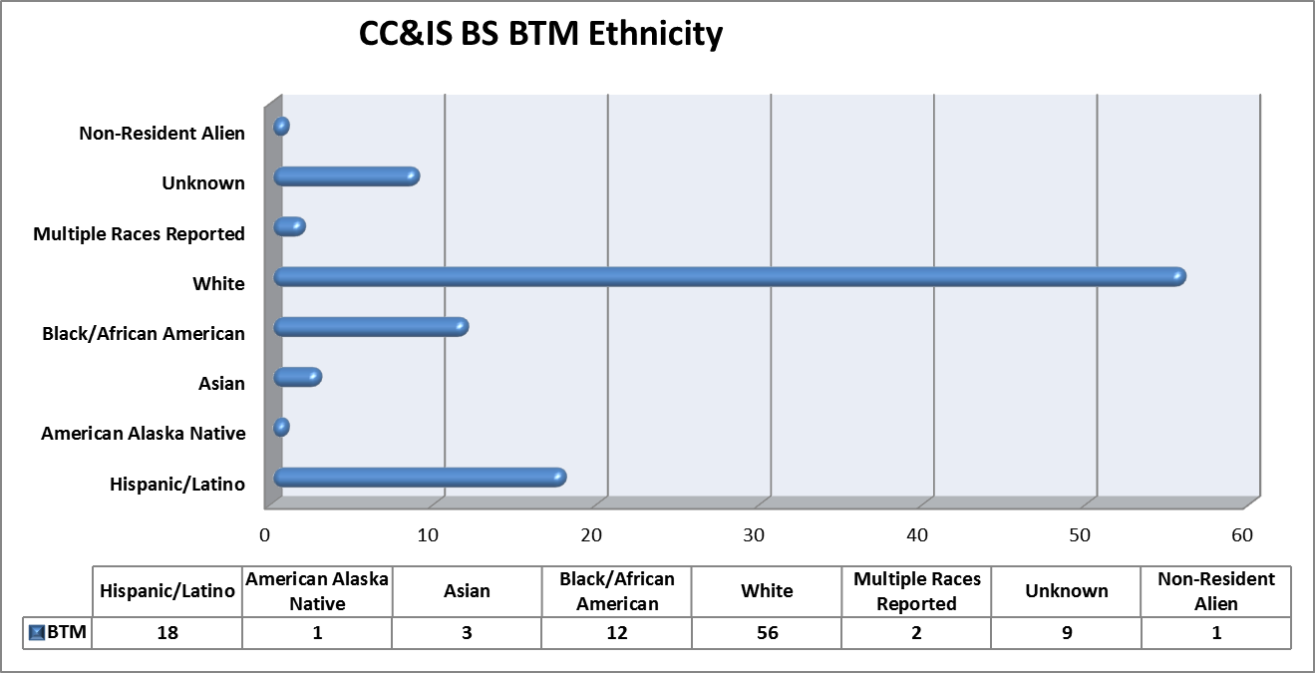
CC&IS UG Ethnic Distribution

Slide 12
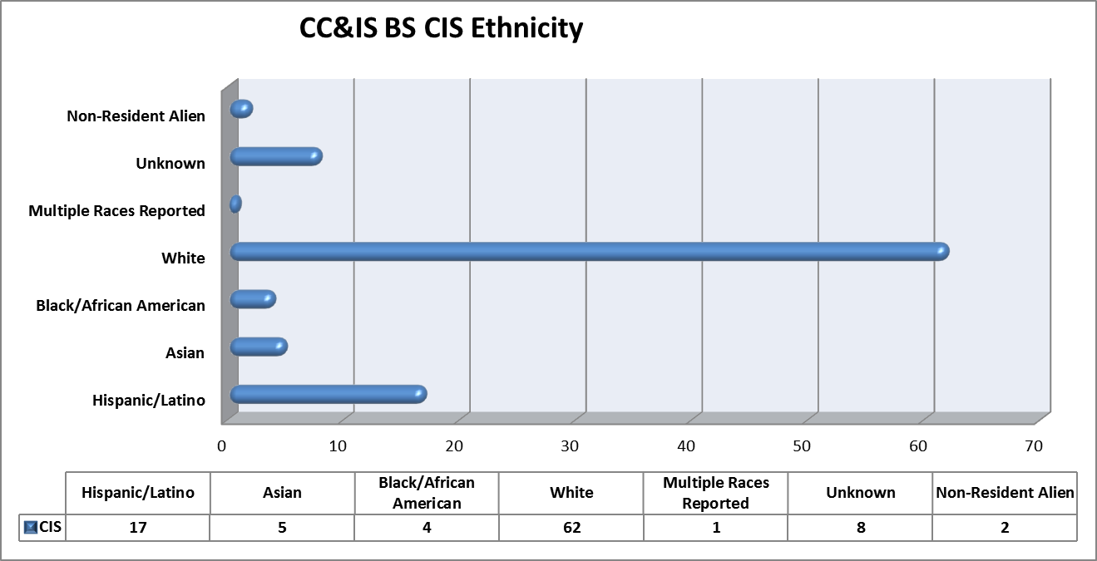
CC&IS UG Ethnic Distribution

Slide 13
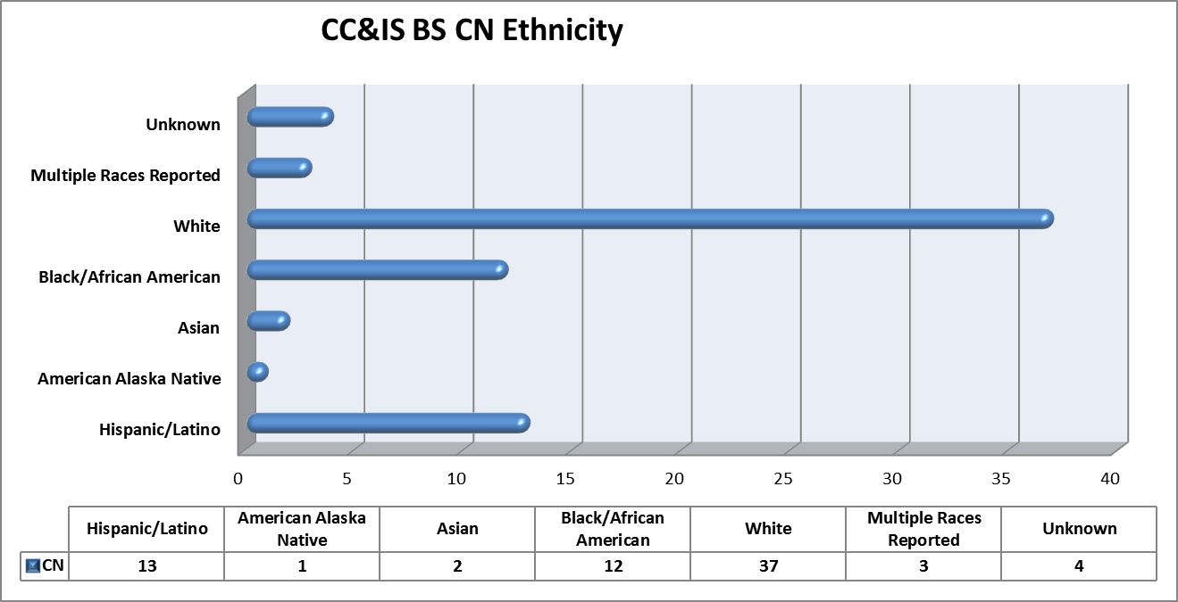
CC&IS UG Ethnic Distribution

Slide 14
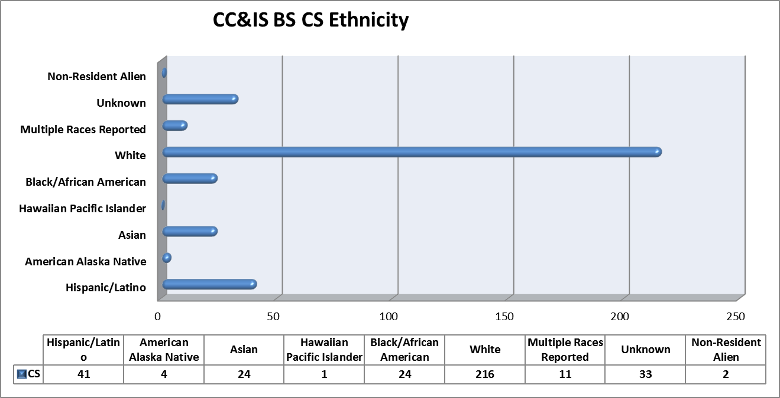
CC&IS UG Ethnic Distribution

Slide 15
Regis University Student Chapter of ACM
Regis University now has a Student Chapter of the ACM
Coordinator: Dr. Jesus Borrego (jborrego @regis.edu)
Chapter objective is to promote computer science, technology, and Information Assurance.
Open to everyone! Traditional and Post-Traditional students.

Slide 16
Questions?

