Slide 1
Introduction to Computers, Programs, and Java
CS1: Java Programming
Colorado State University
Original slides by Daniel Liang
Modified slides by
Kris Brown, Ben Say, Wim Bohm
1

Slide 2
Welcome: a first Java program
// This program prints Welcome to Java!
public class Welcome {
public static void main(String[] args) {
System.out.println("Welcome to Java!");
}
}

Slide 3
Trace a Program Execution
animation
Enter main method
// This program prints Welcome to Java!
public class Welcome {
public static void main(String[] args) {
System.out.println("Welcome to Java!");
}
}
3

Slide 4
Trace a Program Execution
animation
Execute statement
// This program prints Welcome to Java!
public class Welcome {
public static void main(String[] args) {
System.out.println("Welcome to Java!");
}
}
4

Slide 5
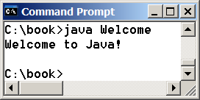
Trace a Program Execution
animation
// This program prints Welcome to Java!
public class Welcome {
public static void main(String[] args) {
System.out.println("Welcome to Java!");
}
}
print a message to the console
5

Slide 6
Anatomy of a Java Program
Class name
Main method
Statements
Statement terminator
Reserved words
Comments
Blocks
6

Slide 7
Class Name
Every Java program must have at least one class. Each class has a name. By convention, class names start with an uppercase letter. In this example, the class name is Welcome.
// This program prints Welcome to Java!
public class Welcome {
public static void main(String[] args) {
System.out.println("Welcome to Java!");
}
}
7

Slide 8
Main Method
Line 2 defines the main method. In order to run a class, the class must contain a method named main. The program is executed from the main method.
// This program prints Welcome to Java!
public class Welcome {
public static void main(String[] args) {
System.out.println("Welcome to Java!");
}
}
8

Slide 9
Statement
A statement represents an action or a sequence of actions. The statement System.out.println("Welcome to Java!") in the program is a statement to display the greeting "Welcome to Java!“.
// This program prints Welcome to Java!
public class Welcome {
public static void main(String[] args) {
System.out.println("Welcome to Java!");
}
}
9

Slide 10
Statement Terminator
Every statement in Java ends with a semicolon (;).
// This program prints Welcome to Java!
public class Welcome {
public static void main(String[] args) {
System.out.println("Welcome to Java!");
}
}
10

Slide 11
Reserved words
Reserved words or keywords are words that have a specific meaning to the compiler and cannot be used for other purposes in the program. For example, when the compiler sees the word class, it understands that the word after class is the name for the class.
// This program prints Welcome to Java!
public class Welcome {
public static void main(String[] args) {
System.out.println("Welcome to Java!");
}
}
11

Slide 12
Blocks
A pair of braces in a program forms a block that groups components of a program.
12

Slide 13
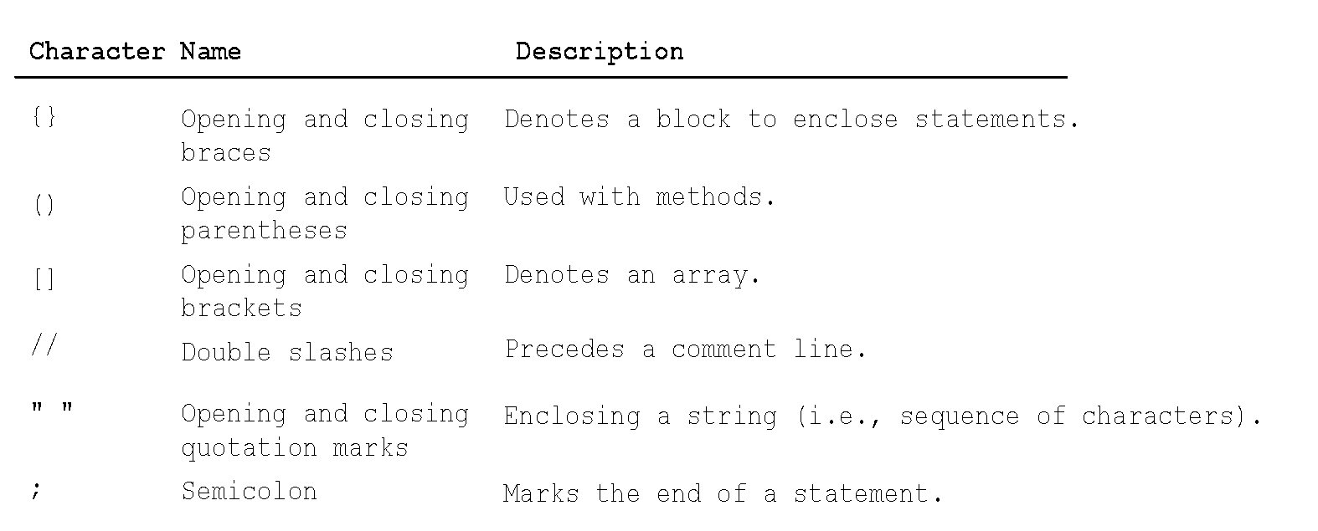
Special Symbols
13

Slide 14
{ … }
// This program prints Welcome to Java!
public class Welcome {
public static void main(String[] args) {
System.out.println("Welcome to Java!");
}
}
14

Slide 15
( … )
// This program prints Welcome to Java!
public class Welcome {
public static void main(String[] args) {
System.out.println("Welcome to Java!");
}
}
15

Slide 16
;
// This program prints Welcome to Java!
public class Welcome {
public static void main(String[] args) {
System.out.println("Welcome to Java!");
}
}
16

Slide 17
// …
// This program prints Welcome to Java!
public class Welcome {
public static void main(String[] args) {
System.out.println("Welcome to Java!");
}
}
17

Slide 18
" … "
// This program prints Welcome to Java!
public class Welcome {
public static void main(String[] args) {
System.out.println("Welcome to Java!");
}
}
18

Slide 19
Programming Style and Documentation
Appropriate Comments
Naming Conventions
Proper Indentation and Spacing Lines
Block Styles
19

Slide 20
Appropriate Comments
Include a summary at the beginning of the program to explain what the program does, its key features, its supporting data structures, and any unique techniques it uses.
Include your name, class section, instructor, date, and a brief description at the beginning of the program.
20

Slide 21
Naming Conventions
Choose meaningful and descriptive names.
Class names:
Capitalize the first letter of each word in the name. For example, the class name ComputeExpression.
21

Slide 22
Proper Indentation and Spacing
Indentation
Indent two spaces.
Spacing
Use blank line to separate segments of the code.
22

Slide 23
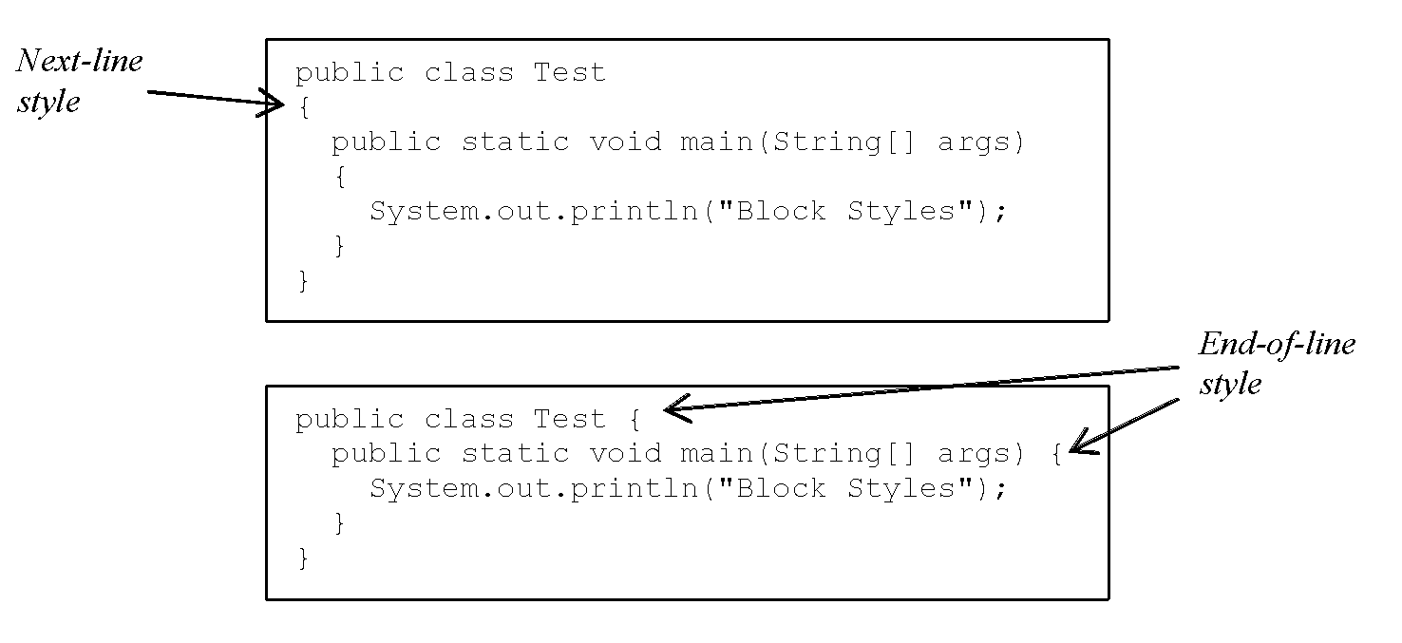
Block Styles
Use end-of-line style for braces.
23

Slide 24
Programming Errors
Syntax Errors
Detected by the compiler
Runtime Errors
Causes the program to abort
Logic Errors
Produces incorrect result
24

Slide 25
Syntax Errors
public class ShowSyntaxErrors {
// This code has syntax error by purpose
public static main(String[] args) {
System.out.println("Welcome to Java);
}
25
Notes:
Will not compile!!
Errors:
public static void main (String[] args)
closing quotation
and closing bracket

Slide 26
Runtime Errors
// Program contains runtime errors
public class ShowRuntimeErrors {
public static void main(String[] args) {
System.out.println(1 / 0);
}
}
26
Notes:
Will compile, but it won’t run completely. It will stop when it finds the error in this case - won’t divide by zero. We’ll see this more when we work with arrays.

Slide 27
Logic Errors
public class ShowLogicErrors {
public static void main(String[] args) {
System.out.print("Celsius 35 is ");
System.out.print("Fahrenheit ");
System.out.println((9 / 5) * 35 + 32);
}
}
27
Notes:
Will successfully compile and execute, but it will not give you the correct output.

Slide 28
Implicit Import and Explicit Import
import java.util.* ; //Implicit import
import java.util.JOptionPane; //Explicit import
No performance difference
28
Notes:
Imports library

Slide 29
What is a Computer?
A computer consists of a CPU, memory, hard disk, other storage devices, monitor, printer, and communication devices.
29

Slide 30
CPU
The Central Processing Unit (CPU) is the brain of a computer. It retrieves instructions from memory and executes them. The CPU speed is measured in gigahertz (GHz), with 1 gigahertz equaling 1 billion cycles per second.
30
Notes:
The speed of the CPU has been improved continuously. If you buy a PC now, you might get an Intel Core i7 running at 2.8 to 4.0 gigahertz.

Slide 31
Memory
Memory is to store data and program instructions for CPU to execute. A memory unit is an ordered sequence of bytes, each byte holds eight bits. If you buy a PC today, it might have 8 gigabytes (GB) of memory.
31
Notes:
A program and its data must be placed in memory before they can be executed. A memory byte is never empty, but it can be uninitialized. The current content of a memory byte is overwritten whenever new information is placed in it.

Slide 32
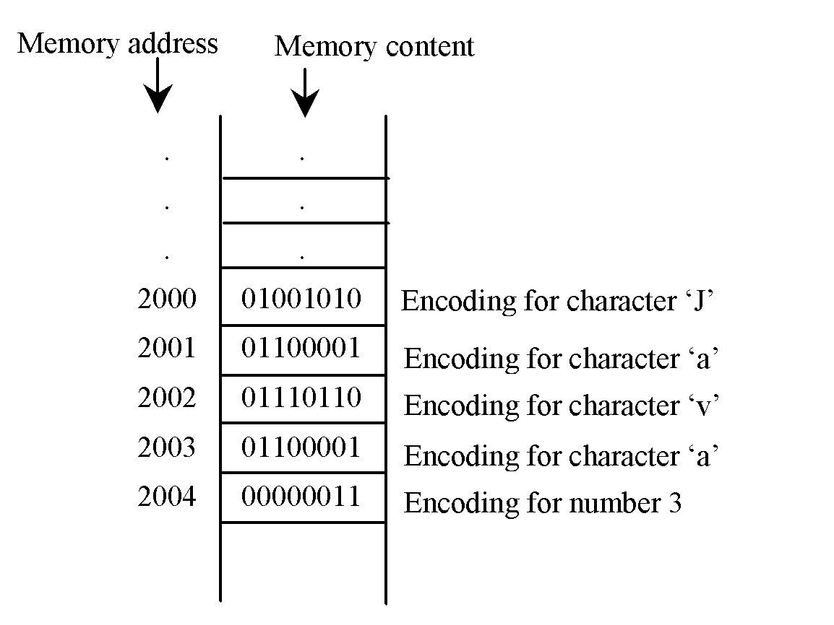
How Data is Stored?
32
Notes:
Data of various kinds, such as numbers, characters, and strings, are encoded as a series of bits (zeros and ones). Computers use zeros and ones because digital devices have two stable states, which are referred to as zero and one by convention. The programmers need not to be concerned about the encoding and decoding of data, which is performed automatically by the system based on the encoding scheme. The encoding scheme varies. For example, character ‘J’ is represented by 01001010 in one byte. A small number such as three can be stored in a single byte. If computer needs to store a large number that cannot fit into a single byte, it uses a number of adjacent bytes. No two data can share or split a same byte. A byte is the minimum storage unit.

Slide 33
Storage Devices
Memory is volatile, because information is lost when the power is off. Programs and data are permanently stored on storage devices and are moved to memory when the computer actually uses them.
33
Notes:
There are three main types of storage devices: disk drives (hard disks and floppy disks), optical drives (CD, DVD), and tape drives. If you buy a PC today, it might have a 500 gigabyte (Gb) or 1 terabyte (Tb) hard drive, or solid state storage.

Slide 34
Output Devices: Monitor
The monitor displays information (text and graphics). The resolution and dot pitch determine the quality of the display.
34
Notes:
Laptops today often approach or exceed the quality of an high-definition (HD) television, which is 1920x1080 pixels, and mobile devices are often even better. For example the Samsung Galaxy S7 has a screen with 2560x1440 pixel resolution.
dot pitch or pixel pitch - the measure from the center of one pixel to an adjacent pixel.

Slide 35
Communication Devices
A regular modem uses a phone line and can transfer data in a speed up to 56,000 bps (bits per second). A DSL (digital subscriber line) also uses a phone line and can transfer data in a speed 20 times faster than a regular modem. A cable modem uses the TV cable line maintained by the cable company. A cable modem is as fast as a DSL. Network interface card (NIC) is a device to connect a computer to a local area network (LAN). The LAN is commonly used in business, universities, and government organizations.
35

Slide 36
Programs
Computer programs, known as software, are structured sets of instructions to the computer.
You tell a computer what to do through programs. Without programs, a computer is an empty machine. Computers do not understand human languages, so you need to use computer languages to communicate with them.
Programs are written using programming languages.
36

Slide 37
Programming Languages
Machine Language Assembly Language High-Level Language
Machine language is a set of primitive instructions built into every computer.
Instructions are in the form of binary code. This is tedious, error prone, hard to read and modify.
For example, to add two numbers, you might write an instruction in binary like this:
1101101010011010
37

Slide 38
Programming Languages
Machine Language Assembly Language High-Level Language
Assembly languages were developed to make machine programming easy. But one assembly-instruction is still one machine-instruction, so this is still tedious and error prone.
A program called assembler is used to convert assembly language programs into machine code. For example, to add two numbers, you might write an instruction in assembly code like this:
ADDF3 R1, R2, R3
And the assembler turns this into 1101101010011010
38

Slide 39
Programming Languages
Machine Language Assembly Language High-Level Language
The high-level languages are structured and English-like and easier to learn and program. For example, the following is a high-level language statement (C, C++, Java, Python) that computes the area of a circle with radius 5:
area = 5 * 5 * 3.1415;
39
Notes:
Computes or approximates?

Slide 40
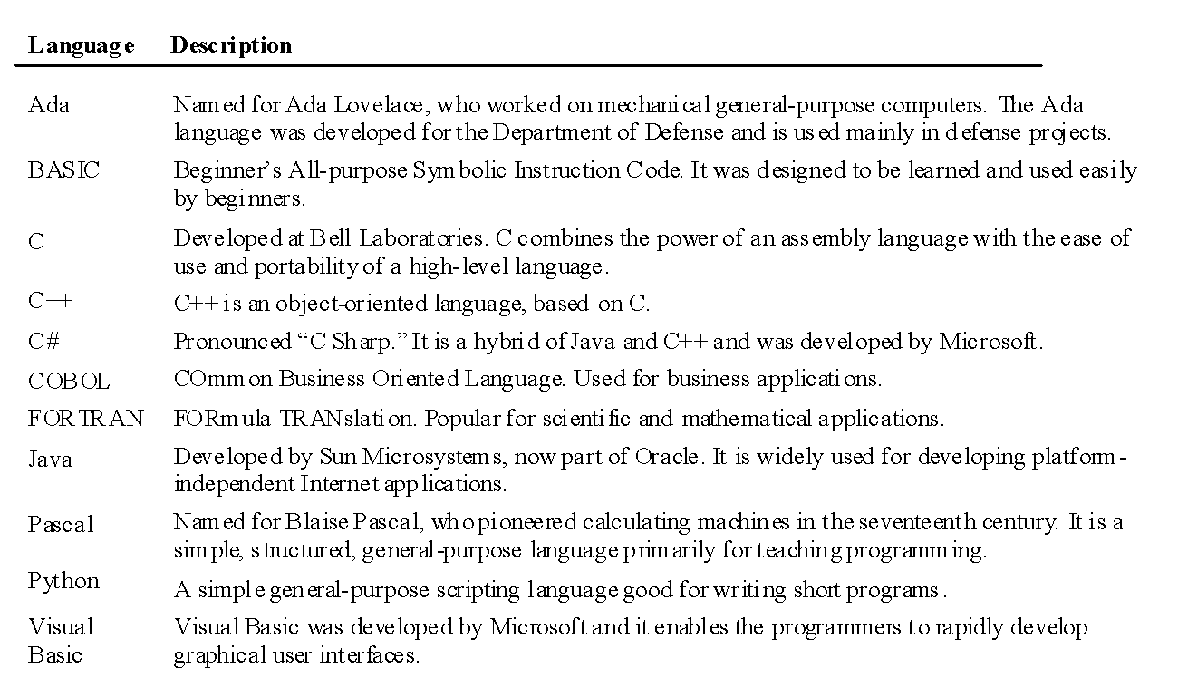
Popular High-Level Languages
40

Slide 41
Interpreting/Compiling Source Code
A program written in a high-level language is called a source program or source code. Because a computer cannot understand a source program, a source program must be translated into machine code for execution. The translation can be done using another programming tool called an interpreter or a compiler.
41

Slide 42
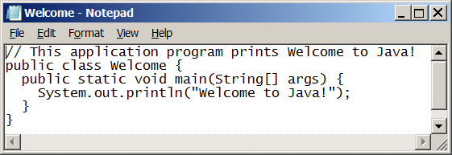
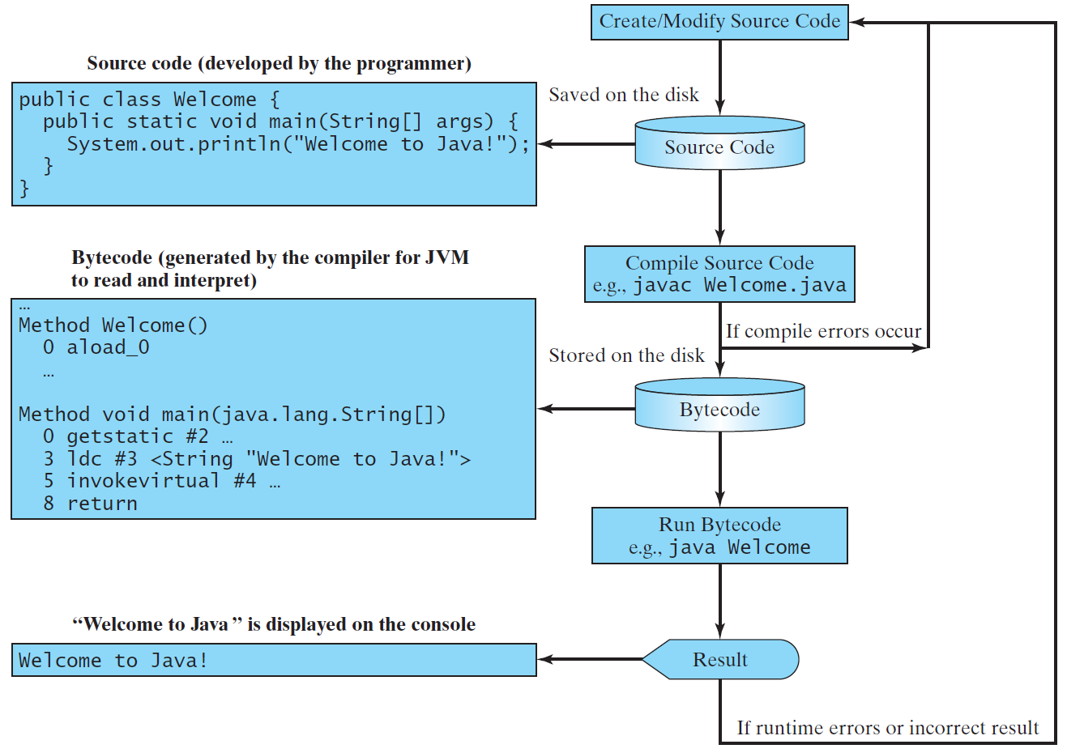
Creating, Compiling, and Running Programs
42

Slide 43
Compiling Java Source Code
Java can be compiled into a special type of object code, known as bytecode. This bytecode can run (interpreted) on any computer using JVM (Java Virtual Machine) software.
43
Notes:
Computers are networked to work together. Java was designed to run object programs on any platform. With Java, you write the program once, and compile the source program into a special type of object code, known as bytecode. The bytecode can then run on any computer with a Java Virtual Machine, as shown below. Java Virtual Machine is software that interprets Java bytecode.

Slide 44
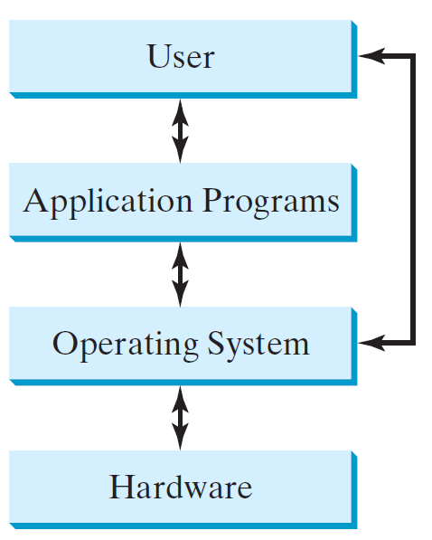
Operating Systems
The operating system (OS) is a program that manages and controls a computer’s activities and file system.
Popular operating systems are Microsoft Windows, Mac OS, and Linux.
Application programs, such as a Web browser or a word processor, cannot run unless an operating system is installed and running on the computer.
44
Notes:
The OS schedules jobs.

Slide 45
Why Java?
Java enables users to develop and deploy applications on the Internet for servers, desktop computers, and small hand-held devices.
Java is a general purpose programming language.
The future of computing is being profoundly influenced by the Internet, and Java promises to remain a big part of that future.
Java is an Internet programming language.
45

Slide 46
Characteristics of Java
Java is relatively simple
Java bytecode is Interpreted (JVM) but can also be compiled to native machine code
Java is Architecture and OS neutral
Java’s performance keeps improving
www.cs.armstrong.edu/liang/JavaCharacteristics.pdf
46
Notes:
I greatly simplified the end java discussion

