Slide 1
Chapter 4: Loops and Iteration
CS1: Java Programming
Colorado State University
Original slides by Daniel Liang
Modified by Kris Brown, Wim Bohm and Ben Say
Liang, Introduction to Java Programming, Tenth Edition, (c) 2015 Pearson Education, Inc. All rights reserved.
1

Slide 2
Motivations
Suppose that you need to print a string (e.g., "Welcome to Java!") a hundred times. It would be tedious to have to write the following statement a hundred times:
System.out.println("Welcome to Java!");
So, how do you solve this problem?
2

Slide 3
Opening Problem
Problem:
System.out.println("Welcome to Java!");
System.out.println("Welcome to Java!");
System.out.println("Welcome to Java!");
System.out.println("Welcome to Java!");
System.out.println("Welcome to Java!");
System.out.println("Welcome to Java!");
…
…
…
System.out.println("Welcome to Java!");
System.out.println("Welcome to Java!");
System.out.println("Welcome to Java!");
100 times
3

Slide 4
Introducing while Loops
int count = 0;
while (count < 100) {
System.out.println("Welcome to Java");
count++;
}
4

Slide 5
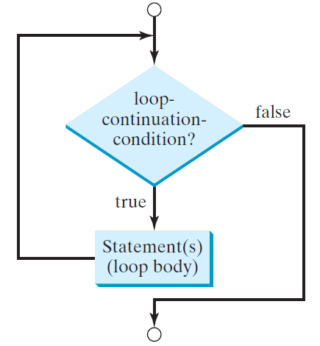
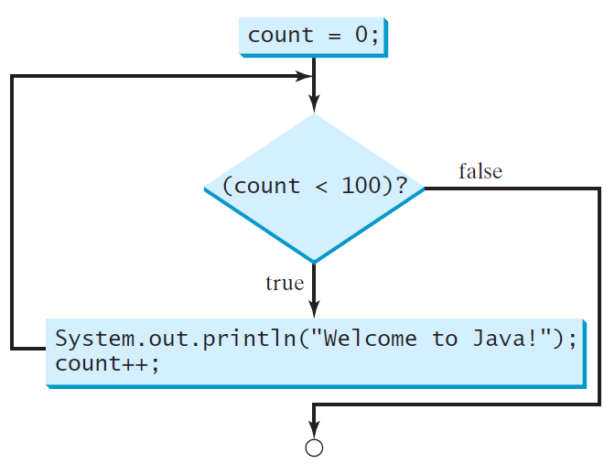
while Loop Flow Chart
int count = 0;
while (count < 100) {
System.out.println("Welcome to Java!");
count++;
}
while (loop-continuation-condition) {
// loop-body;
Statement(s);
}
5

Slide 6
Trace while Loop
animation
Initialize count
int count = 0;
while (count < 2) {
System.out.println("Welcome to Java!");
count++;
}
6

Slide 7
Trace while Loop, cont.
animation
(count < 2) is true
int count = 0;
while (count < 2) {
System.out.println("Welcome to Java!");
count++;
}
7

Slide 8
Trace while Loop, cont.
animation
Print Welcome to Java
int count = 0;
while (count < 2) {
System.out.println("Welcome to Java!");
count++;
}
8

Slide 9
Trace while Loop, cont.
animation
Increase count by 1
count is 1 now
int count = 0;
while (count < 2) {
System.out.println("Welcome to Java!");
count++;
}
9

Slide 10
Trace while Loop, cont.
animation
(count < 2) is still true since count is 1
int count = 0;
while (count < 2) {
System.out.println("Welcome to Java!");
count++;
}
10

Slide 11
Trace while Loop, cont.
animation
Print Welcome to Java
int count = 0;
while (count < 2) {
System.out.println("Welcome to Java!");
count++;
}
11

Slide 12
Trace while Loop, cont.
animation
Increase count by 1
count is 2 now
int count = 0;
while (count < 2) {
System.out.println("Welcome to Java!");
count++;
}
12

Slide 13
Trace while Loop, cont.
animation
(count < 2) is false since count is 2 now
int count = 0;
while (count < 2) {
System.out.println("Welcome to Java!");
count++;
}
13

Slide 14
Trace while Loop
animation
The loop exits. Execute the next statement after the loop.
int count = 0;
while (count < 2) {
System.out.println("Welcome to Java!");
count++;
}
14

Slide 15
Caution
Don’t use floating-point values for equality checking in a loop control. Since floating-point values are approximations for some values, using them could result in imprecise counter values and inaccurate results. Consider the following code for computing 1 + 0.9 + 0.8 + ... + 0.1:
double item = 1; double sum = 0;
while (item != 0) { // No guarantee item will be 0
sum += item;
item -= 0.1;
}
System.out.println(sum);
15

Slide 16
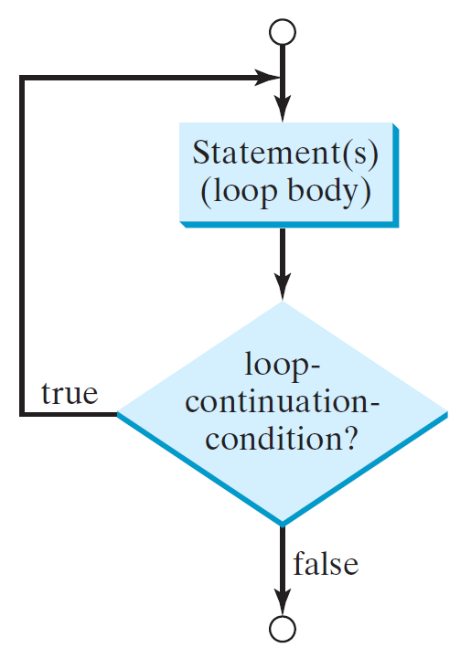
do-while Loop
do {
// Loop body;
Statement(s);
} while (loop-continuation-condition);
16

Slide 17
Your Turn!
Write a program that reads and calculates the sum of an unspecified number of integers from the keyboard and sum them up. Print your intermediate results.
The input 0 signifies the end of the input.

Slide 18
Lecture 2

Slide 19
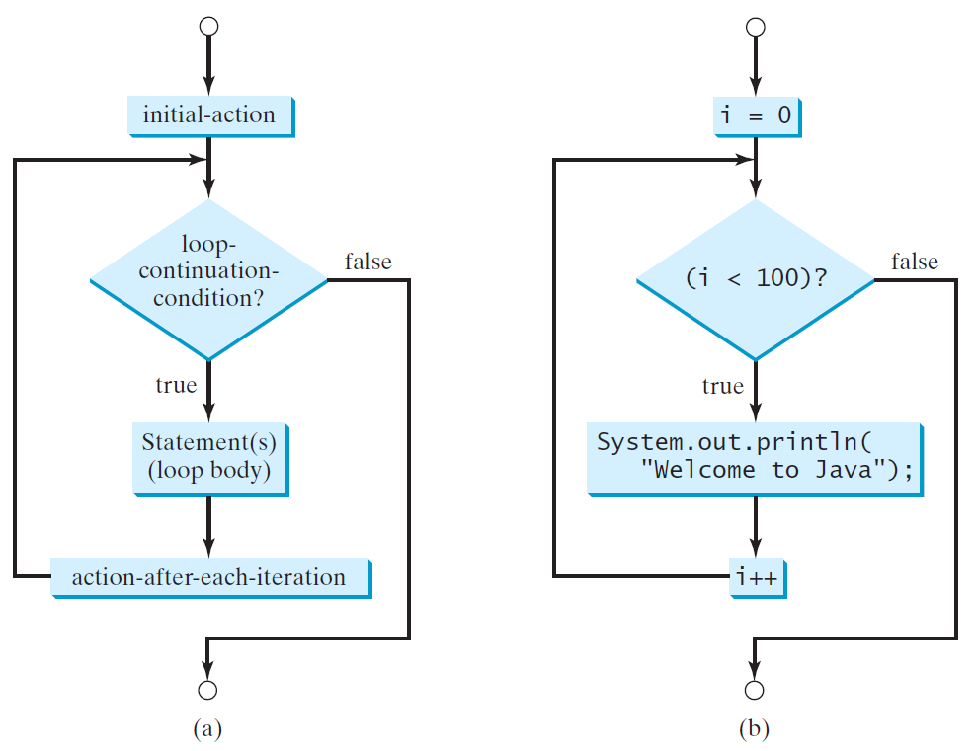
for Loops
for (initial-action; loop-continuation-condition; action-after-each-iteration) {
// loop body;
Statement(s);
}
int i;
for (i = 0; i < 100; i++) {
System.out.println(
"Welcome to Java!");
}
19

Slide 20
Trace for Loop
animation
Declare i
int i;
for (i = 0; i < 2; i++) {
System.out.println(
"Welcome to Java!");
}
20

Slide 21
Trace for Loop, cont.
animation
Execute initializer
i is now 0
int i;
for (i = 0; i < 2; i++) {
System.out.println(
"Welcome to Java!");
}
21

Slide 22
Trace for Loop, cont.
animation
(i < 2) is true
since i is 0
int i;
for (i = 0; i < 2; i++) {
System.out.println( "Welcome to Java!");
}
22

Slide 23
Trace for Loop, cont.
animation
Print Welcome to Java
int i;
for (i = 0; i < 2; i++) {
System.out.println("Welcome to Java!");
}
23

Slide 24
Trace for Loop, cont.
animation
Execute adjustment statement
i now is 1
int i;
for (i = 0; i < 2; i++) {
System.out.println("Welcome to Java!");
}
24

Slide 25
Trace for Loop, cont.
animation
(i < 2) is still true
since i is 1
int i;
for (i = 0; i < 2; i++) {
System.out.println("Welcome to Java!");
}
25

Slide 26
Trace for Loop, cont.
animation
Print Welcome to Java
int i;
for (i = 0; i < 2; i++) {
System.out.println("Welcome to Java!");
}
26

Slide 27
Trace for Loop, cont.
animation
Execute adjustment statement
i now is 2
int i;
for (i = 0; i < 2; i++) {
System.out.println("Welcome to Java!");
}
27

Slide 28
Trace for Loop, cont.
animation
(i < 2) is false
since i is 2
int i;
for (i = 0; i < 2; i++) {
System.out.println("Welcome to Java!");
}
28

Slide 29
Trace for Loop, cont.
animation
Exit the loop. Execute the next statement after the loop
int i;
for (i = 0; i < 2; i++) {
System.out.println("Welcome to Java!");
}
29

Slide 30
Note
The initial-action in a for loop can be a list of zero or more comma-separated expressions. The action-after-each-iteration in a for loop can be a list of zero or more comma-separated statements. Therefore, the following two for loops are correct. They are rarely used in practice, however.
for (int i = 1; i < 100; System.out.println(i++));
for (int i = 0, j = 0; (i + j < 10); i++, j++) {
// Do something
}
30

Slide 31
Note
If the loop-continuation-condition in a for loop is omitted, it is implicitly true. Thus the statement given below in (a), which is an infinite loop, is correct. Nevertheless, it is better to use the equivalent loop in (b) to avoid confusion:
31

Slide 32
Your Turn! Loop forms
Write three loops, a while loop, do while loop and a for loop that all print all square integers between 1 and 100 on one line:
1, 4, 9, 16, 25, … , 100
1, 4, 9, 16, 25, … , 100
1, 4, 9, 16, 25, … , 100
32

Slide 33
Caution
Adding a semicolon at the end of the for clause before the loop body is a common mistake, as shown below:
Logic Error
for (int i=0; i<10; i++);
{
System.out.println("i is " + i);
}
33

Slide 34
Caution, cont.
Similarly, the following loop is also wrong:
int i=0;
while (i < 10);
{
System.out.println("i is " + i);
i++;
}
In the case of the do loop, the following semicolon is needed to end the loop.
int i=0;
do {
System.out.println("i is " + i);
i++;
} while (i<10);
Logic Error
Correct
34

Slide 35
Recommendations
Use the one that is most intuitive and comfortable for you.
A for loop may be used if the number of repetitions is known, as, for example, when you need to print a message 100 times.
A while loop may be used if the number of repetitions is not known, as in the case of reading the numbers until the input is 0.
A do-while loop can be used to replace a while loop if the loop body has to be executed before testing the continuation condition.
35

Slide 36
Your Turn! Nested Loops
Write a program that uses nested loops to print a multiplication table containing i*j for i=2 to5 and j = 2 to 5. Each value of i
should occur on one line, e.g.
2*2=4 2*3=6 2*4=8 2*5=10
3*2=6 3*3=9 3*4=12 3*5=15
…
36

Slide 37
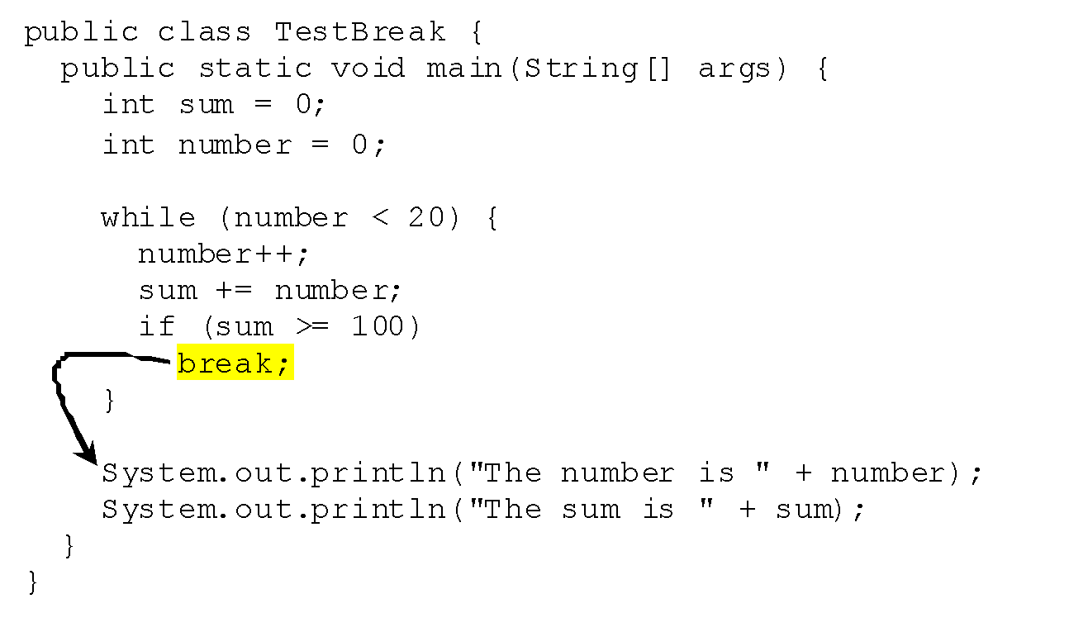
break
break allows you to exit the loop early
37

Slide 38
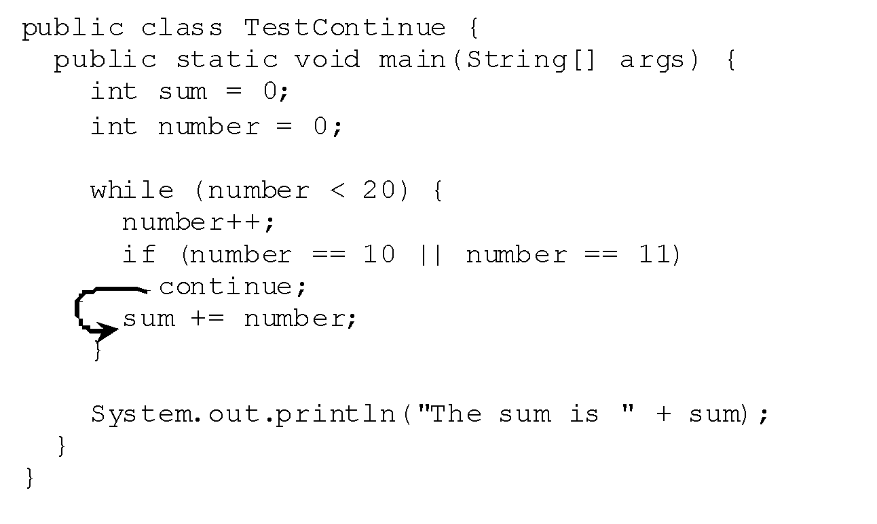
continue
continue allows you to skip part of an iteration
and go to the next
38

