Slide 1
Chapter 18 Recursion
CS1: Java Programming
Colorado State University
Original slides by Daniel Liang
Modified slides by Wim Bohm and Ben Say

Slide 2
Motivations
A directory is a set of files, some of which are directories.
This is an example of a recursive definition.

Slide 3
Motivations
A directory is a set of files, some of which are directories.
This is an example of a recursive definition.
Suppose you want to find all the files under a directory that contains a particular word.
There are several ways to solve this problem.
An intuitive solution is to use recursion by searching the files in the subdirectories
recursively.

Slide 4
Motivations
An H-tree is an H shaped circuit with H shaped circuits at its end points. Another recursive definition.

Slide 5
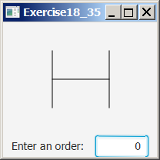
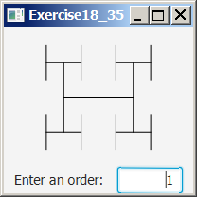
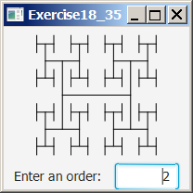
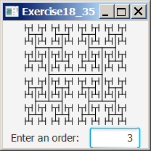
Motivations
An H-tree is an H shaped circuit with H shaped circuits at its end points. Another recursive definition.
H-trees, depicted below, are used in chip as a clock distribution network for routing timing signals to all parts of a chip with equal propagation delays.
How do you write a program to display H-trees?
A good approach is to use recursion.

Slide 6
Fractals
A fractal is a geometrical figure just like triangles, circles, and rectangles, but fractals can be divided into parts, each of which is a reduced-size copy of the whole.
The Sierpinski triangle, named after a famous Polish mathematician.

Slide 7
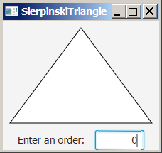
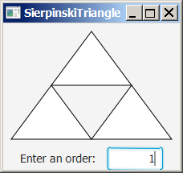
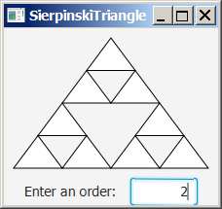
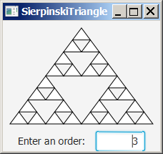
Sierpinski Triangle
It begins with an equilateral triangle, which is considered to be the Sierpinski fractal of order (or level) 0, as shown in Figure (a).
Connect the midpoints of the sides of the triangle of order 0 to create a Sierpinski triangle of order 1, as shown in Figure (b).
Leave the center triangle intact. Connect the midpoints of the sides of the three other triangles to create a Sierpinski of order 2, as shown in Figure (c).
You can repeat the same process recursively to create a Sierpinski triangle of order 3, 4, ..., and so on.

Slide 8
Fractals – the Koch curve

Slide 9
Recursion
A recursive definition
left-hand-side = right-hand-side
uses left-hand-side in the right-hand-side
e.g.,
a list = either empty
or an element followed by a list
This definition has a non recursive base case and a recursive general case.

Slide 10
Recursive method
A recursive method calls itself in its method body, e.g.
public int factorial(int n) {
if (n == 0) // Base case
return 1;
else
return n * factorial(n - 1); // Recursive call
}

Slide 11
Computing Factorial
//recursive method
public int factorial(int n) {
if (n == 0) // Base case
return 1;
else
return n * factorial(n - 1); // Recursive call
}
//recursive definition
n! = n * (n-1)!
0! = 1
ComputeFactorial
Run

Slide 12
Trace Recursive factorial
animation
Executes factorial(4)

Slide 13
Trace Recursive factorial
animation
Executes factorial(3)

Slide 14
Trace Recursive factorial
animation
Executes factorial(2)

Slide 15
Trace Recursive factorial
animation
Executes factorial(1)

Slide 16
Trace Recursive factorial
animation
Executes factorial(0)

Slide 17
Trace Recursive factorial
animation
returns 1

Slide 18
Trace Recursive factorial
animation
returns factorial(0)

Slide 19
Trace Recursive factorial
animation
returns factorial(1)

Slide 20
Trace Recursive factorial
animation
returns factorial(2)

Slide 21
Trace Recursive factorial
animation
returns factorial(3)

Slide 22
Trace Recursive factorial
animation
returns factorial(4)

Slide 23
factorial(4) Stack Trace

Slide 24
Other Recursive definitions
f(0) = 0;
f(n) = n + f(n-1);
g(0)=1;
g(n)=g(n-1)+2
h(0)=1;
h(n)=3*h(n-1);

Slide 25
Characteristics of Recursion
All recursive methods have the following characteristics:
One or more base cases (the simplest case) are used to stop recursion.
Every recursive call reduces the original problem, bringing it increasingly closer to a base case until it becomes that case.
To solve a problem using recursion, you break it into subproblems.
This subproblem is almost the same as the original problem in nature with a smaller size.
Eventually you reach the non-recursive base case.

Slide 26
Problem Solving Using Recursion
Let us consider a simple problem of printing a message for n times, breaking the problem into two subproblems:
One: print the message one time
and two: print the message for n-1 times.
Two is the same as the original problem with a smaller size.
The base case for the problem is n==0:
nPrintln(“Welcome”, 5);
public static void nPrintln(String message, int times) {
if (times >= 1) {
System.out.println(message);
nPrintln(message, times - 1);
} // The base case is times == 0
}

Slide 27
Think Recursively
Many of the problems presented in the early chapters can be solved using recursion if you think recursively. For example, the palindrome problem can be solved recursively as follows:
public boolean isPalindrome(String s) {
if (s.length() <= 1) // Base case
return true;
else if (s.charAt(0) != s.charAt(s.length() - 1)) // Base case
return false;
else
return isPalindrome(s.substring(1, s.length() - 1));
}

Slide 28
Recursive Helper Methods
The preceding recursive isPalindrome method is not efficient, because it creates a new string for every recursive call. To avoid creating new strings, use a helper method:
public static boolean isPalindrome(String s) {
return isPalindrome(s, 0, s.length() - 1);
}
public static boolean isPalindrome(String s, int low, int high) {
if (high <= low) // Base case
return true;
else if (s.charAt(low) != s.charAt(high)) // Base case
return false;
else
return isPalindrome(s, low + 1, high - 1);
}

Slide 29
Recursive Selection Sort
Find the smallest number in the list and swap it with the first number.
The first number is in place, so sort the remaining shorter list recursively, until there is one element left.
RecursiveSelectionSort

Slide 30
Recursive Binary Search
Case 1: If the key is less than the middle element, recursively search the key in the first half of the array.
Case 2: If the key is equal to the middle element, the search ends with a match.
Case 3: If the key is greater than the middle element, recursively search the key in the second half of the array.
RecursiveBinarySearch

Slide 31
Recursive Implementation
/** Use binary search to find the key in the list */
public static int recursiveBinarySearch(int[] list, int key) {
int low = 0;
int high = list.length - 1;
return recursiveBinarySearch(list, key, low, high);
}
/** Use binary search to find the key in the list between
list[low] list[high] */
public static int recursiveBinarySearch(int[] list, int key,
int low, int high) {
if (low > high) // The list has been exhausted without a match
return -low - 1;
int mid = (low + high) / 2;
if (key < list[mid])
return recursiveBinarySearch(list, key, low, mid - 1);
else if (key == list[mid])
return mid;
else
return recursiveBinarySearch(list, key, mid + 1, high);
}

Slide 32
Recursion vs. Iteration
Recursion is an alternative form of program control. It is essentially repetition without a loop.
When a program calls a method, the system must assign space for all of the method’s local variables and parameters on the run time stack.
This takes time and space. Use recursion when it fits the recursive nature of the problem, or as a starting point for the formulation of a solution.

