Slide 1
Software Fiascos
  Debbie Bartlett, Wim Bohm
Fiascos
1

Slide 2
Engineering Fiascos
  Fiasco, according to the dictionary:
    “A complete Failure”
Fiascos
2

Slide 3
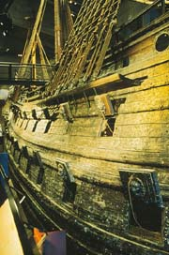
Swedish ship VASA (1628)
The “Great” Swedish King ordered 4 new warships
One was to be a royal ship, greater than any ship ever built
The king (not a ship designer) specified the measurements and design
Fiascos
3

Slide 4
Swedish ship VASA (1628)
The king specified the ship design
  Strongest, heaviest northern oak: 40 acres of timber use, triple-laminated oak walls 18” thick
  Main mast 190 feet tall, two gun decks
  64 bronze cannons, 100 tons
    cannon balls, gunpowder, firearms
  Further ballast equalled 120 tons
  Officers and a crew of 133 sailors
Fiascos
4

Slide 5
Swedish ship VASA (1628)
Launched August 10, 1628
Fate:
  Sailed less than a nautical mile before capsizing
Lessons learned:
  Listen and take advice from the domain experts
Fiascos
5

Slide 6
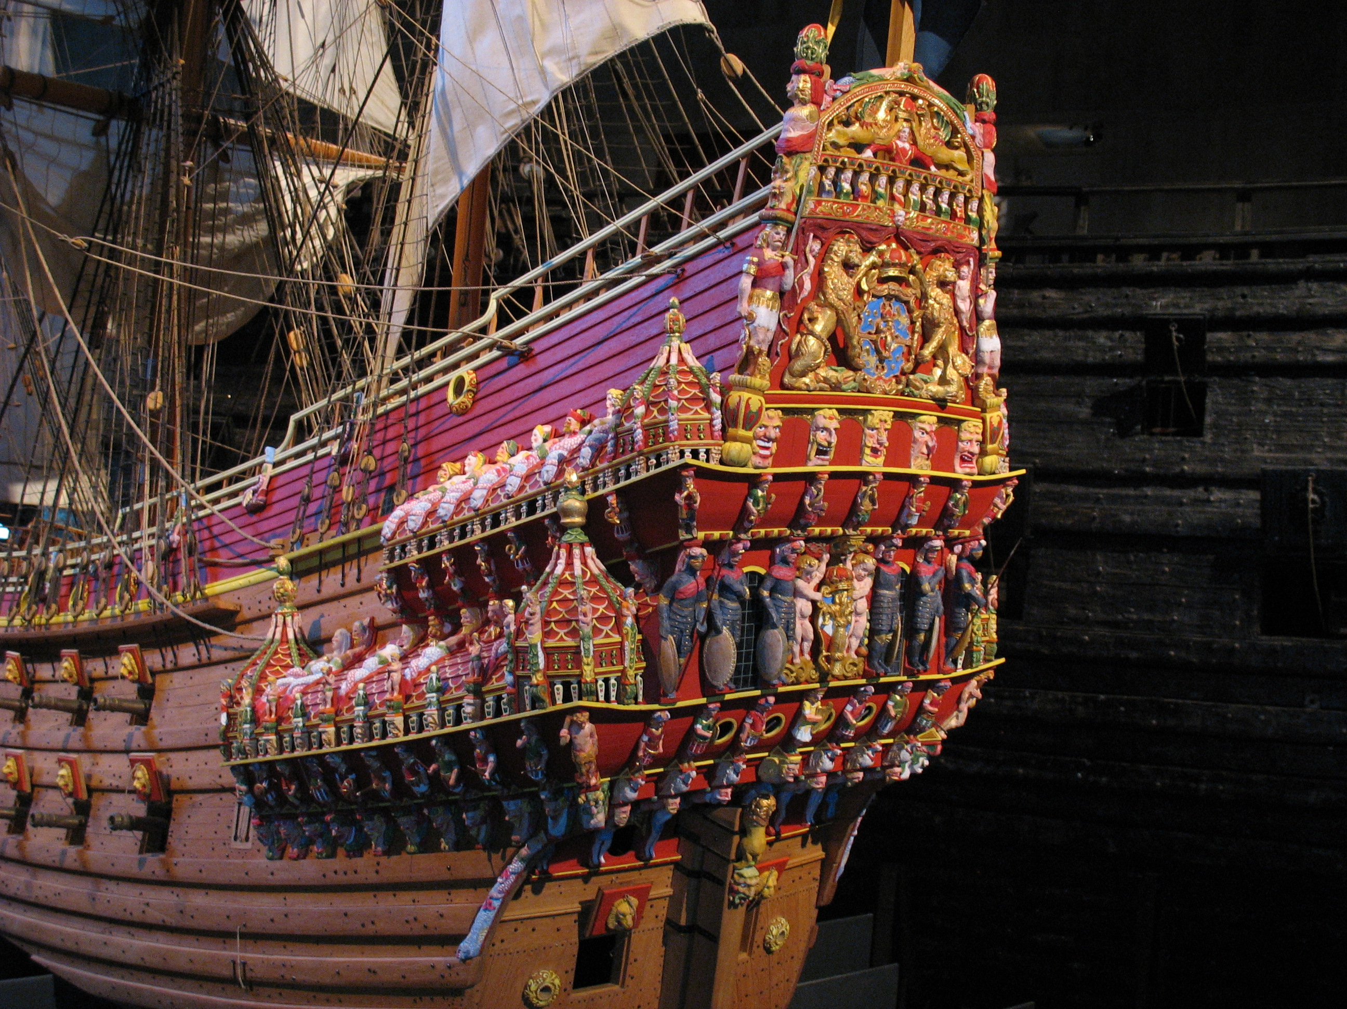
It was a cool boat though…

Slide 7
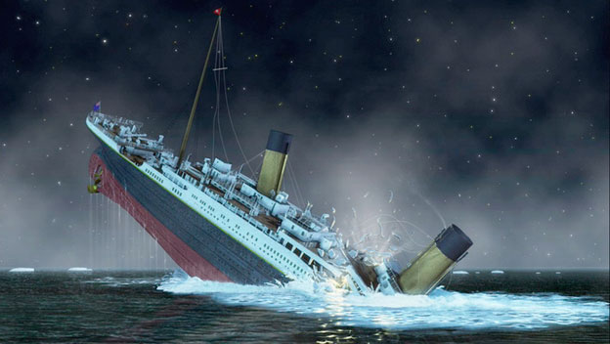
… a bit like this one?
Notes:
the Titanic

Slide 8
Quality assurance
concerns
Business value
concerns
Security, safety,
robustness concerns
Regulatory
concerns
The challenge of developing large (software) systems:
Developers need to balance multiple, interdependent, sometimes competing, concerns such as business value, availability, performance, survivability, fault tolerance, and security.
Prof. Robert France
Notes:
Balancing requires making trade-offs and assessing risks associated with design features that address the concerns
Organizations seldom have all the resources needed to build software systems that have the desired levels of dependability
Need to consider and evaluate alternative features to determine the extent they address concerns cost-effectively mitigate product-related risks.
Pervasiveness of dependability features complicates their evaluation and evolution

Slide 9
Quality assurance
concerns
Business value
concerns
Security, safety,
robustness concerns
Regulatory
concerns
Balancing requires making trade-offs and assessing risks
associated with design features that address the concerns.
Organizations seldom have all the resources needed to build
software systems that have the desired levels of dependability..
Notes:
Balancing requires making trade-offs and assessing risks associated with design features that address the concerns.
Organizations seldom have all the resources needed to build software systems that have the desired levels of dependability.

Slide 10
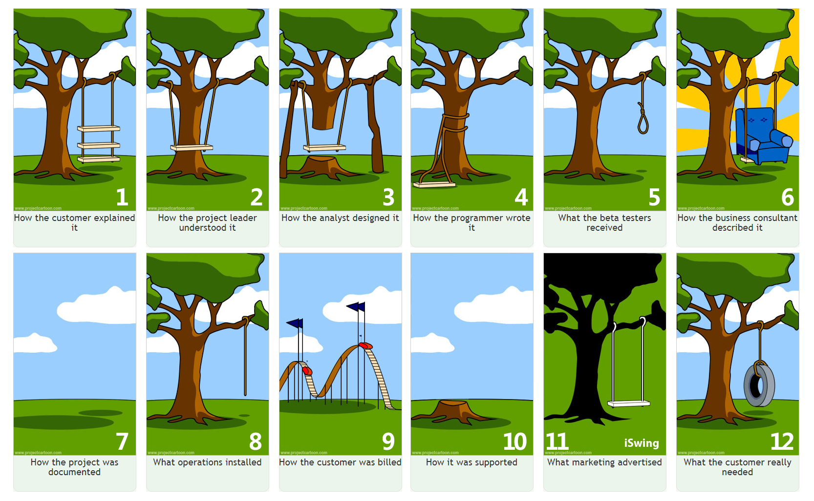

Slide 11
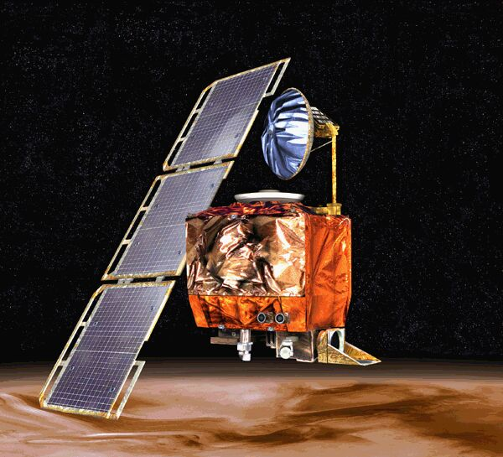
Example “Fiasco”:
NASA’s Mars Climate Orbiter (1999)
Mission Objective:
  Monitor the daily weather & atmospheric
  conditions of Mars
NASA’s Administrator's design objective:
  Faster
  Better
  Cheaper
Fate
  Crashed on the Mars’ surface
  WHY?
Fiascos
11

Slide 12
Example “Fiasco”:
NASA’s Mars Climate Orbiter (1999)
Why?
  Error in the software to control the thrusters: NASA sub-contractor used English units for navigation when NASA had used Metric units
    Off by a factor of 4.45 with the ground station
    Orbiter got too close to the surface and crashed
Loss for NASA
  $327.6 million for the orbiter and lander
  Loss of mission data
  Loss of reputation
Fiascos
12

Slide 13
Example “Fiasco”:
NASA’s Mars Climate Orbiter (1999)
Lessons learned
  Integrated testing should have been done
  Before testing the problem domain should be fully understood
  Error checking in the code should have been added to the software
  e.g. cannot be less than x units from the surface, if so, then invalid situation
    report error
    take action
Fiascos
13

Slide 14
HealthCare.gov
Health Insurance Exchange website (Obamacare)
  Project overseen by the Centre's for Medicare and Medicaid Services
    Many subcontractors
  Continually changing requirements
  Original budget was $93.7 million, grew to $292 million prior to launch
  Numerous Technical Problems
Fiascos
14

Slide 15
HealthCare.gov
  Technical Problems
    Only 1% of interested people able to enroll the first week of operations
    Long wait times
    Variety of problems, including broken pull-down menus
    Data in forms not always submitted
    Software and system design issues
    Unexpected # of simultaneous users
      expected 50,000–60,000; drew 250,000
    Lack of integrated testing
      this was a system of systems
    Stress tests done by contractors 1 day before the launch date, revealed site became too slow with only 1,100 simultaneous users.
Fiascos
15

Slide 16
HealthCare.gov
  Lesson Learned
  From the “DataCenter Journal”
  5 Lessons IT Project Managers Can Learn From
  Obamacare
  http://www.datacenterjournal.com/5-lessons-project-managers-learn-obamacare/
Fiascos
16

Slide 17
HealthCare.gov
If you don’t know what you want, you won’t get it
    Having stable requirements very important
Your project stands a good chance of going over budget or planned time schedule
    Plan for the unexpected
Your project success ultimately depends on how you serve your customers
    Allocate adequate time to understand customer use model and for testing
The more valuable data you pack into one place, the bigger a target you’ll become.
Excuses make the problems worse.
Fiascos
17

Slide 18
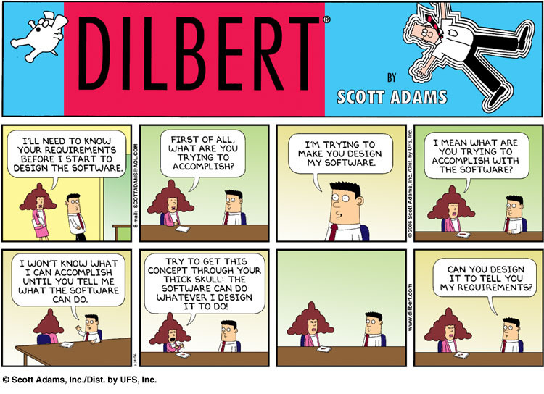
Growth in demand for software leads to users delegating development tasks to programmers

Slide 19
Y2K (Year 2000 problem, millennium bug)
A ticking time bomb
  From 1960s until late 1980s, widespread practice in all computer software to use two digits for representing a year rather than using 4 digits
    Save computer disk and memory space which was very expensive
  In year 2000, ’00’ to a computer would mean 1900 not 2000
  When calculating difference in dates, 01/01/2000 and 12/31/1999 would be 100 years rather than 1 day.
  Threatened all major industries including utilities, banking, manufacturing, telecom, airlines
Widespread fear, further brought about by the media
  Industry testing & results: Tractor factory, waste treatment plan in California
  Will all planes fall from the sky at midnight 01/01/2000?
Fiascos
19

Slide 20
Y2K (Year 2000 problem, millennium bug)
Widespread fear, further brought about by the media
All computer and software companies spent years and billions of dollars preparing for it
  Year 2000 compliant operating systems
  Reading millions of line of application source code
    mostly written in COBOL, very few people still new COBOL well
    much code was outsourced to India
  1000s of engineers and support personnel on call
When clock ticked 01/01/2000 no major problems reported, a few minor problems that were fixed within a day
Question: was it not as bad as the media made it out to be or did the years of prep work pay off?
Lessons learned:
  Anticipate the future when designing software
Fiascos
20

Slide 21
Lessons Learned from “Fiascos”
Seek the input and knowledge of experts
Understand the problem domain before design
Need clear and stable requirements
Listen to customers
  Understand customer use model
  well communicated requirements
Fiascos
21

Slide 22
Lessons Learned from “Fiascos”
Understand the problem domain before design
Do design reviews
  first of parts / units
  then of integrated system
  Anticipate possible error scenarios
  Include error checks in the design of software
Thoroughly test
  units
  systems
  systems of systems…
Fiascos
22

Slide 23
Software development phases
Robert France
Requirements
  What is the problem or opportunity that the software solution must address?
Design
  What are the major parts of the software solution, their responsibilities, and relationships?
  How do they interact with each other to discharge responsibilities?
Implementation (Programming/coding)
  Realizing the design in program(s) written in possibly different languages
  Are we there yet?

Slide 24
Software development phases
4. NO! Verification & validation (V&V), e.g., code testing
  Verifying against explicit specification (if any) and validating against stakeholder requirements
5. Deployment
  Installing software in operating environment
6. Evolution/Maintenance
  Making changes to software after it is deployed
  Changes may arise from changes in stakeholder needs, new stakeholder needs, need to correct errors, need to improve quality.
These phases are done in loops, and sometimes simultaneously.

