Slide 1
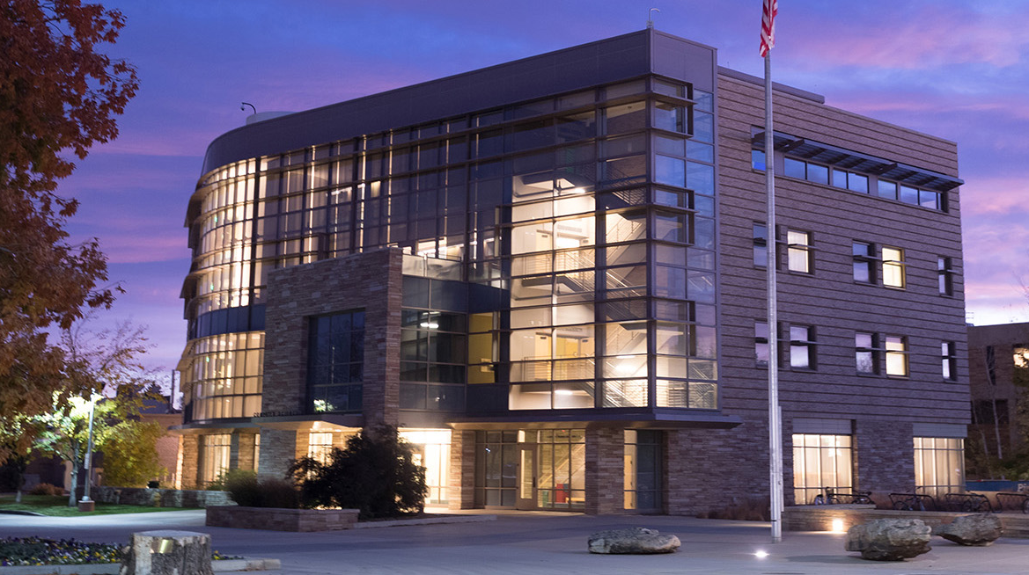
Welcome
I am glad you are here.

Slide 2
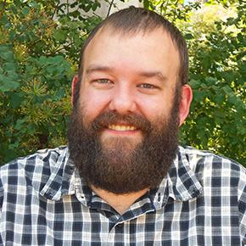
Who am I?
Benjamin Say, MS
Not a Dr.
“Ben” is fine
No Research
From SD
Not the city in CA
Not CA the country
Started programming in 2003
Worked in industry for 7 years
Passion for teaching
Coffee lover
Player of Board Games

Slide 3
Who are you?
I don’t know (yet!)
I want to!
Please…
Tell me your name when you talk to me
Introduce yourself!
Come to office hours (bring a friend!)
Things I do know…
You are a scholar of a fine university
I am glad you are here

Slide 4
How to succeed
Unlike the strategy with flying, you probably can’t
throw yourself at failure and miss.

Slide 5
Keys to Success in a Course
Attend every lecture
Attend every lab
Do everything on time

Slide 6
Keys to Success in general
Join two student organizations
One related to your major
One that relaxes, reenergizes, or reduces stress (AKA fun)

Slide 7
Support
We all need it sometimes.
Please ask for it when you need it.

Slide 8
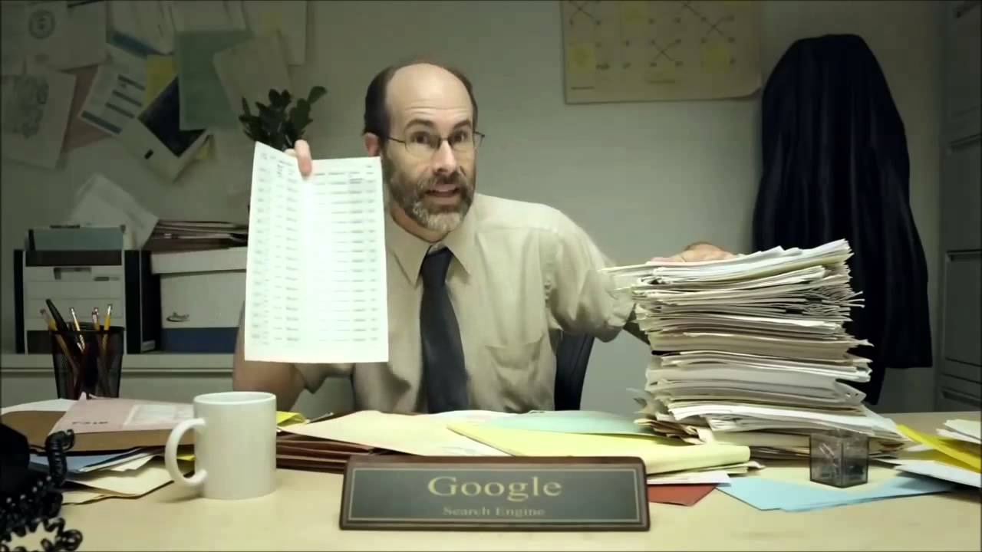
Ask for help
Google can be useful
CSB120
For 100-level, Helpdesk
For 200+, TA Office Hours

Slide 9
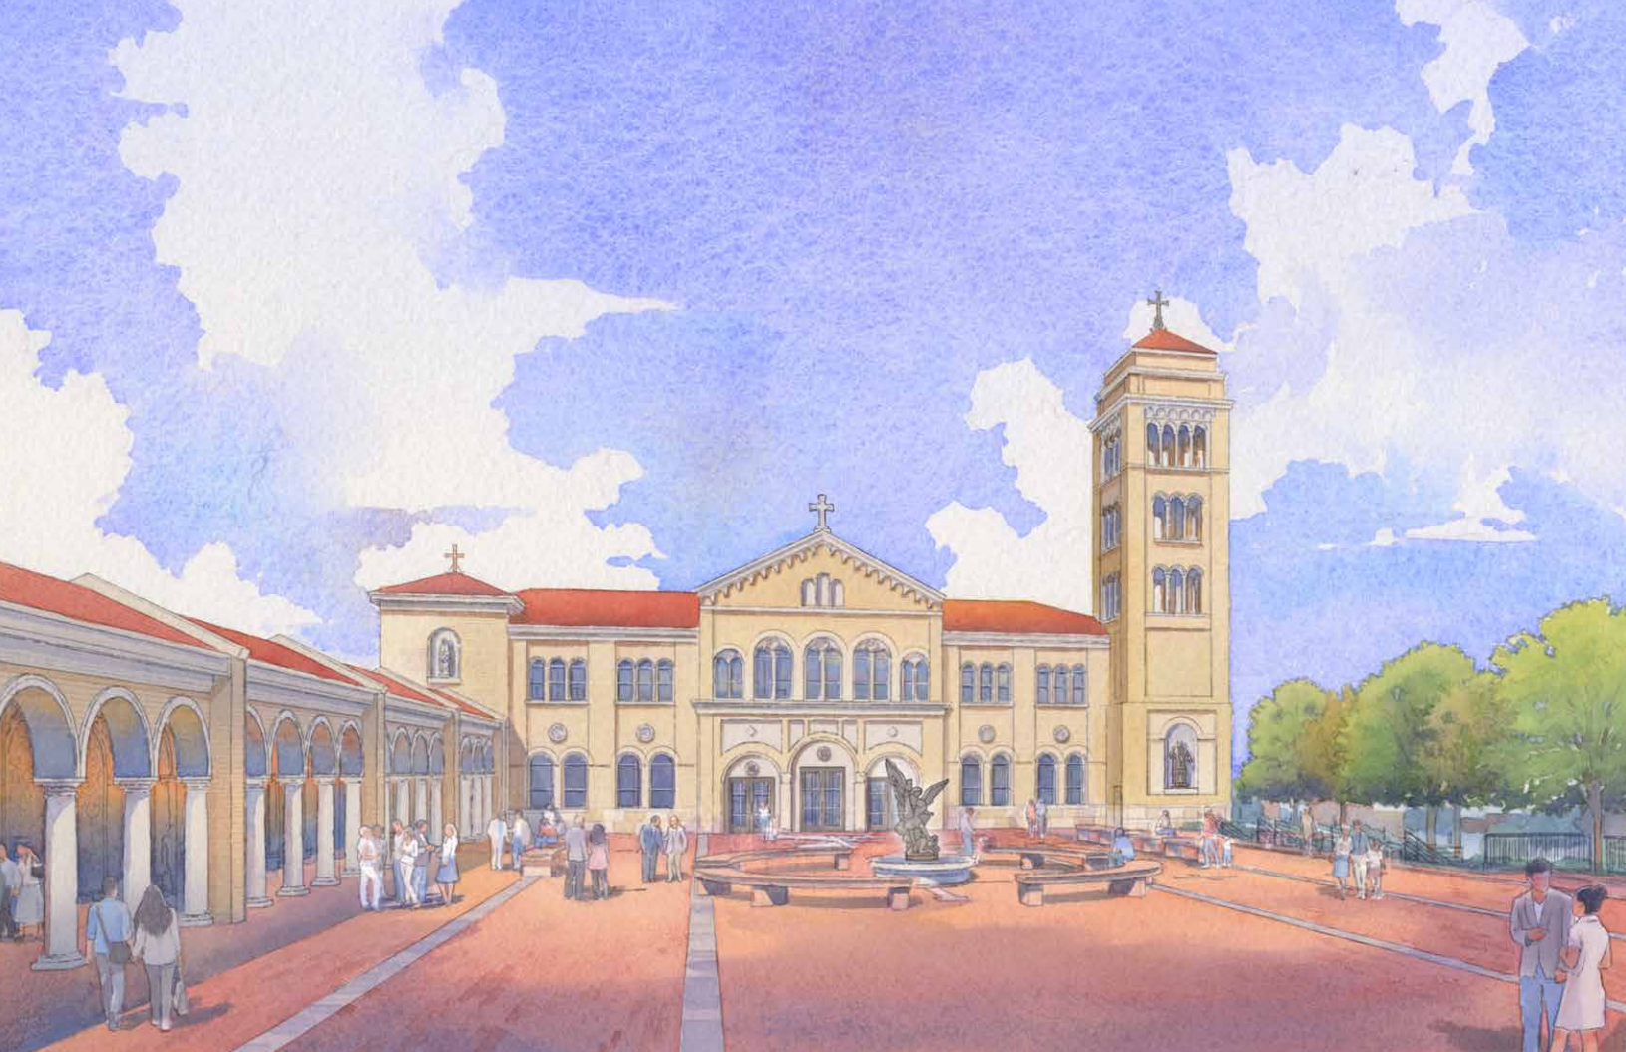
Piazza
In Italy
A Piazza is a square where people would gather to mingle and talk
In Fort Collins, CO
Bulletin board to post questions
Link through Canvas
Answers are collaborative by classmates and instructors/TAs

Slide 10
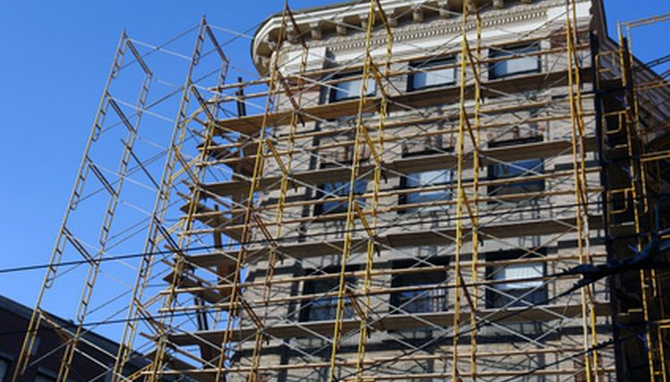
Campus Support System
Student Disability Center
If you have a disability, please meet with them
They will give you a letter, I’d like a paper copy please
Student Case Management
For when you think nothing else can go wrong, then it does
For less severe instances, too
CSU Health Network
Feeling ill? Go there instead of class!
Documentation required for excused absences

Slide 11
ME – I’m a support for you, too!
Please come to office hours
Bring a friend!
Office hours are great for anything you need for this course or as a student in general
Coffee Hour
Bring coffee (or your favorite hot beverage)
Chat about whatever or join the discussion
Not course-specific
No exam review or homework help

Slide 12
Course Tools
What ARE we doing?

Slide 13
Textbook
zyBooks
We are using the online resource zyBooks this semester
The bookstore will give you a code to subscribe
Billed to your student account
Please sign up for zyBooks
But only get ONE ACCOUNT! (VERY IMPORTANT, HENCE ALL THE CAPS)

Slide 14
An Error Has Occurred
Please remember to uphold academic honesty at all times
Collaborate with others only when permitted
(DO Interact with others, though, often)
Just be careful of the kind of help you provide
Exams and quizzes
Know what is allowed
This is CS
We have very sophisticated software that can detect copied code between students with high accuracy

