Slide 1
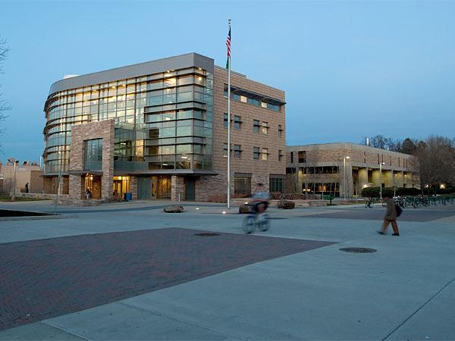
CS 163: Java (CS1) No prior programming experience
http://www.cs.colostate.edu/~cs163/
Introduction to CS1 Java Programming
1

Slide 2
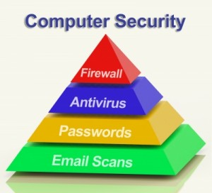
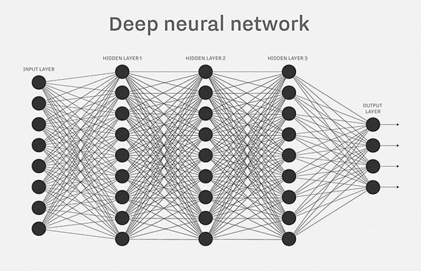
Computer Science: it touches everything!
Department of Computer Science

Slide 3
Bio Informatics
DNA & genomics: who / what we are
DNA: string made out of millions of letters
A,T,C,G
involved in the production of proteins in your body
unique per human, but similar between them
matching: finding similarity of DNA strings, just like
Google when you make a typo
you Google "ocurrance" Google says:
did you mean “occurrence”?
gene expression: finding which parts of the DNA build
which proteins for which purpose
many other applications
Notes:
Example application: bio informatics, study of genomics, DNA and proteins
DNA very large string of 4 letters (A,T,C,G) (millions)
DNA is involved in the production of proteins in your body
Unique per human, but similar between them
DNA matching is finding out how similar DNA strings are
e.g. finding the closest to to yours in a large data base

Slide 4
AI: Artificial Intelligence
Neural nets simulate brains
Cells firing signals at each other
Deep learning
many layers
complex behavior
Google
Face recognition, language
translation, game playing
(chess, go)
Notes:
Bioinformatics is part of AI.
Neural networks are employed in AI to solve hard
problems through deep learning using neural nets with many layers.
Neurons and how they simulate brain cells through firing messages at each other
Deep learning… many layers to emulate complex behavior, the layers represent
different levels of abstraction
e.g. words .. sentences .. meaning wrt the world
face recognition, GO, Google translate

Slide 5
Computers: hardware and software
Hardware:
data centers, racks and racks of servers,
large volumes of data (disks),
data communication
Software:
Programs are like recipes for
cooking
ERRORS (bugs):
need checking / testing / logic
Notes:
We need hardware and software to compute.
hw: the machine, e.g. the cloud (data centers GOOGLE Amazon, employing
parallel and distributed computing: many computers solving large problems
on large data sets)
Large volumes of data: Data analytics, data science
sw: programs: much like recipes for cooking. SW can have (HAS) errors (MARS rover)
SW testing: Finding errors *bug*s in code,
by checking valid input /output vectors,
checking all (many) possible *paths* through a program

Slide 6
Computer Security
protection layers
firewall:
wire / network level
antivirus: OS level
stop malicious program from
executing
authentication:
are you who you say you are
does this e-mail have malware?
Notes:
People abuse computers: Malware, hacking, stealing data
Computer security: protection layers
firewall: network level, the wire: filter malicious packets
antivirus: OS level scan computer for malicious sw: stop malicious pgm from executing
authentication: to make sure I am who I say I am. Passwords are hard to manage, easily stolen and used
email: application level, prevents malware coming in, bad url-s, attachments, phishing

Slide 7
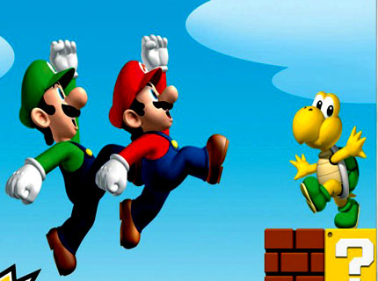
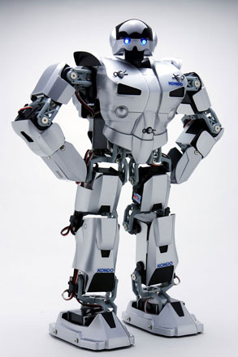
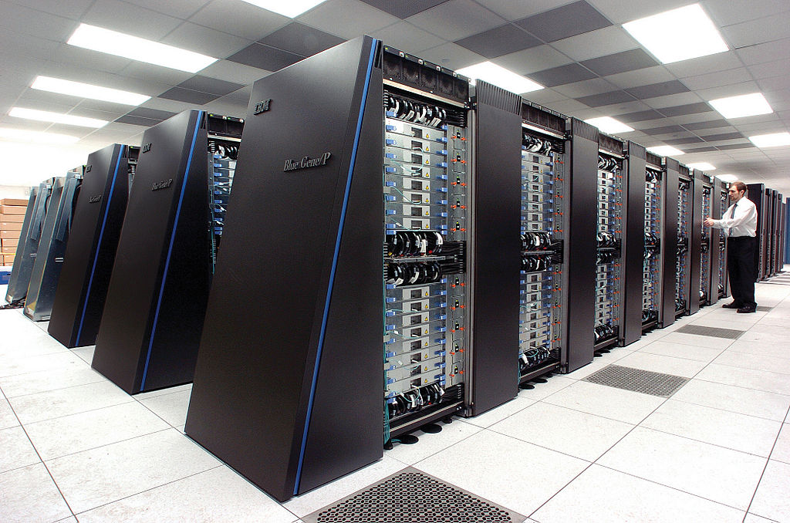
MORE: games, robots, supercomputing
(phone) apps
Department of Computer Science
Notes:
games: (graphics, physics simulation (smoke, fire, fluid), AI, special hardware (co processor) design
related: robotics (robo cup), exa skeletons
Web programming and app development
HPC: weather prediction, car design celestial mechanics

Slide 8
CS1 Course Topics
Languages, Computers, Operating Systems
Identifiers, Variables, Expressions, Operators
Methods: Parameters, Return Values
Conditionals, Booleans, Logical Operators
Math Functions, Characters, Strings
Loops: while, do/while, for
Single and Multidimensional Arrays
Objects and Classes
Inheritance
Abstract Classes and Interfaces
Exceptions and File Input/Output
Recursion
8

Slide 9
Resources eBook: zyBooks
Setup instructions on syllabus
Activities are graded!
Introduced in Lab this week!

Slide 10
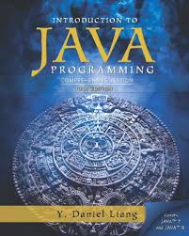
Resources: Java Textbook
Introduction to Java Programming – Daniel Liang, 10th or 11th Edition

Slide 11
Resources: Piazza
Have a question about content? Check Piazza
Need clarification on an assignment? Check Piazza
DO NOT post code to Piazza. You WILL get a zero on the assignment.

Slide 12
Tell Someone!
If you see something concerning, please Tell Someone
Your Instructor
Your TA
CSU Tell Someone Office
http://supportandsafety.colostate.edu/tellsomeone

Slide 13
Motivation
A student asks a roommate, “Could you please go shopping for us and buy one carton of milk and, if they have avocados, get six.” A short time later, the roommate returns with six cartons of milk.
“Why did you buy six cartons of milk?” asks the student. The reply: “They had avocados.”
Reader’s Digest, September 2013
This is exactly what your Java program will do, because computers do what you ask them to do, not what you want them to do!

Slide 14
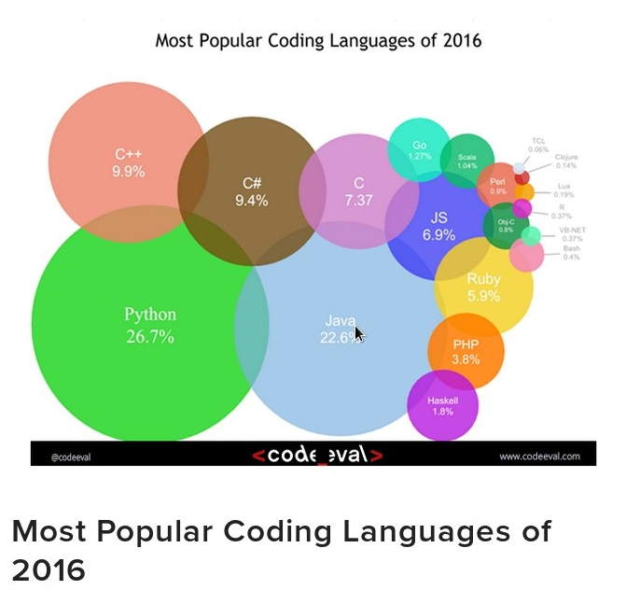
Motivation

Slide 15
Motivation

Slide 16
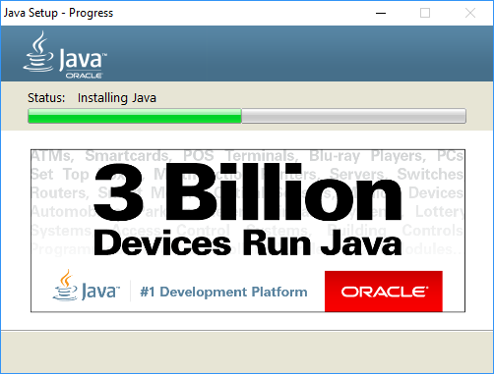
Motivation

Slide 17
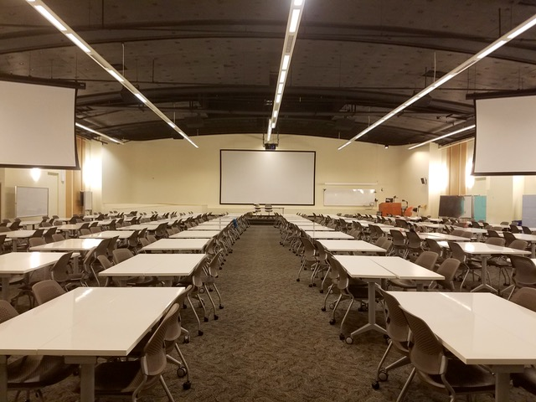

Slide 18
CS 163: Java (CS1) No prior programming experience
http://www.cs.colostate.edu/~cs163/
Introduction to CS1 Java Programming
18

Slide 19
LEARNING: definitions
Learning is a biological process. It occurs when
networks of neurons in your brain send each
other signals.
Thinking is webs (of neurons) sending signals to
other webs. A new idea is a newly formed sub
network of neurons firing signals at each other
Two aspects:
Understanding
Remembering

Slide 20
Understanding
Comes sometimes in a “flash” (Oh I get it)
Often times it takes repeated exposure, examples, associations, hard work
If you don’t get it, go for a walk, come back, try more circuits in your brain
what does that mean?
This requires FOCUS of ATTENTION (concentration) and REPEATED ACTION (do it, do it!)
Understanding cannot be achieved passively; it
demands an active and focused mind.
Notes:
i.e. work more at it

Slide 21
Remembering
Memory: also a biological process involving firing of neurons.
Memories are RECONSTRUCTED (replayed) each time remembering happens.
Use it or lose it: our brain’s web connections are not permanent, they need to be reused / reactivated to stay
Neural nets that get used a lot become stable

Slide 22
Learning
Learning does NOT just happen to you
it is something you do to yourself.
The instructor can teach you theory and practice,
point the way, give you exercises, problems to solve,
do the hoki poki, BUT
Learning is all YOUR ACTIVITY
The basic assumption is that you want to learn.
Without that, nothing will work

Slide 23
You won’t learn unless you want to!
Learning relies on your brain, which demands the same maintenance (food, exercise) as the rest of your body.
Learning is difficult and it requires repeated effort.
Don’t cram the night before a test. Set yourself up for success!
But if done right, it is GREAT!
We wish you the best in your college days.

Slide 24
Grading Criteria
Grades will not be assigned lower than shown:
>= 90% A
>= 80% B
>= 70% C
>= 60% D
Else F
You must have a minimum average of 60% on the exams to receive a C
The instructor reserves the right to assign plus and minus grades. However, an A- (a minus), for example, is a lower grade than an A and therefore cannot be assigned to a score >= 90%. The instructor may choose to lower the cutoffs (i.e. be more generous) at his sole discretion at the end of the semester.

Slide 25
Grading Policy
If you think you have been graded unfairly on a programming assignment, visit the cs163 help desk for an explanation.
All lab grading issues should be resolved in lab with the lead Lab TA BEFORE seeing the instructor.
If you cannot resolve the problem, email the instructor.
Complaints about grades must be made within two weeks of when the grade is released - you cannot come to be more than two weeks after the grade is released to dispute a grade.

Slide 26
Communications
Talk with your teaching assistant before or after labs, at help desk, or during lab hours.
Talk with your instructor during office hours.
Email your instructor directly, especially if privacy is needed (health issue, staff complaint, etc.)
Do not attach comments to Canvas, use the Piazza bulletin board instead.
Piazza is in Canvas modules.
Topics for assignments, Labs, ...

Slide 27
Late Policy
Every assignment has a due date
Full credit requires meeting this deadline
There are no late submissions!
Do the in class worksheets
They help you prepare for tests
Exceptions only for excused absences
Medical emergencies, family emergencies, with documentation
If an emergency happens, email your instructor right away
You will have to get documentation from Student Case Management or another University office.

Slide 28
Getting Help
Web Sites:
www.cs.colostate.edu/~cs163
Especially the Schedule Page
Lectures, Recitations, Lab Hours, Help Desk
Lab operators (general questions)
Office Hours (see syllabus)
Tutors, Friends, Consultants (be careful, you are responsible for your work)
Textbook, Internet

Slide 29
Academic Integrity
All assignments, labs, quizzes, exams are solo
Unless otherwise specified
You may get help from course instructors and TAs
You may discuss concepts with other students, but:
Never share code with another student
Never copy code from another student
Never let anyone else type in code for you
Know the department academic honesty code!

Slide 30
Lecture Expectations
Come to class
Attendance predicts success
Be active, not passive:
Take notes, Ask questions
Do the worksheets
Be prepared
Do reading assignments before the lecture
Be on time
Lectures start and end on time

Slide 31
Lecture Expectations
Cell phones on vibrate-only
If you need to answer, leave the room first
You may use your phone as your iClicker
Laptops for note taking or coding!
No games, audio, video, inappropriate websites
Respect your colleagues
No snide or rude comments
No comments on abilities
No extended conversations

Slide 32
Lab Expectations
Use the Linux Lab – CSB 120
Not the Windows Lab – CSB110
No uncovered drinks and no food
Treat the lab as a professional workplace
No disparaging comments
No loud/rude/distracting behavior
Professional composure at all times
No sexual harassment of any sort, not ever!

