Slide 1
CS 1: Starting Programming
Colorado State University
Department of Computer Science
Notes:
Overall, this one still has a fair amount of slides. It however is early in the semester (you know first week) - so figure it is better to ease them into having to read the book first

Slide 2
Announcements
Learning Objectives
Due Date Reminders
To be able to read, write, declare and initialize basic types.
To trace programs, figuring out what is going on.

Slide 3
Why programming? Think-Pair-Share
On a piece of paper, write:
6 Reasons why people program / advantages of computer programs - start now!
Pair with a partner
Talk through the different reasons you found
Share the answers with others
Share the answer with another group next to you (or same table)
Notes:
Only spend 2 minutes on think - and a couple more on the rest - this is just to get them practicing think-pair-sharing.

Slide 4
Variables
Computers hold *data* as Zeros and Ones
Data is stored in variables
Variables have type (size)
Some common Java ones?
int
double
char
String

Slide 5
Declaring a Variable
int puppyCounter; // Reserves space to store the number of
puppies we want to count - whole numbers: 1, 10, 100
double price; // Reserves space to store the price of an amazon item -
includes decimals: 1.5, 10.45, -10.0
char favoriteLetter; // Reserves space to store my favorite single character.
Only a single character: ‘A’ ‘a’ ‘x’ ‘ ’ ‘&’
String hero; // Reserves space to store ‘an ordered collection of characters’ -
a word or sentence: “marvel”, “iron man”

Slide 6
Assigning Values
We want to assign values to variables!! They have to match the type!
heroCounter = 6;
price = 14.7;
favoriteLetter = ‘y’;
String hero = “Marvel”;

Slide 7
Your turn
Match the assignment with the declaration!
First by yourself - on paper
What would the code look like? Can you do it in one line per variable?
In addition to the variables below, create 5 more of your own!
Then pair up and compare answers
Feel free to use zybooks or other resources.
int blasterCounter | 4.5039
double antCompression | “Marvel”
String captain | 22
char letter | “random%$%$@@!#”
int overTen | 4
String randomChactersInString | ‘A’

Slide 8
Answers
Pro Tip - camelCase
Notice how we name variables with uppercase letters at the start of every word? That is used in industry. Called camelCase.
int blasterCounter = 4; //notice the semicolon!
double antCompression = 4.5039;
String captain = “Marvel”; //notice the type String is capitalized. We will get to why later!
char letter = ‘A’; //In programming ‘A’ and ‘a’ are two different letters- case matters!
int overTen = 22;
boolean check = true; // booleans are either true or false - notice case
String randomCharactersInString = “random%$%$@@!#”;
Some of my own
String captain2 = “America”; // I couldn’t use the same variable captain
int originalAvengers = 6;
double pieSlices = 6.28;
boolean accrds = false;

Slide 9
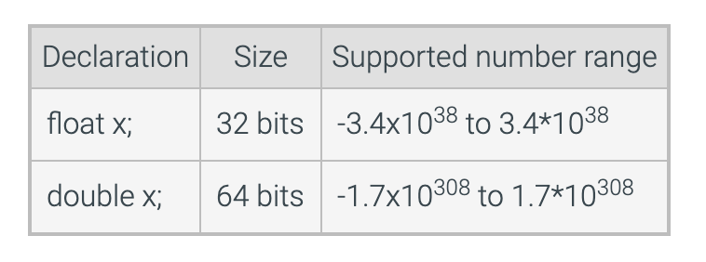
Primitives are 0s and 1s: bits!
There are different types of variables, that hold different amounts of data!
Non-numerics
boolean | true/false
char | ‘A’, ‘B’
Reference: Zybooks
Notes:
Where are boolean and char?
Not sure if we need byte, short, long, float at this point?

Slide 10
Strings are fun
They have functionality (actions) to them
Called Methods
String ironMan = “Stark”;
int len = ironMan.length();
What is the value of len?

Slide 11
You can add Strings!
Adding strings is called String concatenation
String whoIsShe = “C” + “M”;
int len = whoIsShe.length(); // what is the value of len?
You can also add the variables together
String addedTogether = whoIsShe + len; // the value is “CM2” (notice no space)

Slide 12
Printing
Pro Tip:
Use System.out.println() for debugging in your code - every good developer does.
Variables are great, but…
We want the computer screen to show us something!
Computer == The System
The Screen == the output device
To the rescue
System.out.print(“I want to print something”);
System.out.println(“I want to print something and move to next line”);
System.out.println(10); // prints the number 10 to the screen
It can also take in variables
String captain = “Marvel”;
System.out.println(captain); // Will print out Marvel on the screen (note no quotes)
System.out.println(“Captain ” + captain); // prints Captain Marvel on the screen!
Notes:
Example showing System.out.println() not limited to strings

Slide 13
System input?
Pro Tip:
Scanner has a number of methods (actions) that help with input
.next() - grabs the next word
.nextLine() - entire line
.nextInt() - grabs the next, converts to int
.nextDouble() - grabs the next, converts to double
You want to *read* in from the system (computer) - using the keyboard.
This is called System.in
We need to scan that information to use it
Scanner input = new Scanner(System.in);
How do we use it?
System.out.print(“Enter your name, hero: ”); // notice we use print, not println
Scanner input = new Scanner(System.in);
String heroName = input.next(); // grabs the next word - through the next space!
Notes:
May want to start out with nextLine() instead of next() for Scanner

Slide 14
Putting it together
What is printed at each print? Work as a group to figure it out - write it down
public class MyClass {
public static void main(String[] args) {
String captain = “Marvel”; int stones = 6;
System.out.println(captain); // first line - what is printed?
int timeStoneIsMissing = stones - 1;
System.out.println(stones); // second line printed - is this what I wanted? oops!
Scanner scanner = new Scanner(System.in);
System.out.print(“Who is your favorite hero? ”); // third line printed
String yourName = scanner.next(); // Assume the client enters “Vision”
System.out.println();
System.out.println(“Who is better ” + captain “ or ” + yourName + “?”); // fifth print
}
}
Notes:
Do we have them submit the answer to canvas after the class? Or just let them grade it on their own? Do we walk them through an example after doing this - as this replacing the ‘code tracing’ slides - by having them go through it.
Ask “why didn’t we ask you what the fourth print was?”

