Slide 1
CS 1: Operations and Expressions
Colorado State University
Department of Computer Science

Slide 2
Announcements
Learning Objectives
Due Date Reminders
--Check zyBooks!
Name variables according to established conventions
Transform Mathematical Expressions into Computer Code

Slide 3
Introducing Final Variables
Recall
int x = 10;
double pi = 3.14159;
BUT…. pi doesn’t change… What can we do?
final double PI = 3.14159;
This is your ‘datatype’ (int, double, etc)
Tradition - we like to capitalize constant variables
final means you can’t change it once set!

Slide 4
Naming Conventions
Capitalize final (constant) variables - PI, TOTAL_HEROES, SPEED_OF_LIGHT
Capitalize first letter of class names - and follow UppercamelCase MyClass, Main, Circle, Hero
Follow lowerCamelCase for variables and methods
More examples:
int numberOfHeroes = 6;
final long SPEED_OF_LIGHT = 299792458;
int double myCoolMethod() {} // we will learn about methods later
class BlackTie {} // we will learn about classes in more detail later
Further Reading:
https://www.cs.cornell.edu/courses/JavaAndDS/JavaStyle.html

Slide 5
Operations
Java uses Operators to perform operations on variables
These operators work much like the math operators you know, with some interesting differences.

Slide 6
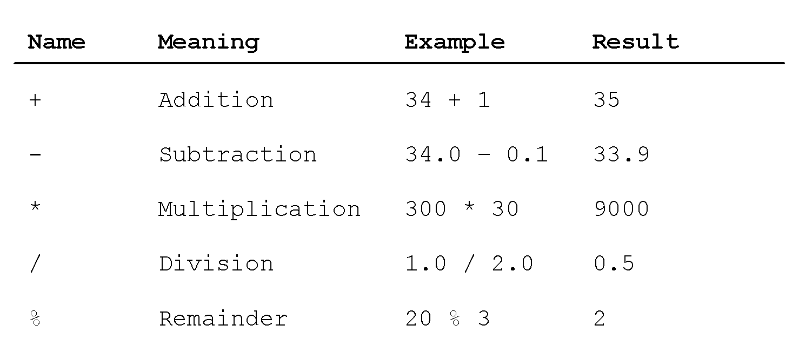
Mathematical Operators

Slide 7
Order of Operations
Java uses the same order of operations that we are used to for mathematical operators
( )
* /
+ -

Slide 8
Not all math operations have an operator
How do we do exponents and square root?
2³ is written as Math.pow(2,3)
√4 is written as Math.sqrt(4)

Slide 9
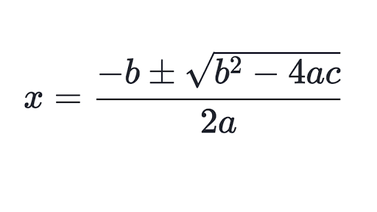
Your Turn
Write a Java statement for the quadratic formula:
What issues did you have?
Share your answer with your table

Slide 10
Learning about Math Operators
How do we learn about Math operators in Java?
Javadocs!

Slide 11
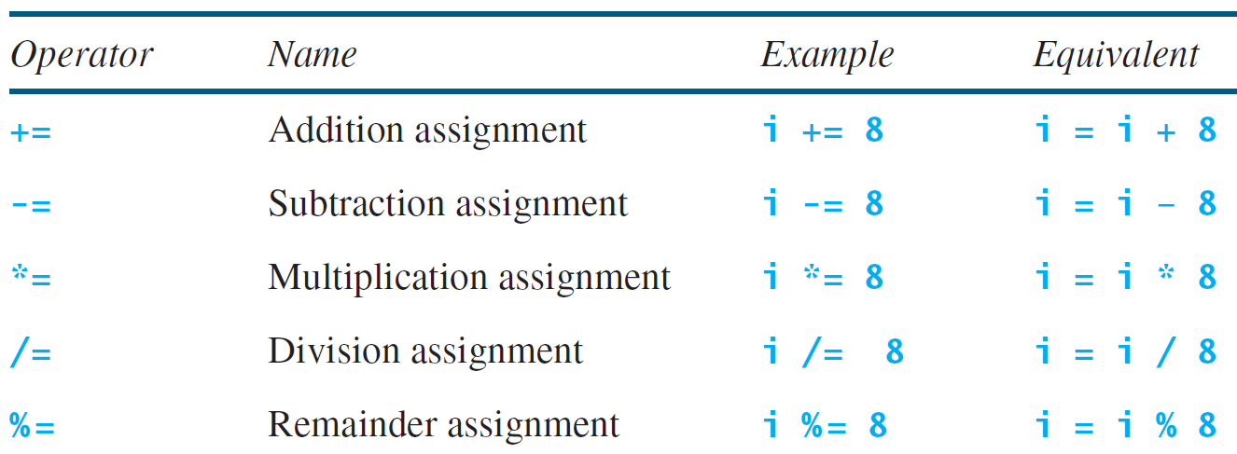
Augmented Assignment Operators

