Slide 1
Chapter 2: Beginning to Program
CS1: Java Programming
Colorado State University
Original slides by Daniel Liang
Modified by Kris Brown, Ben Say, Wim Bohm
1

Slide 2
Motivations
Solve practical problems programmatically
Java primitive data types
Strings
Input/Output
Constants
2

Slide 3
Variables
A named container that holds a specific piece of data.
Variables have a type (set of values). Some Java types are:
int, double, char, String
(more later)

Slide 4
Declaring Variables
int x; // Declare x to be an
// integer variable;
double radius; // Declare radius to
// be a double variable;
char a; // Declare a to be a
// character variable;
String s; // Declare s to be a
// String variable;
4

Slide 5
Assignment Statements
x = 1; // Assign 1 to x;
radius = 1.0; // Assign 1.0 to radius;
a = 'A'; // Assign 'A' to a;
s = ”Java”; // Assign “Java” to s
5

Slide 6
Declaring and Initializing in One Step
int x = 1;
double d = 1.4;
String s = ”Java”;
6

Slide 7
Variable names
A variable name is a sequence of characters that consist of letters, digits, underscores (_), and dollar signs ($).
A variable name must start with a letter, an underscore (_), or a dollar sign ($). It cannot start with a digit.
A variable name cannot be a reserved word. (See Appendix A, “Java Keywords,” for a list of reserved words).
A variable name cannot be true, false, or null.
A variable name can be of any length.
7
Notes:
Which are valid variable names:
_special
Message
message
1message
class
true

Slide 8
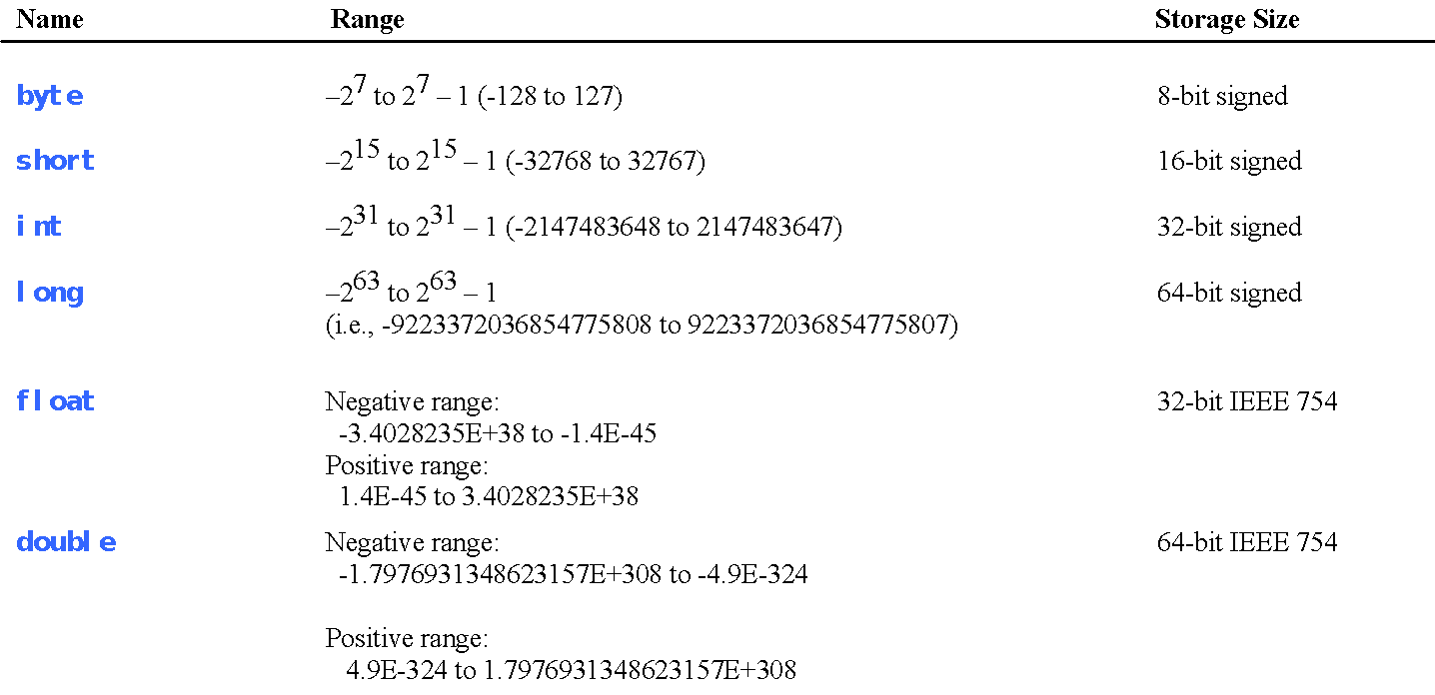
Numerical Data Types
8

Slide 9
Printing
System.out.println(“Hello World”);
get the computer to print something to the console
println prints a line and adds a new line at the end
print prints the line and continues on the same line
use for DEBUGGING!!

Slide 10
Simple String Operations
Concatenation:
Use the “+” (plus sign) to concatenate strings
System.out.println(mm + “ “ + yy);

Slide 11
Simple String Operations
The length() method
String theName = ”Donald Duck”;
int len = theName.length();
What is returned by length() ?
Notes:
11 (count the chars in theName)

Slide 12
Reading Input from the Console
1. Create a Scanner object
Scanner input = new Scanner(System.in);
2. Use the method nextDouble() to obtain to a double value. For example,
System.out.print("Enter a double value: ");
Scanner input = new Scanner(System.in);
double d = input.nextDouble();
Let’s play with IO in Eclipse
12

Slide 13
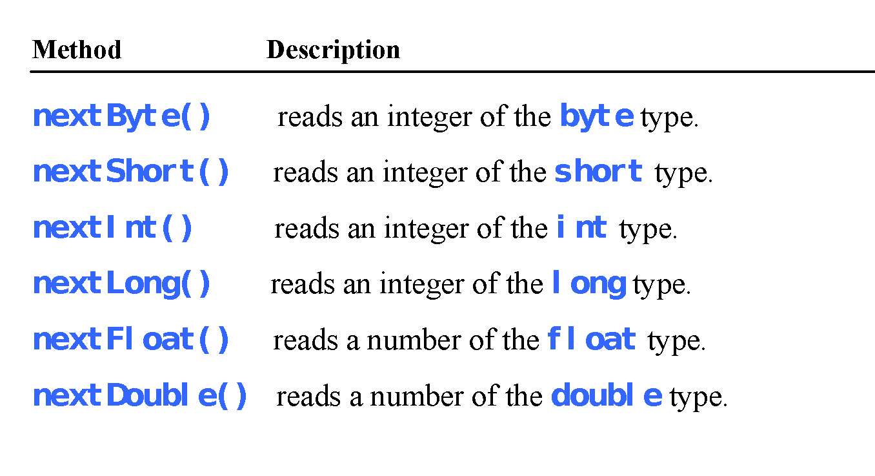
Reading Numbers from the Keyboard
Scanner input = new Scanner(System.in);
int value = input.nextInt();
13

Slide 14
Variables
// Compute the first area
radius = 1.0;
area = radius * radius * 3.14159;
System.out.println("The area is ” + area + " for radius "+radius);
// Compute the second area
radius = 2.0;
area = radius * radius * 3.14159;
System.out.println("The area is ” + area + " for radius "+radius);
14

Slide 15
Trace a Program Execution
animation
allocate memory for radius
public class ComputeArea {
/** Main method */
public static void main(String[] args) {
double radius;
double area;
// Assign a radius
radius = 20;
// Compute area
area = radius * radius * 3.14159;
// Display results
System.out.println("The area for the circle of radius " +
radius + " is " + area);
}
}
radius
no value
15

Slide 16
Trace a Program Execution
animation
public class ComputeArea {
/** Main method */
public static void main(String[] args) {
double radius;
double area;
// Assign a radius
radius = 20;
// Compute area
area = radius * radius * 3.14159;
// Display results
System.out.println("The area for the circle of radius " +
radius + " is " + area);
}
}
memory
radius
no value
area
no value
allocate memory for area
16

Slide 17
Trace a Program Execution
animation
public class ComputeArea {
/** Main method */
public static void main(String[] args) {
double radius;
double area;
// Assign a radius
radius = 20;
// Compute area
area = radius * radius * 3.14159;
// Display results
System.out.println("The area for the circle of radius " +
radius + " is " + area);
}
}
assign 20 to radius
radius
20.0
area
no value
17

Slide 18
Trace a Program Execution
animation
public class ComputeArea {
/** Main method */
public static void main(String[] args) {
double radius;
double area;
// Assign a radius
radius = 20;
// Compute area
area = radius * radius * 3.14159;
// Display results
System.out.println("The area for the circle of radius " +
radius + " is " + area);
}
}
memory
radius
20.0
area
1256.636
compute area and assign it to variable area
18

Slide 19
Trace a Program Execution
animation
public class ComputeArea {
/** Main method */
public static void main(String[] args) {
double radius;
double area;
// Assign a radius
radius = 20;
// Compute area
area = radius * radius * 3.14159;
// Display results
System.out.println("The area for the circle of radius " +
radius + " is " + area);
}
}
memory
radius
20.0
area
1256.636
print a message to the console
19

Slide 20
Your Turn!
Write code in which a String variable message contains “The number of rabbits is”. An integer variable num has a value of 129. Concatenate these variables into a String called report. Then print, using report:
The number of rabbits is 129!!

Slide 21
Lecture 2 Operators, Expressions

Slide 22
Named Constants
final datatype CONSTANTNAME = VALUE;
final double PI = 3.14159;
final int SIZE = 3;
22
Notes:
G=]final means “it cannot change"

Slide 23
Naming Conventions
Choose meaningful and descriptive names.
Variables and method names:
Use lowercase. If the name consists of several words, concatenate all in one, use lowercase for the first word, and capitalize the first letter of each subsequent word in the name. For example, the variables radius and area.
23

Slide 24
Naming Conventions, cont.
Class names:
Capitalize the first letter of each word in the name. For example, the class name ComputeArea.
Constants:
Capitalize all letters in constants, and use underscores to connect words. For example, the constant PI and MAX_VALUE
24

Slide 25
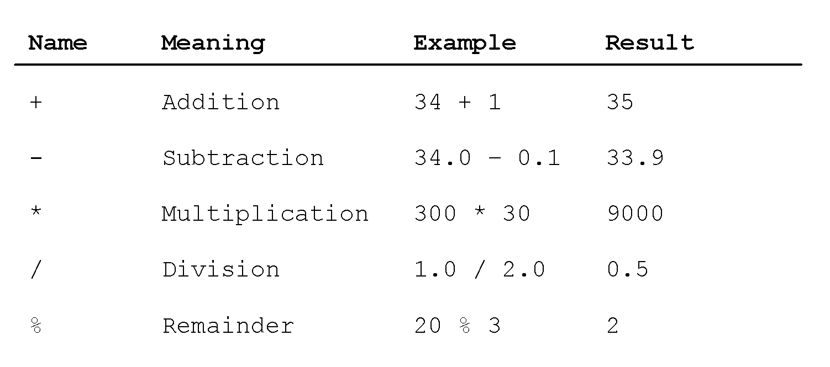
Numeric Operators
25

Slide 26
PEMDAS
What is it? Precedence order in arithmetic expressions:
Parentheses
Exponentiation
Multiplication, Division
Addition, Subtraction
2 + 3 * 5 = ?
(2 + 3) * 5 = ?
Operators at the same level (*, /) and (+,-) go from left to right (left associative (+,-) and left associative (*,/))
2 - 3 + 5 = ?
12 / 3 * 6 = ?

Slide 27
Integer Division
+, -, *, /, and %
5 / 2 yields an integer 2.
5.0 / 2 yields a double value 2.5
5 % 2 yields 1 (the remainder of the
(integer) division)
27

Slide 28
Modulo/Remainder Operator
Remainder is very useful in programming.
An even number % 2 is 0 and an odd number % 2 is 1.
Suppose today is Saturday and you and your friends are
going to meet in 10 days. What day is in 10 days?
Tuesday; use the following expression:
Which day is Sunday?
28

Slide 29
Relationship of / and %
For all integers p and q : p = (p/q)*q + p%q
Terminology:
p: dividend
q: divisor
p/q: quotient
p%q: remainder
The remainder is negative only if the dividend is negative.
Integer division rounds towards 0: 3/2 = 1, -3/2 = -1

Slide 30
Exponent Operations
// these are (Math)library methods
System.out.println(Math.pow(2, 3));
// Displays 8.0
System.out.println(Math.pow(4, 0.5));
// Displays 2.0
System.out.println(Math.pow(2.5, 2));
// Displays 6.25
System.out.println(Math.pow(2.5, -2));
// Displays 0.16
30

Slide 31
Number Literals
A literal is a constant value that appears directly in the program. For example, 34, 1,000,000, and 5.0 are literals in the following statements:
int i = 34;
long x = 1000000;
double d = 5.0;
31

Slide 32
Integer Literals
An integer literal can be assigned to an integer variable as long as it can fit into the variable.
byte b1 = 100;
byte b2 = 1000; // compiler error, WHY?
An integer literal is assumed to be of the int type, whose value is between -2³¹ (-2147483648) to 2³¹–1 (2147483647).
32
Notes:
A compilation error would occur if the literal were too large for the variable to hold. For example, the statement byte b = 1000 would cause a compilation error, because 1000 cannot be stored in a variable of the byte type.
To denote an integer literal of the long type, append it with the letter L or l. L is preferred because l (lowercase L) can easily be confused with 1 (the digit one).

Slide 33
Floating-Point Literals
Floating-point literals are written with a decimal point. By default, a floating-point literal is treated as a double type value.
double d0 = 0.5;
double d1 = 100.2d;
double d2 = 100.1D;
float f1 = 100.2f;
float f2 = 100.3F;
33
Notes:
For example, 5.0 is considered a double value, not a float value. You can make a number a float by appending the letter f or F, and make a number a double by appending the letter d or D. For example, you can use 100.2f or 100.2F for a float number, and 100.2d or 100.2D for a double number.

Slide 34
double vs. float
The double type values are more accurate than the float type values. For example,
System.out.println("1.0 / 3.0 is " + 1.0 / 3.0);
System.out.println("1.0F / 3.0F is " + 1.0F / 3.0F);
34

Slide 35
Scientific Notation
Floating-point literals can also be specified in scientific notation, for example, 1.23456e+2, same as 1.23456e2, is equivalent to 123.456, and 1.23456e-2 is equivalent to 0.0123456. E (or e) represents an exponent and it can be either in lowercase or uppercase.
35

Slide 36
Numeric data types
Name |  | Storage Size
byte
short
int
long
float
double
Name | Storage
byte | 8 bit signed integer
short | 16 bit signed integer
Int | 32 bit signed integer
long | 64 bit signed integer
float | 32 bit floating point number
double | 64 bit floating point number
For value ranges see book. E.g.:
byte range: -128 to 127
int range: ~ 2E10 to 2E10

Slide 37
Arithmetic Expressions
is translated to
(3+4*x)/5 – 10*(y-5)*(a+b+c)/x + 9*(4/x + (9+x)/y)
37

Slide 38
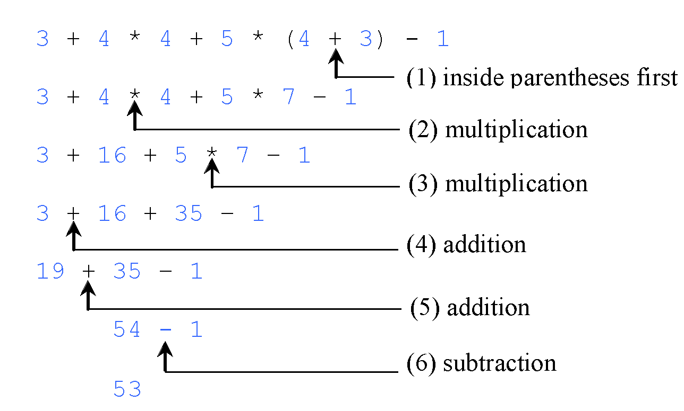
How to Evaluate an Expression
Apply the precedence and associativity rules discussed earlier
To determine the order of evaluation.
Parentheses ( ) allow changing the order of evaluatioin
38

Slide 39
Full parenthesization
In full parenthesization every sub expression is parenthesized. It explicitly defines the evaluation order in an expression:
5 * (3 – 2) - 3 + 4 → (((5 * (3-2)) – 3) + 4)

Slide 40
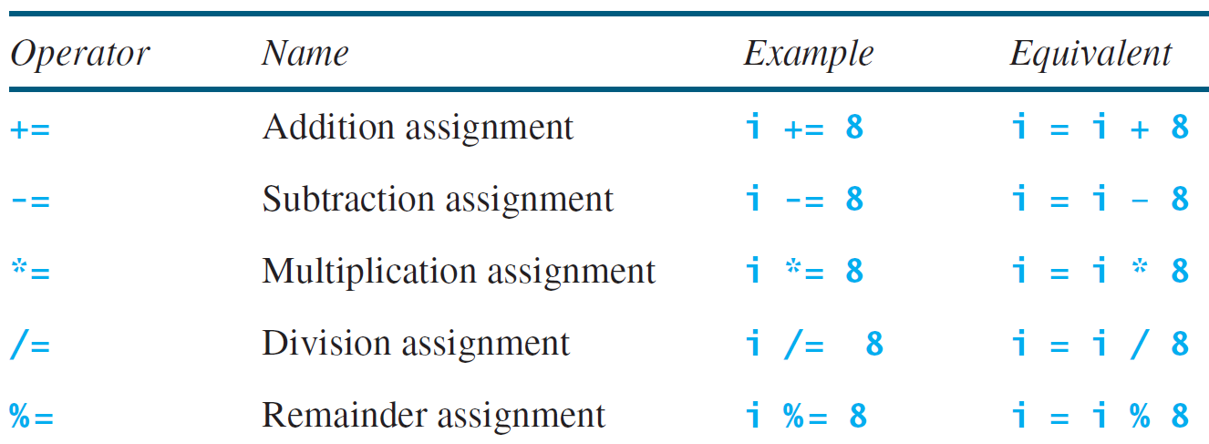
Augmented Assignment Operators
40

Slide 41
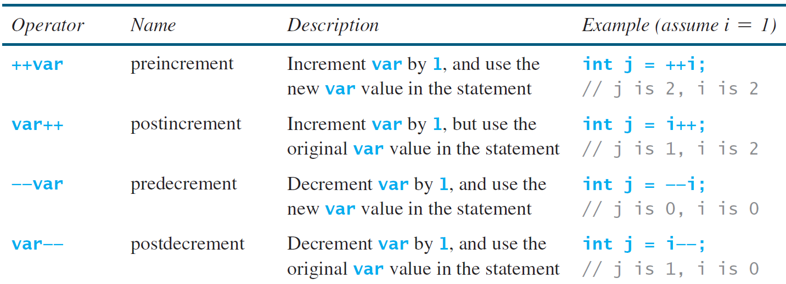
Increment and Decrement Operators
41

Slide 42
Increment and Decrement Operators, cont.
42

Slide 43
Increment and Decrement Operators, cont.
Using increment and decrement operators makes expressions short, but it also makes them complex and difficult to read. Avoid using these operators in expressions that modify multiple variables, or the same variable for multiple times such as this: int k = ++i + i.
43

Slide 44
Assignment Expressions and Assignment Statements
Prior to Java 2, all the expressions can be used as statements. Since Java 2, only the following types of expressions can be statements:
variable op= expression; // Where op is +, -, *, /, or %
++variable;
variable++;
--variable;
variable--;
(because they are implicit assignment statements)
44

Slide 45
Type Casting
Implicit casting
double d = 3; (type widening)
Explicit casting
int i = (int)3.0; (type narrowing)
int i = (int)3.9; (fraction part is truncated)
What is wrong? int x = 5 / 2.0;
45

Slide 46
***Conversion Rules***
When performing a binary operation involving two operands of different types, Java automatically converts the operand based on the following rules:
1. If one of the operands is double, the other is converted into double.
2. Otherwise, if one of the operands is float, the other is converted into float.
3. Otherwise, if one of the operands is long, the other is converted into long.
4. Otherwise, both operands are converted into int.
46
Notes:
So a byte + byte is equivalent to int + int
Java has no byte (or short) +
Important Slide!! Everyone forgets this!!
Java automatically converts up, not down. Java doesn’t like to lose information.

Slide 47
Casting in an Augmented Expression
In Java, an augmented expression of the form
x1 op= x2 is implemented as x1 = (T)(x1 op x2), where T is the type for x1. Therefore, the following code is correct.
int sum = 0;
sum += 4.5; // sum becomes 4 after this statement
// is equivalent to sum = (int)(sum + 4.5).
47
Notes:
Don’t go overboard with this!! Use clear and simple typing / casting.

Slide 48
Common Errors and Pitfalls
Common Error 1: Undeclared/Uninitialized Variables and Unused Variables
Common Error 2: Integer Overflow
Common Error 3: Round-off Errors
Common Error 4: Unintended Integer Division
Common Error 5: Redundant Input Objects
Common Pitfall 1: Redundant Input Objects
48

Slide 49
Common Error 1: Undeclared/Uninitialized Variables and Unused Variables
double interestRate = 0.05;
double interest = interestrate * 45;
49

Slide 50
Common Error 2: Integer Overflow
int value = 2147483647 + 1;
// value will actually be -2147483648
50

Slide 51
Common Error 3: Unintended Integer Division
51

Slide 52
Common Pitfall 4: Redundant Input Objects
Scanner input = new Scanner(System.in);
System.out.print("Enter an integer: ");
int v1 = input.nextInt();
Scanner input1 = new Scanner(System.in);
System.out.print("Enter a double value: ");
double v2 = input1.nextDouble();
Let’s go find out what happens . . .
52

Slide 53
Your Turn!
Write a program that stores the remainder of dividing the integer variable i by integer variable j in an integer variable named k. Use a Scanner object to get those variables from a user at the keyboard. Print k to the console.
Enter i:
Enter j:
Result k:

Slide 54
printf
You can format your decimal numbers using,
for example, the following:
System.out.printf("Total is: $%,.2f%n", dblTotal);
You will learn about printf in recitation.
Notes:
THIS IS NOT AT ALL EXPLAINED!!
$ not part of the format specifier
use of , flag: , separated 3 digit groups
meaning of .2 two decimal digit and float/ double type f
meaning of %n newline
If we do this shouldn’t we also talk about %d, %s, or:
I found a useful, short, pdf about printf

Slide 55
NOTE
Calculations involving floating-point numbers are approximate because these numbers are not stored with complete accuracy. For example,
System.out.println(1.0 - 0.1 - 0.1 - 0.1 - 0.1 - 0.1);
displays 0.5000000000000001, not 0.5, and
System.out.println(1.0 - 0.9);
displays 0.09999999999999998, not 0.1.
Integers are stored precisely. Therefore, calculations with integers yield a precise integer result.
55

Slide 56
Common Error 3: Round-off Errors
System.out.println(1.0 - 0.1 - 0.1 - 0.1 - 0.1 - 0.1);
System.out.println(1.0 - 0.9);
Let’s go look what happens . . .
56

