Slide 1
Introduction to Methods and Interfaces
CS1: Java Programming
Colorado State University
Kris Brown, Wim Bohm and Ben Say
1

Slide 2
Methods - motivation
We want to write a program that manipulates areas of certain 2D shapes
rectangles, squares
circles, and spheres
We do not want to write the expression for these areas every time we need to compute one
Similarly, we do not want to write one monster main method to do all the work!
We want to divide and conquer: separate logical groups of statements together in one construct

Slide 3
Methods
A method allows us to group a set of statements together into a logical operation
There are two aspects to methods:
The method definition
A method is a collection of statements that are grouped together to perform an operation
The method call
Another method can now use the defined method to perform the operation

Slide 4
Method definition
A method is a collection of statements that are grouped together to perform an operation. Defining a method:
modifier return method formal parameters
value type name
public int areaRec (int length, int width) {
// compute area of Rectangle
int area = length * width;
return area;
}
method body, ending with
return value;

Slide 5
Calling a Method
A method is a called in another piece of code (main or another method). Calling a method:
method actual parameters
name
int area = areaRec (5, 7)
// definition
public int areaRec(int length, int width){
// compute area of Rectangle
int area = length * width;
return area;
}
The Method signature is the combination of
the method name and the formal parameter list.

Slide 6
Method call: parameter passing
When a method is called, the values of the actual parameters of the caller are passed (copied) to the formal parameters of the definition.
areaRec(5, 7) (in our example)
passes 5 to length
and 7 to width

Slide 7
Method return
A method may return a value.
The returnValueType is the data type of the value the method returns. If the method does not return a value, the returnValueType is the keyword void.
For example, the returnValueType in the main method is void.
When a method call is finished it returns the returnValue to the caller. In our example code int area = areaRec(5,7)
areaRec(5, 7) returns 35
Let’s go check out the code . . .

Slide 8
Call Stack
In our example code
main called doRectangularShapes()
and
doRectangularShapes called areaRec(9,5)
When our program gets executed, a run time stack allows records called stack-frames to be stacked up and removed, thereby keeping track of the call history.

Slide 9
main starts
main
args: ….

Slide 10
main calls doRectangularShapes()
doRectangularShapes
area:
volume:
main
args: ….

Slide 11
doRectangularShapes calls areaRec(9,5)
areaRec
length: 9
width: 5
doRectangularShapes
area:
main
args: ….

Slide 12
areaRec(9,5) returns 45 doRectangularShapes prints
doRectangularShapes
area: 45
output:
9 by 5 rectangle has area 45
main
args: ….

Slide 13
doRectangularShapes calls areaRec(12)
areaRec
length:
width: 12
doRectangularShapes
area: 45
main
args: ….

Slide 14
areaRec calls areaRec(12,12)
areaRec
length: 12
width: 12
areaRec
length:
width: 12
doRectangularShapes
area: 45
main
args: ….

Slide 15
areaRec(12,12) returns 144 areaRec(12) returns 144 doRectangularShapes prints
doRectangularShapes
area: 144
output:
square with width 12 has area 144
main
args: ….

Slide 16
doRectangularShapes returns
main
args: ….

Slide 17
Your turn!
Read the program and trace what happens next
Draw the run time stack with its stack frames for all the call / return events

Slide 18
Pass by Value
The call
volumeBlck(10,12,6)
in
doRectangularShapes()
passes the integer values 10, 12, and 6 to volumeBlck.
This will become relevant later in the course

Slide 19
Overloading
Notice that there are e.g. two methods volumeBlck, with two different method signatures:
public int volumeBlck(int length, int width, int height)
and
public static int volumeBlck(int width)
We call this method overloading. A call will check the number and types of the parameters and select the method with the matching method signature.
E.g. volumeBlck(11) will select
public static int volumeBlck(int width)

Slide 20
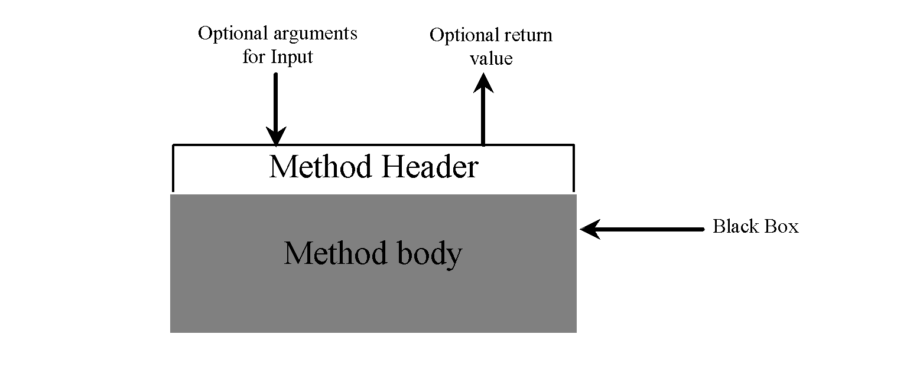
Method Abstraction
You can think of the method body as a black box that contains the detailed implementation for the method.
20

Slide 21
Benefits of Methods
Write a method once and reuse it anywhere.
Hide the implementation from the user.
Reduce complexity (e.g. of main), therby increasing the readability of your program.
Simplify maintenance: if the method needs to change, you only change it in one place.
(and the user does not need to know about it)
21

Slide 22
Your Turn!
Write two methods that will calculate the perimeter of a rectangle and of a square
public int perimRec(int length, int width)
and
public int perimRec(int width)

Slide 23
Introduction to Interfaces

Slide 24
Interfaces - motivation
Consider the task of writing classes to represent 2D shapes such as Ellipse, Circle, Rectangle and Square. There are certain attributes or operations that are common to all shapes: e.g. their area
Idea of interface: contract:
"I'm certified as a 2D shape. That means you can be
sure that my area can be computed.”

Slide 25
Interfaces
interface: A list of methods that a class promises to implement.
Only method stubs (method without a body) and constant declarations in the interface, e.g.
public double PI = 3.14159;
public int areaRec(int length, int width);
A class can implement an interface
A rectangle has an area that can be computed by the method AreaRec
If a class implements an interface, it must have methods for all methods stubs in the interface.

Slide 26
Implementing an interface
A class can declare that it implements an interface:
public class <name> implements <interface name> {
...
}
This means the class needs to contain an implementation for each of the methods in that interface.
(Otherwise, the class will fail to compile.)
Let’s go look at some code . . .

Slide 27
Your Turn!
You wrote two methods that calculate the perimeter of a rectangle and of a square
public int perimRec(int length, int width)
and
public int perimRec(int width)
How does the Interface now change?

