Slide 1
CS 1: Methods
Colorado State University
Department of Computer Science

Slide 2
Announcements
Learning Objectives
Due Date Reminders
Learn about the Boolean type and logic operators
Make decisions in our programs

Slide 3
User Experience? Think-pair-share
On a piece of paper, write:
If a user inputs invalid input into a program, how should the program react to the user?
Pair with a partner
Share the examples you found
Share the answers with others
Share the answer with another group next to you (or same table)
Notes:
Ask the question: Were those subtasks useful on their own? Or as a subtask for another complex task?

Slide 4
The boolean type
We ask questions about variables in a program.
The answer is a strict “Yes” or “No”
Enter the boolean type!
Stores only the value “true” or “false”
boolean b = (3 < 4);

Slide 5
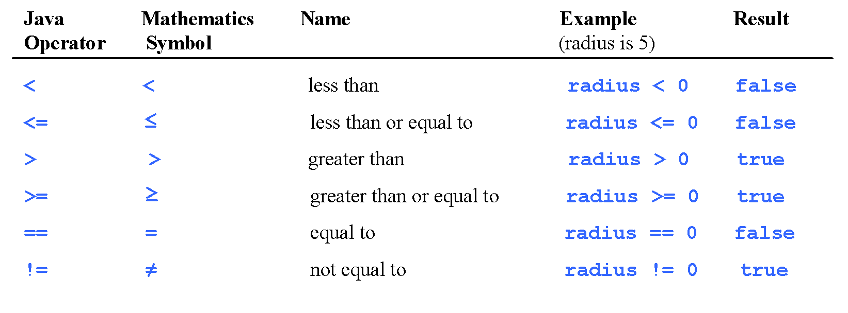
Relational Operators

Slide 6
Making Decisions
boolean b = … ; //some boolean value
if(b){
System.out.println(“b is true”);
}
System.out.println(“b could be true or false”);

Slide 7
Making (better?) Decisions
boolean b = … ; //some boolean value
if(b){
System.out.println(“b is true”);
}else{
System.out.println(“b is false”);
}

Slide 8
Chaining Decisions
if(b){
System.out.println(“b is true, we don’t know c”);
}else if(c){
System.out.println(“c is true, b is false”);
}else{
System.out.println(“both b and c are false”);
}

Slide 9
Cleaning up? Decisions…
if(b)
System.out.println(“b is true, we don’t know c”);
else if(c)
System.out.println(“c is true, b is false”);
else
System.out.println(“both b and c are false”);
//Which do you like better? Braces or no?

Slide 10
Cleaning up? Careful…
if(b)
System.out.println(“b is true”);
if(c)
System.out.println(“c is true”);
else
System.out.println(“both b and c are false”);
//What is the error here?

Slide 11
Making Decisions
boolean b = … ; //some boolean value
if(b);
{
System.out.println(“b is true”);
}
//Error?

Slide 12
Your turn
Write a boolean statement or if statement that determines if an int “yr” is a leap year.
A year is a leap year if:
It is divisible by 4 but NOT by 100
or
It is divisible by 400
GO!

