Slide 1
Ch 5 : Mathematical Functions, Characters, and Strings
CS1: Java Programming
Colorado State University
Original slides by Daniel Liang
Modified slides by Kris Brown
1

Slide 2
Character Data Type
Four hexadecimal digits.
char letter = 'A'; (ASCII)
char numChar = '4'; (ASCII)
char letter = '\u0041'; (Unicode)
char numChar = '\u0034'; (Unicode)
NOTE: The increment and decrement operators can also be used on char variables to get the next or preceding Unicode character. For example, the following statements display character b.
char ch = 'a';
System.out.println(++ch);
2

Slide 3
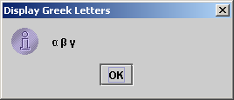
Unicode Format
Java characters use Unicode, a 16-bit encoding scheme established by the Unicode Consortium to support the interchange, processing, and display of written texts in the world’s diverse languages. Unicode takes two bytes, preceded by \u, expressed in four hexadecimal numbers that run from '\u0000' to '\uFFFF'. So, Unicode can represent 65535 + 1 characters.
Unicode \u03b1 \u03b2 \u03b3 for three Greek letters
3

Slide 4
ASCII Code for Commonly Used Characters
4

Slide 5
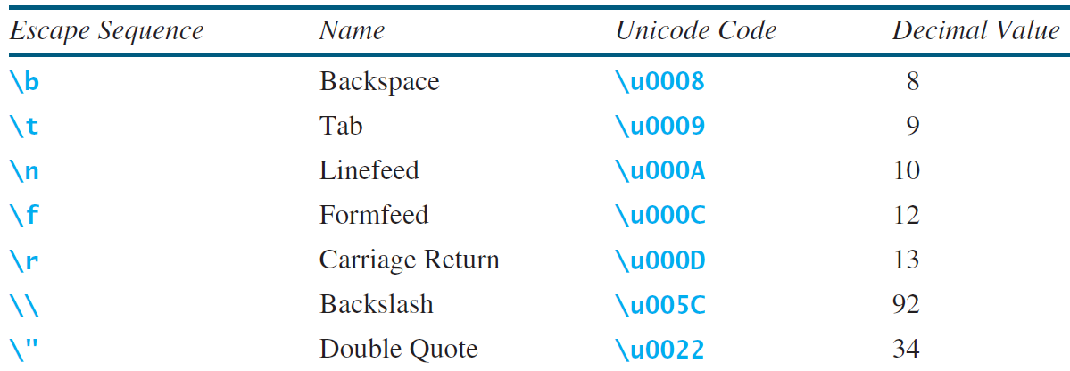
Escape Sequences for Special Characters
5

Slide 6
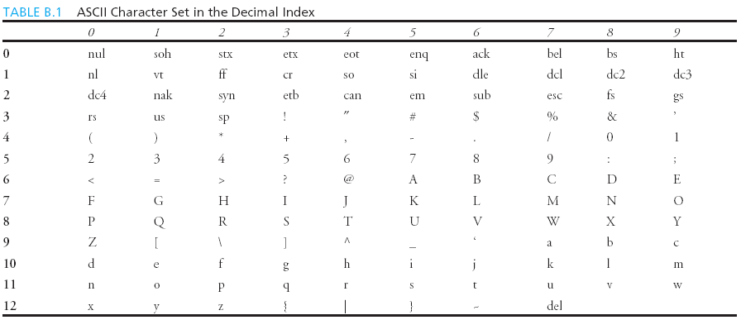
Appendix B: ASCII Character Set
ASCII Character Set is a subset of the Unicode from \u0000 to \u007f
6

Slide 7
ASCII Character Set, cont.
ASCII Character Set is a subset of the Unicode from \u0000 to \u007f
7

Slide 8
Casting between char and Numeric Types
int i = 'a'; // Same as int i = (int)'a';
char c = 97; // Same as char c = (char)97;
8

Slide 9
Comparing and Testing Characters
if (ch >= 'A' && ch <= 'Z')
System.out.println(ch + " is an uppercase letter");
else if (ch >= 'a' && ch <= 'z')
System.out.println(ch + " is a lowercase letter");
else if (ch >= '0' && ch <= '9')
System.out.println(ch + " is a numeric character");
9

Slide 10
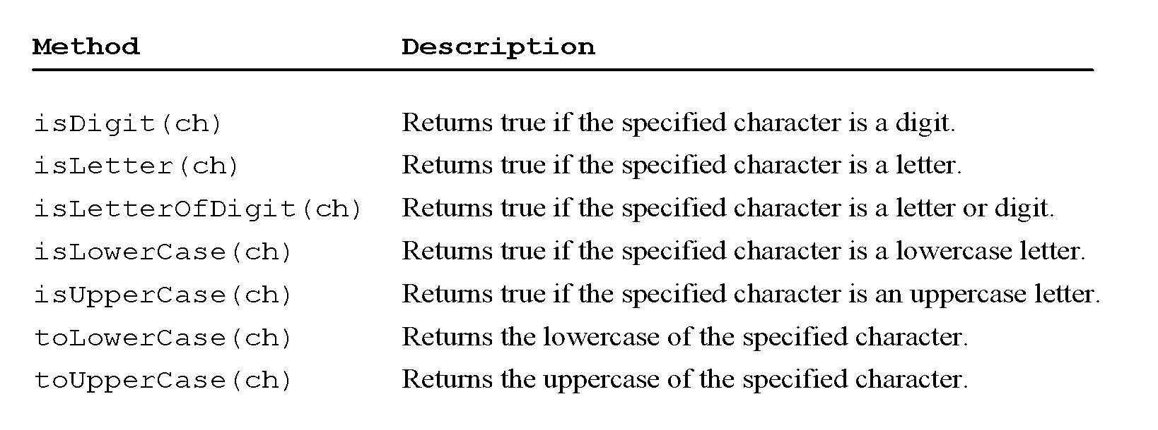
Methods in the Character Class
10

Slide 11
The String Type
The char type only represents one character. To represent a string of characters, use the data type called String. For example,
String message = "Welcome to Java";
String is a predefined class in just like System and Scanner.
String is not a primitive type. It is known as a reference type.
Reference data types will be discussed in Chapter 9, “Objects and Classes.” For now, you just need to know how to declare a String, how to assign a string to the variable, how to perform simple operations on strings.
11

Slide 12
Simple Methods for String Objects
12

Slide 13
Simple Methods for String Objects
Strings are objects in Java. The methods in the preceding table can only be invoked from a specific string instance.
For this reason, these methods are called instance methods.
A non-instance method is called a static method. E.g., all the methods defined in the Math class are static methods.
13

Slide 14
Getting String Length
String message = "Welcome to Java";
System.out.println("The length of " + message + " is "
+ message.length());
14

Slide 15
Getting Characters from a String
String message = "Welcome to Java";
System.out.println("The first character in message is "
+ message.charAt(0));
15

Slide 16
Converting Strings
"Welcome".toLowerCase() returns a new string, welcome.
"Welcome".toUpperCase() returns a new string, WELCOME.
" Welcome ".trim() returns a new string, Welcome.
16

Slide 17
String Concatenation
String s3 = s1.concat(s2); or String s3 = s1 + s2;
// Three strings are concatenated
String message = "Welcome " + "to " + "Java";
// String Chapter is concatenated with number 2
String s = "Chapter" + 2; // s becomes Chapter2
// String Supplement is concatenated with character B
String s1 = "Supplement" + 'B'; // s1 becomes SupplementB
17

Slide 18
Reading a String from the Console
Scanner input = new Scanner(System.in);
System.out.print("Enter three words separated by spaces: ");
String s1 = input.next();
String s2 = input.next();
String s3 = input.next();
System.out.println("s1 is " + s1);
System.out.println("s2 is " + s2);
System.out.println("s3 is " + s3);
18

Slide 19
Reading a Character from the Console
Scanner input = new Scanner(System.in);
System.out.print("Enter a character: ");
String s = input.nextLine();
char ch = s.charAt(0);
System.out.println("The character entered is " + ch);
19

Slide 20
Comparing Strings
OrderTwoCities
Run
20

Slide 21
Obtaining Substrings
21

Slide 22
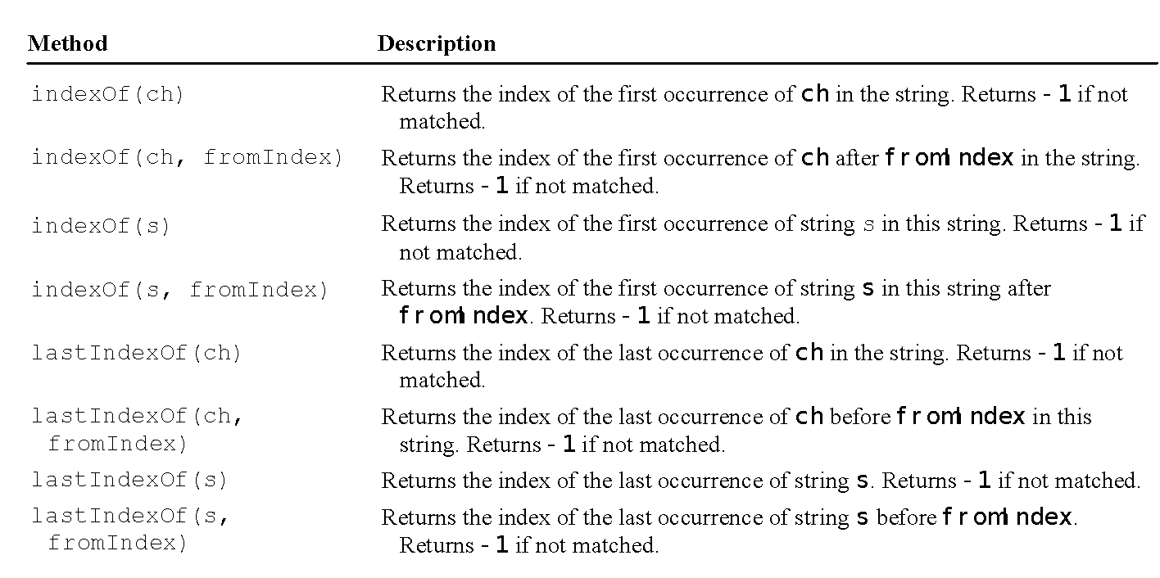
Finding a Character or a Substring in a String
22

Slide 23
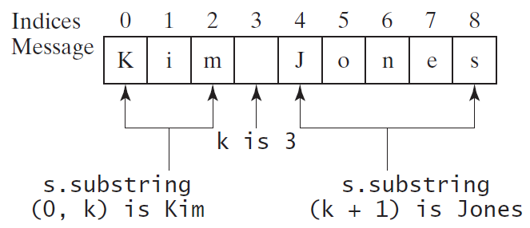
Finding a Character or a Substring in a String
int k = s.indexOf(' ');
String firstName = s.substring(0, k);
String lastName = s.substring(k + 1);
23

Slide 24
Mathematical Functions
Java provides many useful methods in the Math class for performing common mathematical functions.
24

Slide 25
The Math Class
Class constants:
PI
E
Class methods:
Trigonometric Methods
Exponent Methods
Rounding Methods
min, max, abs, and random Methods
25

Slide 26
Trigonometric Methods
sin(double a)
cos(double a)
tan(double a)
acos(double a)
asin(double a)
atan(double a)
Examples:
Math.sin(0) returns 0.0
Math.sin(Math.PI / 6) returns 0.5
Math.sin(Math.PI / 2) returns 1.0
Math.cos(0) returns 1.0
Math.cos(Math.PI / 6) returns 0.866
Math.cos(Math.PI / 2) returns 0
Radians
toRadians(90)
26

Slide 27
Exponent Methods
exp(double a)
Returns e raised to the power of a.
log(double a)
Returns the natural logarithm of a.
log10(double a)
Returns the 10-based logarithm of a.
pow(double a, double b)
Returns a raised to the power of b.
sqrt(double a)
Returns the square root of a.
Examples:
Math.exp(1) returns 2.71
Math.log(2.71) returns 1.0
Math.pow(2, 3) returns 8.0
Math.pow(3, 2) returns 9.0
Math.pow(3.5, 2.5) returns 22.91765
Math.sqrt(4) returns 2.0
Math.sqrt(10.5) returns 3.24
27

Slide 28
Rounding Methods
double ceil(double x)
x rounded up to its nearest integer. This integer is returned as a double value.
double floor(double x)
x is rounded down to its nearest integer. This integer is returned as a double value.
int round(float x)
Return (int) Math.floor(x+0.5).
long round(double x)
Return (long) Math.floor(x+0.5).
28

Slide 29
Rounding Methods Examples
Math.ceil(2.1) returns 3.0
Math.ceil(2.0) returns 2.0
Math.ceil(-2.0) returns –2.0
Math.ceil(-2.1) returns -2.0
Math.floor(2.1) returns 2.0
Math.floor(2.0) returns 2.0
Math.floor(-2.0) returns –2.0
Math.floor(-2.1) returns -3.0
Math.rint(2.1) returns 2.0
Math.rint(2.0) returns 2.0
Math.rint(-2.0) returns –2.0
Math.rint(-2.1) returns -2.0
Math.rint(2.5) returns 2.0
Math.rint(-2.5) returns -2.0
Math.round(2.6f) returns 3
Math.round(2.0) returns 2
Math.round(-2.0f) returns -2
Math.round(-2.6) returns -3
29

Slide 30
min, max, and abs
max(a, b)and min(a, b)
Returns the maximum or minimum of two parameters.
abs(a)
Returns the absolute value of the parameter.
random()
Returns a random double value in the range [0.0, 1.0).
Examples:
Math.max(2, 3) returns 3
Math.max(2.5, 3) returns 3.0
Math.min(2.5, 3.6) returns 2.5
Math.abs(-2) returns 2
Math.abs(-2.1) returns 2.1
30

Slide 31
The random Method
Generates a random double value greater than or equal to 0.0 and less than 1.0 (0 <= Math.random() < 1.0).
Examples:
In general,
31

