Slide 1
CS 1: Loops and Iteration
Colorado State University
Department of Computer Science

Slide 2
Announcements
Learning Objectives
Due Date Reminders
Learn about While Loop
How to write and use loops
Tracing(Debugging) loops

Slide 3
Repetition? Think-pair-share
On a piece of paper, write:
Think of a time when you had to perform the same task multiple times to accomplish a larger task.
Pair with a partner
Share your thoughts
Share the answers with others
Share with your larger group (whole table or next table over)

Slide 4
Task:
With your group, on a piece of paper
Write a code that prints “CS163 class is Awesome” 5 times.

Slide 5
Will this do the trick? YES!!
But what if we have to print it 100 times??
System.out.println("CS163 class is Awesome!");
System.out.println("CS163 class is Awesome!");
System.out.println("CS163 class is Awesome!");
System.out.println("CS163 class is Awesome!");
System.out.println("CS163 class is Awesome!");

Slide 6
System.out.println("CS163 class is Awesome!");
System.out.println("CS163 class is Awesome!");
System.out.println("CS163 class is Awesome!");
System.out.println("CS163 class is Awesome!");
System.out.println("CS163 class is Awesome!");
System.out.println("CS163 class is Awesome!");
System.out.println("CS163 class is Awesome!");
System.out.println("CS163 class is Awesome!");
System.out.println("CS163 class is Awesome!");
System.out.println("CS163 class is Awesome!");
System.out.println("CS163 class is Awesome!");
System.out.println("CS163 class is Awesome!");
System.out.println("CS163 class is Awesome!");
System.out.println("CS163 class is Awesome!");
System.out.println("CS163 class is Awesome!");
System.out.println("CS163 class is Awesome!");
System.out.println("CS163 class is Awesome!");
System.out.println("CS163 class is Awesome!");
System.out.println("CS163 class is Awesome!");
System.out.println("CS163 class is Awesome!");
System.out.println("CS163 class is Awesome!");
System.out.println("CS163 class is Awesome!");
System.out.println("CS163 class is Awesome!");
System.out.println("CS163 class is Awesome!");
System.out.println("CS163 class is Awesome!");
System.out.println("CS163 class is Awesome!");
System.out.println("CS163 class is Awesome!");
System.out.println("CS163 class is Awesome!");
System.out.println("CS163 class is Awesome!");
System.out.println("CS163 class is Awesome!");
System.out.println("CS163 class is Awesome!");
System.out.println("CS163 class is Awesome!");
System.out.println("CS163 class is Awesome!");
System.out.println("CS163 class is Awesome!");
System.out.println("CS163 class is Awesome!");
System.out.println("CS163 class is Awesome!");
System.out.println("CS163 class is Awesome!");
System.out.println("CS163 class is Awesome!");
System.out.println("CS163 class is Awesome!");
System.out.println("CS163 class is Awesome!");
System.out.println("CS163 class is Awesome!");
System.out.println("CS163 class is Awesome!");
System.out.println("CS163 class is Awesome!");
System.out.println("CS163 class is Awesome!");
System.out.println("CS163 class is Awesome!");
System.out.println("CS163 class is Awesome!");
System.out.println("CS163 class is Awesome!");
System.out.println("CS163 class is Awesome!");
System.out.println("CS163 class is Awesome!");
System.out.println("CS163 class is Awesome!");
System.out.println("CS163 class is Awesome!");
System.out.println("CS163 class is Awesome!");
System.out.println("CS163 class is Awesome!");
System.out.println("CS163 class is Awesome!");
System.out.println("CS163 class is Awesome!");
System.out.println("CS163 class is Awesome!");
System.out.println("CS163 class is Awesome!");
System.out.println("CS163 class is Awesome!");
System.out.println("CS163 class is Awesome!");
System.out.println("CS163 class is Awesome!");
System.out.println("CS163 class is Awesome!");
System.out.println("CS163 class is Awesome!");
System.out.println("CS163 class is Awesome!");
System.out.println("CS163 class is Awesome!");
System.out.println("CS163 class is Awesome!");
System.out.println("CS163 class is Awesome!");
System.out.println("CS163 class is Awesome!");
System.out.println("CS163 class is Awesome!");
System.out.println("CS163 class is Awesome!");
System.out.println("CS163 class is Awesome!");
System.out.println("CS163 class is Awesome!");
System.out.println("CS163 class is Awesome!");
System.out.println("CS163 class is Awesome!");
System.out.println("CS163 class is Awesome!");
System.out.println("CS163 class is Awesome!");
System.out.println("CS163 class is Awesome!");
System.out.println("CS163 class is Awesome!");
System.out.println("CS163 class is Awesome!");
System.out.println("CS163 class is Awesome!");
System.out.println("CS163 class is Awesome!");
System.out.println("CS163 class is Awesome!");
System.out.println("CS163 class is Awesome!");
System.out.println("CS163 class is Awesome!");
System.out.println("CS163 class is Awesome!");
System.out.println("CS163 class is Awesome!");
System.out.println("CS163 class is Awesome!");
System.out.println("CS163 class is Awesome!");
System.out.println("CS163 class is Awesome!");
System.out.println("CS163 class is Awesome!");
System.out.println("CS163 class is Awesome!");
System.out.println("CS163 class is Awesome!");
System.out.println("CS163 class is Awesome!");
System.out.println("CS163 class is Awesome!");
System.out.println("CS163 class is Awesome!");
System.out.println("CS163 class is Awesome!");
System.out.println("CS163 class is Awesome!");
System.out.println("CS163 class is Awesome!");
System.out.println("CS163 class is Awesome!");
System.out.println("CS163 class is Awesome!");
System.out.println("CS163 class is Awesome!");

Slide 7
Loops are here to save your day
While Loop :-
int count = 0;
while (count < 100)
{
System.out.println("CS163 class is Awesome");
count++;
}

Slide 8
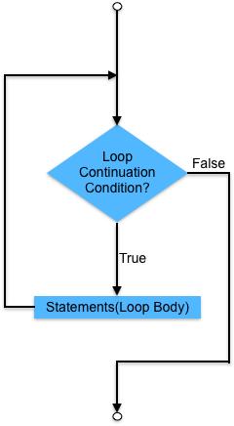
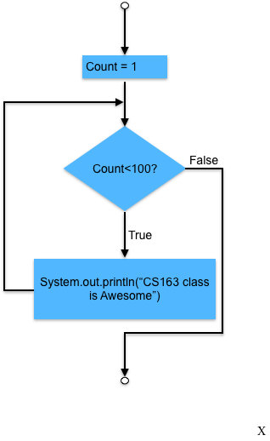
While Loop Flow Chart
while (loop-continuation-condition)
{
// loop-body;
Statement(s);
}
int count = 0;
while (count < 100)
{
System.out.println("CS163 class is Awesome!");
count++;
}

Slide 9
Tracing While Loop
Initialization of variable count to 0.
int count = 0;
while (count < 2)
{
System.out.println("CS163 class is Awesome");
count++;
}
count = 0
Output:

Slide 10
Tracing While Loop, cont.
int count = 0;
while (count < 2)
{
System.out.println("CS163 class is Awesome");
count++;
}
count = 0
(Count < 2 ) is true
Output:

Slide 11
Tracing While Loop, cont.
int count = 0;
while (count < 2)
{
System.out.println("CS163 class is Awesome");
count++;
}
count = 0
Prints the message to the output buffer
Output:

Slide 12
Tracing While Loop, cont.
int count = 0;
while (count < 2)
{
System.out.println("CS163 class is Awesome");
count++;
}
count = 0
Increment count by 1
Output:
CS163 class is Awesome

Slide 13
Tracing While Loop, cont.
int count = 0;
while (count < 2)
{
System.out.println("CS163 class is Awesome");
count++;
}
count = 1
Output:
CS163 class is Awesome

Slide 14
Tracing While Loop, cont.
int count = 0;
while (count < 2)
{
System.out.println("CS163 class is Awesome");
count++;
}
count = 1
(Count < 2 ) is true
Output:
CS163 class is Awesome

Slide 15
Tracing While Loop, cont.
int count = 0;
while (count < 2)
{
System.out.println("CS163 class is Awesome");
count++;
}
count = 1
Prints the message to the output buffer
Output:
CS163 class is Awesome

Slide 16
Tracing While Loop, cont.
int count = 0;
while (count < 2)
{
System.out.println("CS163 class is Awesome");
count++;
}
count = 1
Increment count by 1
Output:
CS163 class is Awesome
CS163 class is Awesome

Slide 17
Tracing While Loop, cont.
int count = 0;
while (count < 2)
{
System.out.println("CS163 class is Awesome");
count++;
}
count = 2
Output:
CS163 class is Awesome
CS163 class is Awesome

Slide 18
Tracing While Loop, cont.
int count = 0;
while (count < 2)
{
System.out.println("CS163 class is Awesome");
count++;
}
count = 2
(count < 2 ) is false
Output:
CS163 class is Awesome
CS163 class is Awesome

Slide 19
Tracing While Loop, cont.
int count = 0;
while (count < 2)
{
System.out.println("CS163 class is Awesome");
count++;
}
count = 2
Output:
CS163 class is Awesome
CS163 class is Awesome

Slide 20
Task:
On a piece of paper, write code:
To add numbers from 1 to 10 using while loop.
Share it with your neighbours

Slide 21
CS 1: Loops and Iteration
Colorado State University
Department of Computer Science

Slide 22
Caution
Don’t use floating-point values for equality checking in a loop control.
Consider the following code for computing 1 + 0.9 + 0.8 + ... + 0.1:
double item = 1; double sum = 0;
while (item != 0) { // No guarantee item will be 0
sum += item;
item -= 0.1;
}
System.out.println(sum);
Notes:
Since floating-point values are approximations for some values, using them could result in imprecise counter values and inaccurate results

Slide 23
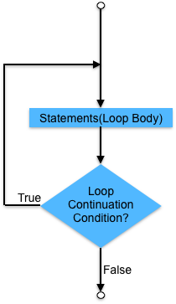
do-while loop
do {
// Loop body;
Statement(s);
} while (loop-continuation-condition);

Slide 24
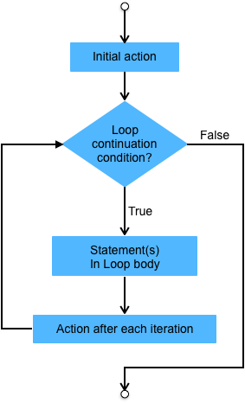
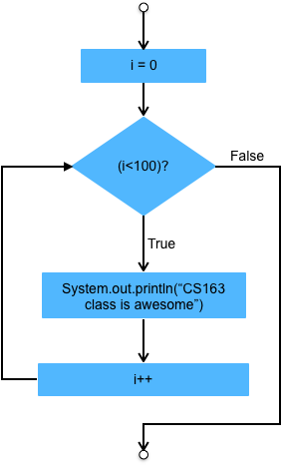
For Loop
for(int i=0; i< 100; i++)
{
System.out.println("CS163 class is Awesome!");
}
for (Initial_action; loop_continuation_condition; action_after_each_iteration)
{
// loop-body;
Statement(s);
}

Slide 25
Tracing a for loop
int i;
for (i = 0; i < 2; i++) {
System.out.println("CS163 class is awesome!");
}
Declaring Variable i
Console :

Slide 26
Tracing a for loop
int i;
for (i = 0; i < 2; i++) {
System.out.println("CS163 class is awesome!");
}
Initializing i = 0 and then check
if (i < 2)? true
Console :

Slide 27
Tracing a for loop
int i;
for (i = 0; i < 2; i++) {
System.out.println("CS163 class is awesome!");
}
i = 0
Print CS163 class is awesome
Console :

Slide 28
Tracing a for loop
int i;
for (i = 0; i < 2; i++) {
System.out.println("CS163 class is awesome!");
}
i = 1
Increment i by 1
if(i<2)? true
Console :
CS163 class is awesome

Slide 29
Tracing a for loop
int i;
for (i = 0; i < 2; i++) {
System.out.println("CS163 class is awesome!");
}
i = 1
Print CS163 class is awesome
Console :
CS163 class is awesome

Slide 30
Tracing a for loop
int i;
for (i = 0; i < 2; i++) {
System.out.println("CS163 class is awesome!");
}
i = 2
Increment i and then check If (i<2) ? false
Console :
CS163 class is awesome
CS163 class is awesome

Slide 31
Tracing a for loop
int i;
for (i = 0; i < 2; i++) {
System.out.println("CS163 class is awesome!");
}
i=2
Console :
CS163 class is awesome
CS163 class is awesome

Slide 32
Tracing a for loop
int i;
for (i = 0; i < 2; i++) {
System.out.println("CS163 class is awesome!");
}
i=2
Console :
CS163 class is awesome
CS163 class is awesome

Slide 33
for loop compartments
Initialization:
Empty: ; // Variable is initialized outside the loop
Single: i = 0;
Multiple: i=0, j=0;
Loop condition:
Empty: ; // Implicitly true resulting in a infinite loop.
Single: i < 10; // Expression that results in Boolean.
Action :
Empty: ;
Single : i++;
Multiple: i++, j--;
Notes:
The initial-action in a for loop can be a list of zero or more comma-separated expressions. The action-after-each-iteration in a for loop can be a list of zero or more comma-separated statements. They are rarely used in practice, however.

Slide 34
Example
for (int i = 1; i < 100; System.out.println(i++));
for (int i = 0, j = 0; (i + j < 10); i++, j++) {
// Do something
}

Slide 35
Caution
Adding a semicolon at the end of the for clause before the loop body is a common mistake, as shown below:
int i;
for (i=0; i<10; i++); // Logical Error
{
System.out.println("i is " + i);
}
-------------------------------------------
Output :
i is 10
-------------------------------------------

Slide 36
Caution
Similarly, the following loop is also wrong:
int i=0;
while (i < 10); // Logical Error
{
System.out.println("i is " + i);
i++;
}

Slide 37
Though
In the case of the do loop, the following semicolon is needed to end the loop.
int i=0;
do {
System.out.println("i is " + i);
i++;
} while (i<10);

Slide 38
Note
A way to make for loop a infinite loop.
for( ; ; )
{
//Statements
}
while(true)
{
//Statements
}
Equals
(a)
(b)
Notes:
If the loop-continuation-condition in a for loop is omitted, it is implicitly true. Thus the statement given below in (a), which is an infinite loop, is correct. Nevertheless, it is better to use the equivalent loop in (b) to avoid confusion:

Slide 39
Task
Write three loops, a while loop, do while loop and a for loop to print integers that are divisible by 2 between 1 and 100 on one line:
2, 4, 6, ….. 100

Slide 40
CS 1: Loops and Iteration
Colorado State University
Department of Computer Science

Slide 41
Which loop you feel is the best?
while loop
do-while loop
for loop

Slide 42
Task:
Using Multiple loops and try to print multiplication tables from 1 to 10
Output :
1*1=1 1*2=2 1*3=3 …….. 1*10=10
2*1=2 2*2=4 2*3=6 …….. 2*10=20
.
.
10*1=10 10*2=20 10*3=30 …….. 10*10=100

Slide 43
Printing multiplication table from 1 to 10
for(int i=1;i<=10;i++)
{
for(int j=1;j<=10;j++)
{
System.out.print(i+ "*" + j + "=" + i*j + "\t");
}
System.out.println();
}

Slide 44
Break : break allows you to exit the loop early
for(int i=1;i<=5;i++)
{
System.out.println(i);
if(i==2)
break; // This will break the loop when i becomes 2
}
Output:
1
2

Slide 45
Continue : Allows you to skip part of a current iteration and continue the loop
//Printing numbers from 1 to 5 but skip the number 3
for(int i=1;i<=15;i++)
{
if(i==3)continue;
System.out.print(i + “ ”);
}
Output:
1 2 4 5

Slide 46
Task
With your group, on a piece of paper
Write the following methods:
skipAtN - which takes an argument n
public void skipAtN(int n) // prints number from 1 to 10 but should not print n
Call the skipAtN method from main

