Slide 1
Chapter 7: Single-Dimensional Arrays
CS1: Java Programming
Colorado State University
Original slides by Daniel Liang
Modified slides by Kris Brown

Slide 2
Opening Problem
Read one hundred numbers, compute their average, and find out how many numbers are above the average.

Slide 3
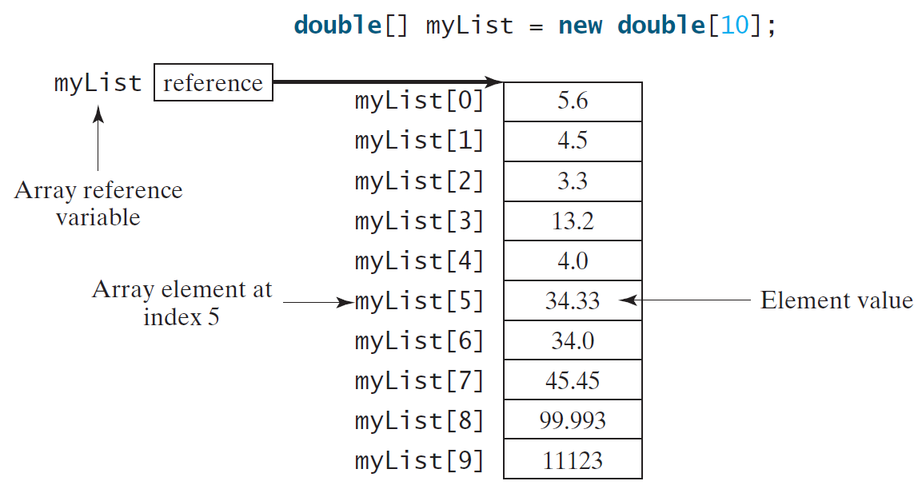
Introducing Arrays
Array is a data structure that represents a collection of the same types of data.

Slide 4
Declaring Array Variables
datatype[] arrayRefVar;
Example:
double[] myList;
// This style is allowed, but not preferred:
datatype arrayRefVar[];
Example:
double myList[];

Slide 5
Creating Arrays
arrayRefVar = new datatype[arraySize];
Example:
myList = new double[10];
myList[0] references the first element in the array.
myList[9] references the last element in the array.

Slide 6
Declaring and Creating in One Step
datatype[] arrayRefVar = new
datatype[arraySize];
double[] myList = new double[10];
datatype arrayRefVar[] = new datatype[arraySize];
double myList[] = new double[10];

Slide 7
The Length of an Array
Once an array is created, its size is fixed. It cannot be changed. You can find its size using
arrayRefVar.length
For example,
myList.length returns 10

Slide 8
Default Values
When an array is created, its elements are assigned the default value of:
0 for the numeric primitive data types,
'\u0000' for char types, and
false for boolean types.

Slide 9
Indexed Variables
The array elements are accessed through the index. The array indices are 0-based, i.e., it starts from 0 to arrayRefVar.length-1.
myList holds ten double values and the indices are from 0 to 9.
Each element in the array is represented using the following syntax, known as an indexed variable:
arrayRefVar[index];

Slide 10
Using Indexed Variables
After an array is created, an indexed variable can be used in the same way as a regular variable.
For example, the following code adds the value in myList[0] and myList[1] and assigns it to myList[2].
myList[2] = myList[0] + myList[1];

Slide 11
Array Initializers
Declaring, creating, initializing in one step:
double[] myList = {1.9, 2.9, 3.4, 3.5};
This shorthand syntax must be in one statement.

Slide 12
Declaring, creating, initializing Using the Shorthand Notation
double[] myList = {1.9, 2.9, 3.4, 3.5};
This shorthand notation is equivalent to the following statements:
double[] myList = new double[4];
myList[0] = 1.9;
myList[1] = 2.9;
myList[2] = 3.4;
myList[3] = 3.5;

Slide 13
CAUTION
Using the shorthand notation, you have to declare, create, and initialize the array all in one statement.
Splitting it would cause a syntax error.
For example, the following is wrong:
double[] myList;
myList = {1.9, 2.9, 3.4, 3.5};

Slide 14
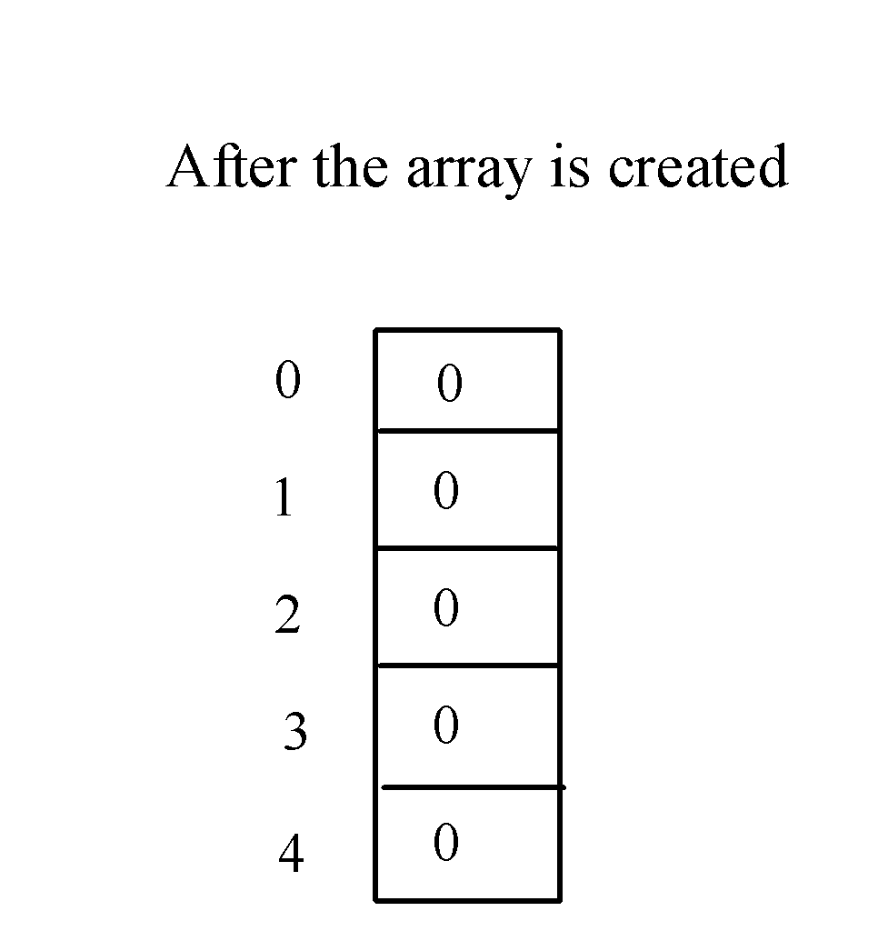
Trace Program with Arrays
animation
Declare array variable values, create an array, and assign its reference to values
public class Test {
public static void main(String[] args) {
int[] values = new int[5];
for (int i = 1; i < 5; i++) {
values[i] = i + values[i-1];
}
values[0] = values[1] + values[4];
}
}

Slide 15
Trace Program with Arrays
animation
i becomes 1
public class Test {
public static void main(String[] args) {
int[] values = new int[5];
for (int i = 1; i < 5; i++) {
values[i] = i + values[i-1];
}
values[0] = values[1] + values[4];
}
}

Slide 16
Trace Program with Arrays
animation
i (=1) is less than 5
public class Test {
public static void main(String[] args) {
int[] values = new int[5];
for (int i = 1; i < 5; i++) {
values[i] = i + values[i-1];
}
values[0] = values[1] + values[4];
}
}

Slide 17
Trace Program with Arrays
animation
After this line is executed, value[1] is 1
public class Test {
public static void main(String[] args) {
int[] values = new int[5];
for (int i = 1; i < 5; i++) {
values[i] = i + values[i-1];
}
values[0] = values[1] + values[4];
}
}

Slide 18
Trace Program with Arrays
animation
After i++, i becomes 2
public class Test {
public static void main(String[] args) {
int[] values = new int[5];
for (int i = 1; i < 5; i++) {
values[i] = i + values[i-1];
}
values[0] = values[1] + values[4];
}
}

Slide 19
Trace Program with Arrays
animation
i (= 2) is less than 5
public class Test {
public static void main(String[] args) {
int[] values = new int[5];
for (int i = 1; i < 5; i++) {
values[i] = i + values[i-1];
}
values[0] = values[1] + values[4];
}
}

Slide 20
Trace Program with Arrays
animation
After this line is executed,
values[2] is 3 (2 + 1)
public class Test {
public static void main(String[] args) {
int[] values = new int[5];
for (int i = 1; i < 5; i++) {
values[i] = i + values[i-1];
}
values[0] = values[1] + values[4];
}
}

Slide 21
Trace Program with Arrays
animation
After this, i becomes 3.
public class Test {
public static void main(String[] args) {
int[] values = new int[5];
for (int i = 1; i < 5; i++) {
values[i] = i + values[i-1];
}
values[0] = values[1] + values[4];
}
}

Slide 22
Trace Program with Arrays
animation
i (=3) is still less than 5.
public class Test {
public static void main(String[] args) {
int[] values = new int[5];
for (int i = 1; i < 5; i++) {
values[i] = i + values[i-1];
}
values[0] = values[1] + values[4];
}
}

Slide 23
Trace Program with Arrays
animation
After this line, values[3] becomes 6 (3 + 3)
public class Test {
public static void main(String[] args) {
int[] values = new int[5];
for (int i = 1; i < 5; i++) {
values[i] = i + values[i-1];
}
values[0] = values[1] + values[4];
}
}

Slide 24
Trace Program with Arrays
animation
After this, i becomes 4
public class Test {
public static void main(String[] args) {
int[] values = new int[5];
for (int i = 1; i < 5; i++) {
values[i] = i + values[i-1];
}
values[0] = values[1] + values[4];
}
}

Slide 25
Trace Program with Arrays
animation
i (=4) is still less than 5
public class Test {
public static void main(String[] args) {
int[] values = new int[5];
for (int i = 1; i < 5; i++) {
values[i] = i + values[i-1];
}
values[0] = values[1] + values[4];
}
}

Slide 26
Trace Program with Arrays
animation
After this, values[4] becomes 10 (4 + 6)
public class Test {
public static void main(String[] args) {
int[] values = new int[5];
for (int i = 1; i < 5; i++) {
values[i] = i + values[i-1];
}
values[0] = values[1] + values[4];
}
}

Slide 27
Trace Program with Arrays
animation
After i++, i becomes 5
public class Test {
public static void main(String[] args) {
int[] values = new int[5];
for (int i = 1; i < 5; i++) {
values[i] = i + values[i-1];
}
values[0] = values[1] + values[4];
}
}

Slide 28
Trace Program with Arrays
animation
i ( =5) < 5 is false. Exit the loop
public class Test {
public static void main(String[] args) {
int[] values = new int[5];
for (int i = 1; i < 5; i++) {
values[i] = i + values[i-1];
}
values[0] = values[1] + values[4];
}
}

Slide 29
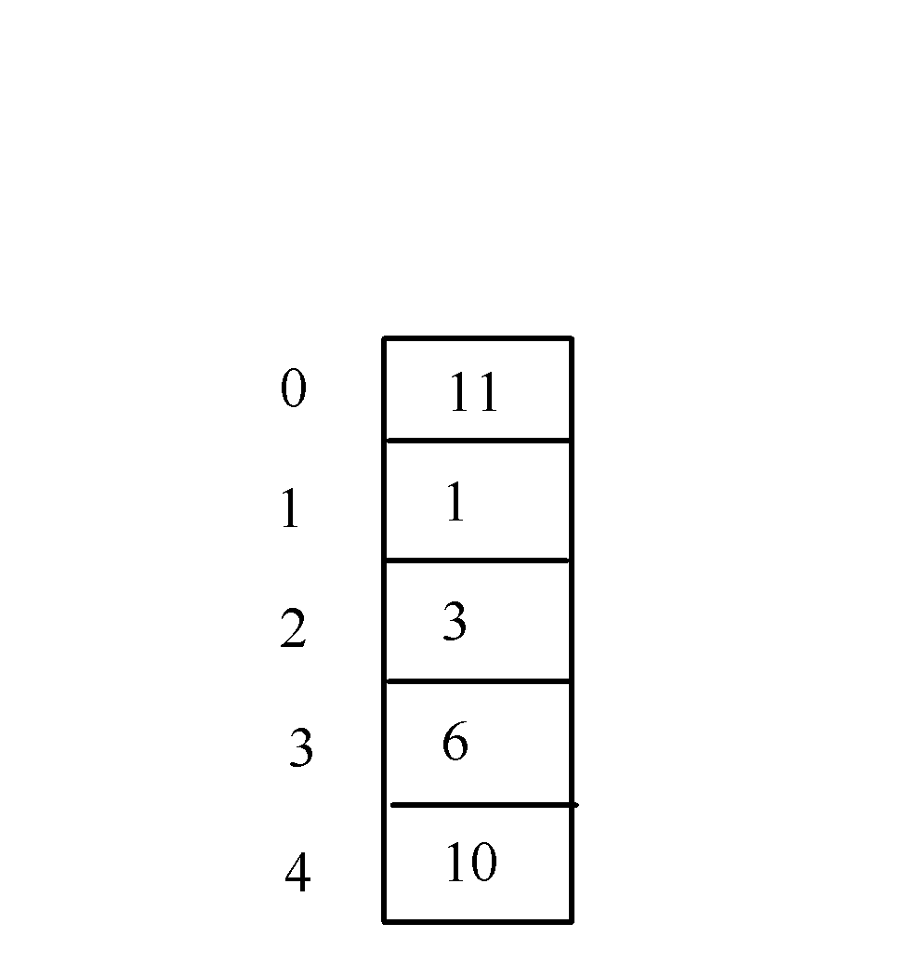
Trace Program with Arrays
animation
After this line, values[0] is 11 (1 + 10)
public class Test {
public static void main(String[] args) {
int[] values = new int[5];
for (int i = 1; i < 5; i++) {
values[i] = i + values[i-1];
}
values[0] = values[1] + values[4];
}
}

Slide 30
Processing Arrays
See the examples in the text.
(Initializing arrays with input values)
(Initializing arrays with random values)
(Printing arrays)
(Summing all elements)
(Finding the largest element)
(Finding the smallest index of the largest element)
(Random shuffling)
(Shifting elements)

Slide 31
Initializing arrays with input values
java.util.Scanner input = new java.util.Scanner(System.in);
System.out.print("Enter " + myList.length + " values: ");
for (int i = 0; i < myList.length; i++)
myList[i] = input.nextDouble();

Slide 32
Initializing arrays with random values
for (int i = 0; i < myList.length; i++) {
myList[i] = Math.random() * 100;
}

Slide 33
Printing arrays
for (int i = 0; i < myList.length; i++) {
System.out.print(myList[i] + " ");
}

Slide 34
Summing all elements
double total = 0;
for (int i = 0; i < myList.length; i++) {
total += myList[i];
}

Slide 35
Finding the largest element
double max = myList[0];
for (int i = 1; i < myList.length; i++) {
if (myList[i] > max) max = myList[i];
}

Slide 36
Finding the largest element and its index
double max = myList[0];
int index = 0;
for (int i = 1; i < myList.length; i++) {
if (myList[i] > max){
max = myList[i];
index = i;
}
}

Slide 37
Enhanced for Loop (for-each loop)
JDK 1.5 introduced a new for loop that enables you to traverse the complete array sequentially without using an index variable. For example, the following code displays all elements in the array myList:
for (double value: myList)
System.out.println(value);
In general, the syntax is
for (elementType value: arrayRefVar) {
// Process the value
}
You still have to use an index variable if you wish to traverse the array in a different order or change the elements in the array.

Slide 38
Lecture 2

Slide 39
Random shuffling

Slide 40
Shifting Elements

Slide 41
Problem: Deck of Cards
The problem is to write a program that picks four cards randomly from a deck of 52 cards. All the cards can be represented using an array named deck, filled with initial values 0 to 51, as follows:
int[] deck = new int[52];
// Initialize cards
for (int i = 0; i < deck.length; i++)
deck[i] = i;

Slide 42
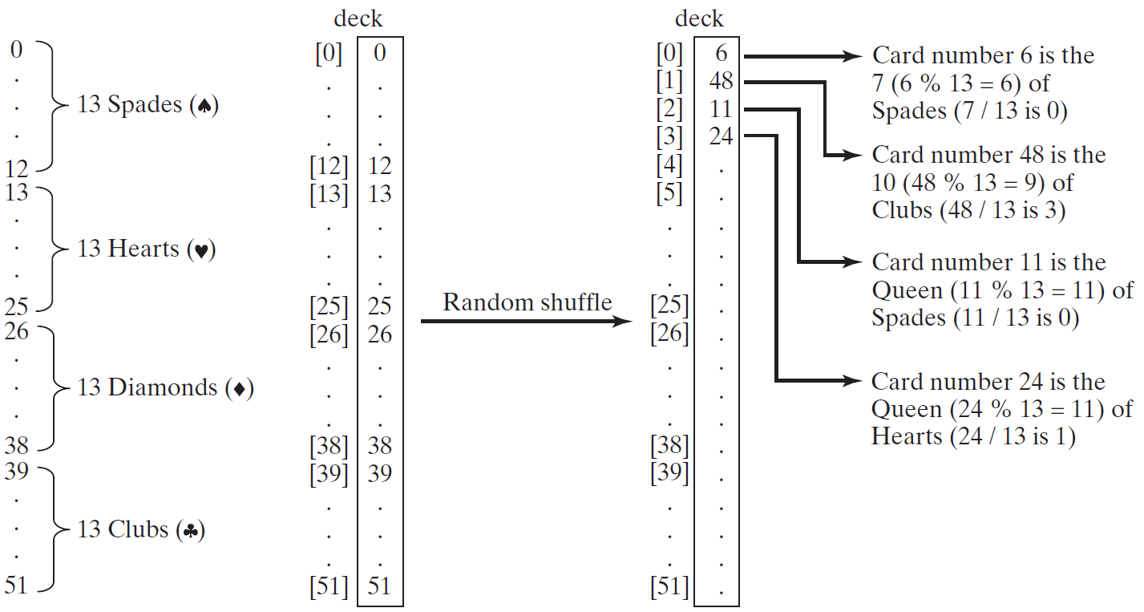
Problem: Deck of Cards, cont.

Slide 43
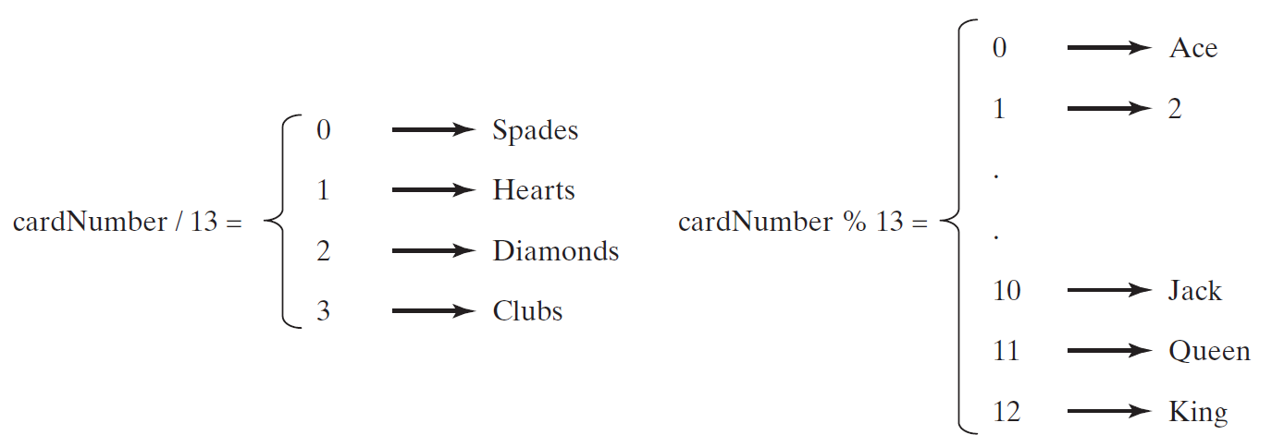
Problem: Deck of Cards, cont.

Slide 44
Problem: Deck of Cards
The problem is to write a program that picks four cards randomly from a deck of 52 cards. All the cards can be represented using an array named deck, filled with initial values 0 to 51, as follows:
int[] deck = new int[52];
// Initialize cards
for (int i = 0; i < deck.length; i++)
deck[i] = i;
// now apply random shuffle code
// from slide 39
// then pick the first 4
Solution: http://www.cs.armstrong.edu/liang/intro11e/html/DeckOfCards.html

Slide 45
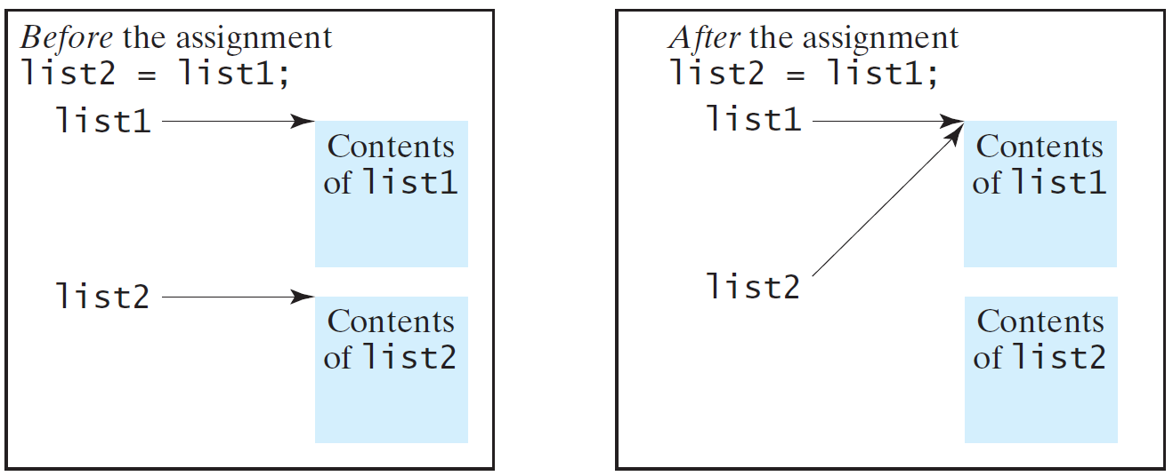
Copying Arrays
Often, in a program, you need to duplicate an array or a part of an array. In such cases you could attempt to use the assignment statement (=), as follows:
list2 = list1;

Slide 46
Copying Arrays
Using a loop:
int[] sourceArray = {2, 3, 1, 5, 10};
int[] targetArray = new int[sourceArray.length];
for (int i = 0; i < sourceArrays.length; i++)
targetArray[i] = sourceArray[i];

Slide 47
The arraycopy Utility
arraycopy(sourceArray, src_pos, targetArray, tar_pos, length);
Example:
System.arraycopy(sourceArray, 0, targetArray, 0, sourceArray.length);

Slide 48
Passing Arrays to Methods
public static void printArray(int[] array) {
for (int i = 0; i < array.length; i++) {
System.out.print(array[i] + " ");
}
}
Invoke the method
int[] list = {3, 1, 2, 6, 4, 2};
printArray(list);
Invoke the method
printArray(new int[]{3, 1, 2, 6, 4, 2});
Anonymous array

Slide 49
Anonymous Array
The statement
printArray(new int[]{3, 1, 2, 6, 4, 2});
creates an array using the following syntax:
new dataType[]{literal0, literal1, ..., literalk};
There is no explicit reference variable for the array. Such array is called an anonymous array.

Slide 50
Pass By Value
Java uses pass by value to pass arguments to a method. There are important differences between passing a value of variables of primitive data types and passing arrays.
For a parameter of a primitive type value, the actual value is passed. Changing the value of the local parameter inside the method does not affect the value of the variable outside the method.
For a parameter of an array type, the value of the parameter contains a reference to an array; this reference is passed to the method. Any changes to the array that occur inside the method body will affect the original array that was passed as the argument.

Slide 51
Simple Example
public class Test {
public static void main(String[] args) {
int x = 1; // x represents an int value
int[] y = new int[10]; // y represents an array of int values
m(x, y); // Invoke m with arguments x and y
System.out.println("x is " + x);
System.out.println("y[0] is " + y[0]);
}
public static void m(int number, int[] numbers) {
number = 1001; // Assign a new value to number
numbers[0] = 5555; // Assign a new value to numbers[0]
}
}

Slide 52
Call Stack
When invoking m(x, y), the values of x and y are passed to number and numbers. Since y contains the reference value to the array, numbers now contains the same reference value to the same array.

Slide 53
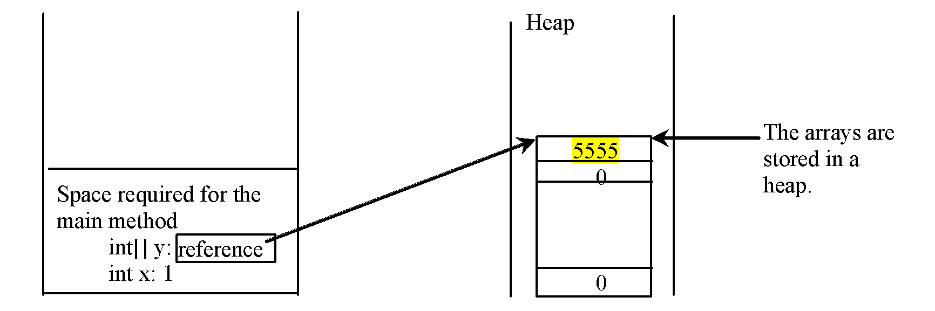
Heap
The JVM stores the array in an area of memory, called heap, which is used for dynamic memory allocation where blocks of memory are allocated and freed in an arbitrary order.

Slide 54
Passing Arrays as Arguments
Objective: Demonstrate differences of passing primitive data type variables and array variables.

Slide 55
Returning an Array from a Method
public static int[] reverse(int[] list) {
int[] result = new int[list.length];
for (int i = 0, j = result.length - 1;
i < list.length; i++, j--) {
result[j] = list[i];
}
return result;
}
list
result
int[] list1 = {1, 2, 3, 4, 5, 6};
int[] list2 = reverse(list1);

Slide 56
Trace the reverse Method
animation
int[] list1 = {1, 2, 3, 4, 5, 6};
int[] list2 = reverse(list1);
Declare result and create array
public static int[] reverse(int[] list) {
int[] result = new int[list.length];
for (int i = 0, j = result.length - 1;
i < list.length; i++, j--) {
result[j] = list[i];
}
return result;
}
list
1
2
3
4
5
6
result
0
0
0
0
0
0

Slide 57
Trace the reverse Method, cont.
animation
int[] list1 = {1, 2, 3, 4, 5, 6};
int[] list2 = reverse(list1);
i = 0 and j = 5
public static int[] reverse(int[] list) {
int[] result = new int[list.length];
for (int i = 0, j = result.length - 1;
i < list.length; i++, j--) {
result[j] = list[i];
}
return result;
}
list
1
2
3
4
5
6
result
0
0
0
0
0
0

Slide 58
Trace the reverse Method, cont.
animation
int[] list1 = {1, 2, 3, 4, 5, 6};
int[] list2 = reverse(list1);
i (= 0) is less than 6
public static int[] reverse(int[] list) {
int[] result = new int[list.length];
for (int i = 0, j = result.length - 1;
i < list.length; i++, j--) {
result[j] = list[i];
}
return result;
}
list
1
2
3
4
5
6
result
0
0
0
0
0
0

Slide 59
Trace the reverse Method, cont.
animation
int[] list1 = {1, 2, 3, 4, 5, 6};
int[] list2 = reverse(list1);
i = 0 and j = 5
Assign list[0] to result[5]
public static int[] reverse(int[] list) {
int[] result = new int[list.length];
for (int i = 0, j = result.length - 1;
i < list.length; i++, j--) {
result[j] = list[i];
}
return result;
}
list
1
2
3
4
5
6
result
0
0
0
0
0
1

Slide 60
Trace the reverse Method, cont.
animation
int[] list1 = {1, 2, 3, 4, 5, 6};
int[] list2 = reverse(list1);
After this, i becomes 1 and j becomes 4
public static int[] reverse(int[] list) {
int[] result = new int[list.length];
for (int i = 0, j = result.length - 1;
i < list.length; i++, j--) {
result[j] = list[i];
}
return result;
}
list
1
2
3
4
5
6
result
0
0
0
0
0
1

Slide 61
Trace the reverse Method, cont.
animation
int[] list1 = {1, 2, 3, 4, 5, 6};
int[] list2 = reverse(list1);
i (=1) is less than 6
public static int[] reverse(int[] list) {
int[] result = new int[list.length];
for (int i = 0, j = result.length - 1;
i < list.length; i++, j--) {
result[j] = list[i];
}
return result;
}
list
1
2
3
4
5
6
result
0
0
0
0
0
1

Slide 62
Trace the reverse Method, cont.
animation
int[] list1 = {1, 2, 3, 4, 5, 6};
int[] list2 = reverse(list1);
i = 1 and j = 4
Assign list[1] to result[4]
public static int[] reverse(int[] list) {
int[] result = new int[list.length];
for (int i = 0, j = result.length - 1;
i < list.length; i++, j--) {
result[j] = list[i];
}
return result;
}
list
1
2
3
4
5
6
result
0
0
0
0
2
1

Slide 63
Trace the reverse Method, cont.
animation
int[] list1 = {1, 2, 3, 4, 5, 6};
int[] list2 = reverse(list1);
After this, i becomes 2 and j becomes 3
public static int[] reverse(int[] list) {
int[] result = new int[list.length];
for (int i = 0, j = result.length - 1;
i < list.length; i++, j--) {
result[j] = list[i];
}
return result;
}
list
1
2
3
4
5
6
result
0
0
0
0
2
1

Slide 64
Trace the reverse Method, cont.
animation
int[] list1 = {1, 2, 3, 4, 5, 6};
int[] list2 = reverse(list1);
i (=2) is still less than 6
public static int[] reverse(int[] list) {
int[] result = new int[list.length];
for (int i = 0, j = result.length - 1;
i < list.length; i++, j--) {
result[j] = list[i];
}
return result;
}
list
1
2
3
4
5
6
result
0
0
0
0
2
1

Slide 65
Trace the reverse Method, cont.
animation
int[] list1 = {1, 2, 3, 4, 5, 6};
int[] list2 = reverse(list1);
i = 2 and j = 3
Assign list[i] to result[j]
public static int[] reverse(int[] list) {
int[] result = new int[list.length];
for (int i = 0, j = result.length - 1;
i < list.length; i++, j--) {
result[j] = list[i];
}
return result;
}
list
1
2
3
4
5
6
result
0
0
0
3
2
1

Slide 66
Trace the reverse Method, cont.
animation
int[] list1 = {1, 2, 3, 4, 5, 6};
int[] list2 = reverse(list1);
After this, i becomes 3 and j becomes 2
public static int[] reverse(int[] list) {
int[] result = new int[list.length];
for (int i = 0, j = result.length - 1;
i < list.length; i++, j--) {
result[j] = list[i];
}
return result;
}
list
1
2
3
4
5
6
result
0
0
0
3
2
1

Slide 67
Trace the reverse Method, cont.
animation
int[] list1 = {1, 2, 3, 4, 5, 6};
int[] list2 = reverse(list1);
i (=3) is still less than 6
public static int[] reverse(int[] list) {
int[] result = new int[list.length];
for (int i = 0, j = result.length - 1;
i < list.length; i++, j--) {
result[j] = list[i];
}
return result;
}
list
1
2
3
4
5
6
result
0
0
0
3
2
1

Slide 68
Trace the reverse Method, cont.
animation
int[] list1 = {1, 2, 3, 4, 5, 6};
int[] list2 = reverse(list1);
i = 3 and j = 2
Assign list[i] to result[j]
public static int[] reverse(int[] list) {
int[] result = new int[list.length];
for (int i = 0, j = result.length - 1;
i < list.length; i++, j--) {
result[j] = list[i];
}
return result;
}
list
1
2
3
4
5
6
result
0
0
4
3
2
1

Slide 69
Trace the reverse Method, cont.
animation
int[] list1 = {1, 2, 3, 4, 5, 6};
int[] list2 = reverse(list1);
After this, i becomes 4 and j becomes 1
public static int[] reverse(int[] list) {
int[] result = new int[list.length];
for (int i = 0, j = result.length - 1;
i < list.length; i++, j--) {
result[j] = list[i];
}
return result;
}
list
1
2
3
4
5
6
result
0
0
4
3
2
1

Slide 70
Trace the reverse Method, cont.
animation
int[] list1 = {1, 2, 3, 4, 5, 6};
int[] list2 = reverse(list1);
i (=4) is still less than 6
public static int[] reverse(int[] list) {
int[] result = new int[list.length];
for (int i = 0, j = result.length - 1;
i < list.length; i++, j--) {
result[j] = list[i];
}
return result;
}
list
1
2
3
4
5
6
result
0
0
4
3
2
1

Slide 71
Trace the reverse Method, cont.
animation
int[] list1 = {1, 2, 3, 4, 5, 6};
int[] list2 = reverse(list1);
i = 4 and j = 1
Assign list[i] to result[j]
public static int[] reverse(int[] list) {
int[] result = new int[list.length];
for (int i = 0, j = result.length - 1;
i < list.length; i++, j--) {
result[j] = list[i];
}
return result;
}
list
1
2
3
4
5
6
result
0
5
4
3
2
1

Slide 72
Trace the reverse Method, cont.
animation
int[] list1 = {1, 2, 3, 4, 5, 6};
int[] list2 = reverse(list1);
After this, i becomes 5 and j becomes 0
public static int[] reverse(int[] list) {
int[] result = new int[list.length];
for (int i = 0, j = result.length - 1;
i < list.length; i++, j--) {
result[j] = list[i];
}
return result;
}
list
1
2
3
4
5
6
result
0
5
4
3
2
1

Slide 73
Trace the reverse Method, cont.
animation
int[] list1 = {1, 2, 3, 4, 5, 6};
int[] list2 = reverse(list1);
i (=5) is still less than 6
public static int[] reverse(int[] list) {
int[] result = new int[list.length];
for (int i = 0, j = result.length - 1;
i < list.length; i++, j--) {
result[j] = list[i];
}
return result;
}
list
1
2
3
4
5
6
result
0
5
4
3
2
1

Slide 74
Trace the reverse Method, cont.
animation
int[] list1 = {1, 2, 3, 4, 5, 6};
int[] list2 = reverse(list1);
i = 5 and j = 0
Assign list[i] to result[j]
public static int[] reverse(int[] list) {
int[] result = new int[list.length];
for (int i = 0, j = result.length - 1;
i < list.length; i++, j--) {
result[j] = list[i];
}
return result;
}
list
1
2
3
4
5
6
result
6
5
4
3
2
1

Slide 75
Trace the reverse Method, cont.
animation
int[] list1 = {1, 2, 3, 4, 5, 6};
int[] list2 = reverse(list1);
After this, i becomes 6 and j becomes -1
public static int[] reverse(int[] list) {
int[] result = new int[list.length];
for (int i = 0, j = result.length - 1;
i < list.length; i++, j--) {
result[j] = list[i];
}
return result;
}
list
1
2
3
4
5
6
result
6
5
4
3
2
1

Slide 76
Trace the reverse Method, cont.
animation
int[] list1 = {1, 2, 3, 4, 5, 6};
int[] list2 = reverse(list1);
i (=6) < 6 is false. So exit the loop.
public static int[] reverse(int[] list) {
int[] result = new int[list.length];
for (int i = 0, j = result.length - 1;
i < list.length; i++, j--) {
result[j] = list[i];
}
return result;
}
list
1
2
3
4
5
6
result
6
5
4
3
2
1

Slide 77
Trace the reverse Method, cont.
animation
int[] list1 = {1, 2, 3, 4, 5, 6};
int[] list2 = reverse(list1);
Return result
public static int[] reverse(int[] list) {
int[] result = new int[list.length];
for (int i = 0, j = result.length - 1;
i < list.length; i++, j--) {
result[j] = list[i];
}
return result;
}
list
1
2
3
4
5
6
list2
result
6
5
4
3
2
1

Slide 78
Main Method Is Just a Regular Method
You can call a regular method by passing actual parameters. Can you pass arguments to main? Of course, yes. For example, the main method in class B is invoked by a method in A, as shown below:

Slide 79
The Arrays.toString(list) Method
The Arrays.toString(list) method can be used to return a string representation for the list.

Slide 80
Command-Line Parameters
class TestMain {
public static void main(String[] args) {
...
}
}
java TestMain arg0 arg1 arg2 ... argn

Slide 81
Processing Command-Line Parameters
In the main method, get the arguments from args[0], args[1], ..., args[n], which corresponds to arg0, arg1, ..., argn in the command line.
Notes:
Example 12.4

Slide 82
Your turn!
Read an int size from System.in, then
read size doubles from System.in,
compute their average,
find out how many numbers are above the average, and
print your results

