Slide 1
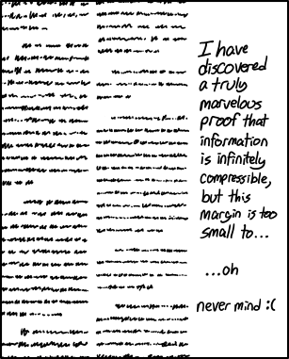
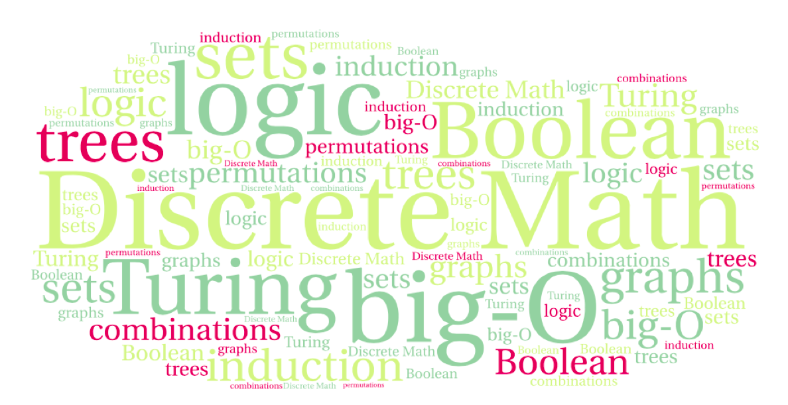
CS 220: Discrete Structures and their Applications
Proofs
sections 2.1-2.3 in zybooks
https://xkcd.com/1381/

Slide 2
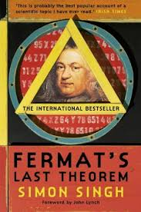
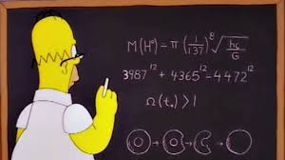
Fermat’s last theorem
Theorem: For every integer n > 2 there is no solution to the equation a^{n} + b^{n} = c^{n}
where a,b, and c are positive integers
Notes:
This theorem was first conjectured by Pierre de Fermat in 1637 in the margin of a copy of Arithmetica where he claimed he had a proof that was too large to fit in the margin. The first successful proof was released in 1994 by Andrew Wiles, and formally published in 1995, after 358 years of effort by mathematicians.

Slide 3
Terminology
Theorem: statement that can be shown to be true
Proof: a valid argument that establishes the truth of a theorem
Conjecture: statement believed to be a true
Notes:
e.g. Goldbach’s conjecture “Every even integer greater than 2 can be written as the sum of two primes.”

Slide 4
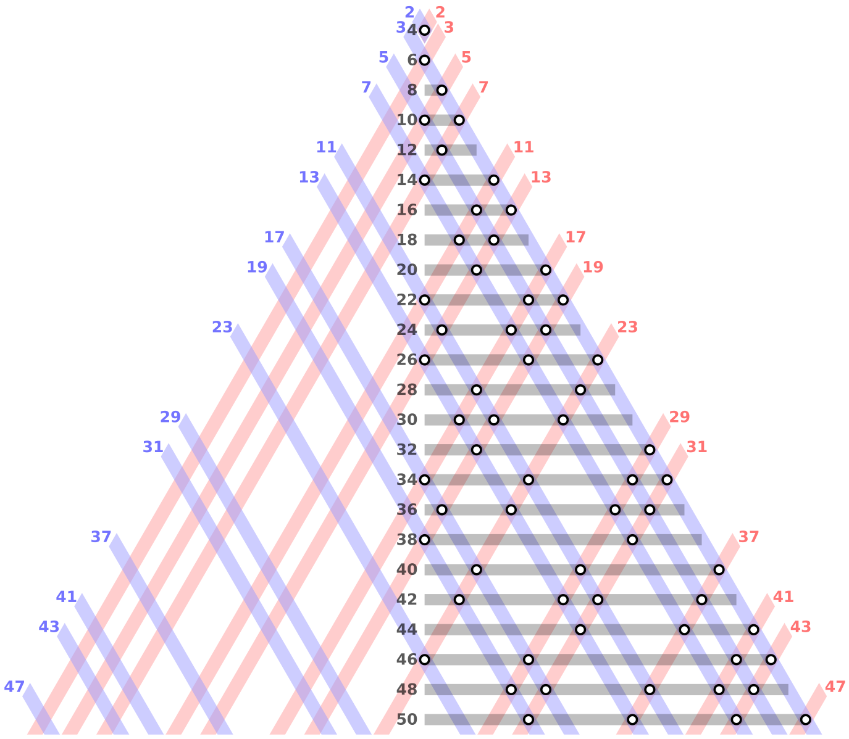
Example
Goldbach’s conjecture:
“Every even integer
greater than 2
can be written as
the sum
of two primes”
Image from https://en.wikipedia.org/wiki/Goldbach%27s_conjecture
Notes:
e.g. Goldbach’s conjecture “Every even integer greater than 2 can be written as the sum of two primes.”

Slide 5
Proofs
What is a proof
A valid argument that establishes the truth of a mathematical statement
The rules of inference we saw:
All the steps and rules were provided
Not practical: formal proofs of useful theorems are long.
In practice: ”informal proofs” (good for human consumption)
We will see methods for constructing proofs

Slide 6
Theorems
Theorem: If x is a positive integer, then x ≤ x².
What is meant is:
For all positive integers x ≤ x².
Many theorems are universal statements.

Slide 7
Theorems
Theorem: If x is a positive integer, then x ≤ x².
What is meant is:
For all positive integers x ≤ x².
Many theorems are universal statements.
And some theorems can be universal statements over multiple variables with different domains:
Theorem: If x and y are positive real numbers and n is a positive integer, then (x + y)^{n} ≥ x^{n} + y^{n}.

Slide 8
Proofs
Theorem: If x is a positive integer, then x ≤ x².
Proof.
Let x be a positive integer, i.e. x > 0.
Since x is an integer and x > 0, x ≥ 1
Since x > 0, we can multiply both sides of the inequality by x to get:
x * x ≥ 1 * x
Simplifying the expression:
x² ≥ x ■
Name a generic object in the domain and
give assumptions about the object
End of proof symbol

Slide 9
Proof by exhaustion
If the domain of a universal statement is small, then all elements can be exhaustively checked.
Theorem: If n ∈ {-1, 0, 1}, then n² = |n|.
Proof.
Check the equality for each possible value of n:
n = -1: (-1)² = 1 = |-1|.
n = 0: (0)² = 0 = |0|.
n = 1: (1)² = 1 = |1|. ■

Slide 10
Counterexamples
Consider the following statement:
If n is an integer greater than 1, then (1.1)^{n} < n¹⁰.
Is it true?
Let’s check some values…
n=2: (1.1)²=1.21<1024=2¹⁰.
n=100: (1.1)¹⁰⁰≈13780.61<100000000000000000000=100¹⁰.
We might be tempted to think that this is true for all n.

Slide 11
Counterexamples
Consider the following statement:
If n is an integer greater than 1, then (1.1)^{n} < n¹⁰.
Is it true?
Let’s check some values…
n=2: (1.1)²=1.21<1024=2¹⁰.
n=100: (1.1)¹⁰⁰≈13780.61<100000000000000000000=100¹⁰.
However: (1.1)⁶⁸⁶>(686)¹⁰.

Slide 12
Counterexamples
What is the counterexample for the following statement:
The multiplicative inverse of a real number x, is a real number y such that xy = 1. Every real number has a multiplicative inverse.

Slide 13
Counterexamples
Once we found a counterexample, we can sometimes fix the statement into a provable theorem:
Theorem: Let x be a real number such that x ≠ 0, then there is a real number y such that xy = 1.
e.g. statement if n is an odd integer then n*n is even
counter example 1*1 = 1 is not even
but we cannot fix the statement to make it true
WHY?
Notes:
For every odd n n*n is odd

Slide 14
Proof techniques
Proof techniques:
Direct proof
Proof by contrapositive
Proof by contradiction
Proof by cases
Proof by induction – later in the course

Slide 15
direct proof
Want to prove a statement of the form p →q
First step: assume p is true
Next steps: apply inference rules using hypotheses and previously proven theorems
Proceed until q is shown to be true

Slide 16
Example
Theorem: For every integer n, if n is odd, then n² is odd.
Definition: an integer n is even if there exists an integer k such that n = 2k, and n is odd if there exists an integer k such that n = 2k + 1.

Slide 17
Example
Theorem: For every integer n, if n is odd, then n² is odd.
Proof.
If n is odd, then n = 2k+1 for some integer k.
n² = (2k+1)² = 4k² + 4k +1
Therefore, n² = 2(2k² + 2k) + 1, which is odd.
apply definition of “odd”
odd number from definition – found k such that n² = 2k + 1

Slide 18
Proof by contrapositive
A proof by contrapositive proves a conditional theorem of the form p → c by showing that the contrapositive ¬c → ¬p is true.
Based on the logical equivalence of p → c and ¬c → ¬p
Proceeds by assuming ¬c and using the same method as direct proof, showing that ¬p

Slide 19
Example
Prove “If n is an integer and 3n + 2 is odd then n is odd.”
Proof by contrapositive.
Suppose the conclusion is false, i.e. n is even. We need to show that 3n + 2 is even.
Then by the definition of an even integer, n = 2k for some integer k
Therefore 3n + 2 = 3(2k) + 2 = 6k + 2 = 2(3k + 1)
Hence, 3n + 2 is even.
Can you produce a direct proof?
Notes:
Sure: 3n+2 is odd so 3n is odd so n is odd

Slide 20
Example
Theorem: For every integer x, if x² is even, then x is even.
Which proof technique?
Direct proof – express x² as 2k for some k, i.e. x = √(2k)
Not clear that sqrt(2k) is an even integer, or even an integer ☺
Proof by contrapositive – prove that if x is odd then x² is odd

Slide 21
Example
Theorem: For every integer x, if x² is even, then x is even.
Proof by contrapositive.
Suppose the conclusion is false, i.e. x is odd. We need to prove that x² is odd.
Then by the definition of an odd integer, x = 2k + 1 for some integer k
Therefore x²=(2k+1)²=4k²+4k+1=2(2k²+2k)+1.
Therefore x² can be expressed as 2k' + 1, where k' = 2k² + 2k is an integer.
Hence, x² is odd. ■

Slide 22
Example
Theorem: For every positive real number r, if r is irrational, then √r is also irrational.
Proof.
Proof by contrapositive. Let r be a positive real number. We assume that √r is not irrational and prove that r is not irrational.
Since √r is not irrational and is real, then √r must be a rational number.
Therefore √r=x/y for two integers, x and y, where y ≠ 0.
Squaring both sides of the equation gives:
(√r)²=r=x²/y².
We expressed r as the ratio of two integers, so r is a rational number. Therefore r is not irrational. ■
Notes:
Do it on the board rather than walking through the proof.

Slide 23
Example
Consider the following statement:
If x and y are real numbers and x + y is irrational, then x is irrational or y is irrational.
What is the contrapositive?
Notes:
Introduce predicates rational(x) and irrational(x) and express the theorem and its contrapositive that way.

