Slide 1
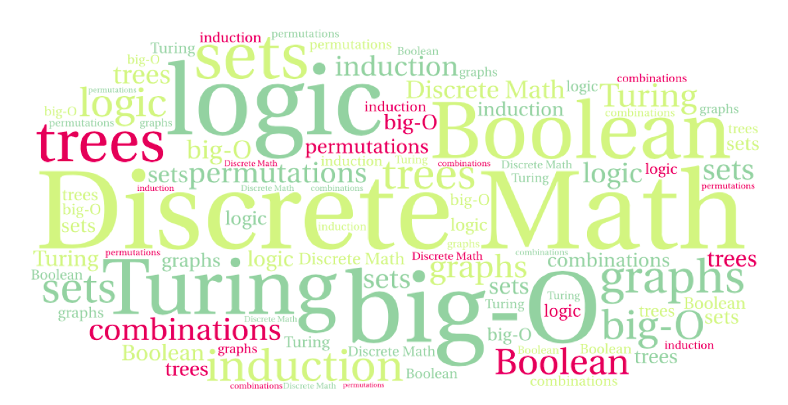
CS 220: Discrete Structures and their Applications
Loop Invariants
Chapter 3 in zybooks

Slide 2
Program verification
How do we know our program works correctly?
In this lecture we will focus on a tool for verifying the correctness of programs that involve loops.

Slide 3
pre- and post-conditions
Precondition: what’s true before a block of code
Postcondition: what’s true after a block of code
Example: computing the square root of a number
Precondition: the input x is a positive real number
Postcondition: the output is a number y such that y²=x

Slide 4
pre- and post-conditions
Precondition: what’s true before a block of code
Postcondition: what’s true after a block of code
Example: sorting a list of numbers
def sort(a_list) :
# code for sorting the list
Precondition: a_list is a list of n numbers in arbitrary order
Postcondition: the list is permutation of the input list and is sorted in ascending order, i.e.
a_list[i] ≤ a_list[i+1] for i ∈ {0,…,n-2}

Slide 5
programming as a contract
Specifying what each method does
Specify it in a comment before/after method's header
Precondition
What is assumed to be true before the method is executed
Caller obligation
Postcondition
Specifies what will happen if the preconditions are met – what the method guarantees to the caller
Method obligation

Slide 6
Example
def factorial(n) :
'''
precondition: n >= 0
postcondition: return value equals n!
'''

Slide 7
Enforcing preconditions
def factorial(n) :
'''
precondition: n >= 0
postcondition: return value equals n!
'''
if (n < 0) : raise ValueError

Slide 8
What about postconditions?
def factorial(n) :
'''
precondition: n >= 0
postcondition: return value equals n!
'''
if (n < 0) : raise ValueError
assert factorial(5)==120
Can use assertions to verify that postconditions hold

Slide 9
Loop invariants as a way of reasoning about the state of your program
<pre-condition: n>0>
i = 0
while (i < n) :
i = i+1
<post-condition: i==n>
We want to prove the post-condition:
i==n right after the loop

Slide 10
Example: loop index value after a loop
// precondition: n>=0
i = 0
// i<=n loop invariant
while (i < n) :
// i < n test passed
// AND
// i<=n loop invariant
i = i + 1
// i <= n loop invariant
// i>=n WHY?
// AND
// i <= n
// → i==n
So we can conclude the
obvious:
i==n right after the loop
But what if the body were:
i = i+2 ?
Notes:
Dropped out of while loop

Slide 11
Loop invariants
A way to reason about the correctness of a program
A loop invariant is a predicate
that is true directly before the loop executes
that is true before and after each repetition of the loop body
and that is true directly after the loop has executed
i.e., it is kept invariant by the loop.

Slide 12
What does it mean...
<loop invariant>
while(test) :
<test AND loop
invariant>
// loop body
<loop invariant>
<not test AND loop invariant>
If we can prove that
the loop invariant holds before the loop
and that
the loop body keeps the loop invariant true
then we can infer that
not test AND loop invariant
holds after the loop terminates
Combined with the loop condition, the loop invariant allows us to reason about the behavior of the loop.

Slide 13
Example: sum of elements in an array
def total(a_list) :
sum = 0
i = 0
// sum == sum of elements from 0...i-1
while (i < n) :
// sum == sum of elements 0...i-1
sum += a_list[i]
i++
// sum == sum of elements 0...i-1
// i==n (previous example) AND
// sum == sum elements 0...i-1
// → sum == sum of elements 0...n-1
return sum

Slide 14
Loop invariant for selection sort
def selection_sort (a_list) :
for i in range(len(a_list) – 1) :
min = i
for j in range(i+1, len(a_list)) :
if (a_list[j] < a_list[min]) :
min = j
a_list[i],a_list[min] = a_list[min],a_list[i]
Invariant?
Notes:
Notice: for loop, can be interpreted as
i=0
while i<len(a)-1
body
i++

Slide 15
Loop invariant for selection sort
def selection_sort (a_list) :
for i in range(len(a_list) – 1) :
min = i
for j in range(i+1, len(a_list)) :
if (a_list[j] < a_list[min]) :
min = j
a_list[i],a_list[min] = a_list[min],a_list[i]
Invariant: a_list[0]…a_list[i-1] are in sorted order
for i in range(n) : i = 0
body is equivalent with while(i<n) :
body
i = i+1
Notes:
i=0
while(i<n)
0..i-1 sorted (init: empty)
inner
i++
0..i-1 sorted
i==n o..n-1 sorted

Slide 16
Closed Curve Game
There are two players, Red and Blue. The game is played on a rectangular grid of points:
6 . . . . . . .
5 . . . . . . .
4 . . . . . . .
3 . . . . . . .
2 . . . . . . .
1 . . . . . . .
1 2 3 4 5 6 7
Red draws a red line segment, either horizontal or vertical, connecting any two adjacent points on the grid that are not yet connected by a line segment. Blue takes a turn by doing the same thing, except that the line segment drawn is blue. Red's goal is to form a closed curve of red line segments. Blue's goal is to prevent Red from doing so.
See http://www.cs.uofs.edu/~mccloske/courses/cmps144/invariants_lec.html

Slide 17
Closed Curve Game
We can express this game as a computer program:
while (more line segments can be drawn):
Red draws line segment
Blue draws line segment
Question: Does either Red or Blue have a winning strategy?

Slide 18
Closed Curve Game
Answer: Yes! Blue is guaranteed to win the game by responding to each turn by Red in the following manner:
if (Red drew a horizontal line segment) {
let i and j be such that Red's line segment connects (i,j) with (i,j+1)
if (i>1) {
draw a vertical line segment connecting (i-1,j+1) with (i,j+1)
} else {
draw a line segment anywhere
}
} else // Red drew a vertical line segment
let i and j be such that Red's line segment connects (i,j) with (i+1,j)
if (j>1) {
draw a horizontal line segment connecting (i+1,j-1) with (i+1,j)
} else {
draw a line segment anywhere
}
}

Slide 19
Closed Curve Game
By following this strategy Blue guarantees that Red does not have an “upper right corner” at any step.
So, the invariant is:
There does not exist on the grid a pair of red line segments that form an upper right corner.
And in particular, Red has no closed curve!

Slide 20
Egyptian multiplication
A B
19 5
/2 9 10 *2
/2 4 20 *2
/2 2 40 *2
/2 1 80 *2
throw away all rows with even A:
A B
19 5
9 10
1 80
__________
add B's 95
--> the product !!
Notes:
show the code

Slide 21
Can we show it works? Loop invariants!!
def egyptian_multiply(left, right) :
# precondition: left>0 AND right>0
a=left; b=right; p=0 #p: the product computed stepwise
# p + (a*b) == left * right loop invariant
while (a!=0) :
# a!=0 and p + (a*b) == left * right
# loop condition and loop invariant
if odd(a):
p+=b
a = a//2
b = b * 2
# p + (a*b) == left*right
# a==0 and p+a*b == left*right --> p == left*right
return p

Slide 22
Try it on 7 * 8
left right a b p
7 8 7 8 0
3 16 +=b: 8
1 32 +=b: 24
0 64 +=b: 56

Slide 23
Try it on 8*7
left right a b p
8 7 8 7 0
4 14 0
2 28 0
1 56 0
0 118 +=b: 56

Slide 24
Relation to binary representation 19*5
00101
10011
______
101 5
1010 10
00000
000000
1010000 80
_______
1011111 95

Slide 25
Incorporating loop invariants into your code
def egyptian_multiply(left, right) :
# precondition: left>0 AND right>0
a=left; b=right; p=0 #p: the product
assert p + (a*b) == left * right
while (a!=0) :
assert a!=0 and p + (a*b) == left * right
# loop condition and loop invariant
if not (a/2 == a//2) :
p+=b
a = a//2
b = b * 2
assert p + (a*b) == left*right
assert a==0 and p+a*b == left*right
return p

