Slide 1
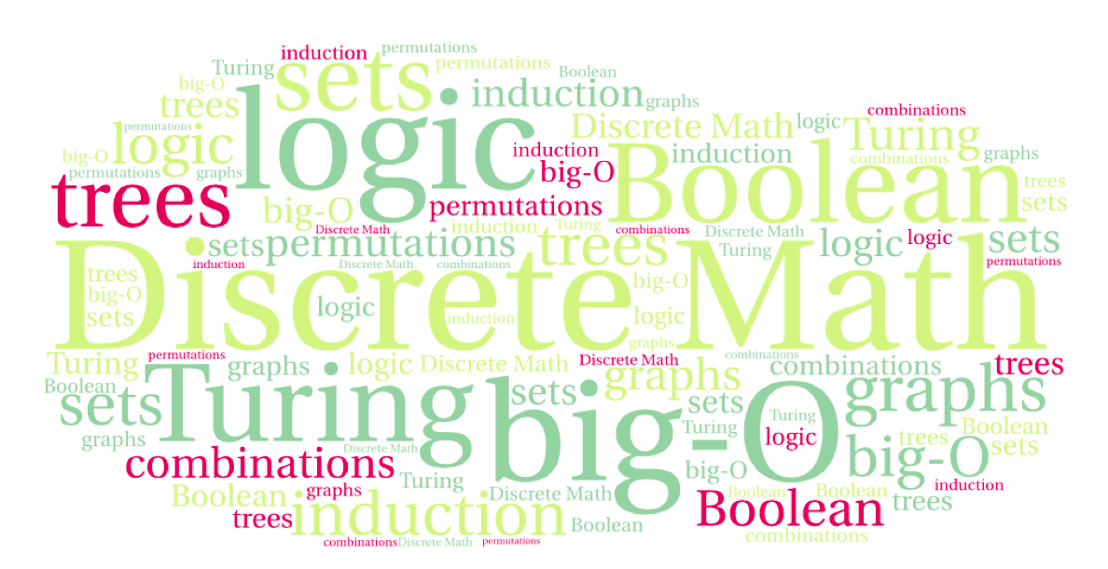

CS 220: Discrete Structures and their Applications
Sets
zybooks sections 4.1-4.7

Slide 2
sets
Set: An unordered collection of objects
The objects in a set are called its members or elements.
Example: {2, 4, 8} is the set containing the elements 2, 4, 8
This form of specifying a set is called roster notation
{2, 4, 8} is the same set as {4, 2, 8} (unordered)

Slide 3
sets
Set: An unordered collection of objects
The objects in a set are called its members or elements.
Notation for set membership ∈
a ∈ A means “a is an element of the set A.”
Upper-case letters for sets
A = {1, 2, 3, 4, 5}
4 ∈ A
Lower-case letters for elements in the set

Slide 4
Examples
V={a, e, i, o, u} Set of vowels
B={False, True} Boolean values
O={1, 3, 5, ... ,99} Odd numbers between 1 and 99

Slide 5
Examples
The natural numbers N = {0,1,2,3…}
The integers Z = {…,-2,-1,0,1,2,…}
The positive integers Z⁺ = {1,2,…}
The rational numbers Q
Cardinality of a set: number of distinct elements in the set. Denoted by |S|.
A set is finite if its cardinality is finite (and infinite otherwise)
A = { x ∈ N : x ≤ 2000 } what is |A| ?
B = { x ∈ N : x ≥ 2000 } what is |B| ?

Slide 6
Building sets
Sometimes it’s hard to list all the elements of the set explicitly
E.g. the set of all odd numbers less than 100:
O = {1,3,5,…,99}
Ellipsis “…” is used instead of the omitted elements
Instead we can characterize the set by the property its elements satisfy:
O = {x : x is an odd positive integer less than 100}
This is called set builder notation

Slide 7
Set builder notation
We can express the set O = {1,3,5,…,99} using set builder notation:
O = {x ∈ Z⁺ : x is odd and x < 100}
Definition of set builder notation:
A = {x ∈ S : P(x)}
or
A = {x ∈ S | P(x)}
S – a set
P(x) – a predicate
Example: D = { x ∈ R : |x| <1 }
Can also be written as : D = { x : x ∈ R and |x| <1 }

Slide 8
Subsets
A set A is said to be a subset of a set B if and only if every element of A is also an element of B.
Notation: A ⊆ B
Using logic:
A ⊆ B ↔ ∀x (x ∈ A ⇒ x ∈ B)
Example: {1, 2, 4} ⊆ {1, 2, 3, 4, 5}

Slide 9
Questions
{1, 2, 3} ⊆ {2, 3} ?
{1, 2, 3} ⊆ {1, 2, 3} ?
What can we say about the relationship between the cardinalities of A and B if A ⊆ B?

Slide 10
Proper subsets
A is a proper subset of B if A ⊆ B and there is an element of B that is not an element of A.
Notation: A ⊂ B
Example:
{1, 2, 3} ⊂ {1, 2, 3, 4, 5}

Slide 11
Venn diagrams
Graphical representation of sets
U – the set of all objects
A ⊆ B
A
U
B
U
A
B

Slide 12
Example
integers between 1 and 9
2
even
4
6
8
1
3
5
7
odd
9
prime

Slide 13
Set equality
Two sets are equal if and only if they have the same elements.
We write A=B to denote set equality
Using logic:
A=B ↔ ∀x (x ∈ A ↔ x ∈ B)

Slide 14
The empty set
The empty set has no elements.
Notation: {} or ∅
Is ∅ ⊆ {1,2,3}? Yes! Since
∀x x ∈ ∅ ⇒ x ∈ {1, 2, 3}
In fact, this is true for any set.
The cardinality of ∅ is zero: |∅| = 0.

Slide 15
Questions
Is {a} ⊆ {a}?
Is {a} ∈ {a}?
Is {a} ∈ {a,{a}}?

Slide 16
sets of sets
As the previous example suggests, a set can have a set as an element!
Example:
A = { { 1, 2 }, ∅ , { 1, 2, 3 }, { 1 } }
Note the following:
1 ∉ A
{ 1 } ∈ A
{ 1 } ⊈ A since 1 ∉ A.
The empty set ∅ is not the same as { ∅ }

Slide 17
The power set
The power set of a set S is the set of all subsets of S.
Notation: P(S)
Examples:
P({0,1,2}) = {∅, {0}, {1}, {2}, {0,1}, {0,2}, {1,2}, {0,1,2}}
P(∅) = {∅}
Theorem: Let A be a set of cardinality n, then |P(A)| = 2^{n}.
Notes:
Relate this to the number of bit strings of length n

Slide 18
The power set
Video game example:
  Given there are four objects a player could pick up, what are all the possible states the player could be in with respect to the set of objects
  O = {coin, apple, sword, shield}
  Answer: P(O)

Slide 19
Set Operations

Slide 20
set intersection
The intersection of sets A and B is the set containing those elements that are in both A and B.
Notation: A ∩ B
A ∩ B = { x : x ∈ A and x ∈ B}.
Example: {1,2,3} ∩ {1,3,5} = {1, 3}
Two sets are called disjoint if their intersection is the empty set.
U
A
B

Slide 21
set intersection
You can take the intersection of infinite sets:
A = { x ∈ Z : x is a multiple of 2 }
B = { x ∈ Z : x is a multiple of 3 }
A ∩ B = { x ∈ Z : x is a multiple of 6 }

Slide 22
set union
The union of sets A and B is the set that contains those elements that are either in A or in B, or in both.
  Notation: A ∪ B
  A ∪ B = { x : x ∈ A or x ∈ B }.
  Example: {1,2,3} ∪ {1,3,5} = {1,2,3,5}
U
A
B

Slide 23
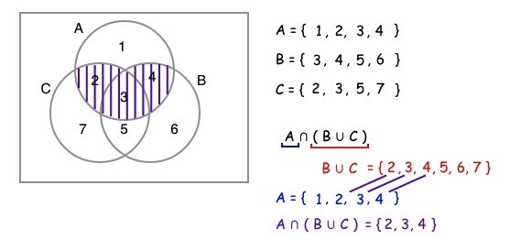
operations on multiple sets
The use of parentheses is important!
E.g., what is A ∩ B ∪ C ?
Notes:
{2,3,4} ∪ {2,3,5,7} = {2,3,4,5,7}

Slide 24
intersection/union of many sets
applying the intersection/union operations to large numbers of sets:

Slide 25
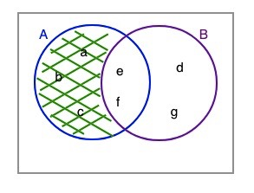
set difference
The difference of sets A and B is the set containing those elements that are in A but not in B.
A - B = { x | x ∈ A and x ∉ B }.
Example: {a, b, c, e, f} – {d, e, f, g} = {a, b, c}

Slide 26
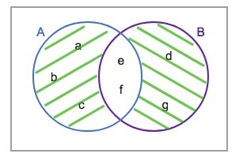
symmetric difference
The difference operation is not commutative since it is not necessarily the case that A - B = B - A.
Check this in the diagram
The symmetric difference between two sets, A and B, denoted A ⊕ B, is the set of elements that are a member of exactly one of A and B, but not both.
Also defined as:
A ⊕ B = ( A - B ) ∪ ( B - A )
Check it again

Slide 27
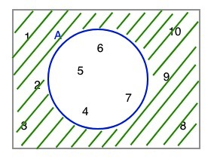
set complement
The universal set: the set of all elements in some domain (e.g. positive integers)
The complement of a set A is the set of all elements in the universal set U that are not elements of A.
Notation:
An alternative definition: U - A

Slide 28
set complement
Example:
What is the complement of the natural numbers (N) with respect to the integers (Z)?
Notes:
(remember N: {0,1,…} Z:{…,-2,-1,0,1,2,…} ) Answer: negative integers

Slide 29
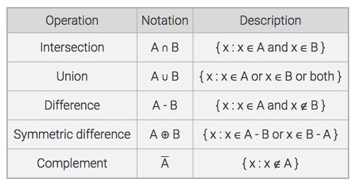
summary of set operations

Slide 30
expressing sets operations using logic
x ∈ A ∩ B ↔ (x ∈ A) ∧ (x ∈ B)
x ∈ A ∪ B ↔ (x ∈ A) ∨ (x ∈ B)
x ∈ ↔ ¬(x ∈ A)
The sets U and ∅ correspond to the constants true (T) and false (F):
x ∈ ∅ ↔ F
x ∈ U ↔ T

Slide 31
DeMorgan's laws for sets
We can use the laws of propositional logic to derive corresponding set identities:
Result:
Notes:
Show Venn diagram to demonstrate that!

Slide 32
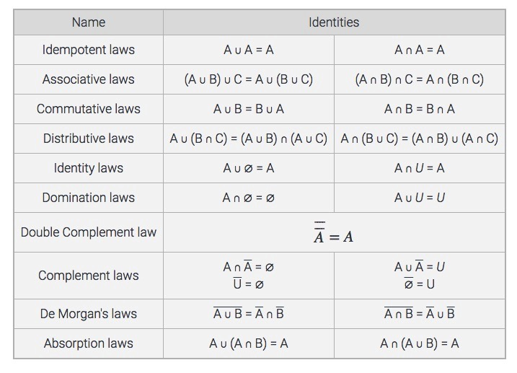
set identities

Slide 33
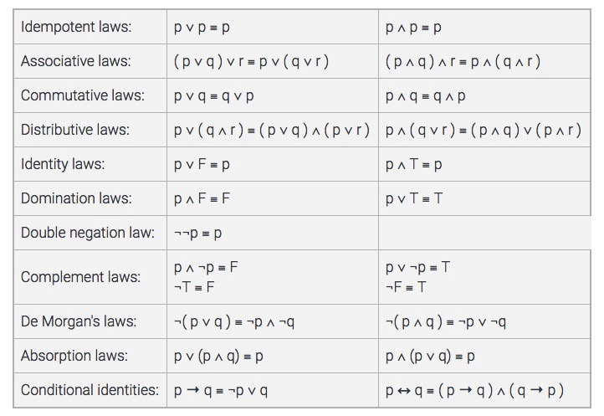
Every set identity has
a corresponding rule of
propositional logic

Slide 34
tuples
If order matters:
An ordered n-tuple is a sequence of n objects
(a₁, a₂, …, a_{n})
  First component is a₁
  …
  n-th component is a_{n}
An ordered pair: 2-tuple (a, b)
An ordered triple: 3-tuple (a, b, c)
Sets do not have the same element more than once:
{1, 1, 2} = {1,2}
Tuples can have the same element more than once:
(1,1,1) is a valid 3-tuple
Notes:
n-tuple is the same as k-tuple

Slide 35
tuples
Two tuples are equal iff corresponding pairs of elements are equal:
  (a₁, a₂, …, a_{n}) = (b₁, b₂, …, b_{n}) iff
  a₁ = b₁, a₂ = b₂, …, a_{n} = b_{n}
(2, 1) ≠ (1, 2), but {2, 1} = {1, 2}
Think of tuples as book chapters and sections
(1, 1) : Chapter 1, section 1
(1, 2, 4): Chapter 1, section 2, sub-section 4

Slide 36
cartesian products
The cartesian product of sets A and B is denoted by A x B and is defined as:
{ (a, b) : a ∈ A and b ∈ B}
Example: A = {1, 2}, B = {a, b, c}
A x B = { (1, a), (1, b), (1, c), (2, a), (2, b), (2, c)}
Is A x B the same as B x A?

Slide 37
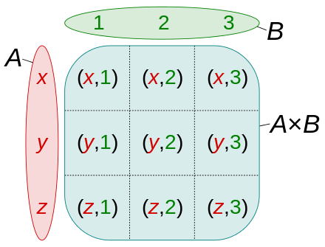
cartesian products
Cartesian product of the sets
A = {x, y, z} and
B = {1, 2, 3}
image from https://en.wikipedia.org/wiki/Cartesian_product

Slide 38
cartesian products
The cartesian product R x R (R being the real numbers) gives
every point in a 2D plane a pair of x,y coordinates:
y coordinate
x coordinate

Slide 39
cartesian products
Fact: |A x B| = |A| * |B|
Example: A = {1, 2}, B = {a, b, c}
A x B = { (1, a), (1, b), (1, c), (2, a), (2, b), (2, c)}

Slide 40
cartesian products
The cartesian product of sets A₁,…,A_{n} is the set of n-tuples (a₁,a₂,…,a_{n}), where a_{i} ∈ A_{i} for i=1, 2, …, n.
Denoted by A₁ x A₂ x,…,x A_{n}
Example: A={0, 1}, B={2, 3}, C={4, 5, 6}
What is A x B x C?
What is |A x B x C|?
Notes:
Method / function parameters are tuples.

Slide 41
cartesian products of a set with itself
You can take the cartesian product of a set with itself.
Given a set A we can look at A x A (denoted A²), and more generally
A x A x ... x A denoted as A^{k}.
Example: if A = {0, 1}, then A^{k} is the set of all ordered k-tuples whose entries are bits (0 or 1).
{0, 1}³ = { (0, 0, 0), (0, 0, 1), (0, 1, 0), (0, 1, 1), (1, 0, 0), (1, 0, 1), (1, 1, 0), (1, 1, 1) }
Example: R² is the set of all points in the plane.
k times

Slide 42
strings
If A is a set of symbols, then members of A^{k} can be written without commas/parentheses.
For example:
If A = {0, 1} then we can express A² as {00, 01, 10, 11}.

Slide 43

partitions
Two sets, A and B, are said to be disjoint if their intersection is empty (A ∩ B = ∅ ).
A collection of sets, A₁, A₂, ..., A_{n}, is pairwise disjoint if every pair of sets is disjoint i.e., A_{i} ∩ A_{j} = ∅ when i ≠ j.
A partition of a non-empty set A is a collection of non-empty subsets of A such that each element of A is in exactly one of the subsets.
A₁, A₂, ...,A_{n} is a partition for a non-empty set
A if:
A_{i} ⊆ A for all i.
A_{i} ≠ ∅
A₁, A₂, ...,A_{n} are pairwise disjoint.
A = A₁ ∪ A₂ ∪ ... ∪ A_{n}

Slide 44
partitions
practice question:
Suppose that every student is assigned a unique 8-digit ID number.
A_{i} : the set students whose ID number begins with the digit i.
Assume that for each digit, i, there is at least one student whose ID starts with i.
Do the sets A₀, …, A₉ form a partition of the set of students?

