Slide 1
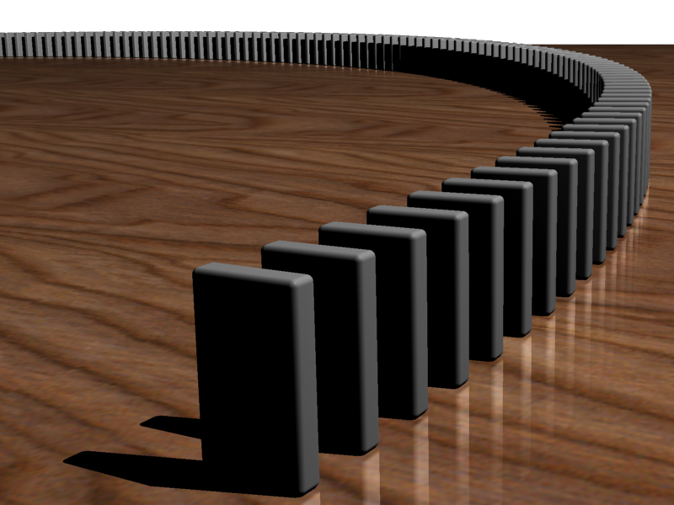
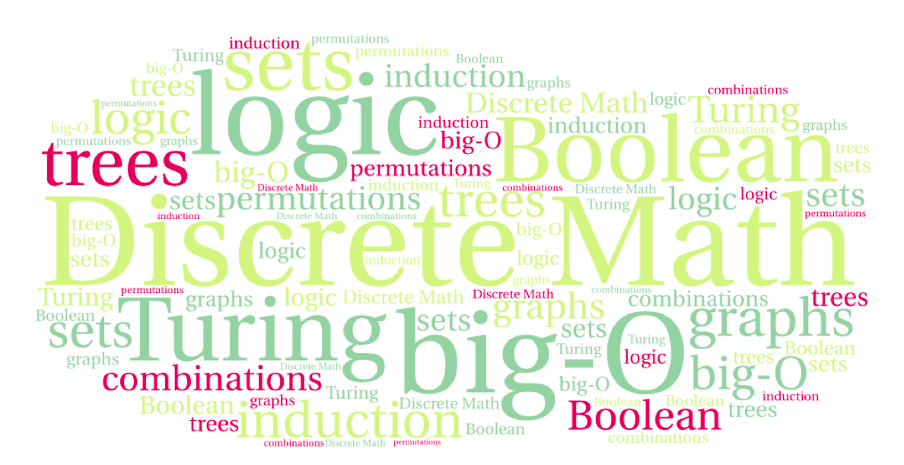

CS 220: Discrete Structures and their Applications
Recursive objects and structural induction
6.9 – 6.10 in zybooks

Slide 2
Using recursion to define objects
We can use recursion to define functions:
The factorial function can be defined as:
n! = 1 for n = 0; otherwise
n! = n (n - 1)!
This gives us a way of computing the function for any value of n.

Slide 3
factorial
This is all we need to put together the function:
  def factorial(n):
  # precondition: n is an integer >= 0
  if (n == 0)
  return 1
  else :
  return n * factorial(n-1);

Slide 4
recursive sets
Some sets are most naturally specified by recursive definitions.
A recursive definition of a set shows how to construct elements in the set by putting together simpler elements.
Example: balanced parentheses
(()(())) is balanced
()) and ())()(() are not

Slide 5
recursive sets
Some sets are most naturally specified by recursive definitions.
A recursive definition of a set shows how to construct elements in the set by putting together simpler elements.
Example: balanced parentheses
Basis: The sequence () is properly nested.
Recursive rules: If u and v are properly-nested sequences of parentheses then:
(u) is properly nested.
uv is properly nested.

Slide 6
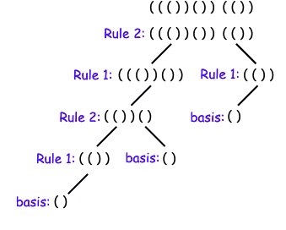
recursive sets
Example: balanced parentheses
Basis: The sequence () is properly nested.
Recursive rules: If u and v are properly-nested sequences of parentheses then:
(u) is properly nested.
uv is properly nested.

Slide 7
balanced parentheses
Basis: The sequence () is properly nested.
Recursive rules: If u and v are properly-nested sequences of parentheses then:
(u) is properly nested.
uv is properly nested.
Is there a unique way to construct ()()() ?
Notes:
No, ambiguity

Slide 8
recursive sets
Some sets are most naturally specified with recursive definitions. A recursive definition of a set shows how to construct elements in the set by putting together simpler elements.
The basis explicitly states that one or more specific elements are in the set.
Recursive rules show how to construct more complex elements from elements already known to be in the set.

Slide 9
binary strings
Let B = {0, 1}
B^{k}: the set of binary strings of length k: {0, 1}^{k}
The empty string: λ
B⁰ = {λ}
The set of all binary strings:

Slide 10
binary strings
The set of all binary strings:
This set can be defined recursively:
Base case: λ ∈ B*
Recursive rule: if x ∈ B* then
x0 ∈ B*
x1 ∈ B*

Slide 11
strings
Example: length of a string
Let Σ be an alphabet
The length of a string over the alphabet Σ can be defined recursively:
l(λ) = 0
l(wx) = l(w) + 1 if w ∈ Σ* and x ∈ Σ

Slide 12

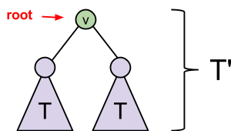
perfect binary trees
Basis: A single vertex with no edges is a perfect binary tree.
Recursive rule: If T is a perfect binary tree, a new perfect binary tree T' can be constructed by taking two copies of T, adding a new vertex v and adding edges between v and the roots of each copy of T. The new vertex v is the root of T'.

Slide 13
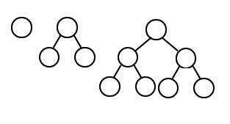
perfect binary trees
Basis: A single vertex with no edges is a perfect binary tree.
Recursive rule: If T is a perfect binary tree, a new perfect binary tree T' can be constructed by taking two copies of T, adding a new vertex v and adding edges between v and the roots of each copy of T. The new vertex v is the root of T'.

Slide 14
structural induction
We can use induction to prove properties of recursively defined objects.
This is called structural induction.
As an example, we'll prove the following:
Theorem: Properly nested strings of left and right parentheses are balanced.
A string of parentheses x is called balanced if left[x] = right[x],
where left[x] (right[x]) is the number of left (right) parentheses in x. In fact, they are more than balanced (as defined above).
Notes:
But they are more than balanced! From left to right there are never more )s than (s

Slide 15
structural induction
Theorem: Properly nested strings of left and right parentheses are balanced.
Proof.
By induction.
Base case: () is properly nested. left[ () ] = right[ () ] = 1.

Slide 16
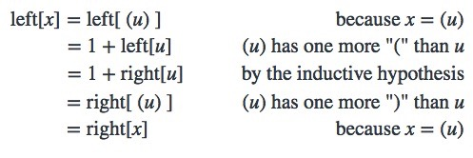
structural induction
Inductive step: If x is a string of properly nested parentheses then x was constructed by applying a sequence of recursive rules starting with the string (). We consider two cases, depending on the last recursive rule that was applied to construct x.
Case 1: Rule 1 is the last rule applied to construct x. Then x = (u), where u is properly nested. We assume that left[u] = right[u] and prove that left[x] = right[x]:

Slide 17
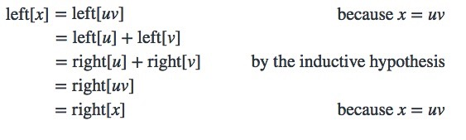
structural induction
Inductive step: If x is a string of properly nested parentheses then x was constructed by applying a sequence of recursive rules starting with the string (). We consider two cases, depending on the last recursive rule that was applied to construct x.
Case 2: rule 2 is the last rule applied to construct x. Then x = uv, where u and v are properly nested. We assume that left[u] = right[u] and left[v] = right[v] and then prove that left[x] = right[x]:

Slide 18
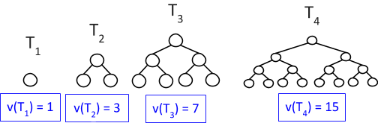
number of vertices in a perfect binary tree
Theorem: Let T be a perfect binary tree. Then the number of vertices in T is 2^{k} - 1 for some positive integer k.
v(T): the number of vertices in T

Slide 19
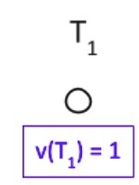
number of vertices in a perfect binary tree
Theorem: Let T be a perfect binary tree. Then the number of vertices in T is 2^{k} - 1 for some positive integer k.
Proof.
By induction.
Base case: the tree with one vertex has 2¹ – 1 = 1 leaves

Slide 20
number of vertices in a perfect binary tree
Theorem: Let T be a perfect binary tree. Then the number of vertices in T is 2^{k} - 1 for some positive integer k.
Inductive step: Let T' be a perfect binary tree. The last recursive rule that is applied to create T' takes a perfect binary tree T, duplicates T and adds a new vertex v with edges to each of the roots of the two copies of T. We assume that v(T) = 2^{k} - 1, for some positive integer k and prove that v(T') = 2^{j} - 1 for some positive integer j.

Slide 21
number of vertices in a perfect binary tree
Theorem: Let T be a perfect binary tree. Then the number of vertices in T is 2^{k} - 1 for some positive integer k.
The number of vertices in T' is twice the number of vertices in T (because of the two copies of T) plus 1 (because of the vertex v that is added), so v(T') = 2·v(T) + 1. By the inductive hypothesis, v(T) = 2^{k} - 1 for some positive integer k. Therefore
v(T') = 2·v(T) + 1 = 2(2^{k} - 1) + 1 = 2·2^{k} - 2 + 1 = 2^{k+1} – 1

