Slide 1
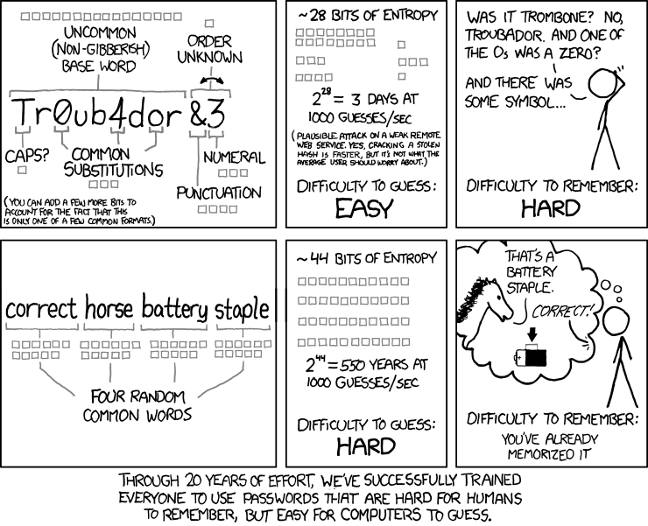
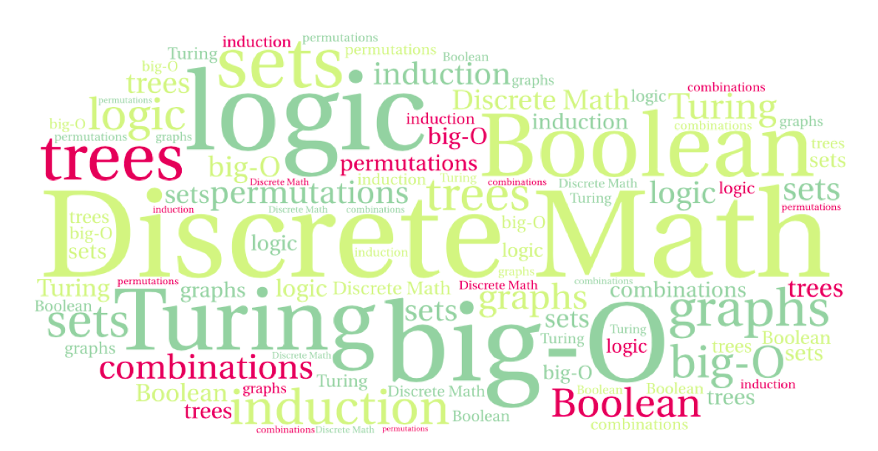
CS 220: Discrete Structures and their Applications
Counting: the bijection rule
zybooks 7.3
http://www.xkcd.com/936/

Slide 2
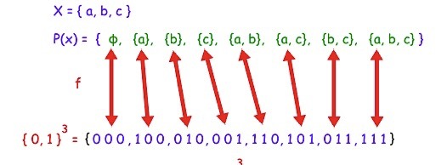
counting subsets
Show that the number of different subsets of a finite set X is 2^{|X|}

Slide 3
counting subsets
Show that the number of different subsets of a finite set X is 2^{|X|}
The correspondence between subsets and bit strings is a bijection

Slide 4
the bijection rule
The bijection rule
Let S and T be two finite sets. If there is a bijection from S to T, then |S| = |T|.

Slide 5
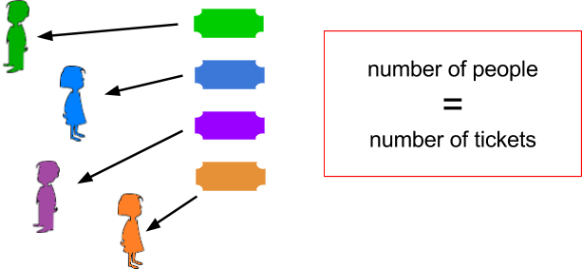
the bijection rule
The bijection rule
Let S and T be two finite sets. If there is a bijection from S to T, then |S| = |T|.
Example: Suppose that every person in a theater must submit a ticket to an usher in order to enter. One way to count the number of people in the theater is to count the number of tickets submitted.

Slide 6
counting palindromes
If x is a string, then x^{R} is the reverse of the string. For example, if x = 1011, then x^{R} = 1101. A string x is a palindrome if x = x^{R}. Let B = {0, 1}. The set B^{n} is the set of all length n bit strings. Let P^{n} be the set of all strings in B^{n} that are palindromes.
(a) Show a bijection between P⁶ and B³.
(b) What is |P⁶|?
(c) Determine the cardinality of P⁷ by showing a bijection between P⁷ and B^{n} for some n.

Slide 7
the k-to-1 rule
A group of kids at a slumber party all leave their shoes in a big pile at the door. How to count the kids? Count the shoes and divide by two.
This assumes a well defined function that maps each shoe to the kid who owns it. This is an example of a k-to-1 correspondence:
Let X and Y be finite sets. A function f:X→Y is a k-to-1 correspondence if for every y ∈ Y, there are exactly k different x ∈ X such that f(x) = y.

Slide 8
the k-to-1 rule
Let X and Y be finite sets. A function f:X→Y is a k-to-1 correspondence if for every y ∈ Y, there are exactly k different x ∈ X such that f(x) = y.
The k-to-1 rule.
Suppose there is a k-to-1 correspondence from a finite set A to a finite set B. Then |B| = |A|/k

Slide 9
example
Ten kids line up for recess:
{Abe, Ben, Cam, Don, Eli, Fran, Gene, Hal, Ike, Jan}.
Let S be the set of all possible ways to line up the kids. For example, one ordering might be:
(Fran, Gene, Hal, Jan, Abe, Don, Cam, Eli, Ike, Ben)
Let T be the set of all possible ways to line up the kids in which Gene is ahead of Don. Note that Gene does not have to be immediately ahead of Don.
It's easy to count |S|. Computing |T| is harder.

Slide 10
example
Ten kids line up for recess:
{Abe, Ben, Cam, Don, Eli, Fran, Gene, Hal, Ike, Jan}.
Let S be the set of all possible ways to line up the kids. For example, one ordering might be:
(Fran, Gene, Hal, Jan, Abe, Don, Cam, Eli, Ike, Ben)
Let T be the set of all possible ways to line up the kids in which Gene is ahead of Don. Note that Gene does not have to be immediately ahead of Don.
Define a function f whose domain is S and whose target is T. Let x be an element of S, so x is one possible way to order the kids. If Gene is ahead of Don in the ordering x, then f(x) = x. If Don is ahead of Gene in x, then f(x) is the ordering that is the same as x, except that Don and Gene have swapped places.
What does this tell us about |T| ?

