Slide 1
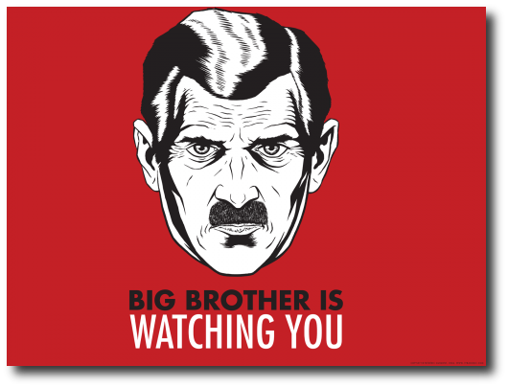
How Private Is Your Cyber Identity and
What Can You Do to Protect It?
Indrajit Ray
Professor, CS Department
Colorado State University
Big brother picture from http://1.bp.blogspot.com/-S5pvSThqSpo/TybEM8zoloI/AAAAAAAACIQ/LQ08g1XQ_Ec/s640/BB+is+watching+you.png

Slide 3
Privacy of Personal Information
Personal information is more than just one’s name, address or social security number
  Medical history, Work history, Shopping habits, Driving record, Political views, Credit score and many more ….
Privacy is an interest that the user has in maintaining such information securely under control without that control being compromised by others

Slide 4
Outline of Presentation
Case study of real life incidents
How privacy violations occur
How to safeguard yourself
Conclusions

Slide 5
Privacy Violation Case Study #1
Identity Fraud from Identity Theft

Slide 6
Identity Fraud – The Michelle Brown Story
Started with mishandling of rental application of Michelle Brown at property management office and subsequent theft
  Perpetrator obtains duplicate driver’s license with assumed identity
  Sets up cellular service, residential telephone service, utility services
  Obtains department store credit card and other loans
  $32,000 truck
  Rents property under assumed identity
  Gets $5,000 worth of liposuction on her body

Slide 7
Identify Fraud – The Michelle Brown Story (2)
Perpetrator runs drug trafficking business under assumed identity
  Presents forged identification papers when arrested for carrying 1,300 Kg of marijuana
    Results in erroneous criminal record under Michelle Brown’s name
Perpetrator becomes fugitive
  Warrant for Michelle Brown’s arrest
Perpetrator arrested
  Prison record established in Michelle Brown’s name

Slide 8
Identify Fraud – The Michelle Brown Story (3)
Real Michelle Brown eventually cleared after months of anguish and enormous financial drain
However, months later was wrongly stopped by an international airport’s customs agents and held for several hours

Slide 9
Source: Insurance Information Institute – Identify theft and Cybercrime http://www.iii.org/fact-statistic/identity-theft-and-cybercrime

Slide 10
Privacy Violation Case Study #2
Demographic Re-identification
&
Its Consequences

Slide 11
Data Collection and Dissemination
Personally identifiable information collected whenever a user
  creates an account
  submits an application
  signs up for newsletter
  participates in a survey
  …
Data sharing and dissemination is often useful and may be done
  to study trends or to make useful statistical inference
  to share knowledge
  to outsource the management of data
  ….
Introduction

Slide 12
Easy to Link Data from Different Sources
SSN | Name | DOB | Sex | ZIP | Disease
123456789 | W. Carter | 04/12/67 | F | 80542 | hypertension
234567891 | P. Jack | 04/21/67 | F | 80541 | obesity
345678912 | R. Robert | 09/27/63 | M | 80535 | chest pain
456789123 | D. Young | 03/13/63 | M | 80539 | obesity
567891234 | J. Lin | 09/27/63 | M | 80539 | hypertension
678912345 | K. Martin | 03/18/64 | F | 80538 | short breath
789123456 | F. Clark | 10/22/64 | F | 80539 | short breath
891234567 | J. Young | 04/21/69 | F | 80549 | chest pain
912345678 | R. Smith | 04/22/69 | F | 80541 | short breath
Name | DOB | Address | Sex | ZIP
… | … | ... | … | …
J. Young | 4/21/69 | 600 Welker Av. Mead, CO | F | 80549
… | … | … | … | …
Breach: J. Young who lives at 600 Welker Av., Mead, CO suffers from chest pain.
Notes:
sequence according to animation
data set as such is not safe since SSN and Name are visible
So, we remove SSN and Name; but still it may not be safe because of linking attacks
Say there is another data set with no potential sensitive information (voters list)
Attacker knows J. Young’s information is also in medical data set; so it observes the combination 4/21/69 + F + 80549 only appears once in voters list as well
J. Young is related to chest pain
So, a privacy breach

Slide 13
Linking Data from Various Sources (1)
In Massachusetts, the Group Insurance Commission (GIC) is responsible for purchasing health insurance for state employees
GIC has to publish the data for research purposes
GIC (zip, dob, gender, diagnosis, procedure, ...)

Slide 14
Linking Data from Various Sources (2)
Researcher paid $20 and bought the voter registration list for Cambridge, MA
GIC (zip, dob, gender, diagnosis, procedure, ...)
VOTER (name, party, ..., zip, dob, gender)

Slide 15
Linking Data from Various Sources (3)
William Weld (former governor) lives in Cambridge, hence is in VOTER
6 people in VOTER share his date of birth
Only 3 of them were men (same gender)
Weld was the only one in that zip
Researcher learned Weld’s medical records

Slide 16
Medical Records Misuse (USA Case Study)
Burlington Northern “allegedly” obtained genetic tests results on employees who had filed worker’s compensation claims for carpal tunnel syndrome, without their knowledge.
  The company’s intention was presumably to be able to reject some claims because of genetic predisposition to the condition.
Source - The Dark Side of Genetic Testing: Railroad Workers Allege Secret Testing, by Dana Hawkins, U.S. News and World Report, February 11 (19), 2001
Genetic Information Nondiscrimination Act of 2008 addresses privacy related issues with genetic testing.

Slide 17
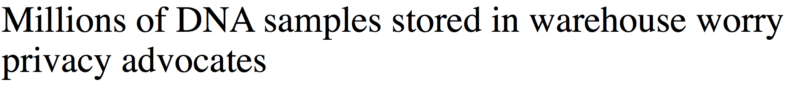

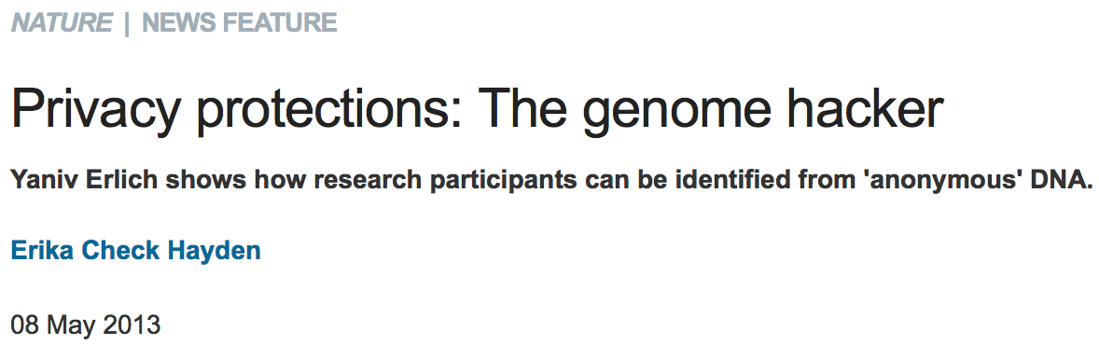
Genetic Data Can Be Misused

Slide 18
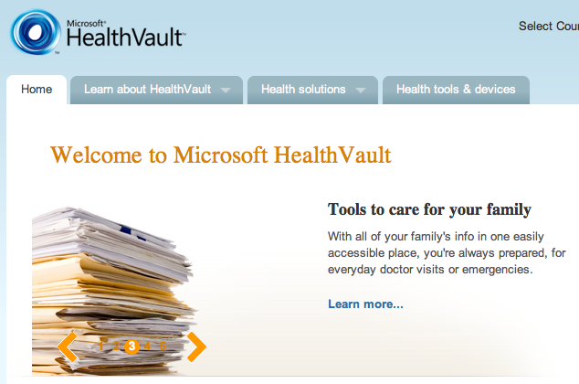
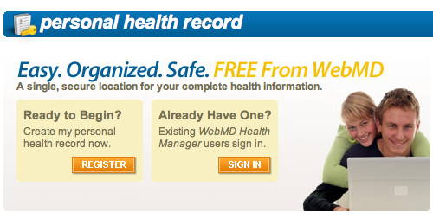
Personal Health Record Systems Store Medical Data

Slide 19
Examples of Privacy Policy for PHR Data
WebMD Personal Health Record

Slide 20
Examples of Privacy Policy for PHR Data
WebMD Personal Health Record

Slide 23
So, How Do They Get My Data?

Slide 24
Users Are Unwitting Accomplices
Users misplace valuable data items
Users post many personal details on social network sites like Facebook, MySpace, Instagram, Snapchat, Bebo etc
  Can be combined with information from other sources to create profile
Users tend to be law abiding citizens
  Give out many information voluntarily when asked by anybody appearing to be authority

Slide 25
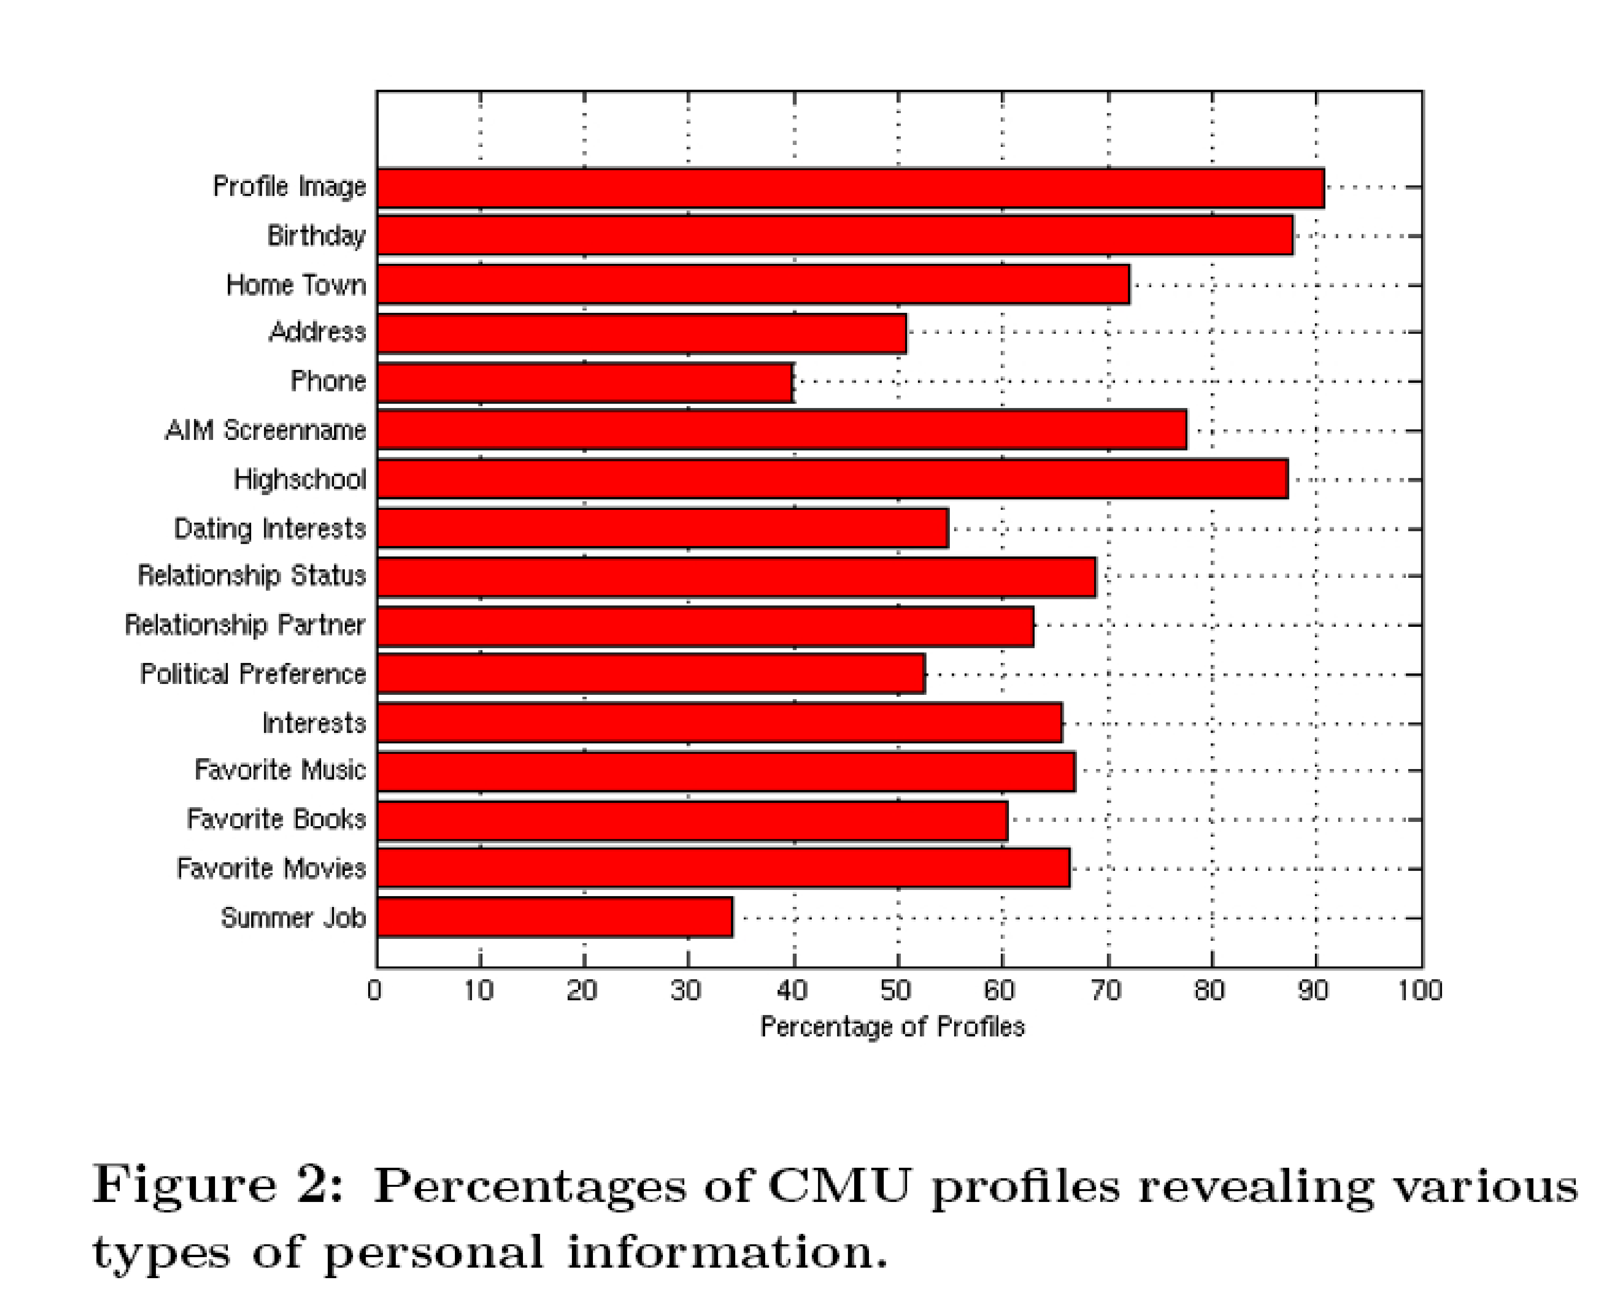
Carnegie Melon University Heinz School Study of Facebook

Slide 26
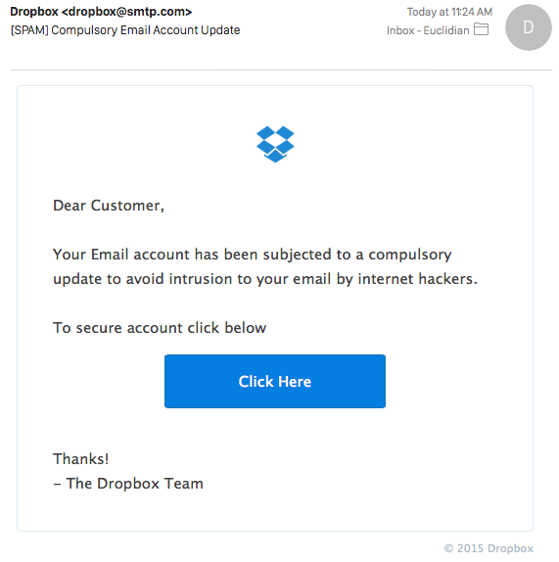
User Falls Victim to Phishing Attacks

Slide 27
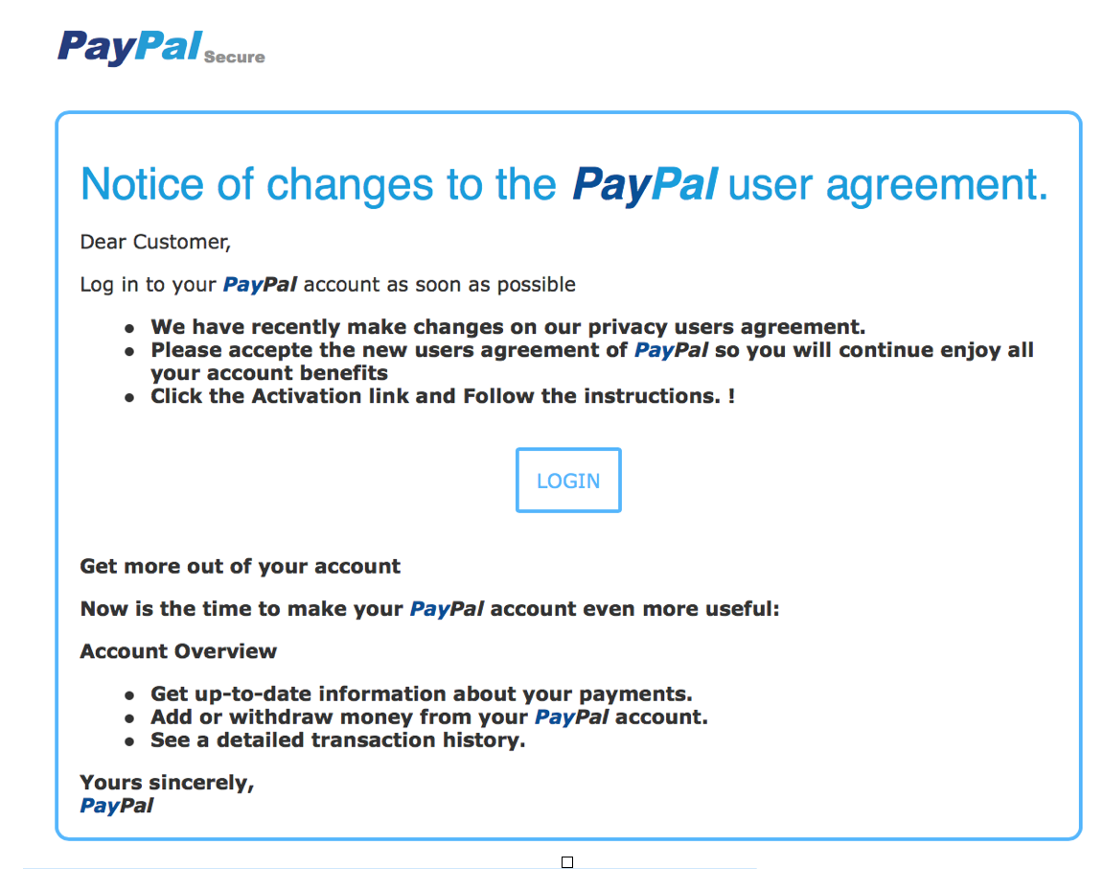
User Falls Victim to Phishing Attacks

Slide 28
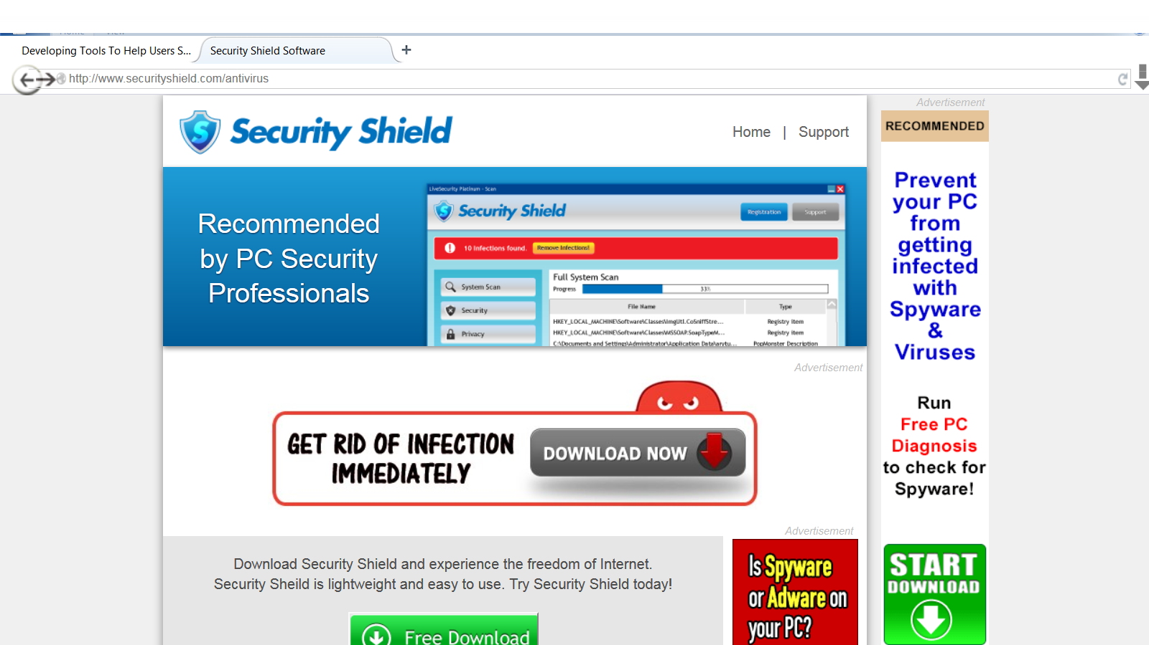
Spyware Gets Installed on Machines Without Users Realizing

Slide 29
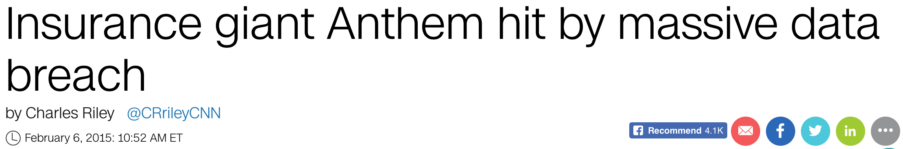
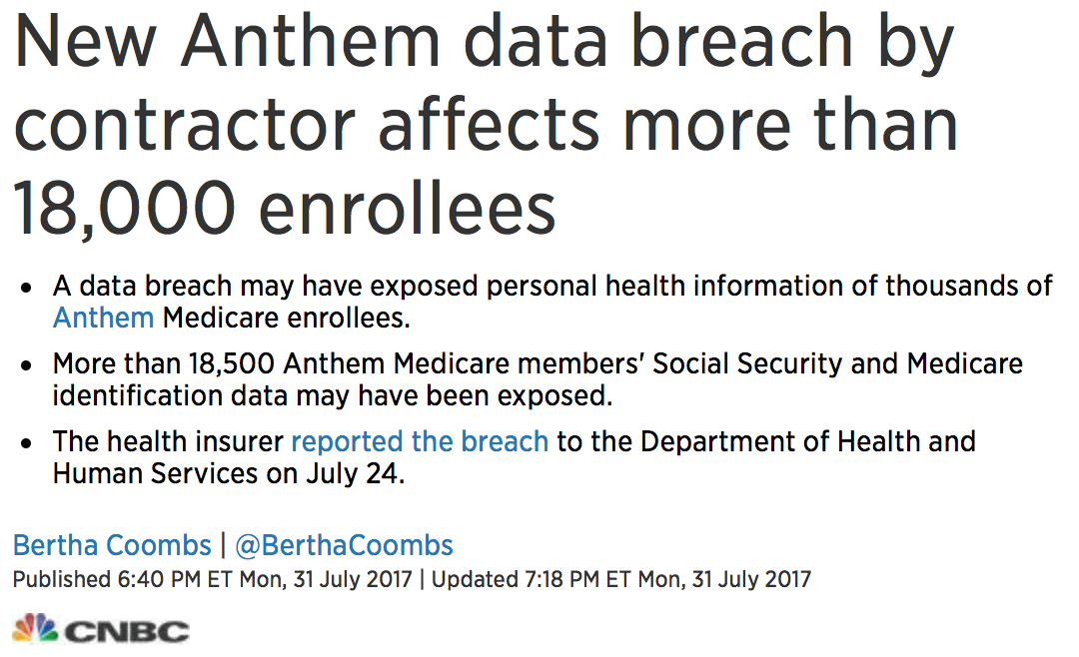
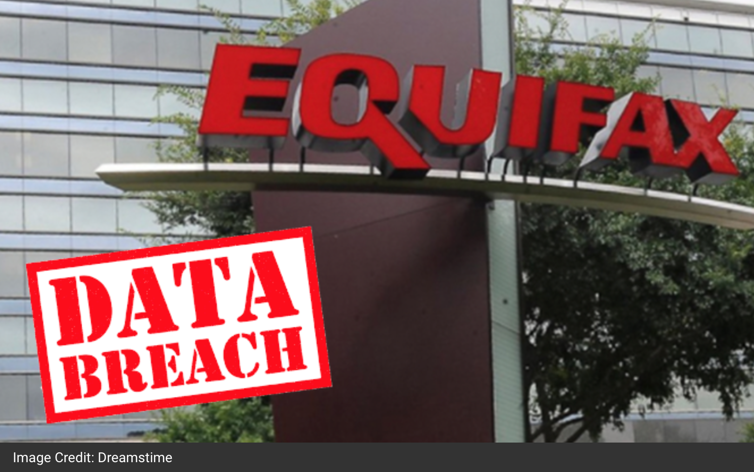
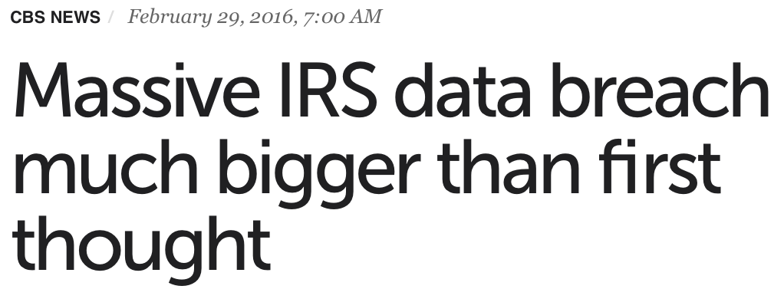
Companies are Sloppy with Data

Slide 30

Insider Threat is Also a Concern

Slide 31
Workplace Monitoring
80+% of employers monitor their employees’ website visit
  Most computer monitoring equipment allows monitoring remotely without user’s knowledge
Almost all employers review employee email
  Deleted emails are not really deleted
50% track keystrokes and time spent at the keyboard
Currently there are very few laws regulating employee monitoring

Slide 32
Browser Chatter
Browsers chatter about
  IP address, domain name, organization,
  Referring page
  Platform: O/S, browser
  What information is requested
    URLs and search terms
  Cookies
To anyone who might be listening
  End servers
  System administrators
  Internet Service Providers
  Other third parties
    Advertising networks
  Anyone who might subpoena log files later

Slide 33
Monitoring on the Internet - What your browsing reveals
Privacy.Net Browsing Analysis Results

Slide 34
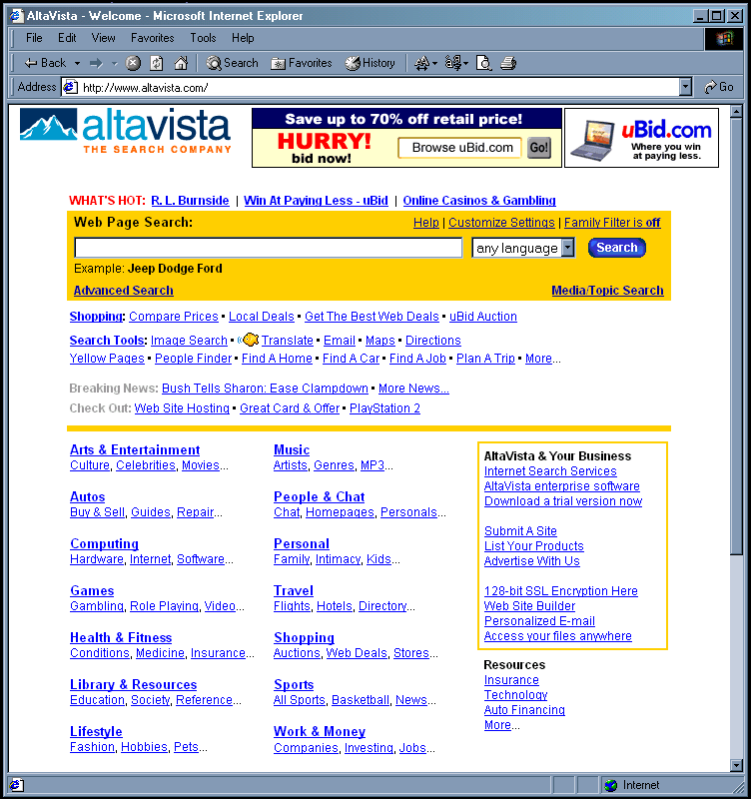
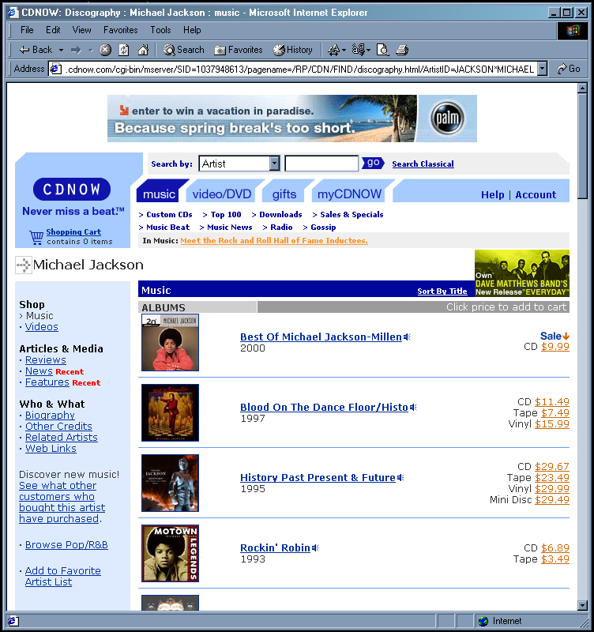
Browsing Gets Linked Via Cookies
search for medical information
buy CD
set cookie
replay cookie
Ad
Ad
Ad company
can get your
name and
address from
CD order and
link them to
your search
Search Service
CD Store

Slide 35
Summary - On-line Privacy Concerns
Data is often collected silently
  Web allows large quantities of data to be collected inexpensively and unobtrusively
Data from multiple sources may be merged
  Non-identifiable information can become identifiable when merged
Data collected for business purposes may be used in civil and criminal proceedings

Slide 36
Should We Be Worried?
Users given no meaningful choice
Few sites offer alternatives

Slide 37
CRA Reports Are Regulated
Most consumers are in the dark about the very existence of specialty consumer reports from CRAs
  Know about these only after having been denied a job, insurance, or an apartment rental
However
  Consumers have right to access their files to view what data CRA maintains about them
  Consumers have a right to correct errors
  Consumers have a right to opt out of certain marketing uses of their information

Slide 38
Most Data Brokers Are Not CRAs
Can obtain information from a variety of sources
  Government and public records
  Self-reported information directly from consumers
    Warranty cards, sweepstakes entries, contest, surveys
  Social media sites, web browsing activities etc.
  Purchasing or licensing information from other data brokers, retailers, financial institutions etc.

Slide 39
Non-CRA Data Brokers Are Not Regulated
Accuracy of data broker information varies widely
  People search sites do not generally assess sources for accuracy
  Data brokers providing marketing services rely upon the reputation of their sources
  Data brokers providing risk mitigation services take steps to ensure reliable information
No laws exist requiring privacy of consumer information unless the data is used for credit, employment, housing etc.

Slide 40
Personal Information = Real Money to Companies
In November 1999, DoubleClick purchased Abacus Direct, a company possessing detailed consumer profiles on more than 90% of US households.
In mid-February 2000 DoubleClick announced plans to merge “anonymous” online data with personal information obtained from offline databases
By the first week in March 2000 the plans were put on hold after complains from privacy advocates
  Stocks dropped from $125 (12/99) to $80 (03/00)

Slide 41
What Can We Do About It?
Privacy Enhancing Technologies
Educating Users to Privacy Threats

Slide 42
Anti-Phishing Phil
http://cups.cs.cmu.edu/antiphishing_phil/
An interactive game that teaches users how to identify phishing URLs, where to look for cues in web browsers, and how to use search engines to find legitimate sites

Slide 43
Anti-Phishing Phil

Slide 44
Use Technology Wisely

Slide 45
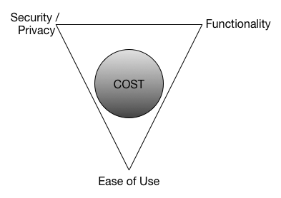
Security/Privacy vs. Functionality vs. Ease of Use
No Free Lunch!!
Think about the cost before signing up for the next best website

Slide 46
Set Browser Security and Privacy Settings Carefully

Slide 47
Revisit Social Networking Site’s Privacy Settings

Slide 48
Use Privacy Enhancing Technologies

Slide 49
Knowing Privacy Policies – Platform for Privacy Preferences (P3P)
Allows websites to express their privacy practices in a machine as well human readable way
Can be retrieved automatically by P3P enabled web browsers and interpreted – use
  Users can be made aware of privacy practices
  Enables automated decision making based on these practices
http://www.w3.org/P3P/

Slide 50

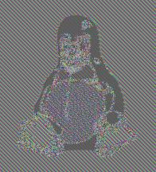

Use Good Encryption Technology

Slide 51
Anonymizing Protocols
Makes it difficult from someone to trace back a message to its source
Prevents
  Linkability
  Traceability
Examples
  Anonymizing Proxy and Remailers
  Mix Networks and Onion Routing
    Tarzan, Tor, I2P
  Anonymous sharing
    Freenet

Slide 52

Anonymizing Remailers
Traffic Analysis Can Break Anonymity

Slide 53
Mix Networks and Onion Routing
Database of Mix
Nodes & their
Public Keys
Prevent edge analysis by introducing cover traffic

Slide 54
Tor – Working Mix Network
From the Tor project website ( http://www.torproject.org )
Tor is a toolset for a wide range of organizations and people that want to improve their safety and security on the Internet. Using Tor can help you anonymize web browsing and publishing, instant messaging, IRC, SSH, and other applications that use the TCP protocol. Tor also provides a platform on which software developers can build new applications with built-in anonymity, safety, and privacy features.

Slide 55
Browsing with Tor
Privacy.net Browser Privacy Results with Tor

Slide 56
Privacy Enhancing Technology
Personal Data Servers
@
SMIS.INRIA

Slide 57
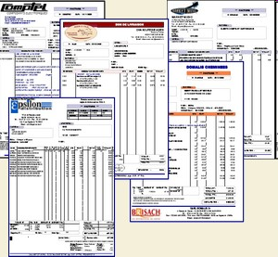
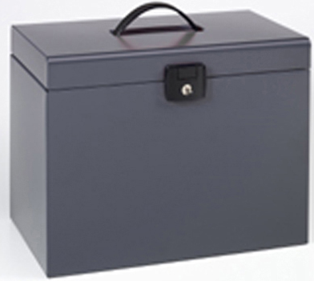
Paper Based Personal Data
Yesterday
  Many paper based personal data
    Invoices, bank, salary form, …
    Diplomas, official forms, …
    Health folder, insurance, …
Today
  More and more electronic versions
    e-invoice, e-health, e-government, …
  And new forms of data
    Bookmarks, navigation history, location tracking …
➔ Need to store those data while ensuring important properties !!!
  Availability: 24/24, 7/7, from everywhere
  Durability
  Query facilities
  Security (confidentiality, controlled sharing)
Slide courtesy of the SMIS group @ INRIA

Slide 58
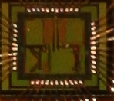
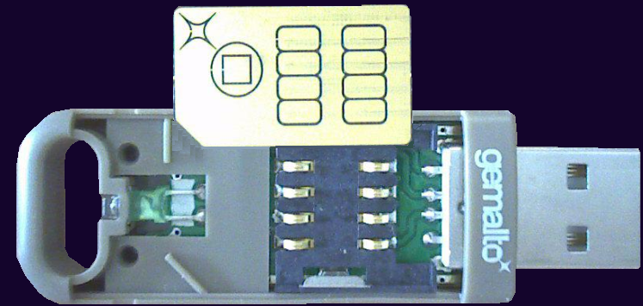
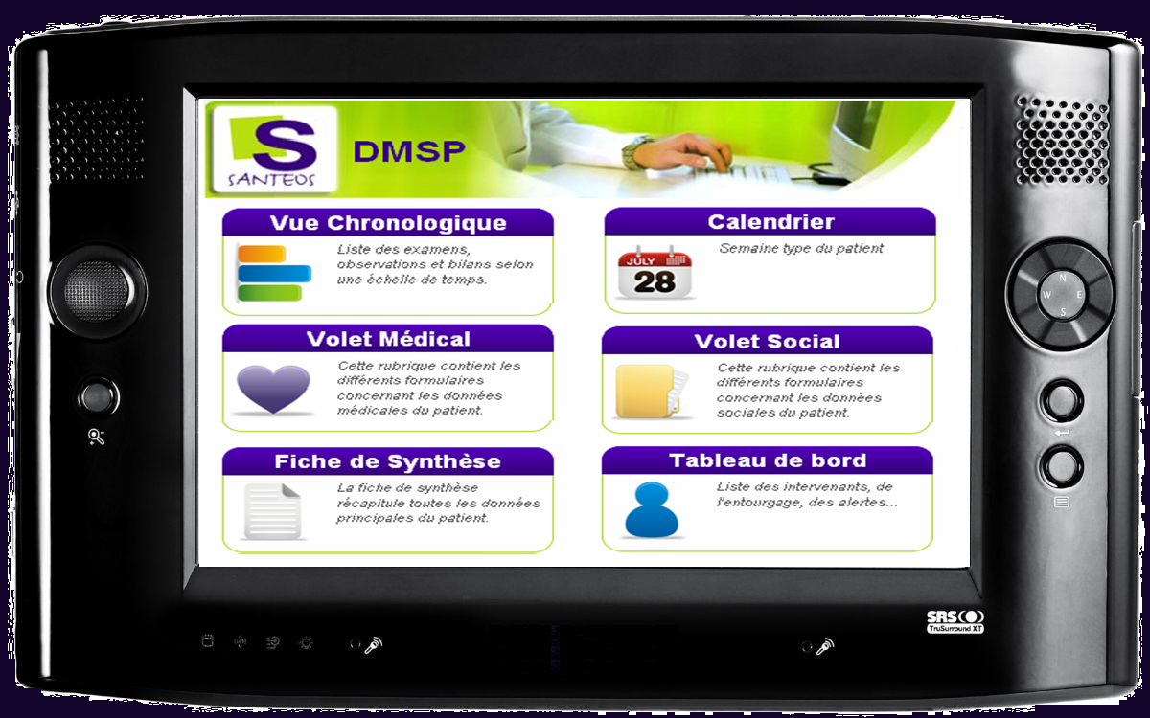
Baseline = Secure Portable Token
Embed the traditional chain of software in secure hardware
  Web server – Application – DBMS – Database
Elements of trust
  Negligence : data at rest always encrypted
  Abusive usage = the user is the Database Service Provider (DSP)
  External attacks = high cost (secure HW + certified code) for little benefit
  Internal attacks = no DBA
Authentication
FLASH (qq Go)
Web Server
Access Control
RAM
Dossier
médico-
social
Transaction manager
CPU
Crypto
Web browser
Synchronization
Query manager
FLASH NOR
Servlets
Cryptography mgr
Index / Storage
Operating system
TCP/IP
USB
JVM
OS multi - thread
USB 2.0
HTTPS
JDBC
SQL
Slide courtesy of the SMIS group @ INRIA

Slide 59
Personal Data Servers (PDS)
Store data under strong trusted hardware-guaranteed protection on SPTs
Do not share unless absolutely needed
  Share only what is needed to be shared
Ability to specify
  Data sharing, usage and retention policies
Ability to audit access

Slide 60
Privacy Enhancing Technology
Microdata Disclosure Control

Slide 61
Data Dissemination
Personally identifiable information collected whenever a user
  creates an account
  submits an application
  signs up for newsletter
  participates in a survey
  …
Data sharing and dissemination is often useful and may be done
  to study trends or to make useful statistical inference
  to share knowledge
  to outsource the management of data
  ….
Introduction

Slide 62
The Anonymity Problem
SSN | Name | DOB | Sex | ZIP | Disease
123456789 | W. Carter | 04/12/67 | F | 80542 | hypertension
234567891 | P. Jack | 04/21/67 | F | 80541 | obesity
345678912 | R. Robert | 09/27/63 | M | 80535 | chest pain
456789123 | D. Young | 03/13/63 | M | 80539 | obesity
567891234 | J. Lin | 09/27/63 | M | 80539 | hypertension
678912345 | K. Martin | 03/18/64 | F | 80538 | short breath
789123456 | F. Clark | 10/22/64 | F | 80539 | short breath
891234567 | J. Young | 04/21/69 | F | 80549 | chest pain
912345678 | R. Smith | 04/22/69 | F | 80541 | short breath
Name | DOB | Address | Sex | ZIP
… | … | ... | … | …
J. Young | 4/21/69 | 600 Welker Av. Mead, CO | F | 80549
… | … | … | … | …
Privacy breach: J. Young who lives at 600 Welker Av., Mead, CO suffers from chest pain.
Notes:
sequence according to animation
data set as such is not safe since SSN and Name are visible
So, we remove SSN and Name; but still it may not be safe because of linking attacks
Say there is another data set with no potential sensitive information (voters list)
Attacker knows J. Young’s information is also in medical data set; so it observes the combination 4/21/69 + F + 80549 only appears once in voters list as well
J. Young is related to chest pain
So, a privacy breach

Slide 63
Preserving Privacy: k-Anonymity
The released data should be indistinguishably related to no less than a certain number, k, of respondents
The respondents must be indistinguishable with respect to a set of attributes (quasi-identifiers)
k-Anonymity requires that every combination of values of quasi-identifiers in the released table must have at least k occurrences
Enforced using generalization and suppression
Introduction

Slide 64
Generalization and Suppression
Generalization: the values of a given attribute are replaced by more general values
  ZIP codes 80521 and 80523 can be generalized to 8052*
  date of birth 12/04/64 and 12/10/64 can be generalized to 64 or 12/64
Suppression: remove the information altogether
  usually done locally
  suppression can reduce the amount of generalization necessary to satisfy the k-anonymity requirement
Introduction

Slide 65
Domain Generalization Hierarchy
H⁰_{ZIP}
H¹_{ZIP}
H²_{ZIP}
{12345} {12346}{12355} {12356}
{1234*}
{1235*}
{123**}
0 full specialization
N_{ZIP} full generalization
H
generalization level
attribute name
Notes:
slide shows what a DGH is

Slide 66
Anonymizing a Tuple
H⁰_{ZIP}
H¹_{ZIP}
H²_{ZIP}
{12345} {12346}{12355} {12356}
{1234*}
{1235*}
{123**}
H⁰_{SEX}
H¹_{SEX}
(12355 , M , <50K)
(1235* , M , *)
{M} {F}
{*}
1 0 1
generalize using levels
1 for ZIP
0 for SEX
1 for SALARY
H⁰_{SALARY}
H¹_{SALARY}
{< 50K}
{≥ 50K}
{*}
Notes:
shows how a tuple is anonymized using DGHs and a given generalization vector (1 0 1)

Slide 67
Privacy by k-Anonymity
SSN | Name | DOB | Sex | ZIP | Disease
123456789 | W. Carter | 04/12/67 | F | 80542 | hypertension
234567891 | P. Jack | 04/21/67 | F | 80541 | obesity
345678912 | R. Robert | 09/27/63 | M | 80535 | chest pain
456789123 | D. Young | 03/13/63 | M | 80539 | obesity
567891234 | J. Lin | 09/27/63 | M | 80539 | hypertension
678912345 | K. Martin | 03/18/64 | F | 80538 | short breath
789123456 | F. Clark | 10/22/64 | F | 80539 | short breath
891234567 | J. Young | 04/21/69 | F | 80549 | chest pain
912345678 | R. Smith | 04/22/69 | F | 80541 | short breath
Generalization: group attribute (quasi-identifier) values into larger domains
SSN | Name | DOB | Sex | ZIP | Disease
 |  | 67 | F | 8054* | hypertension
 |  | 67 | F | 8054* | obesity
 |  | 63 | M | 8053* | chest pain
 |  | 63 | M | 8053* | obesity
 |  | 63 | M | 8053* | hypertension
 |  | 64 | F | 8053* | short breath
 |  | 64 | F | 8053* | short breath
 |  | 69 | F | 8054* | chest pain
 |  | 69 | F | 8054* | short breath
equivalence class
k-Anonymity: size of every equivalence class is at least k
2-anonymous
Notes:
So we generalize different attributes into larger semantic groups.
For DOB, we keep only year, for ZIP we remove last digit
This results in equivalence classes; J. Young’s info (and everyone else’s) can be linked to at least two different individuals
Introduce k-anonymity

Slide 68
Other Models of Microdata Disclosure Control
Other models are proposed around the privacy issues identified by k-anonymity
  l-diversity and t-closeness
  Mondrian multidimensional k-anonymity
  k-type anonymizations
  (α,k)-anonymity, p-sensitive k-anonymity, (k,l)-anonymity
  Anatomy, personalized privacy, skyline privacy
  Differential privacy
All existing anonymity models are minimalistic view models
  privacy of a table is characterized by the minimum privacy level of all individuals

Slide 69
Privacy Research @ CSU
Optimal microdata disclosure with focus on data publisher’s dilemma and biased privacy
Identifying trustworthy data recipients
Network trace data anonymization
Privacy preserving protocols
  E-commerce
  E-voting
Searching over encrypted data
Privacy preserving record linkage

Slide 70
Identifying Trustworthy Data Recipients
Pareto optimal anonymization produces a set of optimal privacy level, information loss pairs
No guarantees that data recipients are not malicious and hence misuse data
Evaluate trustworthiness of data recipients to handle data properly
  Previous experience with data recipient
  Properties of data recipient
  Recommendation for data recipient
Use specific privacy level (from optimal set) suitable for recipient

Slide 71
Conclusions
Privacy survey indicates concern among Internet users
  Increasingly people say they are concerned about online privacy (80-90% of Net users)
  27% of Net users have abandoned online shopping carts due to privacy concerns
  64% of Net users decided not to use a web site or make an online purchase due to privacy concerns
  34% of Net users who do not buy online would buy online if they didn’t have privacy concerns
Improved privacy protection is factor most likely to persuade more users and previous non-Net users to go online

Slide 72
Conclusions
Often users are left with little choice but to accede
  However, user can benefit from conscious decision
  Other times there are tools to help user (at least partially)
  User should know what these tools can or cannot do
More research needed in privacy enhancing technologies

Slide 73
Thank You

