Slide 1
Advanced Cryptography Protocols
Colorado State University

Slide 2
Existing Challenges
Secret key / Symmetric Key Cryptosystems
Communication / Protected files on disk
How to store the key? Full? Partial? Outsource?
How to get the key when I need it?
Public Key / Asymmetric Key Cryptosystems
Communication – Encryption, Digital Signatures.
How to store the “secret” key.
Certificates – Expensive. Management? Revocation?

Slide 3
Topics
Shamir’s Secret Sharing.
Storing a secret. Information Dispersal.
Identity Based Cryptosystems.
PKC without(one) certificates.
Blockchain
Merkle Tree.
Forward Chaining.
Consensus algorithm.

Slide 4
Shamir's Secret Sharing

Slide 5
Secret Sharing
Example Scenario
You obtain nuclear launch codes (somehow!).
You cannot afford to get caught.
You cannot share the same with your friends. They know the code. They have the same power.
Split the code.
e.g. code is 12345. You – 6745, 1st friend – 3011, 2nd friend – 2589 (6745 + 3011 + 2589 = 12345)

Slide 6
Secret Sharing
All 3 must be present to recalculate the code.
Problem – If any one gets caught, that part is lost and now you cannot compute the actual code.
Wouldn’t it be better - 3011 + 2589 = 12345.
All shareholders need not be present, a certain number (threshold) is enough to compute the code.

Slide 7
Secret Sharing
Generalizing the idea, given a secret s, we would like n parties to share the secret so that the following properties hold.
All n parties can get together and recover s.
Less than n parties cannot recover s.
This is called linear secret sharing (n out of n).
Another way, we would like n parties to share the secret so that the following properties hold.
Any k parties, k < n can get together and recover s.
Less than k, k-1 parties cannot recover s.
This is called threshold scheme. (k out of n)

Slide 8
Secret Sharing
Introduced by Adi Shamir in 1979, “How to share a secret”.
Basic idea –
Y = 12X + 34
How many points are needed to draw the straight line?
Given the straight line how many points are on it?
Can we call it a (2,n) threshold?
For, higher k, increase the order of the polynomial.
(3,n) – quadratic, (4,n) – cubic …. So on.

Slide 9
Generating the Shares
Threshold = k , order of polynomial = k-1.
E.g. lets choose threshold 3, order = 2
Y = aX² + bX + c
a and b can be anything, c must be the secret, f(0) = c.
For x = 1 to n, calculate (x, f(x)), these are the shares.
Lets choose – y = 2X² + x + 3, secret = 3, threshold = 3.
f(0) = 3, f(1) = 6, f(2) = 13, f(3) = 24, f(4) = 39
(1,6) (2,13) (3,24) (4,39) …. are the shares.
Never use (0,3) … this is the secret.

Slide 10
Recovering the Secret
(1,6) (2,13) (3,24) (4,39) is what you start with.
Take any 3 points – threshold 3. We want to find the polynomial and f(0) – the secret.
Use Lagrange interpolation.

Slide 11
Recovering the Secret
Lets choose these 3 points - (1,6) (2,13) (3,24)
f(1) = 6 , f(2) = 13, f(3) = 24.
f(x) = δ₁(x) + δ₂(x) + δ₃(x).
δ₁ (x) = 6.(x-2).(x-3)/ (1-2) (1-3).
δ₂ (x) = 13.(x-1).(x-3)/ (2-1) (2-3).
δ₃ (x) = 24.(x-1).(x-2)/ (3-1) (3-2).
Calculate f(x) and find f(0).

Slide 12
Secret Sharing
For uses in cryptography
All calculations are done over finite fields.
Choose a large prime P.
Perform modulo P for every operation.
Generation of shares (x mod P , y mod P)
Reconstruction
Division is modulo inverse.

Slide 13
Identity Based Cryptography

Slide 14
Present PKC model

Slide 15
Alternate model
Wayne
PRIVATE – d_{w}
PUBLIC - e_{w}

Slide 16
Alternate model
If anyone uses e_{w} to encrypt, who can decrypt?
If anyone uses d_{w} to sign, it can be verified by e_{w}
If you know d_{w}, you are “Wayne”.
Target –
One key-pair with a certificate.
Everyone will use that. (encryption / signing)
d_{w} is never disclosed to others.

Slide 17
Identity-Based Cryptosystem
Introduced by Adi Shamir in 1984, “Identity-Based Cryptosystems and Signature Schemes.”
A unique string is used as an identity.
Publicly known to all.
Email ID, ORCID etc.
A central authority (Wayne) has a key-pair.
Users keys are derived from their ID and the central authorities keys.

Slide 18
Shamir’s IBS
A user wants to sign a message.
User needs a private key.
Sends ID to central authority.
Central authority authenticates the user and provides a token / private key (S_{ID}).
S_{ID} = [H(ID)]^{d} mod n.
Given, S_{ID} hard to find d – DLP.

Slide 19
Shamir’s IBS
Signing a message –
Choose r at random.
Compute t = r^{e} mod n.
Compute f = H(t||m).
Compute s = S_{ID} . r^{f} mod n
Signature = (s,t)
Verifying a message –
s^{e} = ? = ID . t ^{H(t||m)} mod n.

Slide 20
Shamir’s IBE
Shamir did not give a concrete way of solving identity based encryptions.
Given ID, append bits to it to make co-prime to n. (e_{ID})
Find its corresponding d_{ID} [d_{ID} . e_{ID} = 1 mod φ(n)]
Note d_{ID} is not same as d, e_{ID} is not same as e.
Essentially, create a key-pair for every user based in their ID.
Does not solve the problem.

Slide 21
Present day IBE
Was an open problem till 2001.
Dan Boneh, Matthew K. Franklin, 2001, “Identity-Based Encryption from the Weil Pairing.”
Based on Elliptic Curve Cryptography.
Bilinear Pairings.
Suggested path to understand this.
ECC -> Bilinear pairings -> IBE.
Not only IBE but IBS, IBI, IBA, IBKE are all possible now thanks to bilinear pairing.

Slide 22
Blockchain !

Slide 23
What is blockchain?
It is NOT Bitcoin. (or other cryptocurrencies)
Bitcoin (others) USE blockchain.
Blockchain is a technology. Conceptualized by a person (or group of people) known as Satoshi Nakamoto in 2008.
It is a distributed ledger/database.
Maintains a continuously growing list of records (blocks). Transactions are grouped into a block.
New blocks are appended at the end of existing ones.
Uses cryptography to prevent altering tampering etc.

Slide 24
What is blockchain?
The underlying principles were already there.
Blockchain is the combination.
Some important principles:
Forward chaining (attaching one block to another)
Merkle Tree (verifying the transactions in a block)
Consensus Protocol (Voting/agreement that a new block is valid and can be added to the chain)
Proof of Work(PoW) Consensus. (others - Proof of stake (PoS), Delegated Proof of Stake(DPoS), Practical Byzantine Fault Tolerance (PBFT) etc.)

Slide 25
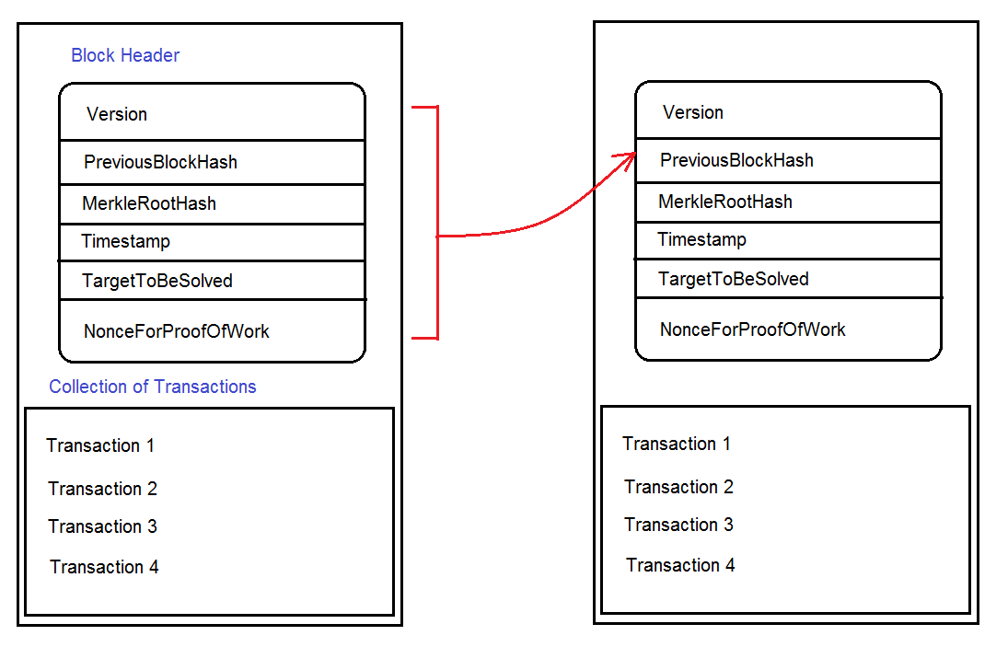
Structure of a block

Slide 26
Forward Chaining

Slide 27
Forward Chaining
Like CBC – Cipher block chaining.
Each block contains hash of previous block, its own data and its own block hash.
Provides a chain of linked blocks.
Any change in any previous block will have a ripple effect.
Protects integrity of the chain.
First block in the chain is called “Genesis” block.
Previous block hash - 0

Slide 28
Merkle Tree

Slide 29
Merkle Tree
Introduced by Ralph Merkle, 1979, “A Certified Digital Signature.”
One hash for an entire list of data.
Used for efficient data verification.
Used in a lot of areas apart from blockchain.
Distributed storage. (Cassandra)
File download (torrent)

Slide 30
Merkle Tree

Slide 31
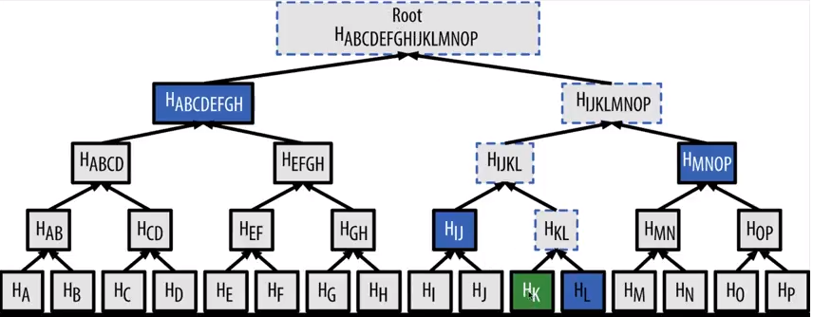
Merkle Tree

Slide 32
Consensus: Proof of Work

Slide 33
Consensus: PoW
There is no single central authority in a blockchain.
The ledger is distributed.
Everyone has a copy of the ledger.
Generally the longest chain is considered correct.
Given a chain, I can pick arbitrary transactions and create new blocks and extend the chain.
Whether my block is correct is determined by voting by others.
One who creates a block is called a “miner”.

Slide 34
Consensus: PoW
Recall we had two fields in the block –
Nonce.
Target to be solved.
Without this there would be easy creation and addition of blocks.
Miners use these two to show that they have put some “effort ” or work to validate the block.
The target contains the challenge e.g. the block hash must start with 16 0’s.

Slide 35
Consensus: PoW
Keeping other contents unchanged, find a Nonce that will produce 16 0’s.
The best way to find this is brute-force.
Once the nonce is found the block is broadcasted.
Verifications is very simple and fast.
Others check this block and add this to chain making it the current last block.
Miners are rewarded for this work that they put in.
This ensures that there are minimal forks.

Slide 36
Consensus using PoW
New transactions are broadcast to all nodes.
Each node collects new transactions into a block.
Each node works on finding a difficult proof-of-work for its block.
When a node finds a proof-of-work, it broadcasts the block to all nodes.
Nodes accept the block only if all transactions in it are valid and not already spent.
Nodes express their acceptance of the block by working on creating the next block in the chain, using the hash of the accepted block as the previous hash.
Nodes always consider the longest chain to be the correct one and will keep working on extending it.

Slide 37
Consensus using PoW

Slide 38
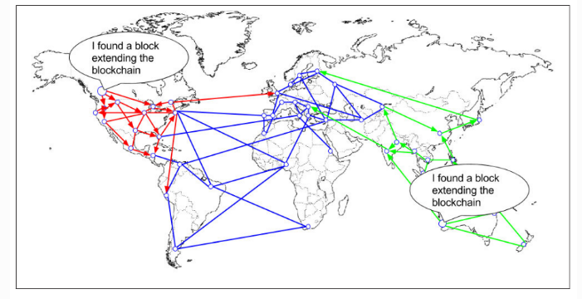
Consensus using PoW

Slide 39
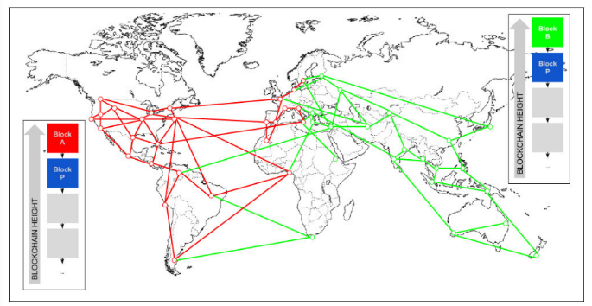
Consensus using PoW

Slide 40
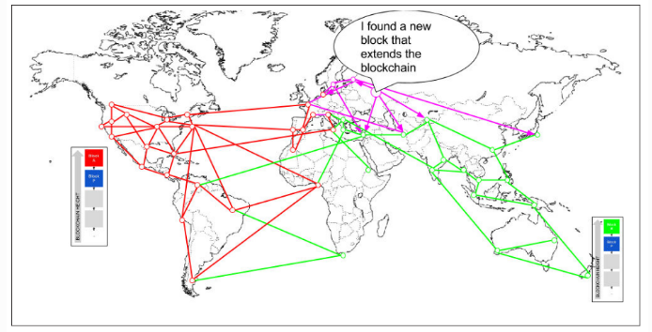
Consensus using PoW

Slide 41
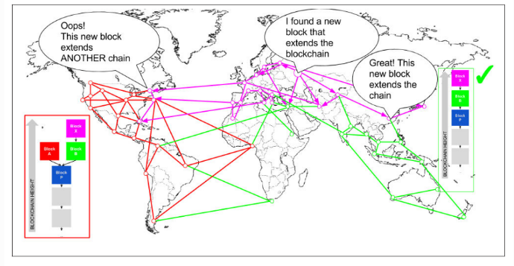
Consensus using PoW

Slide 42
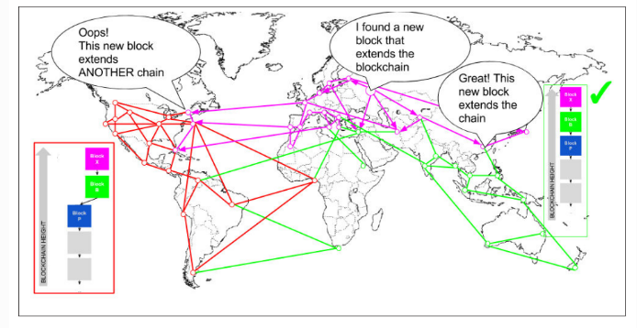
Consensus using PoW

Slide 43
Questions?

