Slide 1
Heavy/Medium Duty Vehicle Hacking
From Myth to Reality
Subhojeet Mukherjee
Colorado State University

Slide 2

So What Type of Vehicles Are We Talking?
Transport goods worth about $53 billion were moved each day in 2015 [BTS].
  Commercially motivated attacks can have severe financial consequences.
Emergency vehicle response time is critical.
  Personally motivated attacks can have life threatening consequences.
Capital equipment bear high asset value.
  Commercially motivated attacks can have severe financial and legal consequences.
Military vehicles are mission critical.
  Politically motivated attacks can have widespread negative consequences.

Slide 3
Scope of Today’s Talk
Not all heavy/medium vehicles are alike
  Internal operations might be similar
  Externally design can vary
    Depends on the purpose of use
Heavy duty vehicles
  Trucks (with or without trailers) and buses are alike.
  Let us focus on them for now.

Slide 4
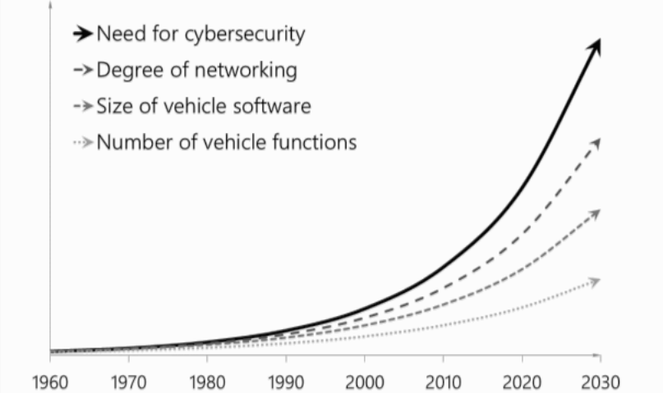
The Rise of the Electronic Vehicle [1]

Slide 5
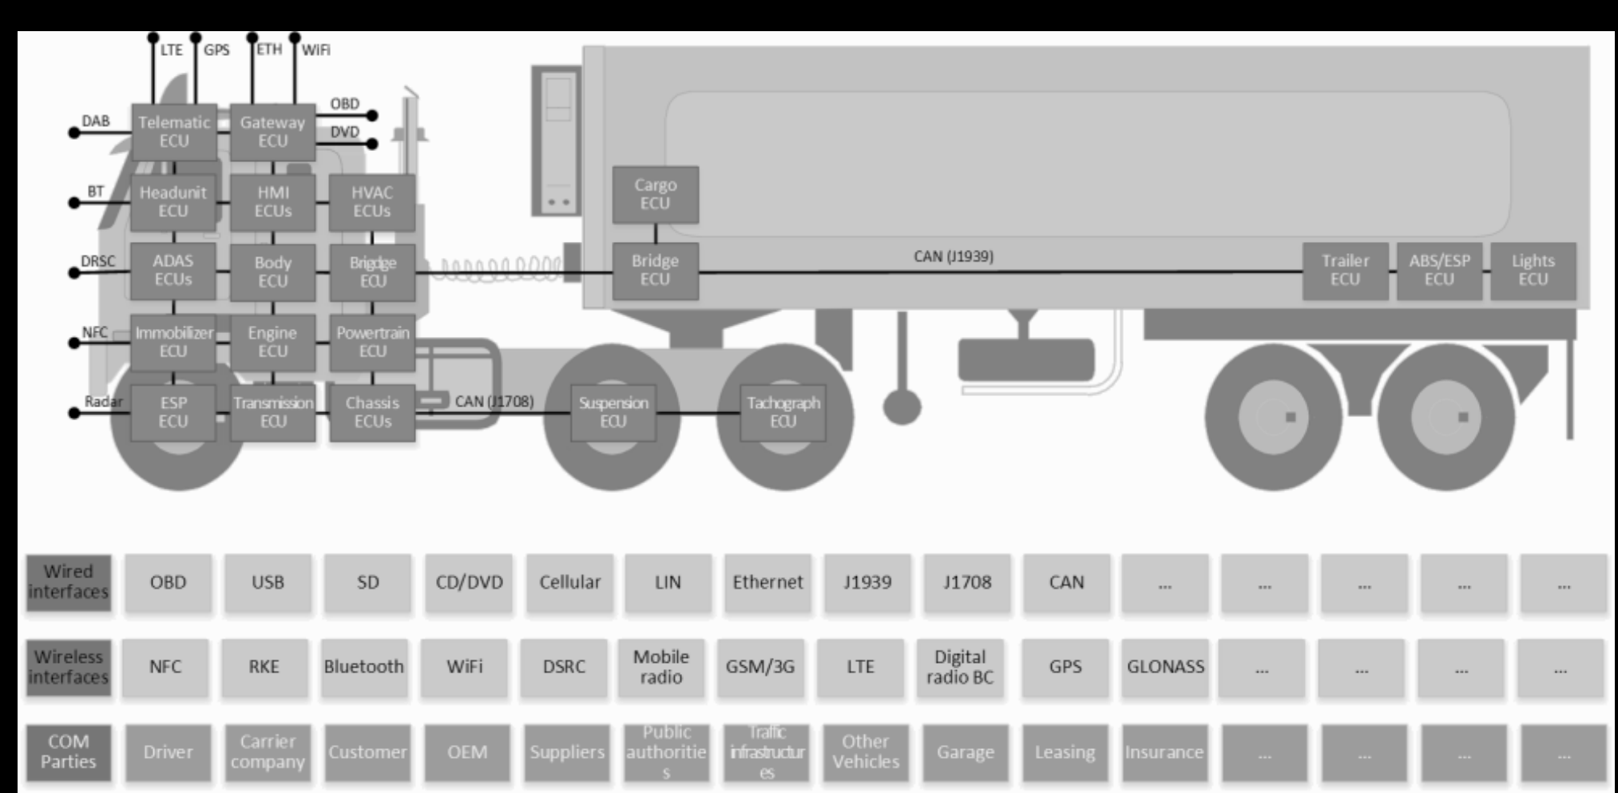

Trucks Nowadays
The Era of Electronic Transportation
Why the electrification?
  Early initiative was emission control
  From then onwards
    Reduced wiring
    Enhanced functionality
    Diagnostics
    Fleet Management
Just some examples of electronic control….
  Entertainment
    Headunit
  Diagnostic and fleet management
    Telematics
  Safety
    Electronic stability program (ESP)
    Advanced driver-assistance system (ADAS)
  Security
    Immobilizer
Image Sources:-
M. Wolf and R. Lambert, “Hacking Trucks - Cybersecurity Risks and Effective Cybersecurity Protection for Heavy Duty Vehicles,” in Automotive - Safety & Security 2017 - Sicherheit und Zuverlässigkeit für automobile Informationstechnik, 2017, pp. 45–60.

Slide 6


Slide 7
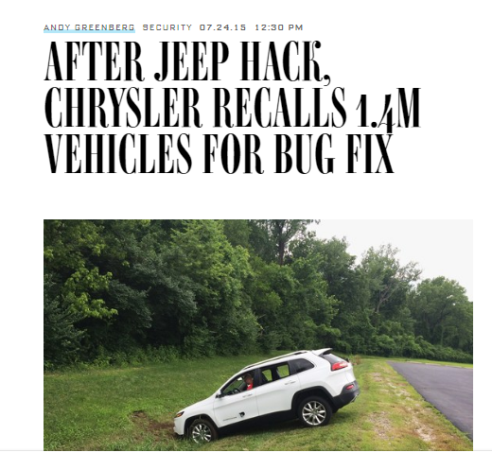
The Good is the Bad and the Ugly
There is a need
  To know
    Operators/Owners -- the truck’s runtime stats
    Drivers -- the directions, emergency situations.
    Garage people -- the fault codes, vital forensics.
  To act
    Owner/Operator manipulating internal operations to control driving and fuel economy
    Automatic control from ESP, ADAS etc.
    Theft prevention by immobilizer.
  For comfort
    Latest songs, news, on internet radio.
The needs are often served/met by remote/local connections to the vehicle bus.
The needs are often served by the same control unit.
Security was not a major concern in making design decisions, until this happened….
  At CAN and J1939 protocol level
  At the ECU design level

Slide 8
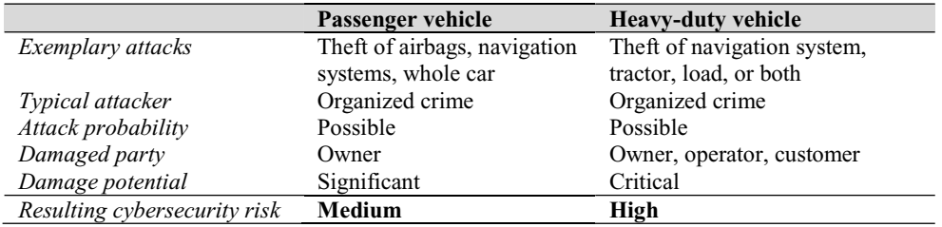
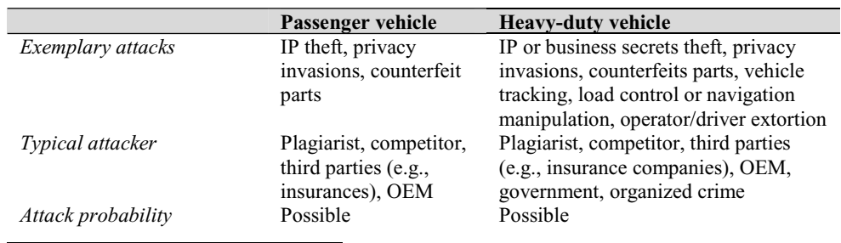
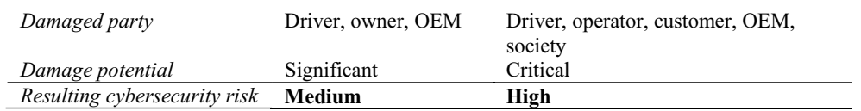
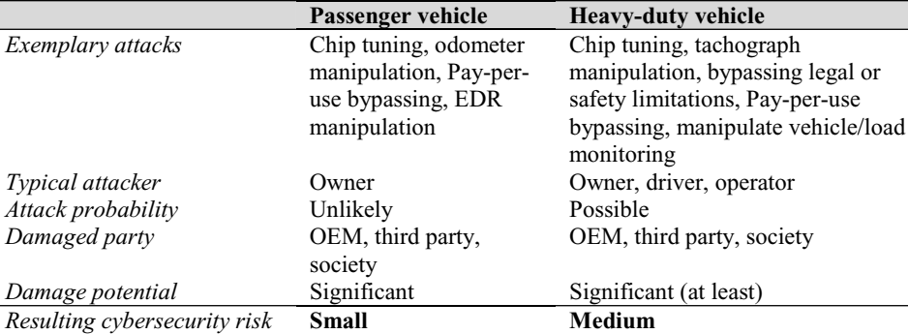
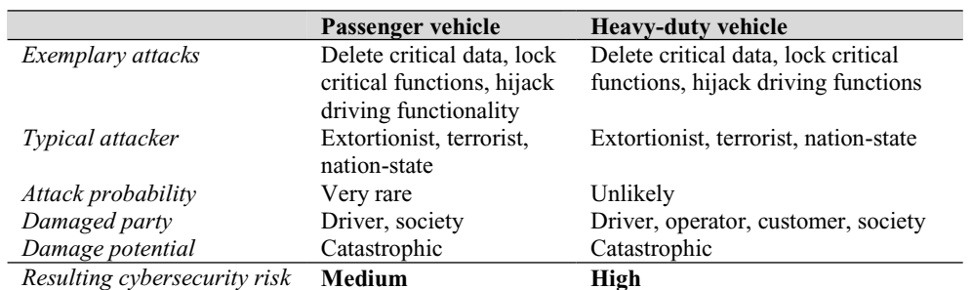
Bad Guys and their Cruel Intentions!! Wolf et al. [1]
Physical Theft
Data Theft
Manipulation
Attacks on Reliability and Safety

Slide 9

OK
SO
Today, I will try to chalk out bottom-up plan for the bad guys to achieve their respective goals.
  Show common attack surfaces between cars and trucks.
  Use an example automotive network that they will break into.
  Perform any intermediary steps.
  Inject necessary messages to achieve the eventual goal.
Although, I am using references, a large bulk of this is part of my research.

Slide 10
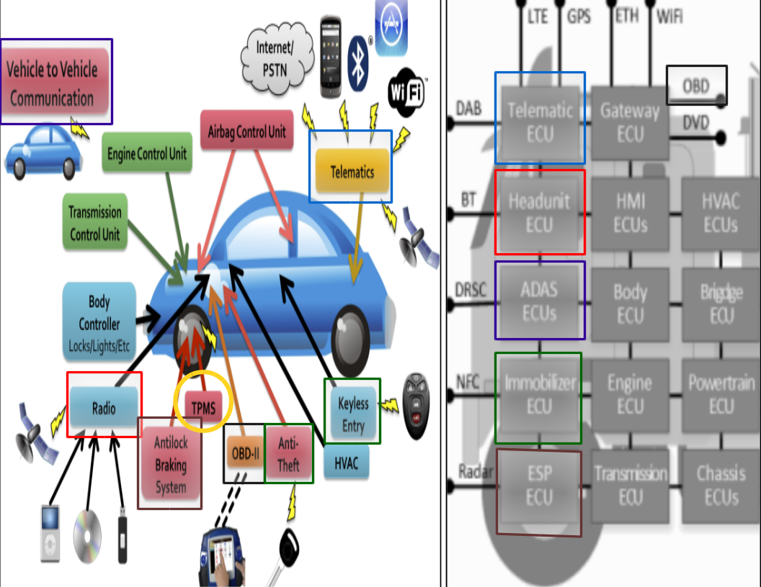
Common Attack Surfaces

Slide 11
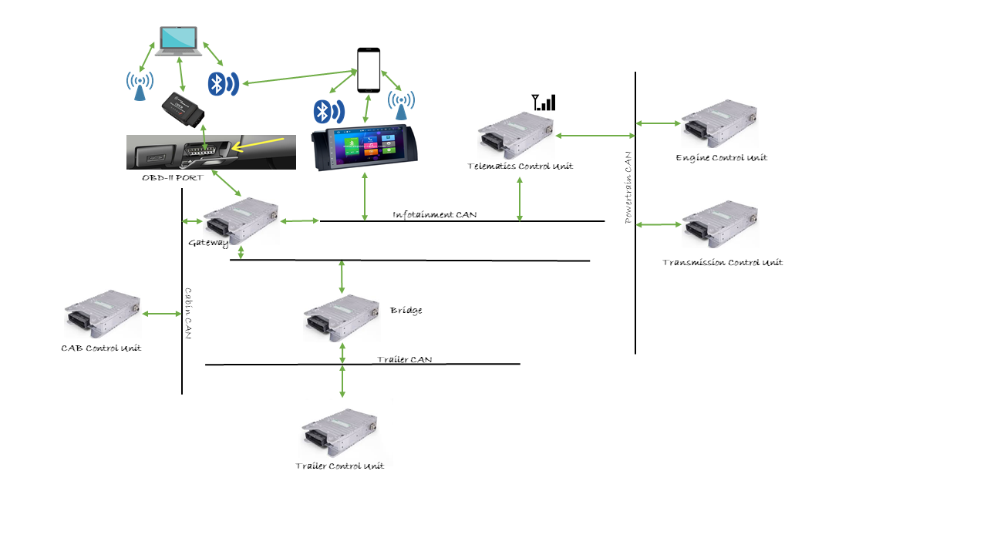
Example Network
(Created from descriptions in [1,2,3])
OBD-II passthrough device
  Connected to the OBD-II port
Service computer
  Can communicate remotely and physically with the passthrough device
Headunit
  Includes a GPS, CD player and Bluetooth for handsfree entertainment
Telematics Control Unit
  For communication with operator/owner
  Uses a cellular network
Engine Control Unit
  Controls driving critical functions
Transmission control unit
  Controls transmission related functions.
CAB Control Unit
  Controls cabin functions like temperature, door control etc.
Trailer Control Unit
  Controls trailer functions like temperature, door control etc.
Bridge
  Sits between networks.
  Filters traffic across networks to control bandwidth utilization.
Gateway
  Same as bridge, except with protocol conversion functionalities.
Image Sources
https://www.amazon.com/BAFX-Products-34t5-Bluetooth-Android/dp/B005NLQAHS
http://www.espony-cargo.com/bmw-e39-car-stereo-head-unit-navigation-system.html
https://www.yourmechanic.com/article/how-to-read-and-understand-check-engine-light-codes-by-jason-unrau
https://www.sensor-technik.de/en/component/stwproducts/?view=category&stwcid=66

Slide 12

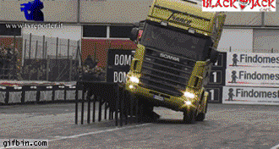


Steps to HACK, from a High Level
(Created from descriptions in [1,5])
Physical Theft
Achieved
Attack on Safety/Reliability Achieved
Target ECU
Attacked
Data theft
Target ECU
Reached
Data theft
Access to the bus through a compromised Surface

Slide 13

Lets dive a bit deeper

Slide 14

Compromise an Attack Surface [2]
Access to the bus through a compromised Surface
Arbitrary code execution
OR
Access to the service computer
Access to the OBD-II port
OR
Weak authentication scheme
Access to the passthrough Device
Access to the Headunit
Access to the Telematics CU
AND
Disabled in-cabin notification features
OR
OR
Compromise the CD/USB module
Access to vehicle call number
Compromise the Bluetooth module
Compromise the wireless hotspot module
Vulnerability in gateway
Compromised smartphone
AND
AND
Vulnerability in wireless
modules
AND
Friends with this guy
OR
Connected
Connected
AND
Vulnerability in Bluetooth
Stack
OR
Compromised smartphone
Weak PIN
Persistent presence
Vulnerability in CD/USB
modules
Presence within 100 m
Presence within 32 m
KRACK!!!

Slide 15
Steps to HACK, from a High Level
(Created from descriptions in [5])
Target ECU
Reached
Data theft
Access to the bus through a compromised Surface

Slide 16
Before we move forward,
Lets Understand SOME
fundamentals of in-vehicle networking

Slide 17
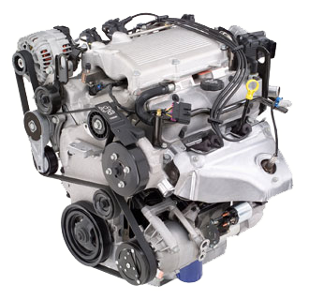
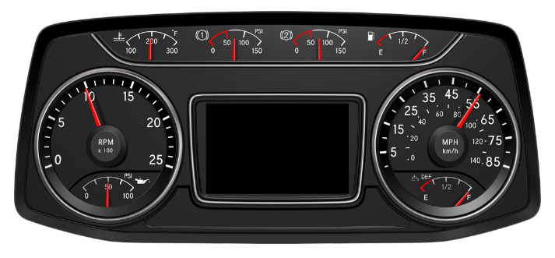
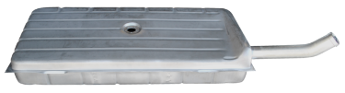

Mechatronics In-Vehicle Communication Technology
Electronic control units (ECU) regulate critical vehicle functions.
Need to communicate with other units.
  Request information.
  Command operations.
  Report parameter status and faults if any.
Sensor readings and possible actions are embedded in messages according to the SAE J1939 standards.
  RPM reading from the crankshaft position sensor.
  Initiate fuel injection.
Transmitted as sequence of bits on the CAN bus
  Bundled into CAN frames.
ECUs receive, interpret and use messages
  RPM displayed on the dash.
  Fuel injection initiated.
Communication model is requirement dependent
  Might vary across manufacturers.
actuators
actuators
sensors
sensors
Engine
Instrument
Cluster
Fuel
System
Thanks guys,
Let me process the messages and display that stuff on the dash.
Here is the current engine speed and other stuff
Here are the current fuel levels
010101010….
010101010….

Slide 18
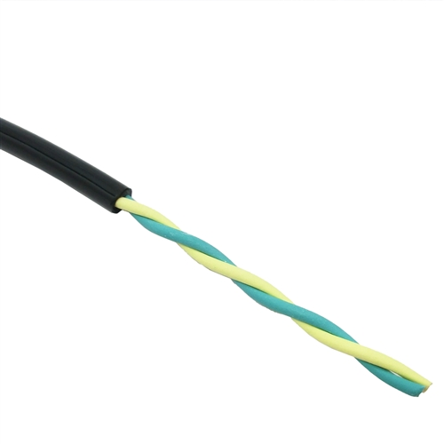
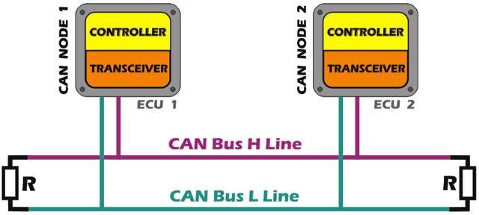
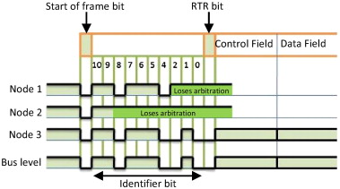
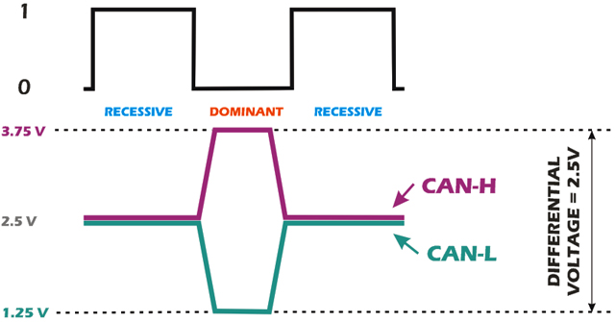
The CAN protocol
Facilitates broadcast communication over a 2-wire multi-master serial bus.
  Shielded wires
    Reduced EMI.
  Twisted wires
    Cancel EMI.
  Terminating resistors
    Maintain recessive level.
    Reduce reflection.
Differential voltage
  Cancel out any residual noise.
  Dominant bit : 0
  Recessive bit: 1
CSMA/CD with message priority-based arbitration
  Nodes transmit when bus is free.
  Arbitration is performed on the Identifier field.
CAN Frame format
  11/29 bit identifier
  0…64 bits of data.
https://www.linkedin.com/pulse/automotive-can-bus-system-explained-kiril-mucevski
http://www.sciencedirect.com/science/article/pii/S0920548915000422

Slide 19


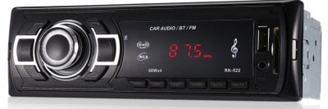
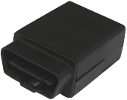
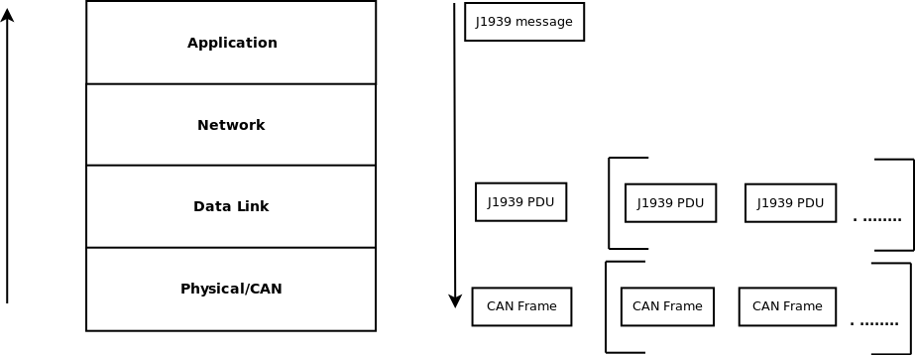
SAE J1939: A Layered Networking Paradigm
Broadcast networks.
  High speed CAN, 250 kbps.
  Readily connectable using bridge/gateway.
    Possible message filtering.
  Nodes/ECUs connected to main or implement networks/sub-networks.
Messages composed and interpreted at the application layer.
  Identifier and data.
Message data can be longer than 64 bits, eg. VIN number.
  Split into ~128 bit J1939 PDU
  CAN frames can only be maximum 128 bit.
  Reliable message delivery.
No message encapsulation
  Modular functionalities invoked when required.
    Eg. Reliable delivery functions at layer 2.
Transmitted as stream of bits at the Physical/CAN layer.
Bridge
Trailer
ECM
TCM
BCM

Slide 20
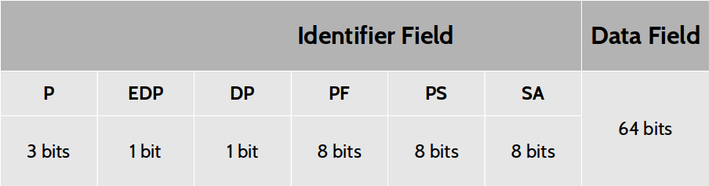
J1939 PDU Interpretation
CAN frame is obtained
    start-of-frame and end-of-frame bits are used
CAN specific bits are removed to obtain a J1939 PDU
PDU has a 29 bit identifier and 64 bits data
Parameter Group Number (PGN) is obtained
  E.g. PGN 64993 “Cab/AC Climate Information”.
Associated Suspect Parameter Numbers (SPNs) are obtained from J1939 Digital Annex
  SPN 2609 “Cab/AC Refrigerant Compressor Outlet Pressure”
  SPN 7853 “Air Conditioner Compressor Status”
SPNs bits extracted using Length and Starting bit position
SPNs interpreted using Resolution and Offset
  SPN 2609 [Cab/AC Refrigerant Compressor Outlet Pressure] -> 01100100₂*16₁₀ + 0₁₀ -> 100*16 -> 1600 kPa.

Slide 21
Lets get
Back to business

Slide 22
Steps to HACK, from a High Level
(Created from descriptions in [5])
Target ECU
Reached
Data theft
Access to the bus through a compromised Surface

Slide 23
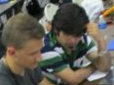
Reach the Target ECU [3]
Target ECU
Reached
OR
AND
Jump Bridge/Gateway
A lot of effort
For the next couple of months
Makeshift
Bridge/Gateway
Access to desired network
AND
OR
Access to bus through a
single-homed ECU
Access to a multi-homed ECU
Re-flashing enabled on multi-homed ECU
ECU
On network
OR
Access to the OBD-II port
Access to the Headunit

Slide 24
Steps to HACK, from a High Level
(Created from descriptions in [5])
Target ECU
Attacked
Data theft
Target ECU
Reached
Data theft
Access to the bus through a compromised Surface

Slide 25
Before we move forward,
Lets Enjoy SOME
real world ATTACKS !!!
on embedded Truck networks

Slide 26
Practical dos attacks on target ecus
Subhojeet Mukherjee, Hossein Shirazi, Indrakshi Ray, Jeremy Daily, and Rose Gamble, “Practical DoS Attacks on Embedded Networks in Commercial Vehicles,” in Proceedings of the 12th International Conference on Information Systems Security, 2016, pp. 23–42.

Slide 27
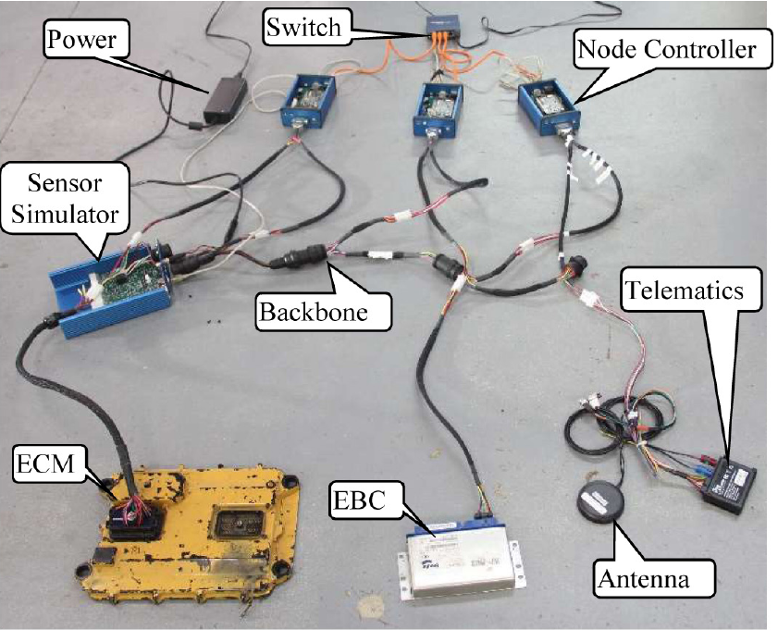
Experiment set-up: A Remote testbed Truck in a box
A remotely accessible testbed for conducting heavy vehicle research.
  Sandboxed experiments.
Nodes connected to the network
  Engine control module
    Engine and retarder controller.
  Brake controller
  Telematics unit
  Beaglebone node controllers.
    Remote access.
    Allows access to CAN bus.

Slide 28
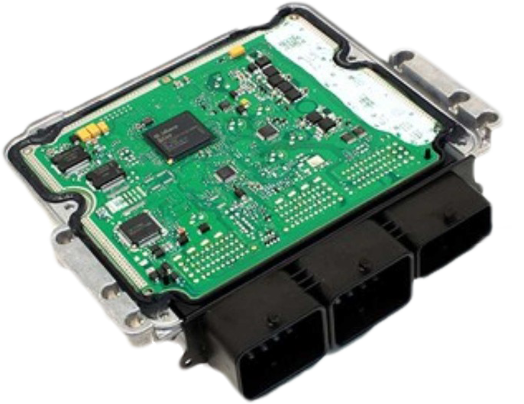
Some background Multi-packet request transfer protocol
Label | PGN | 1 | 2 | 3 | 4 | 5 | 6 | 7 | 8
Request | EA00 | Requested PGN in reverse byte order
RTS | EC00 | 10 | Total num bytes |  | Total num packets | Max num packets to be sent in response to one CTS | Requested PGN in reverse byte order
CTS | EC00 | 11 | Num packets | Next seq number | FF | FF | Requested PGN in reverse byte order
Data | EB00 | seq | Data
Request
RTS
CTS
Data
End of Message

Slide 29
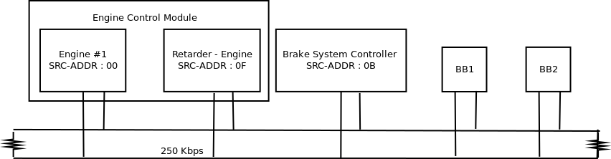
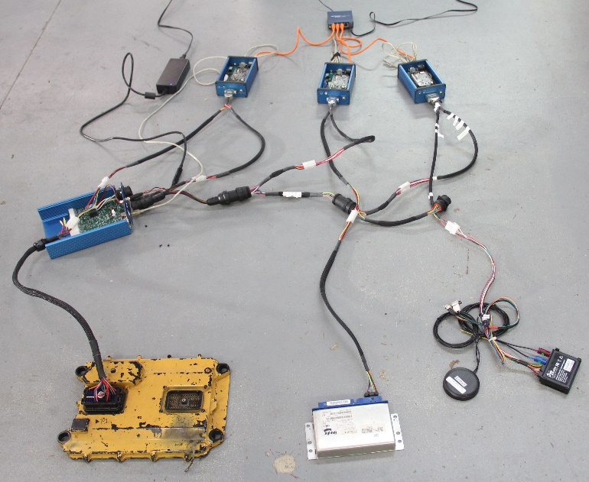
Experiment testbed
ID | P | Count | ID | P | Count
0CF00400 | High | 500 | 18FEEF00 | Low | 20
18FEDF00 | Low | 500 | 18FEF600 | Low | 20
0CF00300 | High | 200 | 18ECFF00 | Low | 12
18EBFF00 | Low | 130 | 18E0FF00 | Low | 10
18F0000F | Low | 100 | 18FD7C00 | Low | 10
18F00100 | Low | 100 | 18FEBD00 | Low | 10
18FEBF0B | Low | 100 | 18FEC100 | Low | 10
18FEE000 | Low | 100 | 18FEE400 | Low | 10
18FEF000 | Low | 100 | 18FEEE00 | Low | 10
18FEF100 | Low | 100 | 18FEF500 | Low | 10
18FEF200 | Low | 100 | 18FEF700 | Low | 10
18F0010B | Low | 99 | 18EBFF0F | Low | 6
18FDB300 | Low | 20 | 18ECFF0F | Low | 2
18FDB400 | Low | 20 | 18FEFF00 | Low | 1
Remotely accessible testbed
J1939 speaking Engine Control Module and Brake Controller.
High speed (250 kbps) CAN bus with terminating 120 ohm resistors.
2 Beagle Bone Black devices running 32 bit Ubuntu@Linux operating systems running on an ARM rev 2 v7l@1000MHz processor with 500 MB of RAM.
14-15% bus load.
Daily, Jeremy, et al. "Towards a Cyber Assurance Testbed for Heavy Vehicle Electronic Controls." SAE International Journal of Commercial Vehicles9.2016-01-8142 (2016).

Slide 30

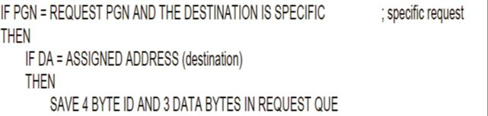
Request Overload – Attack Scenario @CSUSource
Issue
  When ECUs follow the above mentioned algorithm, they de-queue items and process requests.
  Multi-packet requests have a higher processing requirement.
Attack
  Destination specific multi-packet request messages are sent at a rapid interval.
Impact
  Periodic message volume decreases significantly
  Failure to respond to legitimate requests
Request
Response
Cannot Respond
Periodic Messages

Slide 31
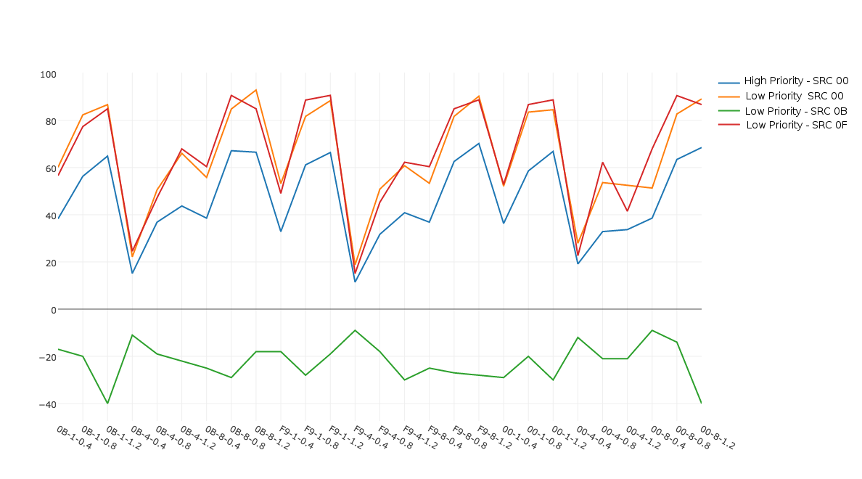
Request overload Results
Experiment independent Factors
  number of concurrent thread [1,4,8]
  injection time interval in ms [.4, .8, 1.2]
  source address [00, 0B, F9]
High Priority messages
  Average drop: 46%
Low Priority Messages
  Average drop: 65 %
Pearson correlation coeff.
  Source: -0.01
  Thread: 0.137
  Interval: 0.66
Two-tailed Mann-Whitney U test
  p-value of 0.01468 (<= .5)
  5% confidence interval
8,1.2,F9
4,.4,F9

Slide 32
False Rts – The Warning
Theory
  Message size is piggybacked on the RTS message.
  RTS retransmission shall be acted upon.
  Sender is not notified.
Attack
  Listen for an RTS
  Send a spoofed RTS with reduced number of bytes or packets.
Impact
  Crash [Buffer Overflow]
Request
21
RTS Tot-bytes = 28
Allocate
5
RTS Tot-bytes = 21
Reallocate
CTS
Data
CRASH !!

Slide 33
Connection exhaustion
00
0B
11
Theory
  Only 255 possible nodes.
  Each pair of ECUs can have at most one connection at any given time.
  Keep connections open by sending CTS messages within a specified time period
Attack
  Scan the network for all available source addresses.
    A max of 255.
  Create connections by spoofing all source addresses.
  Keep the connections alive.
Impact
  Legitimate connection attempts are rejected.
Conn 0B
Conn 0F
No Response
Keep Alive

Slide 34
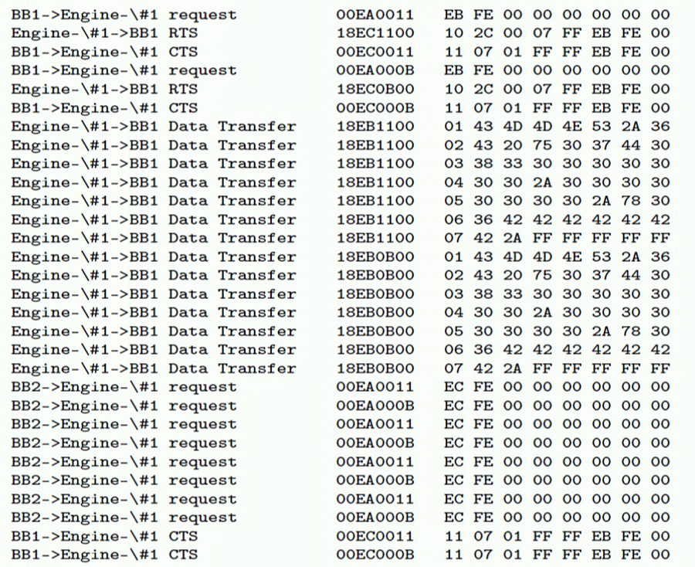
Connection exhaustion Trace
Connection Initiate: SRC 11
Connection Initiate: SRC 0B
Data Transfer
Legitimate conn requests
No response
Keep Alive CTS

Slide 35
Making the ecus do bad things
Y. Burakova, B. Hass, L. Millar, and A. Weimerskirch, “Truck Hacking: An Experimental Analysis of the SAE J1939 Standard,” in Proceedings of the 10th USENIX Workshop on Offensive Technologies (WOOT 16), Austin, Texas, USA, 2016, pp. 211–220.

Slide 36
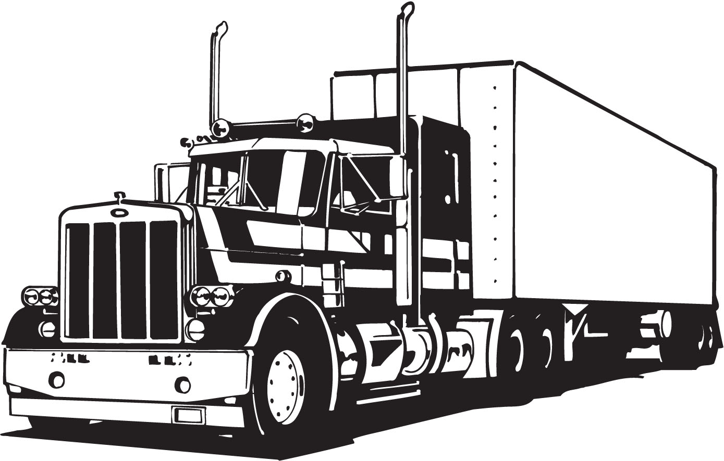

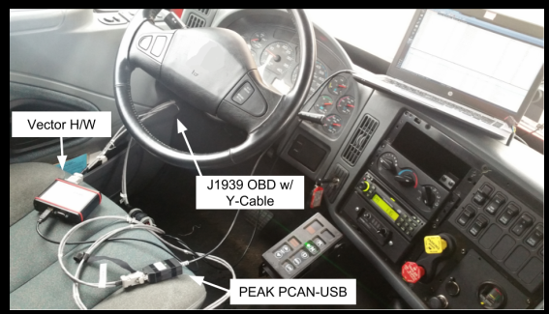
Experiment Set up

Slide 37
Attacks in a Nutshell
PGN | Pre-Conditions | Payload | Impact | Severity
0xFEEE | Ignition ON | Arbitrary value | Set Oil & Coolant Temperature Gauges | Low
0xFEEF | Ignition ON | Arbitrary value | Set Oil Pressure Gauge | Low
0xFEAE | Ignition ON | Arbitrary value | Set Service Brake Pressure Gauge | Moderate
0xFEF1 | Ignition ON | Arbitrary value | Set Speedometer Gauge | Low
0xF004 | Ignition ON | Arbitrary value | Set RPM Gauge | --
0xFEF7 | Ignition ON | Arbitrary value | Set Battery Gauge | --
0xFEFC | Ignition ON | Arbitrary value | Set Fuel Level Gauge | --
0x0 | Fuzzing, speed control-mode, pause before engine controller timeout, forward motion | High RPM | Increase Engine RPM, sudden acceleration | High
0x0 | Active acceleration | Low torque | Decrease Engine RPM, idle engine, no further acceleration | High
0x0 | Speed below 30 mph, actively decelerating | 0% torque | Disable Engine Brake | High

Slide 38
Lets get
Back to business

Slide 39
Steps to HACK, from a High Level
(Created from descriptions in [5])
Target ECU
Attacked
Data theft
Target ECU
Reached
Data theft
Access to the bus through a compromised Surface

Slide 40
The Big Bang!! [4,6,7]
Physical Theft
Achieved
Attack on Safety/Reliability Achieved
False RTS and Request Overload are attacks that I introduced in 2016 [6], and turned out to be successful at the US TARDEC event in Michigan last year.
  In False RTS
    We kill the engine ECU by making it respond to a flurry of request messages.
  In Request Overload
    We attempt to crash the engine ECU firmware with a buffer-overflow attack, only theoretical though.
Ramping up RPM and disabling engine braking were demonstrated by the group at Umich [7].
AND
OR
Unlock door
Crash Engine ECU
Request overload
OR
Sudden ramped up RPM
Sudden disabled engine braking
AND
AND
Verified
Low vehicle speed
AND
AND
CAB ECU controls doors
CAB ECU responds
False RTS
0% torque commanded
OR
AND
Heap-buffer overflow
Door unlock commanded
Engine ECU responds
High RPM commanded
OR
Previous knowledge
Fuzzing
Target ECU
Reachable

Slide 41
Steps to HACK, from a High Level
(Created from descriptions in [5])
Physical Theft
Achieved
Attack on Safety/Reliability Achieved
Target ECU
Controlled
Data theft
Target ECU
Reached
Data theft
Access to the bus through a compromised Surface

Slide 42


Slide 43
References….
Wolf, Marko, and Robert Lambert. “Hacking Trucks - Cybersecurity Risks and Effective Cybersecurity Protection for Heavy Duty Vehicles.” In Automotive - Safety & Security 2017 - Sicherheit Und Zuverlässigkeit Für Automobile Informationstechnik, 45–60. Gesellschaft für Informatik, Bonn, 2017.
Checkoway, Stephen, Damon McCoy, Brian Kantor, Danny Anderson, Hovav Shacham, Stefan Savage, Karl Koscher, et al. “Comprehensive Experimental Analyses of Automotive Attack Surfaces.” In USENIX Security Symposium. San Francisco, 2011.
Koscher, Karl, Alexei Czeskis, Franziska Roesner, Shwetak Patel, Tadayoshi Kohno, Stephen Checkoway, Damon McCoy, et al. “Experimental Security Analysis of a Modern Automobile.” In Proceedings of the 2010 IEEE Symposium on Security and Privacy, 447–62. Oakland, CA, USA: IEEE, 2010.
K.-T. Cho, Y. Kim, and K. G. Shin, “Who Killed My Parked Car?,” arXiv:1801.07741 [cs], Jan. 2018.
C. Miller and C. Valasek, “A survey of remote automotive attack surfaces,” black hat USA, 2014.
Subhojeet Mukherjee, Hossein Shirazi, Indrakshi Ray, Jeremy Daily, and Rose Gamble. “Practical DoS Attacks on Embedded Networks in Commercial Vehicles.” In Proceedings of the 12th International Conference on Information Systems Security, 23–42. Lecture Notes in Computer Science. Springer International Publishing, 2016.
Burakova, Yelizaveta, Bill Hass, Leif Millar, and André Weimerskirch. “Truck Hacking: An Experimental Analysis of the SAE J1939 Standard.” In Proceedings of the 10th USENIX Workshop on Offensive Technologies (WOOT 16), 211–20. Austin, Texas, USA: USENIX Association, 2016.

