Slide 1
jQuery
*
* Course logo spider web photograph from Morguefile openstock photograph by Gabor Karpati, Hungary.

Slide 2
Why jQuery
Some aspects of JavaScript grow tiresome to us programmers.
For starters ….
Querying the DOM for objects
Connecting events to call backs
Applying functions to collections
Asynchronous client-server interaction

Slide 3
What is jQuery?
Too big a question for one slide, but
In practice it acts much like a language extension
But not strictly a good characterization
Hence, first step is to connect …
A new syntax to …
A new set of behaviors

Slide 4
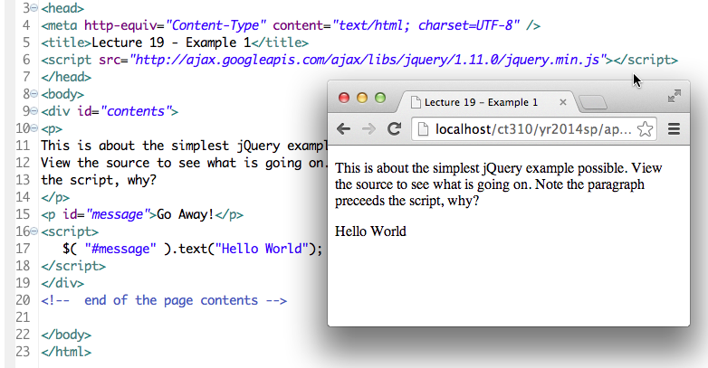
Starting by Example
Hello World in jQuery (2014)

Slide 5
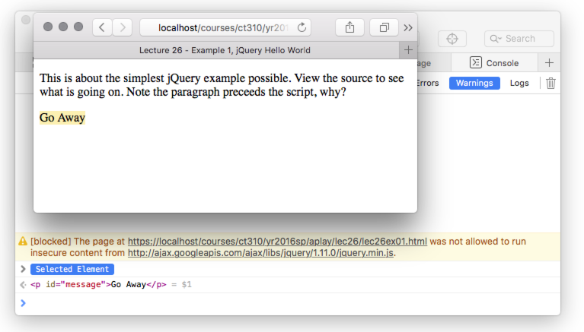
But Wait - 2016
Even before we touch jQuery, we need to talk briefly about http and https.

Slide 6
Getting Adjusted to SSL
There are 3 URL forms in this context.
Start with http:// - this failed!
Start with https:// - this will work
Start with // - this is non committal
Which is best? (think about it …)
For example01 they are:

Slide 7
Back to jQuery - Selectors
Here is way to think about syntax
$ ( selector ) . action
Think of selector as DOM query.
Large set of actions/methods defined.

Slide 8
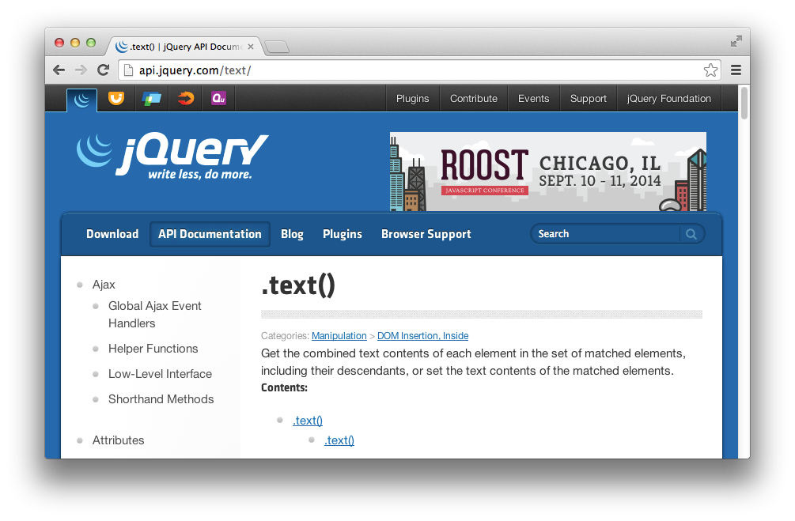
The text method

Slide 9
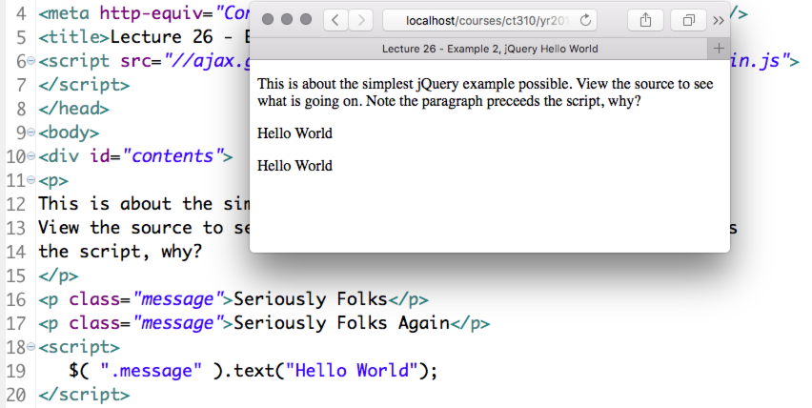
Already Powerful – A Twofer
Pay attention to the fine print on text, it can operate on sets.

Slide 10
Detail – Dollars = Conflict
The concise syntax has many virtues
But, sometimes library conflicts arise over ‘$’ and so, use ‘jQuery’ instead.
This also is helpful in terms of understanding.
jQuery is a library and it defines a single very powerful function ‘jQuery’.

Slide 11
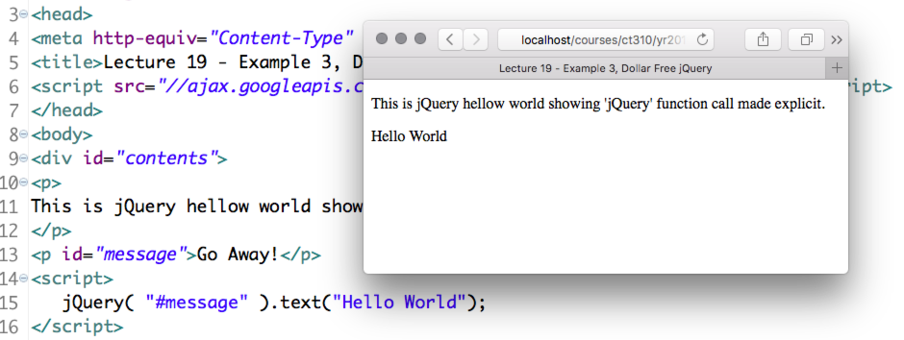
Dollar Free jQuery
For compatibility with other libraries that may want prior claim on ‘$’

Slide 12
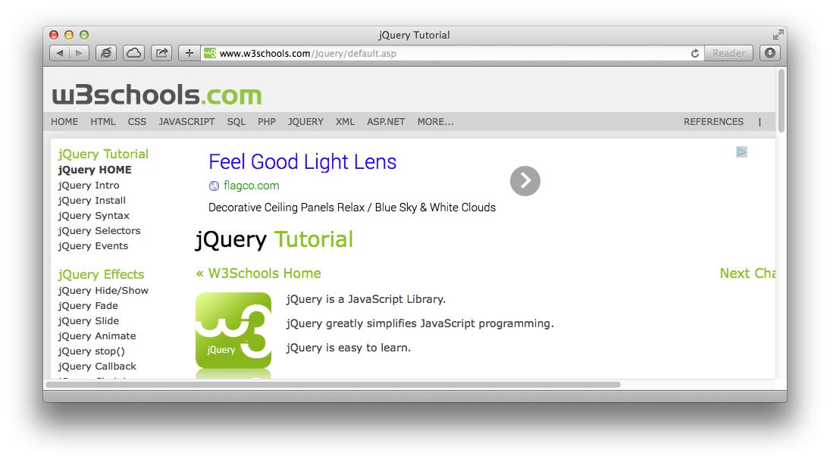
Credit Where Credit …
w3schools jQuery tutorial is good.

Slide 13
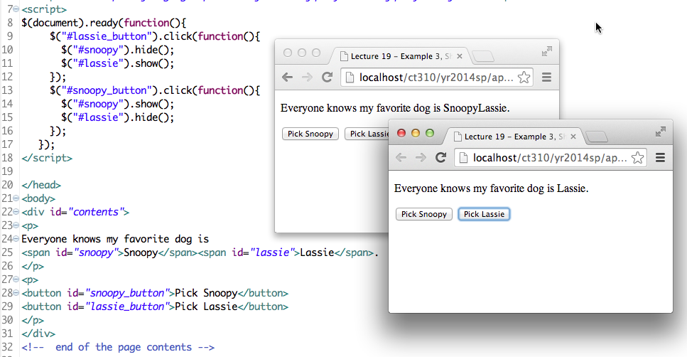
Hide, Show & Buttons
Pay attention to ready function.

