Slide 1
JavaScript
*
* Slide background spider web photograph from Morguefile openstock photograph by Gabor Karpati, Hungary.

Slide 2
Client-side Dynamic HTML
Definition by behavior
HTML Document Changes Client-Side.
In response to user.
Automatically, for example animation.
Definition by example – Mix
Client side scripting, e.g. JavaScript
Page elements are object, e.g. DOM
Properties of objects, e.g. CSS

Slide 3
Document Object Model
There is a lot going one here!
Appropriate for this course:
Common elements on a page,
Including the page itself,
Are objects to which actions may be attached.

Slide 4
JavaScript – Look Hither
Do not confuse Java and JavaScript.
Learning JavaScript. Where to start.
Learn by example:
Textbook
The web
We will not be going too deep.
Mind security/convenience tradeoff.

Slide 6
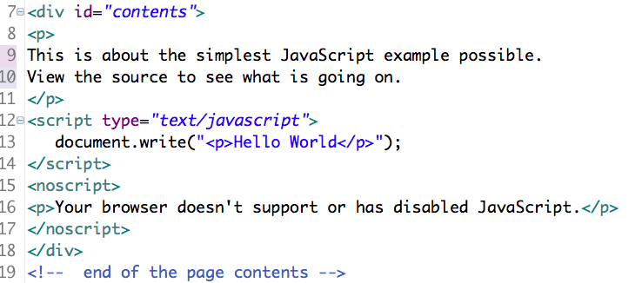
Hello World
You may write to the document.

Slide 7
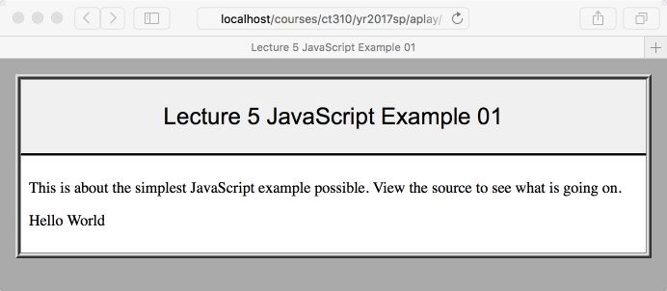
Hello World Page

Slide 8
Example 1 - Observations
The script tag has ‘type’ attribute.
Language attribute is depricated.
Note the use of <noscript> tags.
Arguably less important now, but …
No accounting for older browsers.
First taste of document object model.
The document object has method ‘write’.

Slide 9
Example 2
Using CSS id’s to name objects.
Accessing properties of objects.
Assignment to variables.
String concatenation.

Slide 10
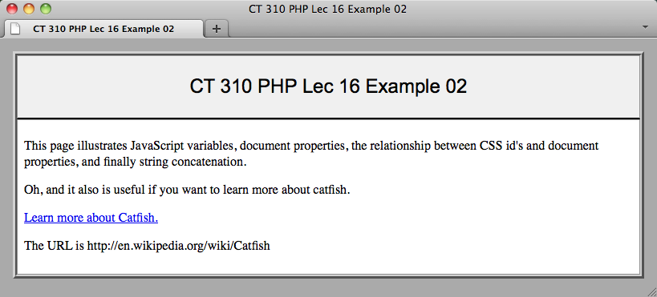
Example 2 – The Page
The printed URL is pulled from link.

Slide 11
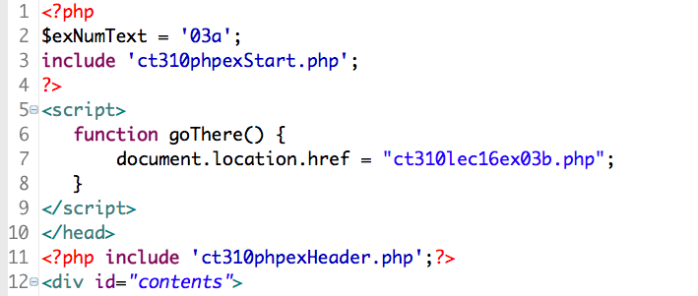
Example 3 – Functions
Usually in header or separate file.
Definition syntax pretty standard.

Slide 12
First Taste of Power
What is document.location.href ?
It is the URL of the current window.
It can be used to retrieve a URL.
In our example it is on the left side of an assignment statement.
… think about this …
That is enough to switch the page!
Fun, but not generally a good idea.

Slide 13
Example 3 - Events
JavaScript is about exploiting events.
Many events involve the mouse.
For example, a click (up or down).
Or, simply passing over an object.

Slide 14
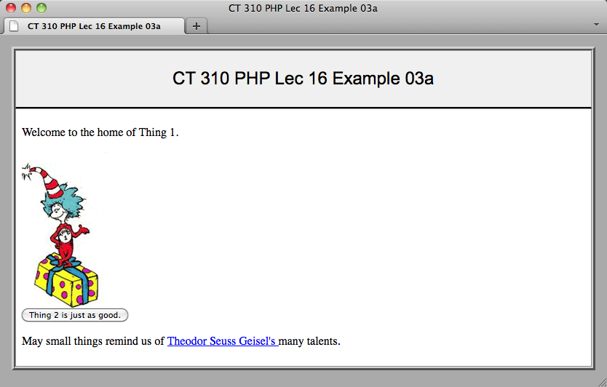
Example 3 – The Page

Slide 15
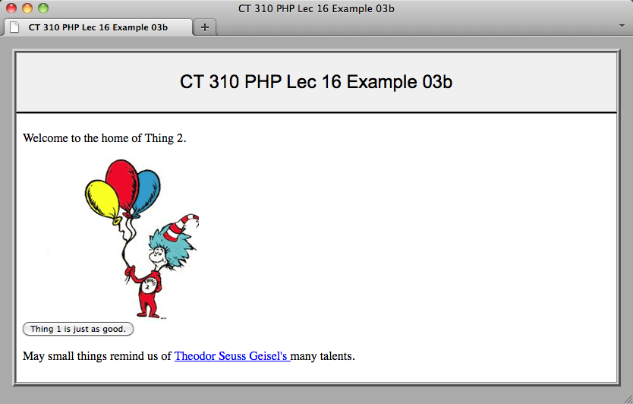
Example 3 – The Page

Slide 16
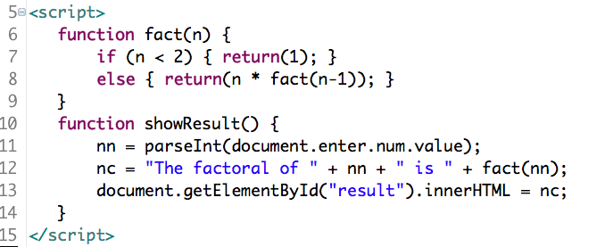
Example 4 – More Functions
Conditionals, recursion and return.
Get in touch with ‘innerHTML’ ☺

Slide 17
Example 4 – Make it Go
What makes this page do something?
Think about object’s ‘enter’ and ‘num’.
Assignment to ‘innerHTML’ is powerful.
Caution
Try ‘return’ vs. ‘tab’ key

Slide 18
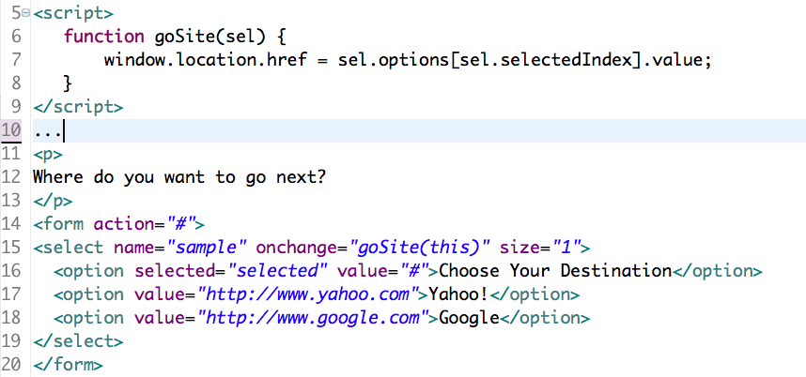
Example 5 – Navigation
Notice how the URL passes to goSite().

Slide 19
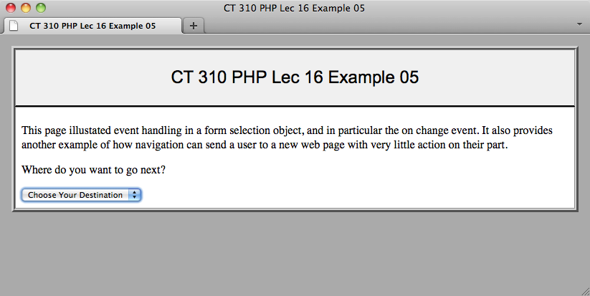
Example 5 – The Page

Slide 20
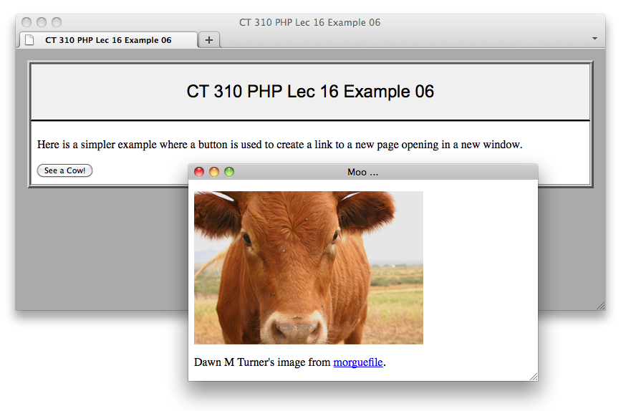
Example 6 - Buttons

Slide 21
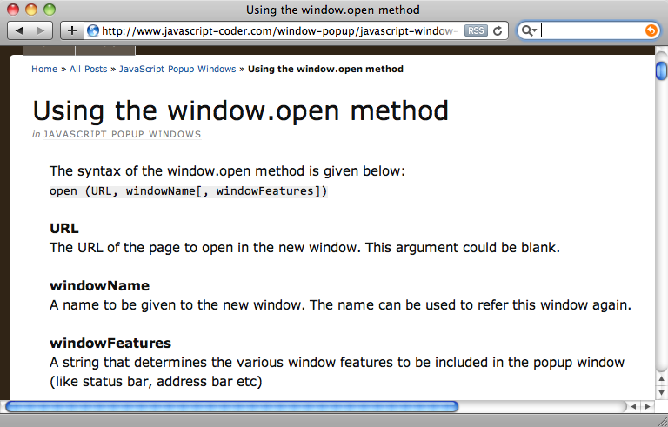
Example 6 – Window.open

Slide 22
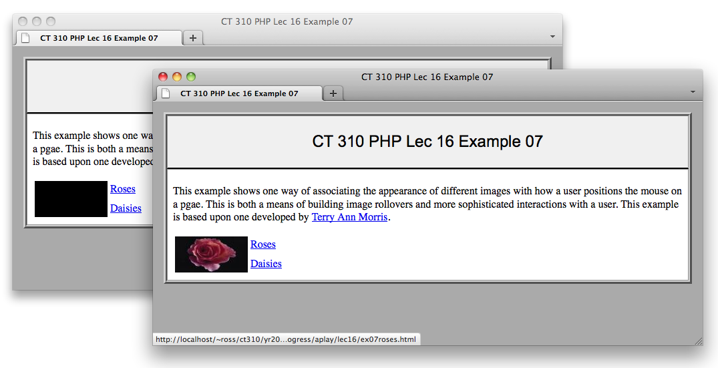
Example 7 – Rollover
Change the image based upon mouse.

Slide 23
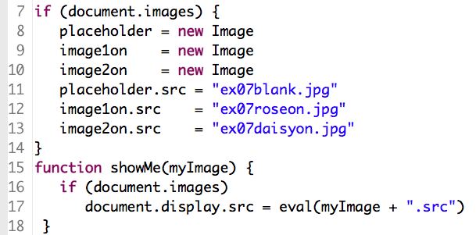
Example 7 - Header
Note the variables and image objects.

Slide 24
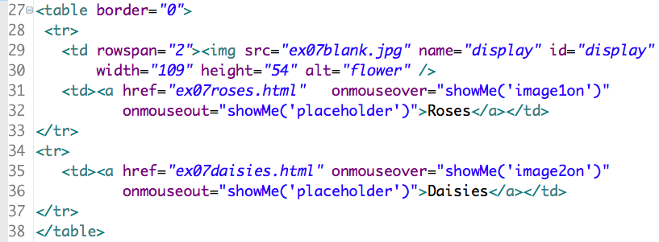
Example 7 – The Table
Note that ‘display’ is the name of an image object on the page.
Two types of mouse events.

