Slide 1
Lecture 15
*
Authentication Stepped Up
Persistent User Data
Protected Content.
* Course logo spider web photograph from Morguefile openstock photograph by Gabor Karpati, Hungary.

Slide 2
First - Update on Hashing
Previous Lecture covered
md5 using explicit salt
There is a better way
The password hash and verify pair.
Also, in this lecture
A step toward databases
Object information in spreadsheets
Users in comma-separated-value files

Slide 3
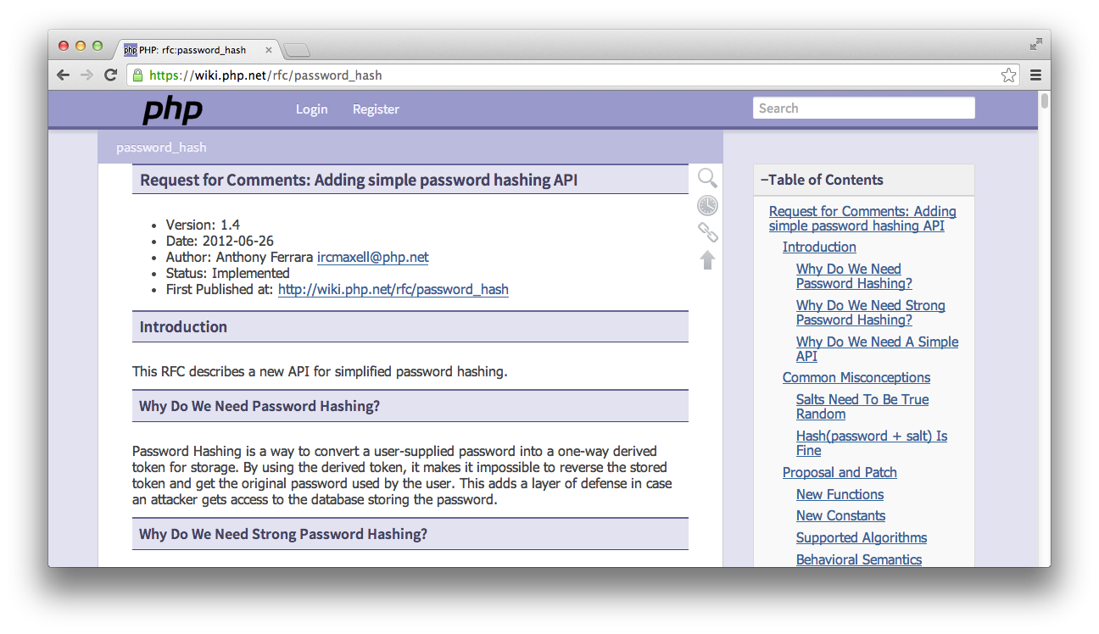
A Better Way
md5 is getting tired
Today – password_hash()

Slide 4
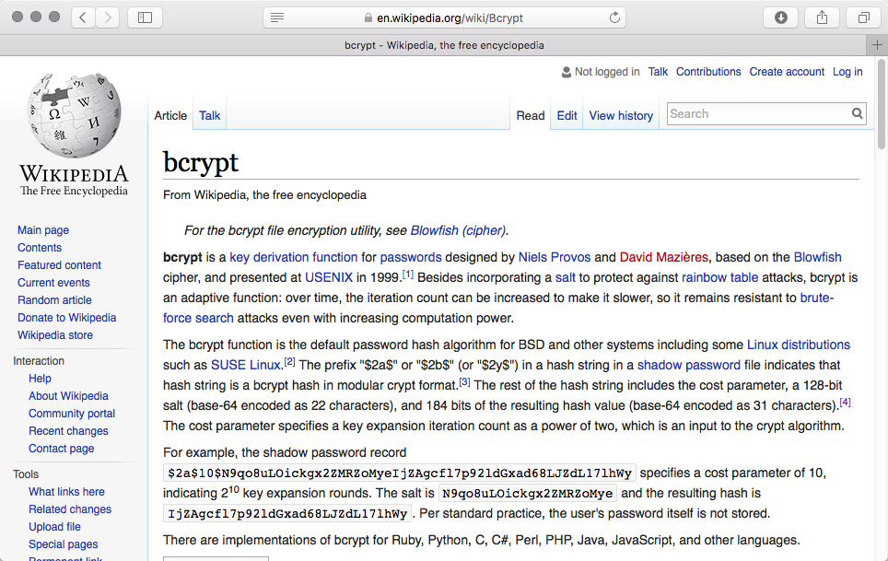
Blowfish Hashing

Slide 5
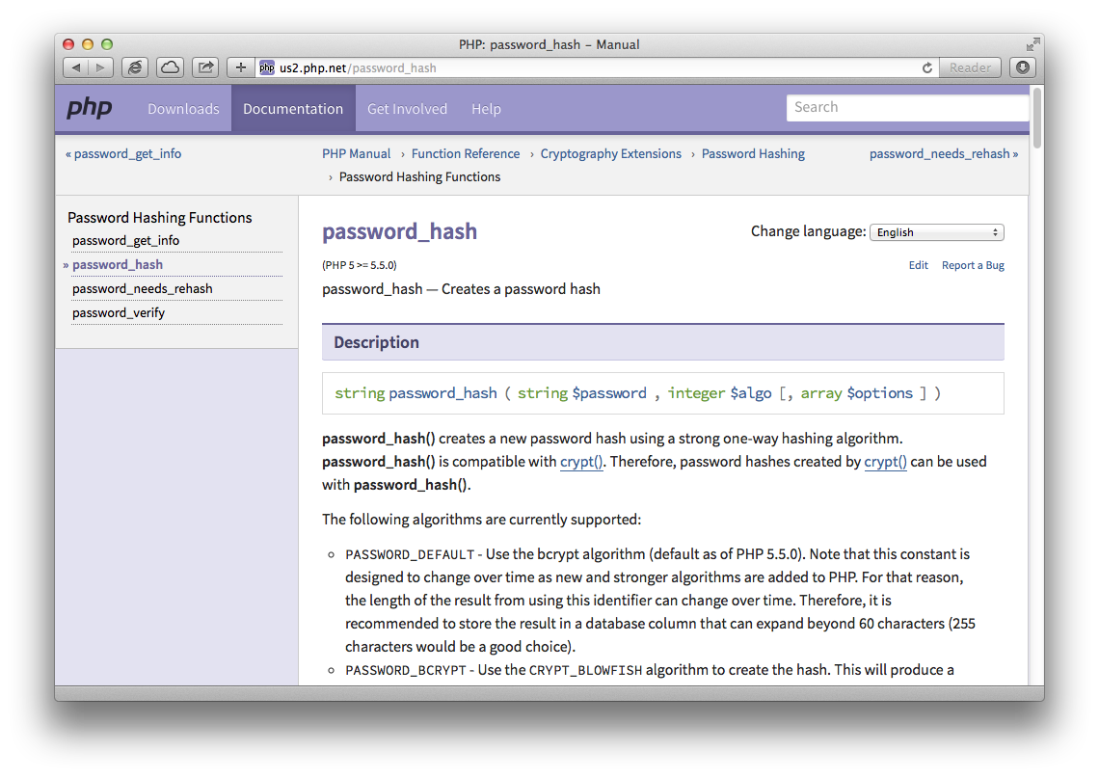

Slide 6
Back to Authentication
Where to store information?
Up until now - hard coded info.
This lecture we want info on disk.
But how?
Separate database server (not yet)
Lightweight database system (not yet)
In a plain file (yes!)
But how to format the file?

Slide 7
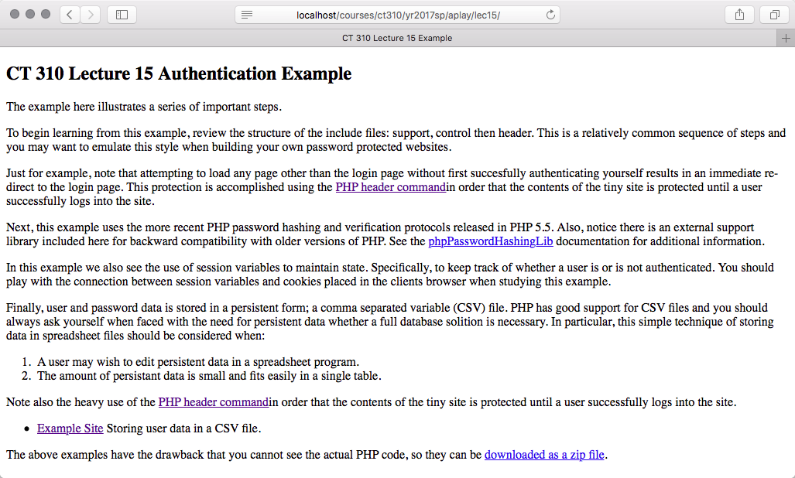
Again – Learn by Example

Slide 8
Example 02: Learn
Use of bcrypt in PHP
Paired functions hash and verify
Persistent store of user data (CSV)
KISS principal sometimes applies.
Protected pages, password control
Protection through redirects
The header command

Slide 9
Example 02: File Overview
admin.php: when logged in, see hash of alternative passwords.
control.php: always include, redirects to login unless login established.
footer.php: common page footer with links.
header.php: common header with title.
index.php: represents protected site content.
login.php: implement password login with redirect when successful.
logout.php: destroy session, redirect to login.
support.php: function library, mostly to support creation, reading, and writing of users file.
users.csv: list of site users and hashed passwords.

Slide 10
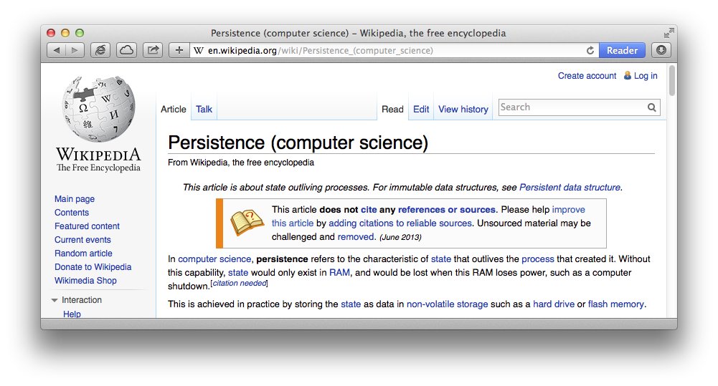
Overview - Persistence
Issue: Data Persistence

Slide 11
Two Faces
RAM
Store user information as an array of User Object Instances
Disk
Store user information as a comma separated variable spreadsheet
writeUsers()
readUsers()

Slide 12
Define a User
Take note that if no user.csv file exists then a new default file is created.
This bootstraps the system and avoids the problem of formatting a file from scratch.

Slide 13
Step Away from PowerPoint
Please study this example carefully!
There is a lot to notice
Try deleting the users.csv file
Pay attention to redirects!
Study password hashing and verification
Ask yourself:
Why no web interface to set password?

