Slide 1
PHP Sessions
Persisting Data in a Stateless Environment

Slide 2
First…
Any exam questions?
Any project questions?
Any Assignment questions?
Any quiz questions?
Any other questions?

Slide 3
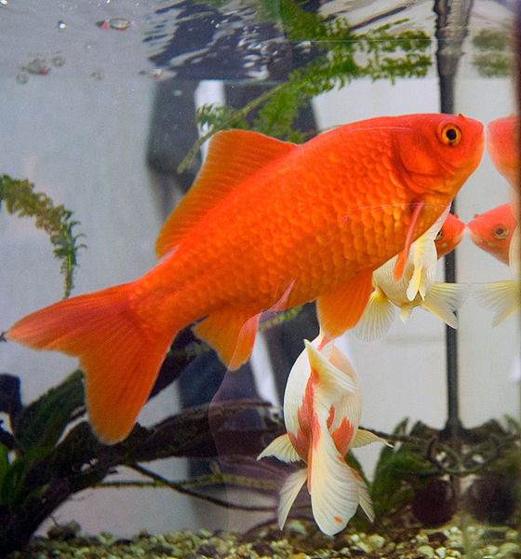
HTTP is stateless

Slide 4
HTTP is stateless

Slide 5
Each request is like talking to someone for the first time
Except they don’t remember you the next time…
Or the next…
Or the next…
Or the next…
Or the next…
Or the next…
Or the next…
Or the next…
Or the next…
Or the next…you get the point.

Slide 6
So, we artificially built in state…
Authentication isn’t the issue
The issue is having to re-authenticate EVERY TIME

Slide 7
To do that, we need the browser’s help
So what do we do? Bribe the browser!

Slide 8
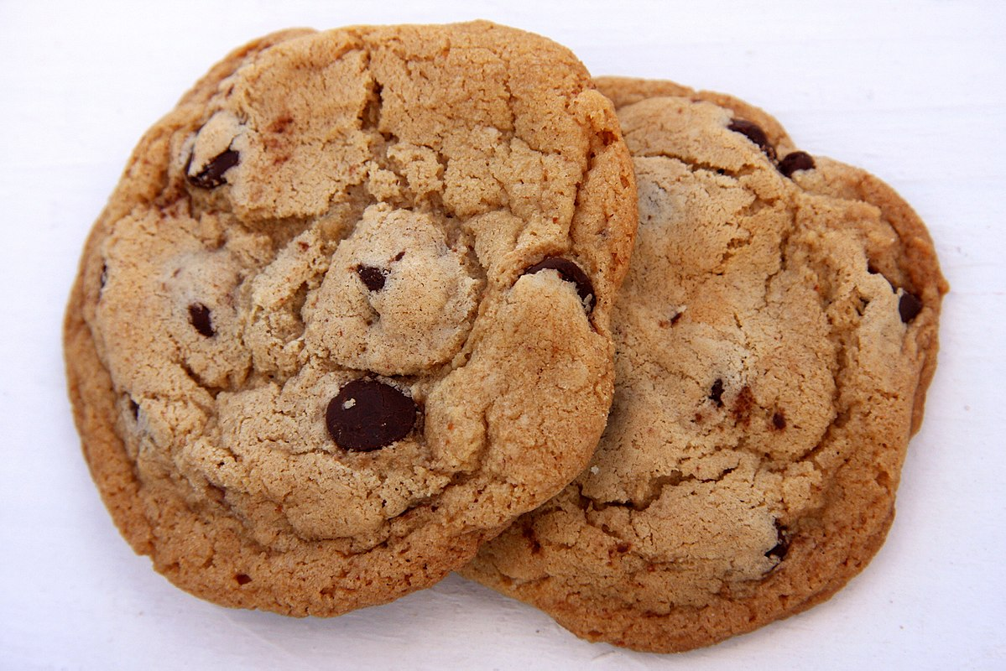
With cookies!
This presentation uses cookies. You don’t have to eat one…
Learn More

Slide 9
In all seriousness…
A cookie is a text entry
<= 4kB
Generally only stores an ID

Slide 10
Where do cookies come from?
The server sends the cookie with the HTTP response headers
Can also be set with Javascript
The client doesn’t create cookies

Slide 11
Then with each request…
The client (browser) sends the cookie to the server
Cookies can be further restricted, such as by path in the browser

Slide 12
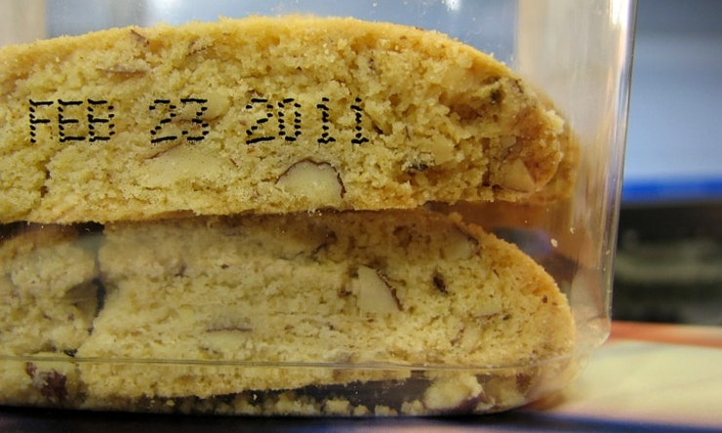
Cookies Expire

Slide 13
All this means nothing, without state on the server
Server stores state
In the cookie itself – TRUST ISSUES
In a file – Look up by ID (Trust issues?)
In a Database – Look up by ID
Wherever else you can store data!

Slide 14
In PHP…
The data stored on the server is called Session Data
Generally accessed using $_SESSION
In Fuel PHP
We can configure it to use $_SESSION
Or use Fuel’s built-in class
Either way is fine!

Slide 15
Example time
A simple state example
Addition to our MVC example
Now with flash messages!

