Slide 1
Lecture 1
*
Introduction
* Slide background spider web photograph from Morguefile openstock photograph by Gabor Karpati, Hungary.

Slide 2
CT 310 - Welcome Musings : Ancient History
When I took office, only high energy physicists had ever heard of what is called the Worldwide Web.... Now even my cat has its own page. Bill Clinton, 1996*
The Internet is just a world passing around notes in a classroom. Jon Stewart**
… and bring me a hard copy of the Internet so I can do some serious surfing. Scott Adams**
* Source, The Quotations Page.
** Source, The Quote Garden

Slide 3
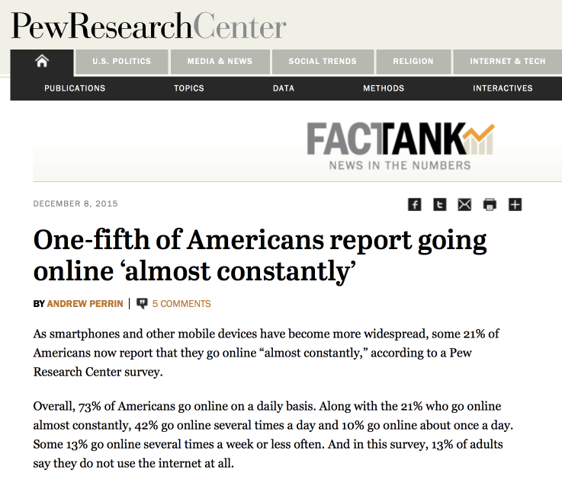
CT 310 2017 – Welcome Is the Web Important?
Ok, I guess there are stupid questions!

Slide 4
CT 310 - Why?
CT 310 is a one semester course on web development. Emphasis is placed on the essentials needed to create fully functional websites including rich graphical content and dynamic content. The course will cover HTML, Cascading Style Sheets and graphical content. Dynamic web pages will be developed using PHP and JavaScript. MySQL and SQLite are introduced for website data management. Asynchronous JavaScript (AJAX) is introduced for fine-grained client-server interaction. Students will develop their own dynamic websites able to manage authentication, transactions and user updates.

Slide 5
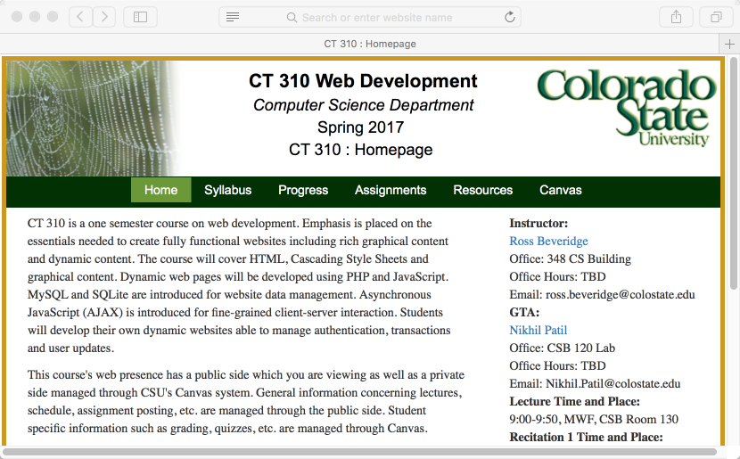
CT 310 – Start Here

Slide 6
Review for Yourself
The Syllabus
The textbook – yes you should have one.
The policies on lecture.
The policies on recitation.
Professional conduct.
The Progress Page
Go here to synch up with the course.

Slide 7
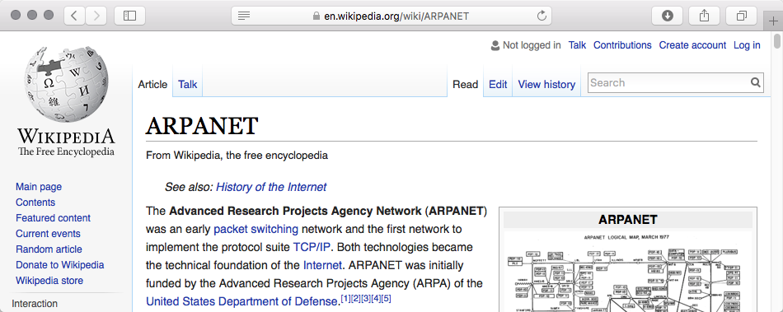
History of the Internet
Resources:
Wikipedia – yes this is a great resource
Computer History Museum

Slide 8
History of the Internet At a minimum, know …
via Wikimedia Commons

Slide 9
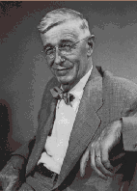
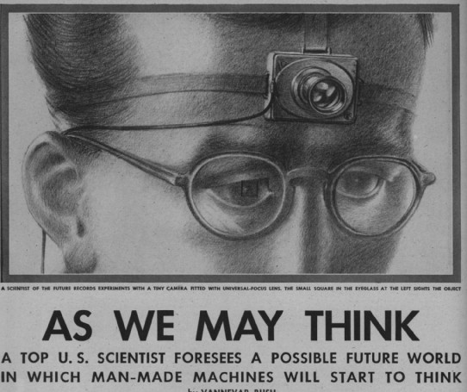
Vannevar Bush
Director of Us Office of Science Research and Development throughout World War II.
1945 article “As We May Think” in The Atlantic inspires computer scientists to present day
Personal Computer
Tiny, low cost library storage
Commerce with automatic inventory control and billing
Digital cameras
Speech interfaces
Hypertext-links
Goal was to augment human intellect

Slide 10
Memex
“A memex is a device in which an individual stores all his books, records, and communications, and which is mechanized so that it may be consulted with exceeding speed and flexibility”
Full-text search, text & audio annotations, and hyperlinks
Proposes associative links between content
Dual display setup!
Direct annotation of stored content
Proposes direct connection to nervous system

Slide 11
Networks

Slide 12
Networks
LAN
(CS Dept.)
CSU WAN
LAN
(Math Dept.)
LAN
(Psychology)

Slide 13
Networks
LAN
(CS Dept.)
CSU WAN
And it goes on and on …
WAN
LAN
(Math Dept.)
LAN
(Psychology)
LAN
(CS Dept.)
LAN
(Ft. Collins)
UC WAN
HP
LAN
(Math Dept.)
LAN
(Physics)
LAN
(Palo Alto
LAN
(Research)
If it is not obvious, the particulars are made up.

Slide 14
A Worked Example (2009)
Consider loading the Moscow State University website.

Slide 15
Uniform Resource Locator
http://www.msu.ru/en
Protocol
HTTP
Domain Name
Server Name
Web pages
(entry point)

Slide 16
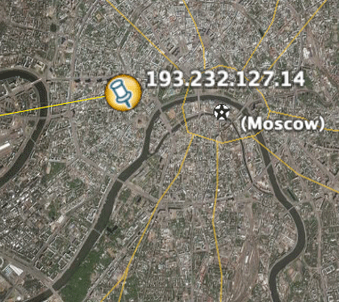
Servers and Clients
Client on my desk.
Server in Moscow, Russia
*
* Image from Google Earth

Slide 17
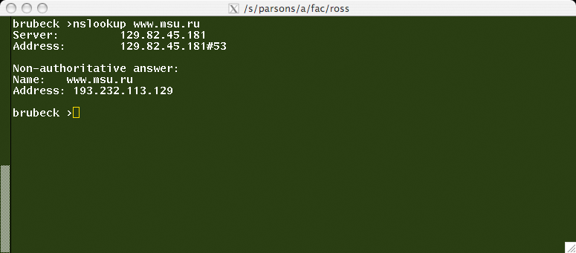
Domain Name System DNS
www.msu.ru maps to
193.232.113.129
Browser on client requests IP address from DNS server, then requests page from server (193.232.113.129)

Slide 18
TCP IP Packet Routing.
Browser initiates a TCP connection
From 67.166.55.44 to 193.232.113.129
Packets flow from server to client.
Packets include header plus data.
Dropped packets will be resent.
Route can make your head spin.

Slide 19
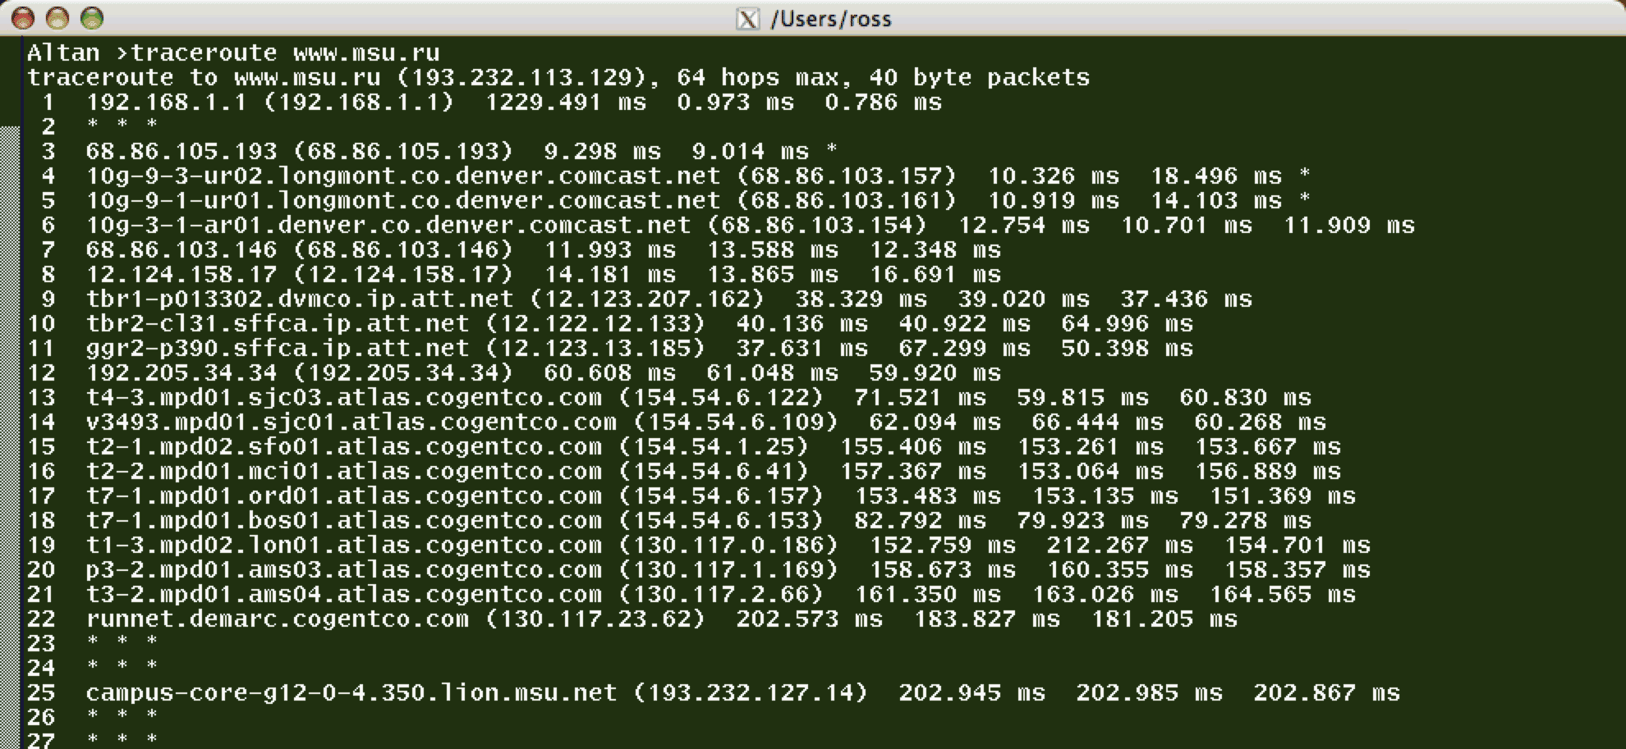
Unix Utility traceroute
… and how can we make this a bit more compelling?

Slide 20
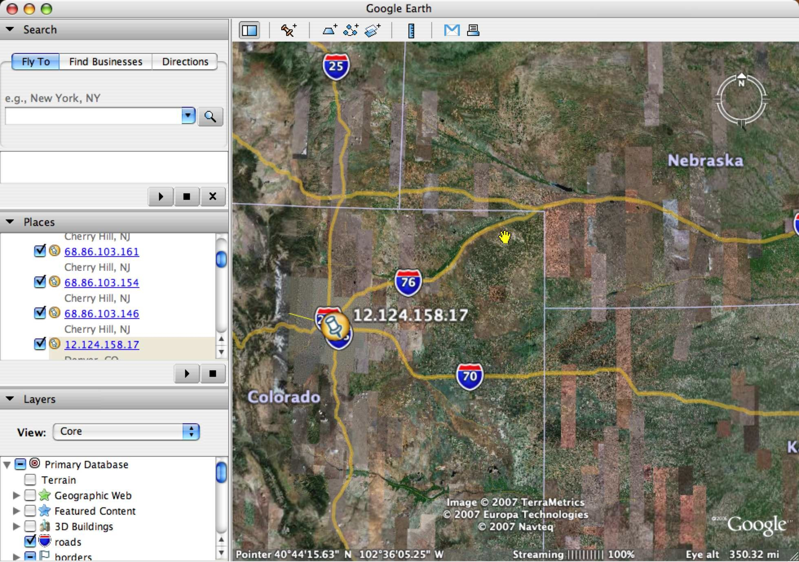
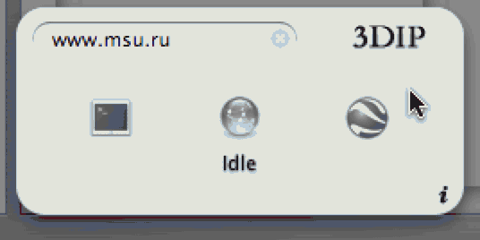
Routing Example Takeoff point - Denver
Route generated by 3DIP dashboard widget.
Claudio Procida
(http://www.emeraldion.it/)

Slide 21
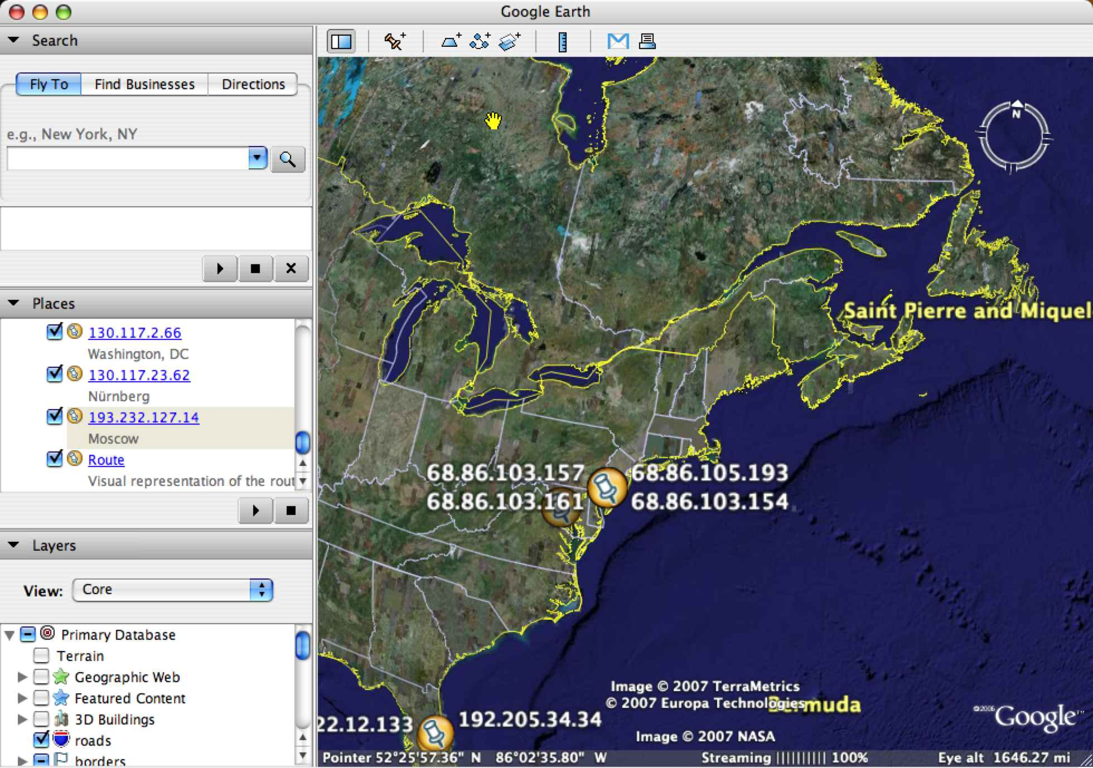
Routing Example Through East Coast

Slide 22
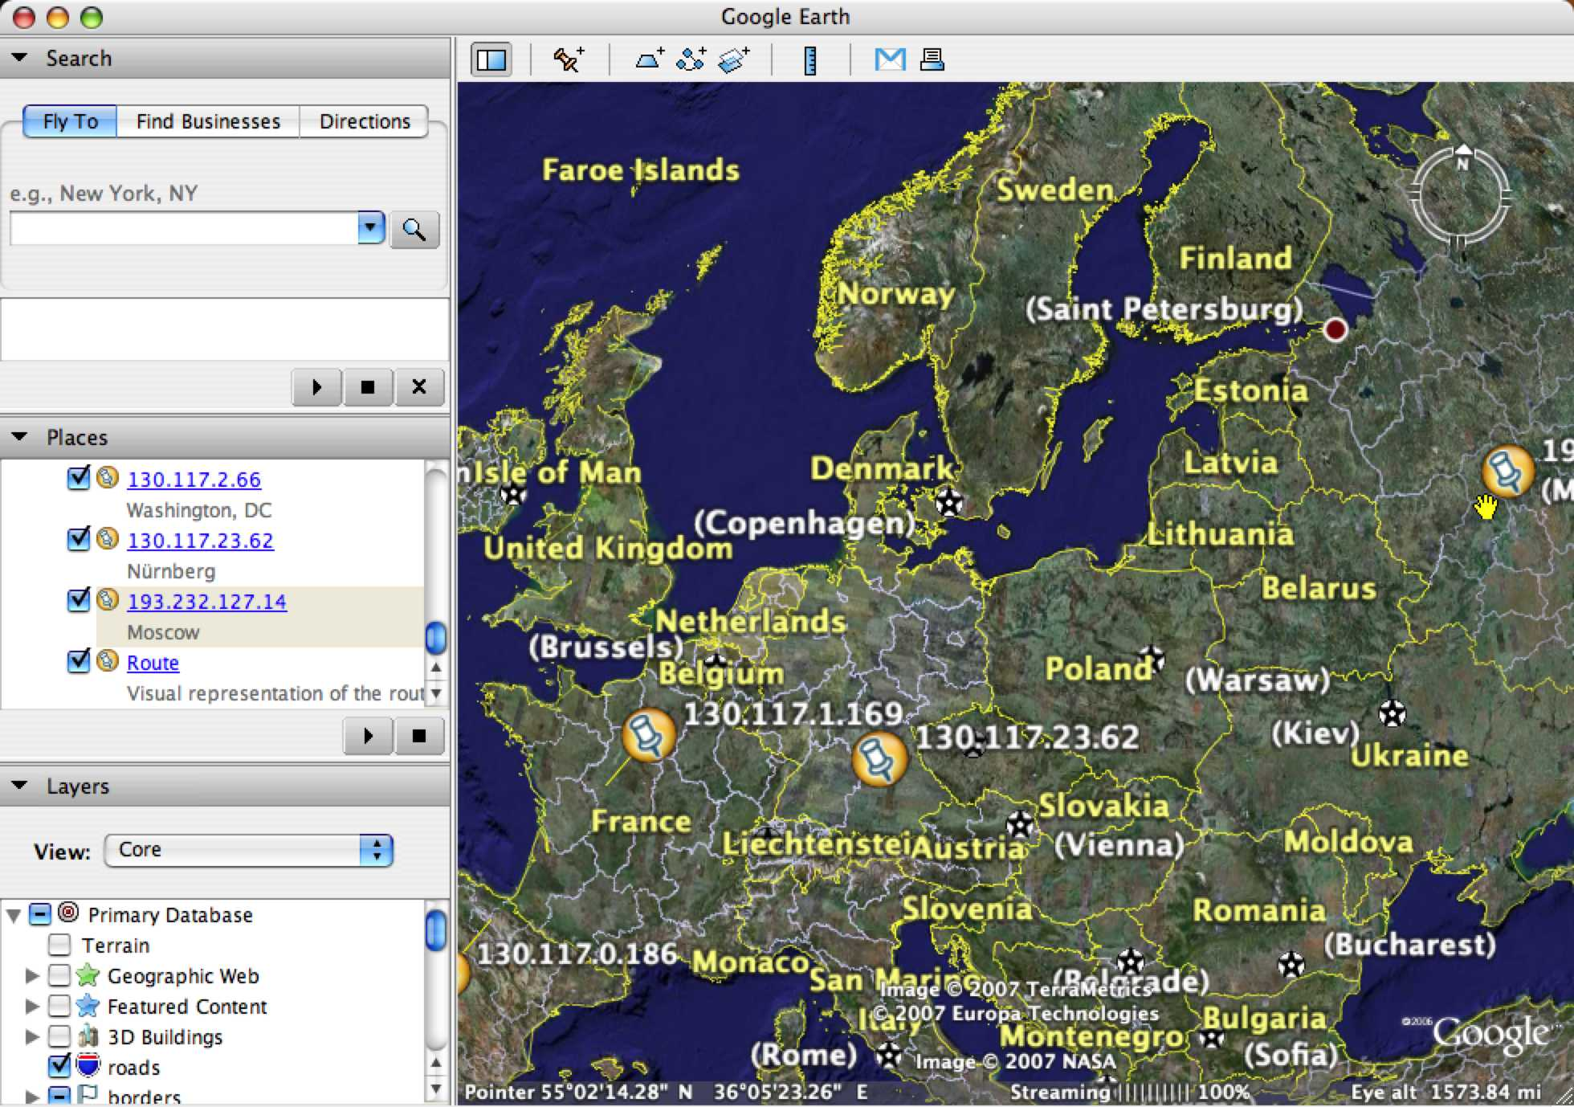
Routing Example Across Europe

Slide 23
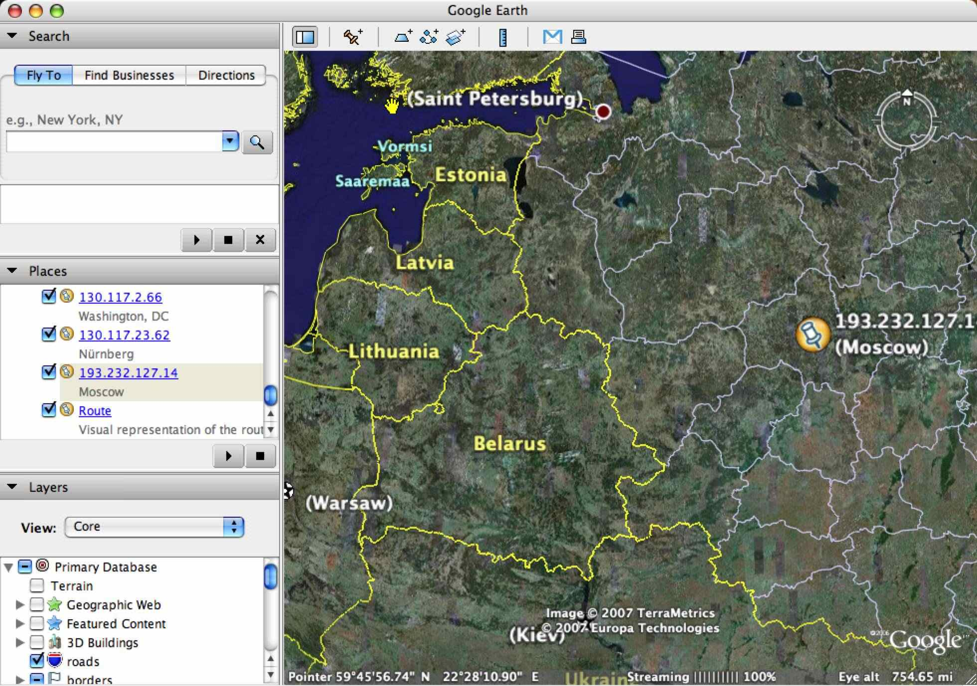
Routing Example … and into Russia

Slide 24
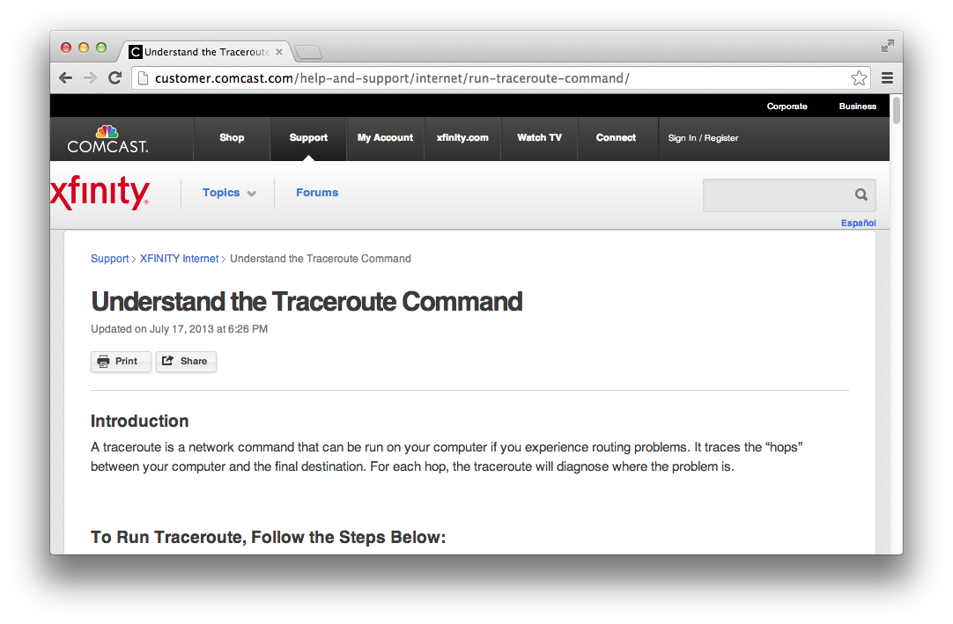
Traceroute Goes Mainstream

Slide 25
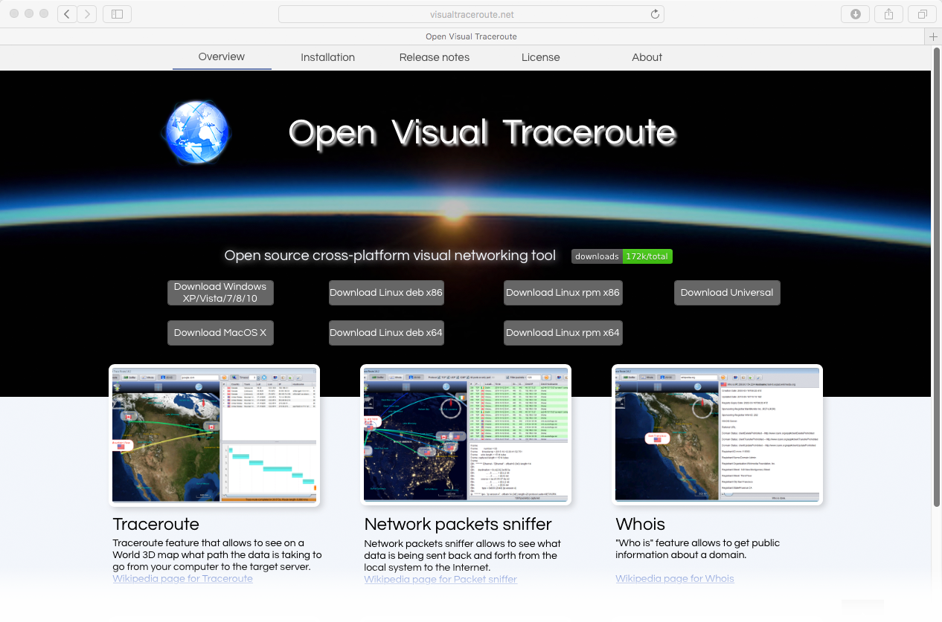
New Visual Traceroute

Slide 26
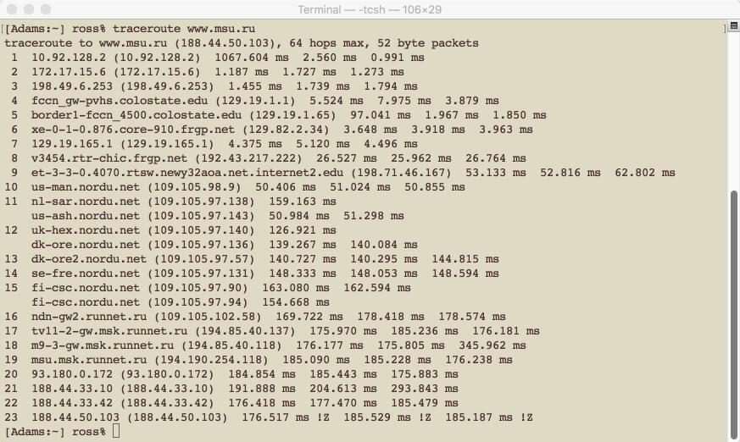
Tidbit 1/12/17 – Go CSU
This traceroute was initiated from PVH; note how CSU is acting as a conduit for the Hospital. Specifically, hops 4 and 5 include:
fccn_gw-pvhs.colostate.edu

Slide 27
Law, Privacy, security
A few comments about being a resident on the web

Slide 28
Law & Ethics
What happens to material you post?
What material can you post?
What can you do with stuff you see?
Are you comfortable explaining your actions to a reporter for a major newspaper?
(remember Newspapers?)

Slide 29
Want to Know a Secret …
… there aren’t any.
Good rule of thumb … what you say and do on the web is public.
And you leave permanent footprints.
Search, web mail, Netflix, …
What rights transfer, example …
Section 11 of Google terms of service
Compare April 16 2007 to current.

Slide 30
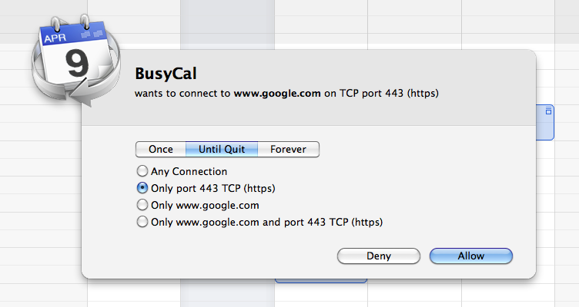
Privacy / Security
With whom is your computer conversing?
What’d it say?
Have you
noticed?

Slide 31
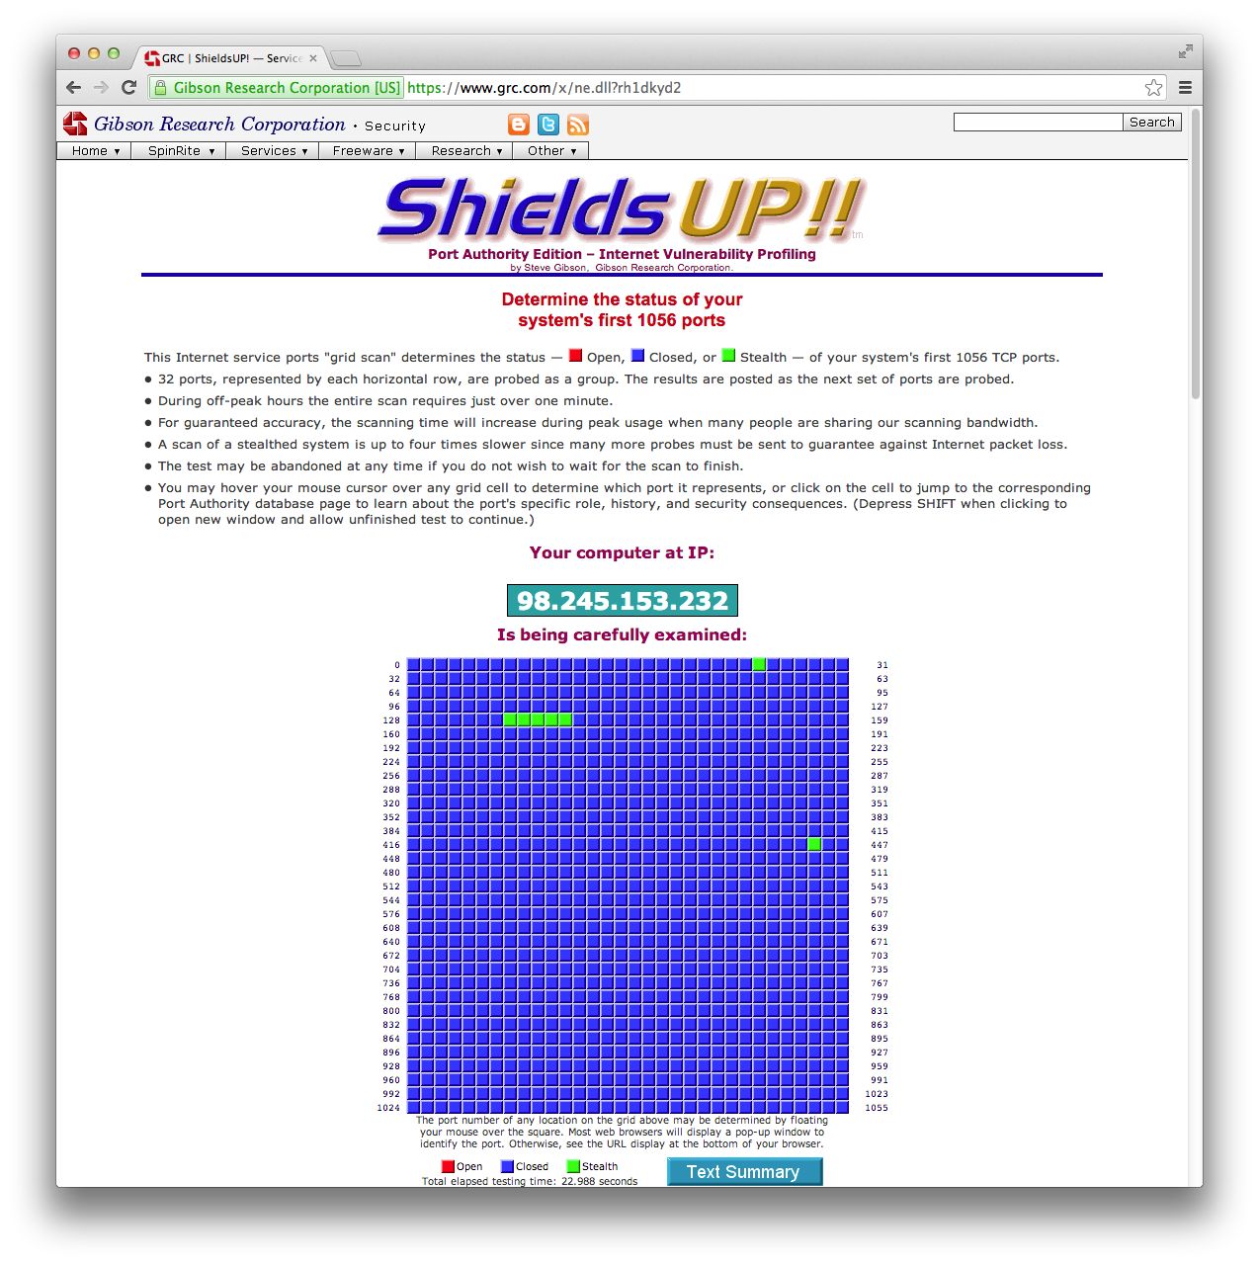
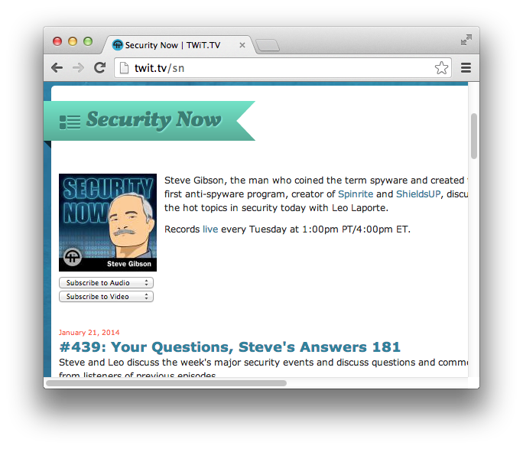
Much to Learn
Much to Check

Slide 32
Lecture Wrapup
Programming, elements and what comes next …

Slide 33
Dynamic Content
Once upon a time …
index.html was a text file.
With the advent of Web 2.0, page content is created on the fly.
With ubiquitous mobile the Site vs. Apps distinction is blurred.
Punchline! Building moderns Sites and Apps equals client/server interactive web programming.

Slide 34
Characters in this Drama
Browser – pretty obvious.
Renders HTML + CSS.
Network – TCP/IP etc.
Server (Apache) – behind the scenes.
Server Programming – PHP, .net, …
Persistent information – MySQL, …
Browser (again) – a machine
GUI plus language - JavaScript

Slide 35
Where to Next?
How fast can you learn HTML?
What do you have to help you?
A world wide web, truly, of examples.
What do you have going for you?
Most all of it is designed to be obvious.
… basic html is NOT rocket science.
What about CSS? …
There is more to CSS, next week.

Slide 36
Assignment 00 - Best of …
For the first assignment, every student will contribute a unique link to a site they consider important.
Important may mean beautiful, useful, creative, essential, etc. Students, use your own best judgement.

