Slide 1
Lecture 04a/05
*
Server Side Programming Overview
And file system basics
* Course logo spider web photograph from Morguefile openstock photograph by Gabor Karpati, Hungary.

Slide 2
About Document Root
The document root is established in the apache httpd.conf file.
In the CS department it is “public_html” in your home folder.

Slide 3
File Permissions
All HTML and CSS files must be world readable, as must images, etc.
PHP files are special on CS server! They may be restricted to owner.
Rant 1: View your files with ‘ls –al’ so you get in the habit of reading file permissions – always!
Rant 2: You must master the unix command chmod!

Slide 4
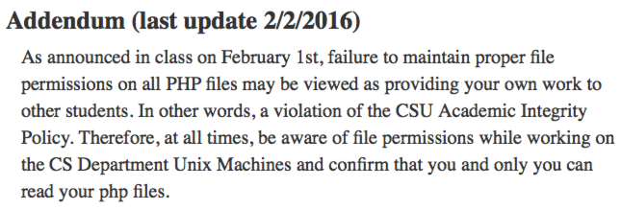
Academic Integrity Note
You cannot protect HTML/CSS/image files and have them display properly.
see the previous slide.
You can and must protect your PHP files.

Slide 5
WWW in the Beginning
Type HTML/CSS by hand!
A necessary skill still today,
But … Impractical!
HTML/CSS production is generally:
Automated.
Interaction.
Data service.
From Wikimedia Commons

Slide 6
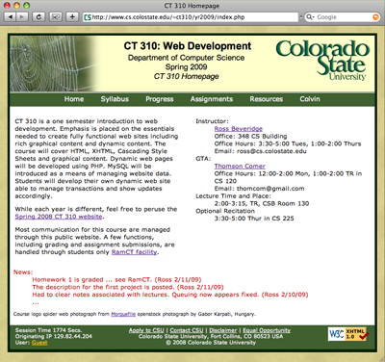
Client-Server Starting Point A Brief Review
Client Computer
Web Server (Apache)
Static Files (index.html)

Slide 7
Add Client/Server Scripting
Client Computer
Web Server (Apache)
File System /cgi-bin
Server Side cgi, Perl, PHP, …
Native Code (enter.exe)
Client Side
(JavaScript)

Slide 8
A Brief Preview
Client Computer
Web Server (Apache)
+
PHP Interpreter
File System (enter.php)
MySQL Database

Slide 9
Context/History
CGI: Common Gateway Interface 1993. Callout to native applications.
CGI + Perl
Applications written in Perl.
Lead to built in Apache Perl Module.
Java
Possible as Server Side Language.
Not typically built into server as module.

Slide 10
Context/History Continued
Coldfusion
Dynamic html generation environment
Tied to Macromedia - now Adobe
Microsoft .NET Framework
Key modern component of Windows
Includes infrastructure for web development
JavaScript
Typically run on the client side.
Now there is node.js (start 2011)
Security/Sandboxing a concern.
And very widely used - PHP …

Slide 11
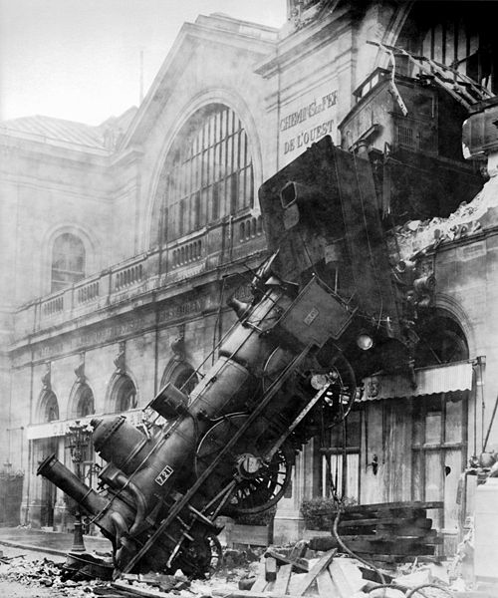
Warning Language Train Wreck is Coming!
So far we’ve covered:
HTML
CSS
Now we introduce
Server Side Programs
Specifically, PHP
Keep your head on …
Four syntaxes,
Client vs. Server view,
All interdependent,
Wikimedia Commons: Train wreck at Montparnasse

Slide 12
PHP resources
The source - the PHP Group (www.php.net).
The PHP Group Tutorial and Manual.
Our Textbook –
Learning PHP, MySQL & JavaScript, by Robin Nixon.
Refsnes Data W3 School
W3 School PHP Tutorial.

Slide 13
Basics
Server runs all *.php files through PHP interpreter before sending to client
Special language constructs
pretend to be functions
These include
print, echo, include, require, return, exit, array
<?php
print “Hello World!”;
?>
Vs.
<?
print “Hello World!”;
?>

Slide 14
Echo, Print, Comments
echo and print both output strings
echo allows for multiple parameters to be passed
print acts more like a function and only allows one
// and # comment out single lines
/* blah blah */ comment out blocks of text

Slide 15
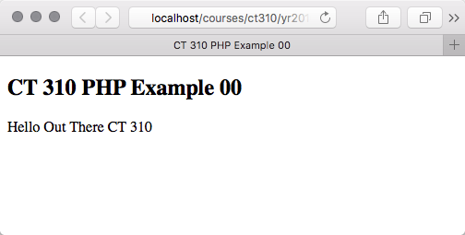
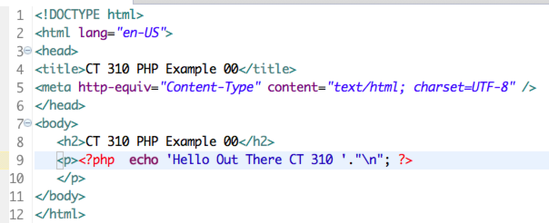
Example – 00

Slide 16
What the Client Sees!
PHP code NEVER leaves the server.
Paying attention to how another person will see the source is like?
Keeping your house clean.
Cleaning behind the refrigerator.

Slide 17
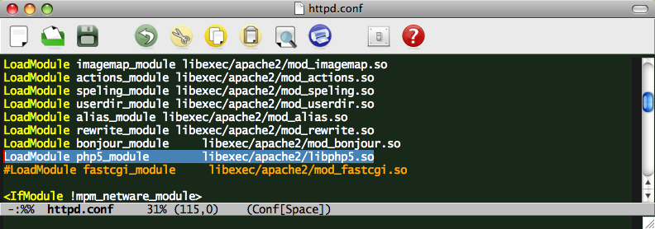
An Aside - Enabling
PHP is already turned on for CS Dept.
On your own machine you may need.

Slide 18
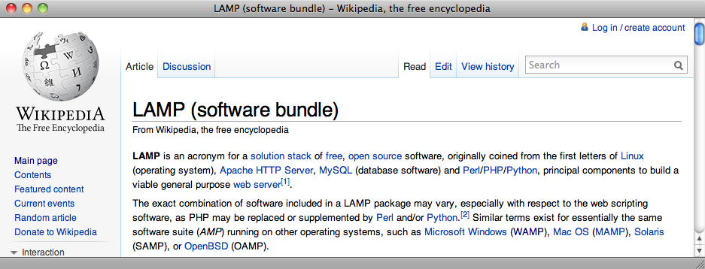
More about Your Machine
Looking ahead to PHP and MySQL
Chapter 2 of text on LAMP, MAMP, WAMP

