Slide 1
Lecture 5
*
PHP Basics
* Course logo spider web photograph from Morguefile openstock photograph by Gabor Karpati, Hungary.

Slide 2
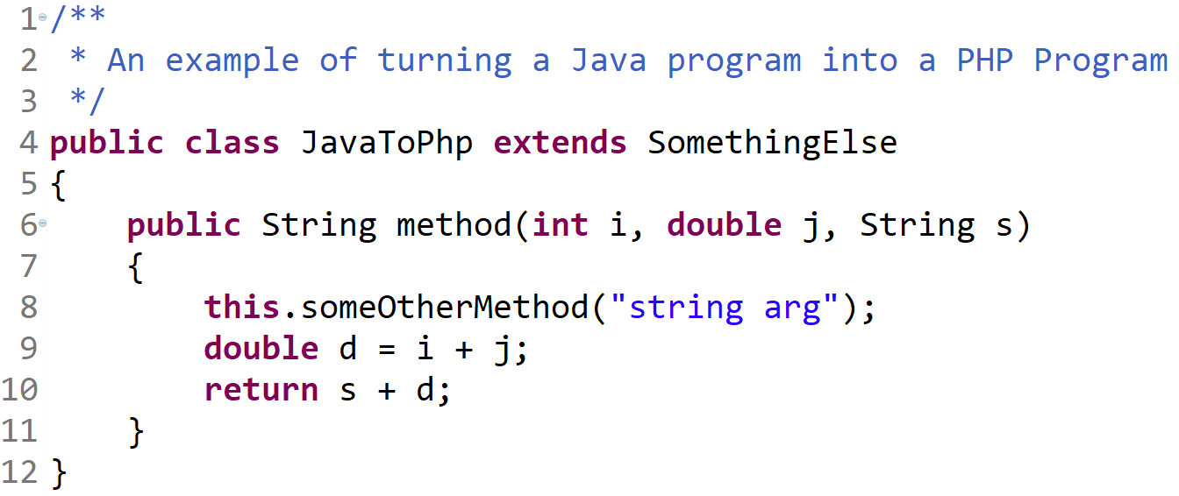
Learn PHP in 5 easy steps! (people who try to get views on their articles HATE THIS!)

Slide 3
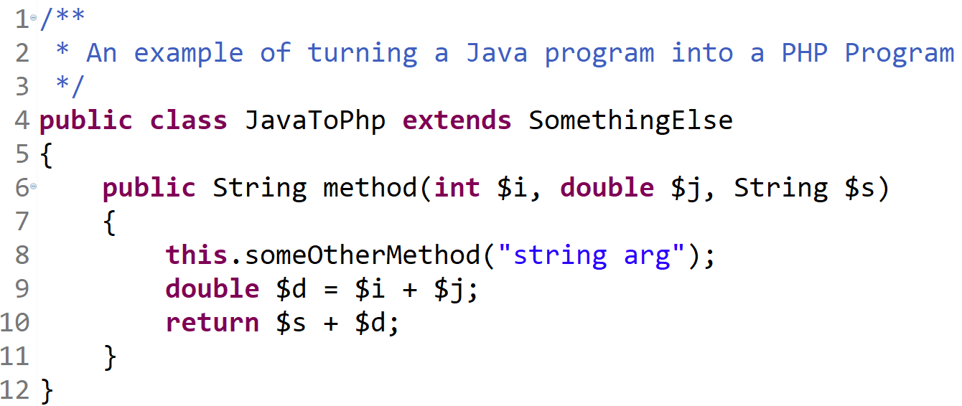
Put dollar signs in front of variables.

Slide 4
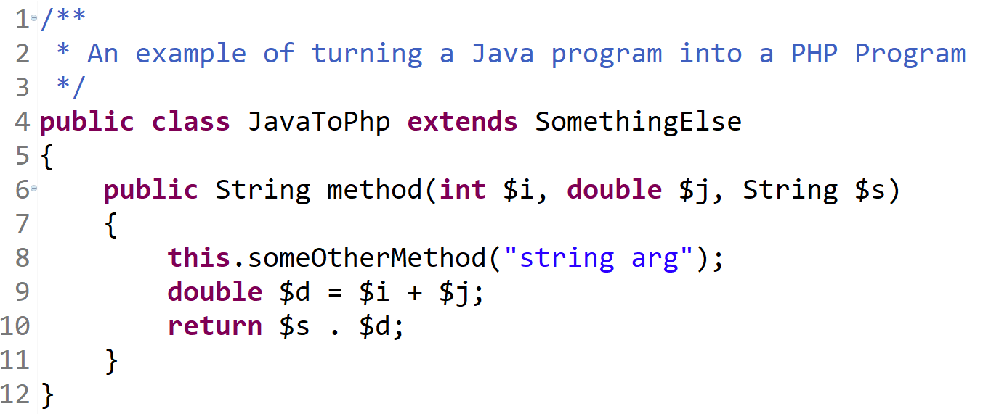
Change String Concatenation Operators

Slide 5
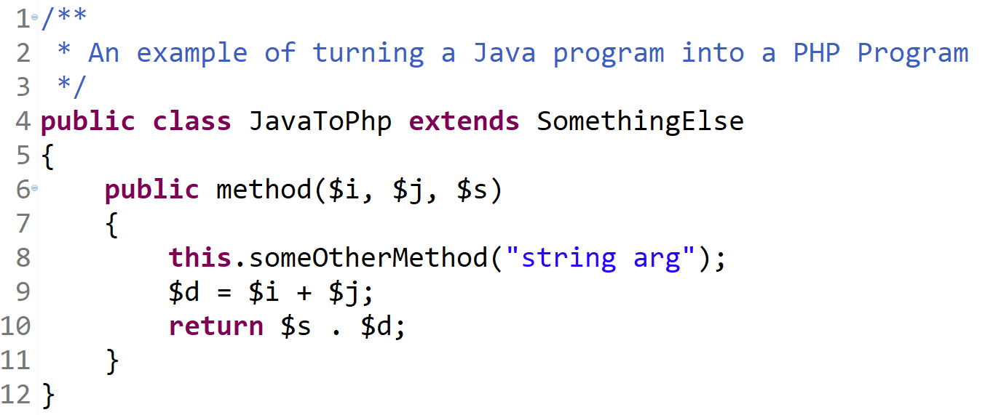
Remove Types

Slide 6
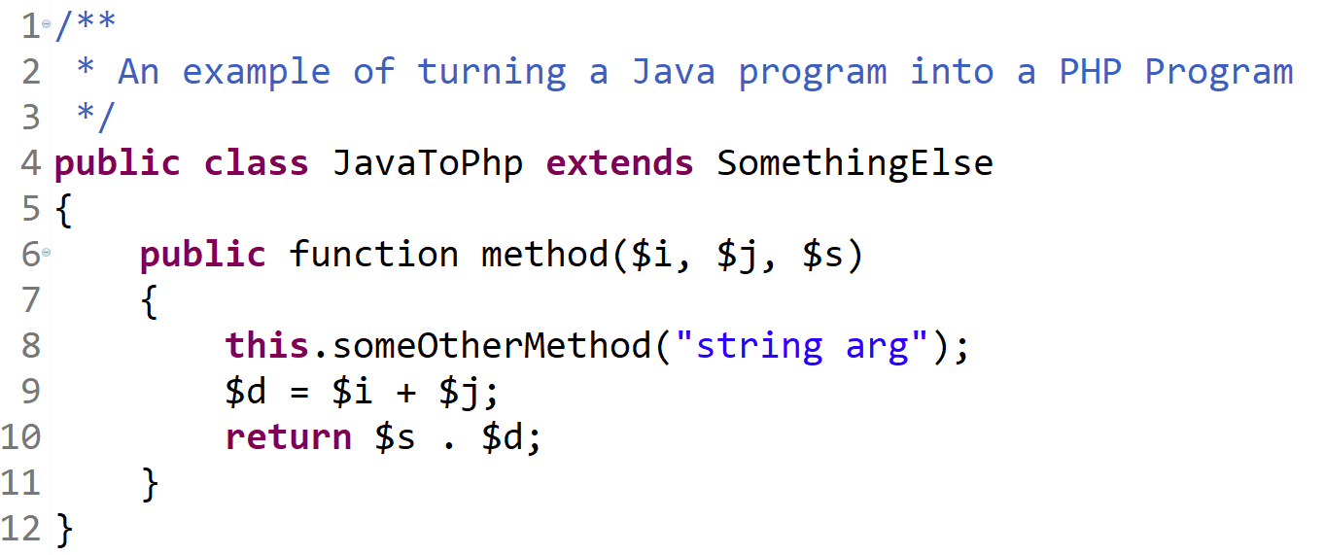
Call a function a function

Slide 7
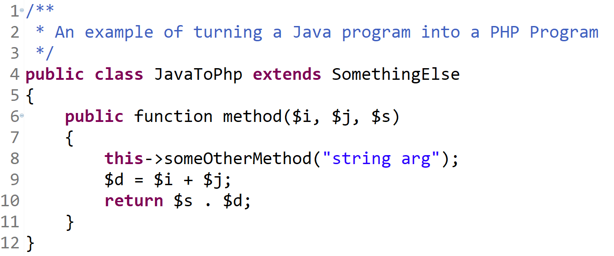
Change function call punctuation

Slide 8
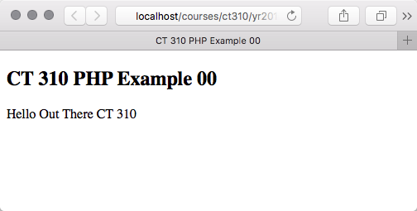
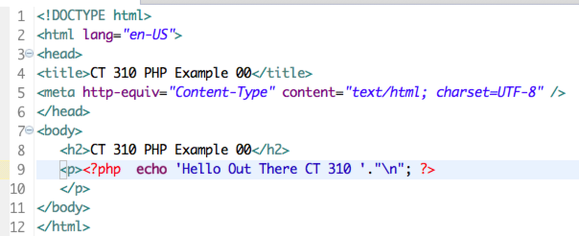
Example – 00

Slide 9
Basics
Server runs all .php files through PHP interpreter before sending to client
Special language constructs
pretend to be functions
These include
print, echo, include, require, return, exit, array
<?php
print “Hello World!”;
?>
Vs.
<?
print “Hello World!”;
?>

Slide 10
Echo, Print, Comments
echo and print both output strings
echo allows for multiple parameters to be passed
print acts more like a function and only allows one
// and # comment out single lines
/* blah blah */ comment out blocks of text

Slide 11
PHP Variables
Start with $ - always!
Case sensitive, and can contain letters, underscores and numbers
$exNumText, $1_exNumText, $_1exNumText, $_exNumText
No type declarations are needed
Automatic type conversion
Automatic substitution, except in ‘ ‘

Slide 12
Include()
Interpreter drops out of PHP mode when processing included files, then drops back in when it’s done
<?php
echo “Sometimes I like to play with “;
include (‘dogs.php’);
echo “.”;
?>
Outputs:
Sometimes I like to play with dogs more than cats.
The processor runs it like:
<?php
echo “Sometimes I like to play with ”;
?>
<?php
echo “dogs more than cats”;
?>
<?php
echo “.”;
?>

Slide 13
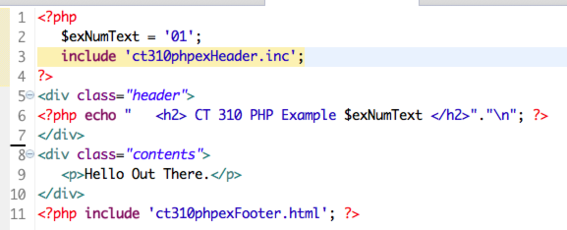
Example 01
This example introduces:
The use of a variable
The use of include files
Most important, dynamic content!

Slide 14
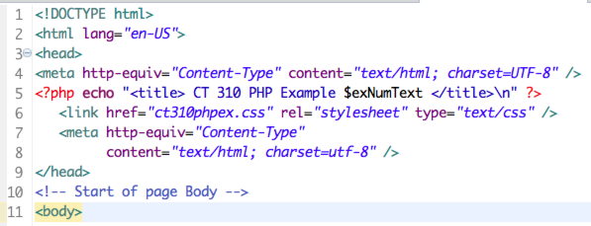
Header and Footer
Reuse Common Components

Slide 15
HTML for Example 01
At the risk of being repetitive: from a client browser perspective there is no such thing as PHP.

Slide 16
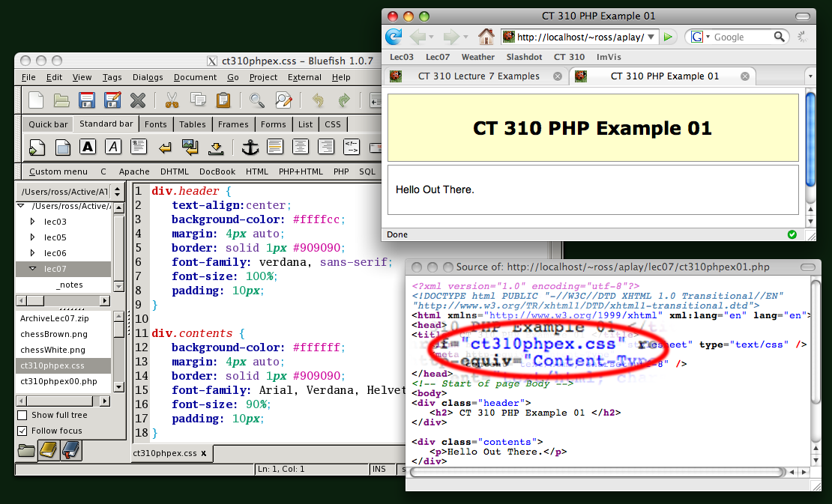
Keep your style !
Note: this is a ‘vintage slide’ showing older xml header and Bluefish editor.

Slide 17
Date() & Other Functions
Functions are not case sensitive
They ignore whitespace
Date allows for several variables to be passed for different formats
Explicitly set the time zone
date_default_timezone_set('America/Denver');
For a complete list of arguments
http://us3.php.net/manual/en/function.date.php

Slide 18
Example 02

Slide 19
Heavy Reliance on echo
Note large PHP block, single quotes, double quote new lines in this example.
Double quote
Function call
HTML new line
Leading Space
String Concatenation
New line
You must master control of all these interacting features. Must you always use them – next slide.

Slide 20
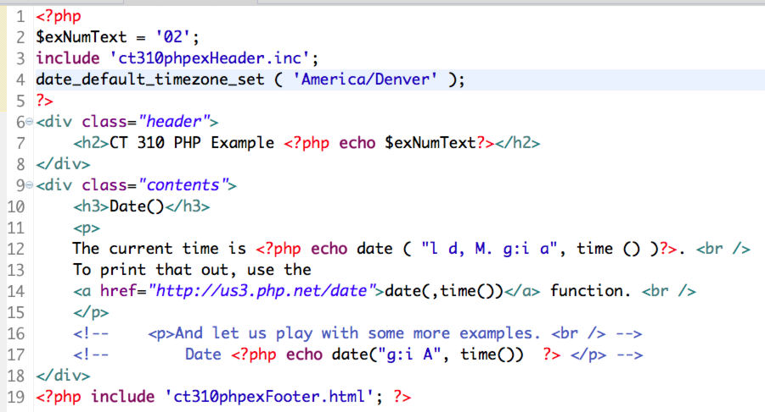
Example 02 Clean
I am strongly moving toward this more sparing use of PHP, but be aware and able to use both styles.

Slide 21
Example 02 Cleaner

