Slide 1
Lecture 6
*
Querying Client Information
Forms and Passing Data,
* Course logo spider web photograph from Morguefile openstock photograph by Gabor Karpati, Hungary.

Slide 2
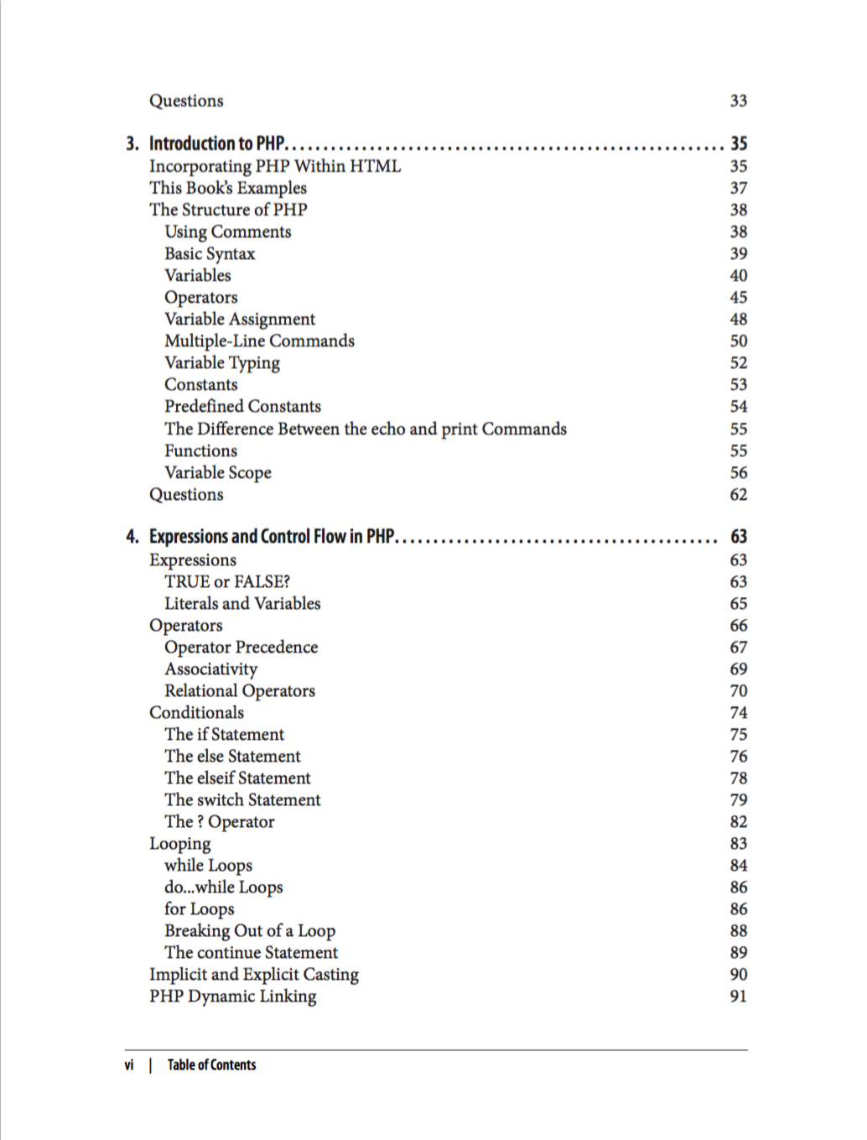
PHP Resources 1

Slide 3
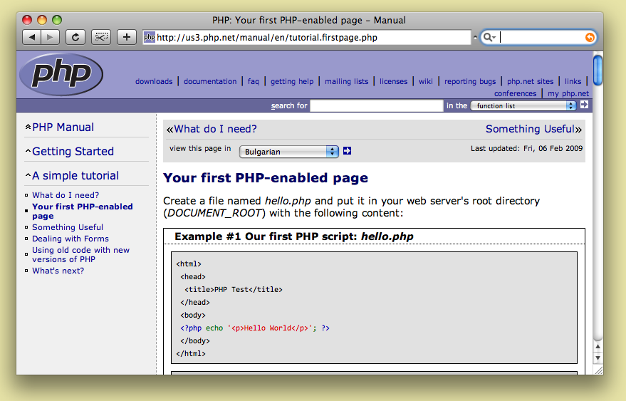
PHP Resources 2

Slide 4
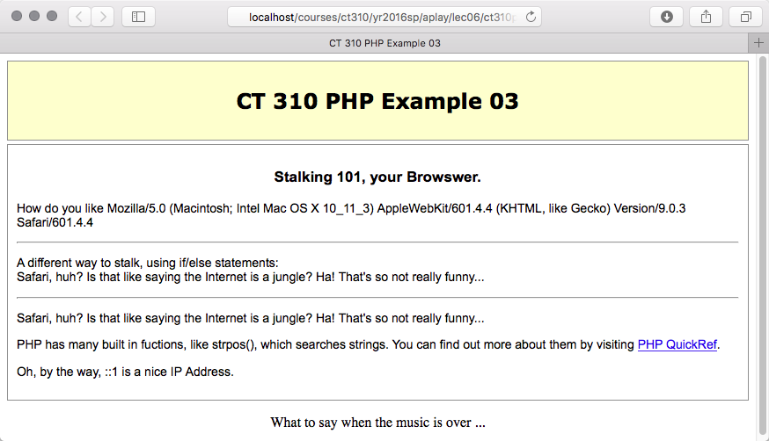
PHP Example 03 You are always known?

Slide 5
Example 03 Part 1
The global variable array $_SERVER provides information primarily about the server, but also some information passed back by the client.
Notice that arrays in PHP are commonly indexed by names.

Slide 6
Example 03 Part 2
PHP has standard control logic – if/elseif/else.
Querying for substring inclusion is provided.

Slide 7
Example 03 Part 3
PHP also has the more compact switch statement.
Also not the ‘REMOTE_ADDR’ element in the $_SERVER array used to get the clients IP address.

Slide 8
Passing Variables GET vs. POST
GET sends data in the URL, where everyone can see it
POST passes information behind the scenes
REQUEST essentially a merge of GET and POST responses.
Mostly used for forms, variables, etc

Slide 9
Forms
Field types:
checkbox, file, hidden, password, radio, reset, submit, text
Also:
select, option, textarea
Action
where you want it to go/a script you want it to run
Method = get/post

Slide 10
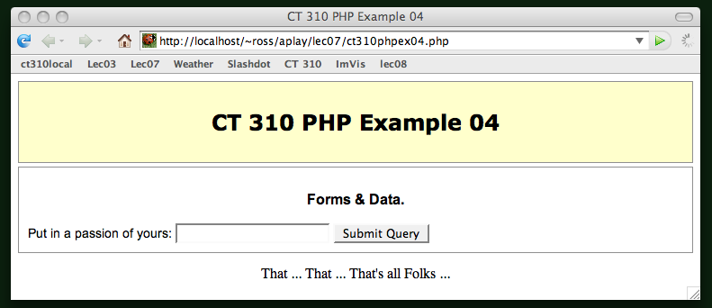
PHP Example 04

Slide 11
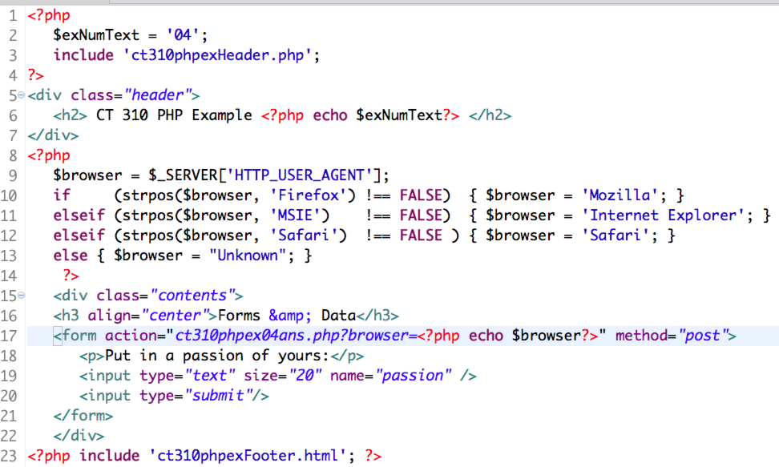
PHP Example 04 - 2016
Pay attention to the browser query!

Slide 12
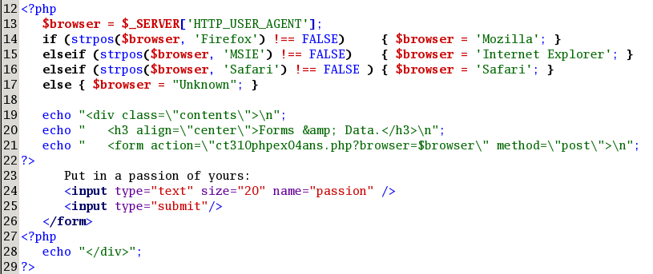
PHP Example 04 - 2011
See in this older version above a different approach to when to start/stop PHP.

Slide 13
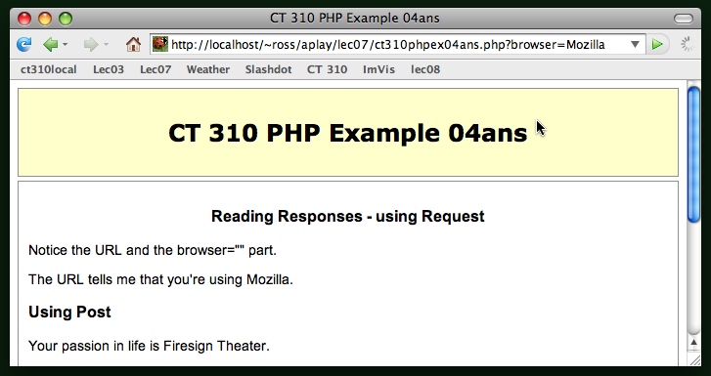
PHP Example 04

Slide 14
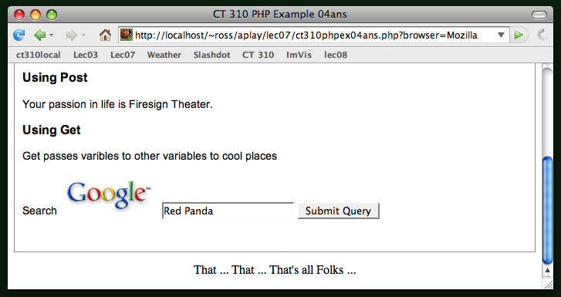
PHP Example 04

Slide 15
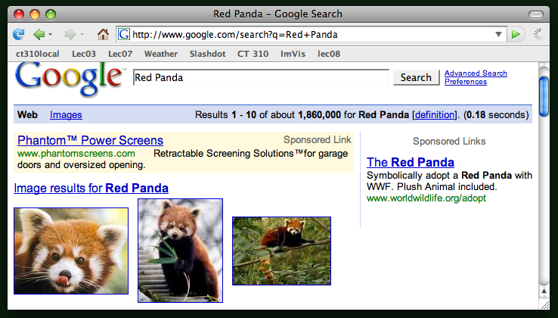
PHP Example 04

