Slide 1
Lecture 12
*
Mapping, Map Reduction
Summing integers,
Map Reduce & Strings
PHP Objects
* Course logo spider web photograph from Morguefile openstock photograph by Gabor Karpati, Hungary.

Slide 2
Example 02
Reduction trumps iteration!
Two arguments,
First builds result,
Second is current array element.

Slide 3
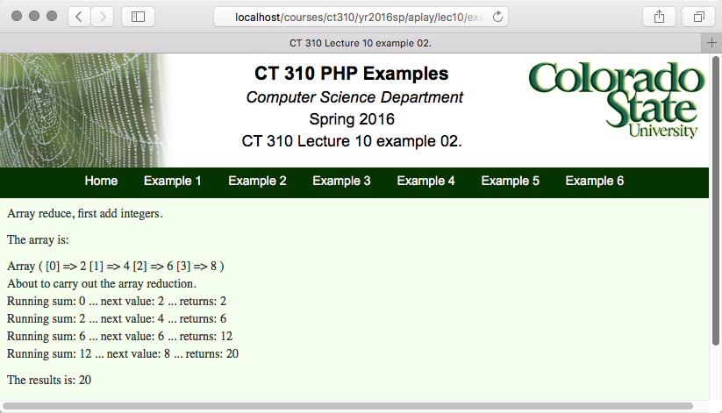
Example 02

Slide 4
Basics - Functions
Here is how functions are defined.
Feature you have come to expect:
A name: “runsum”
Arguments – no typing
Code body
Explicit return value – no typing again.

Slide 5
The Naming of Functions
Consider Carefully this Code
What is the second argument?
Is it a string literal?
Is it a function?
When you are comfortable saying yes to be both and understand why that answer makes sense you will be on your way to understanding array_reduce in particular and the idea of a run-time symbol table more generally.

Slide 6
Mapping In General
In C, C++, Java and the like there is a STRONG bias in favor of loops.
There has always been an alternative view in CS …
PHP supports Mapping !!
Excerpt from: John McCarthy, Paul W. Abrahams, Daniel J. Edwards, Timothy P. Hart and Michael I. Levin. LISP 1.5 Programmer's Manual. The M.I.T. Press, 1962, second edition. Posted here by permission of The MIT Press.

Slide 7
Map runsum as a Figure
‘’
2
‘’ + 2
6
2 + 4
12
6 + 6
12 + 8
20
[0]=>2
[1]=>4
[2]=>6
[3]=>8
Accumulation variable $s
Array element $next

Slide 8
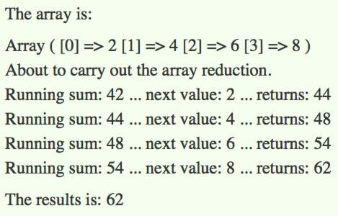
In Honor of Douglas Adams

Slide 9
Starting with 42
42
44
42 + 2
48
44 + 4
54
48 + 6
54 + 8
62
[0]=>2
[1]=>4
[2]=>6
[3]=>8

Slide 10
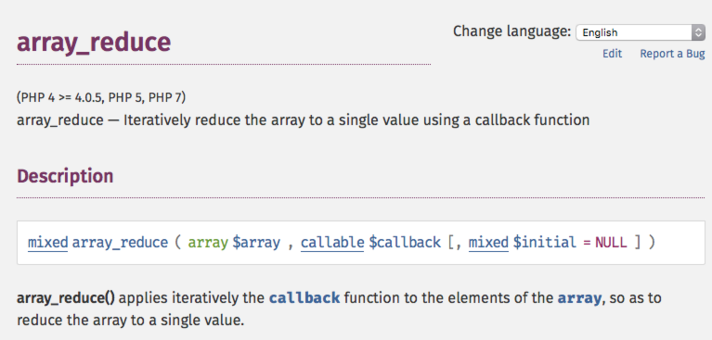
The PHP.net Documentation
array_reduce is a function.
It does return a result.

Slide 11
Example 03
The combination function may be created in place, not named.
The short if-then-else format is handy for the return.
Second example is better.

Slide 12
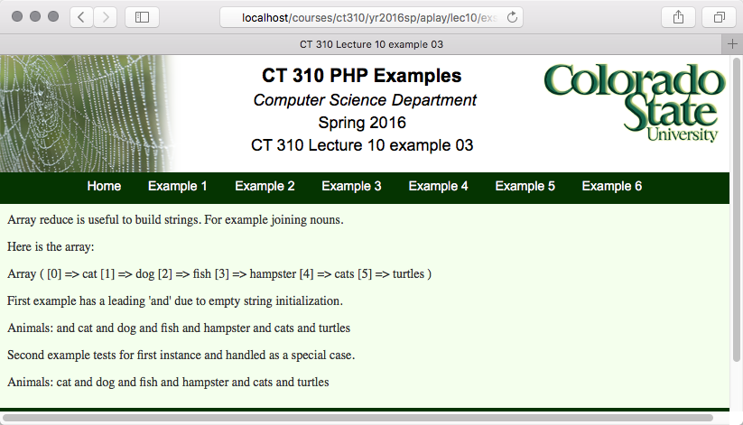
Example 03

Slide 13
Why The Leading ‘and’
In the first case, foo, the initialization value is null the first time the function is called.
What is returned is null – the empty string for strings – concatenated with ‘and’
The second example uses the short syntax if-the-else to avoid the problem.

Slide 14
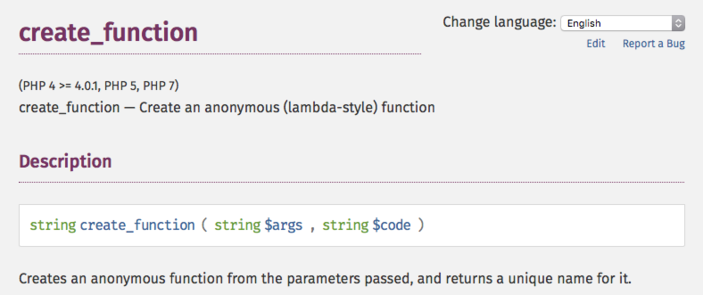
A Function with No Name
Notice the in-place definition of the function passed to map_reduce.

Slide 15
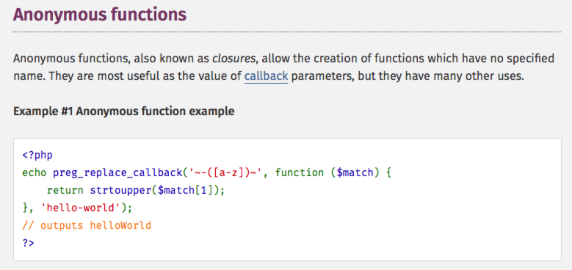
Reading the Fine Print
A more modern, preferred, way.

Slide 16
Updating Example 3
Here is a portion of Example 3 using the new more general way of creating anonymous functions
This new format better implements what is commonly called a closure. Put simply, closures have everything to do with variable scoping, and the PHP documentation has some nice examples.

Slide 17
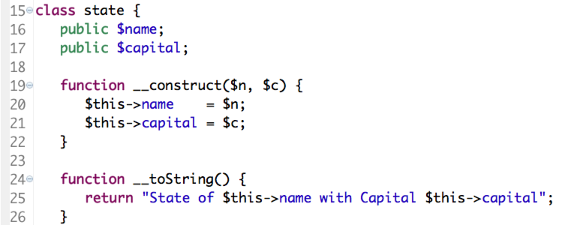
Example 04
PHP is an object oriented language.
Here is a class for ‘States’.

Slide 18
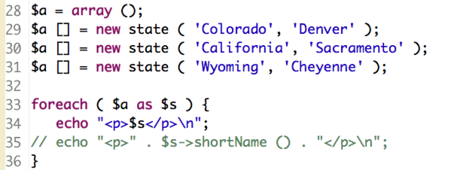
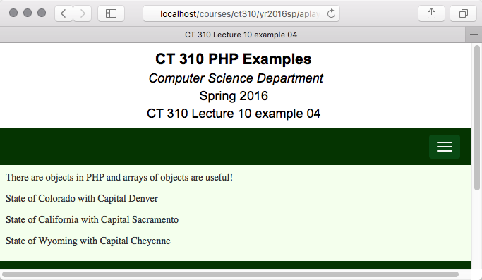
Example 04

Slide 19
Object, print thy self
In Example 4, pay attention to the use of the __toString() method.
Most modern Object Oriented Languages expect a programmer to take responsibility for how an object responds to a print – echo – statement.
Since so much of PHP is about generating text - HTML – output this is a useful capability.

Slide 20
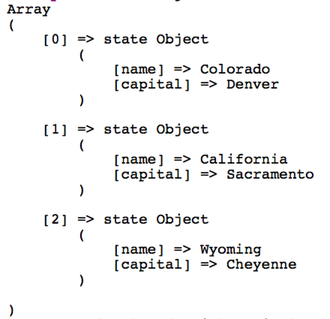
About Arrays of Objects
Recognize This Format?

