Slide 1
Lecture 13
*
Tables from Arrays of Objects
Exploding Strings
* Course logo spider web photograph from Morguefile openstock photograph by Gabor Karpati, Hungary.

Slide 2
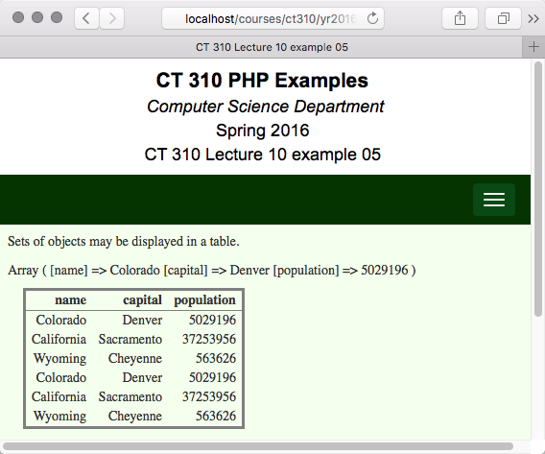
Example 5 combines:
Objects
Arrays
HTML Tables

Slide 3
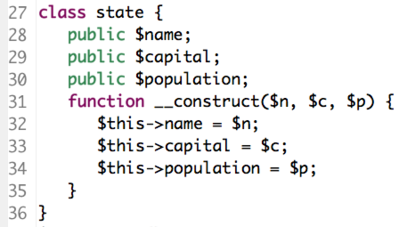
Example 05
Use objects to manage information
A state is a singular thing with 3 related data items:

Slide 4
Punchline: Transform an array of objects to a table

Slide 5
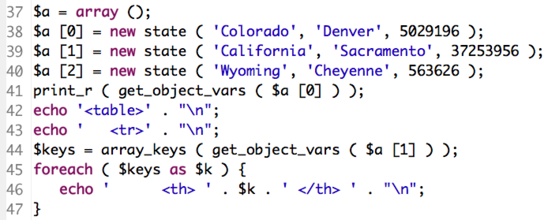
An Array of States
Create three states in an array
Note line 41: array holds all the member data for the first state.

Slide 6
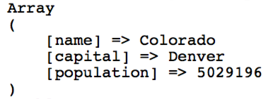
More about get_object_vars
With one function you can fully equate object member data with a keyword style array.
Access to the keys is very handy.

Slide 7
Keys Are Column Headers
Here again is a part of the code.
Line 44: Object member data to an array
Line 44: Retrieve keywords from array
Line 45: Iterate through keys
Line 46: One table column header per key.

Slide 8
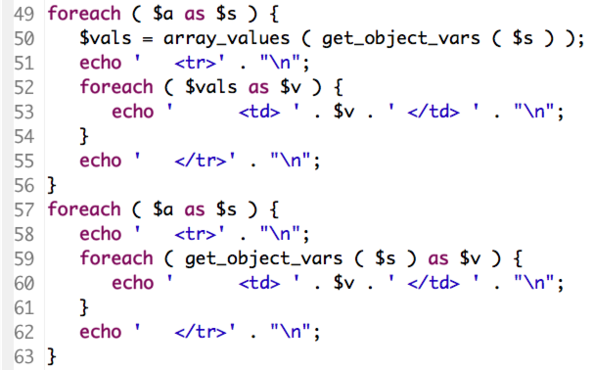
Filling in the Table
Enumerate the values in the table
Upper and lower versions function the same. Lower avoids intermediate variable

Slide 9
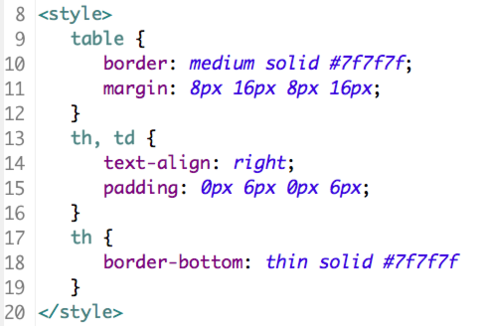
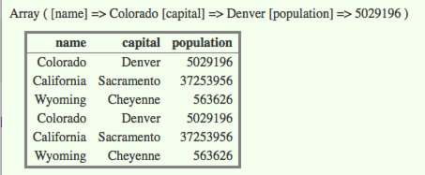
Style

Slide 10
Now Without Loops
Same goal, build a table from an array of objects.
But, no loops, just array reduction
Nested array reduction at that.
Many ways this could be done.
In this example, table header and table data rows first built as strings.
Then sent to the client, i.e. a succinct echo command inside table tags.

Slide 11
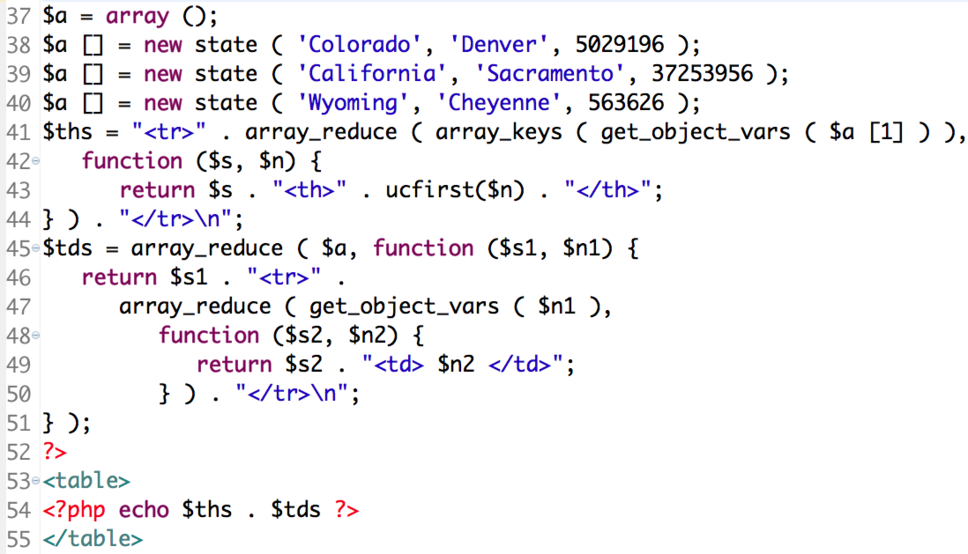
Example 6 Code

Slide 12
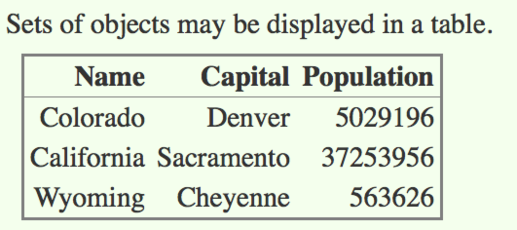
Example 06 on Client
Think of it this way. Map reduce can be very good at constructing repeated patterns from arrays.

Slide 13
Example 06 Observations
Example 06 may be a bit extreme
OK to ask, who finds this more readable?
On the plus side
Highly functional limits side-effects.
Internal function easy to modify.
Punchline for CT 310
Study and understand Example 06!
For now avoid loops when you can.
Once you master both styles, then you will be able to make informed choices.

Slide 14
Manipulating Files/Strings
Here is a plain text file:
As a text file, it has three lines
What about if we want to
Count words?
Change newlines into HTML newlines?
Group by words or lines?

Slide 15
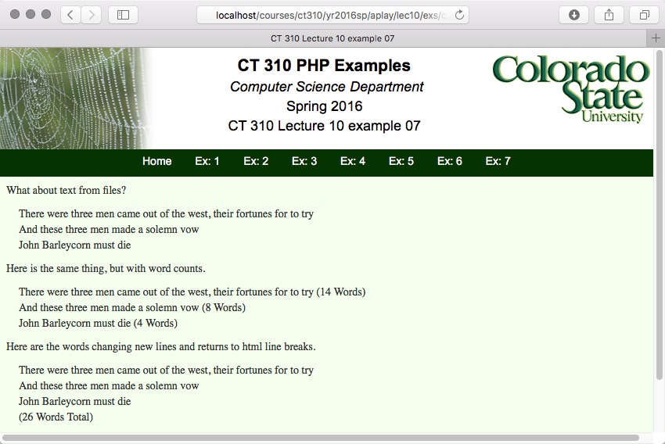

Slide 16
First Part – Split on Newlines
First, note one command reads file.
Now, one command builds an array, one array entry per line.
preg_split well worth studying!

Slide 17
Second Part – Word Counts
Ever explode a string?
Similar to preg_split, but simpler, and better if there is only one delimiter.
Pay attention to the ease of word counting.

Slide 18
Third Part - Substitution
Explicitly convert ASCII newlines to line break tags.
Note need to avoid counting <br> tags.

