Slide 1
Databases! (MySQL)
*
Introduction to Databases
with MAMP/LAMP/WAMP
thrown in!
* Course logo spider web photograph from Morguefile openstock photograph by Gabor Karpati, Hungary.

Slide 2
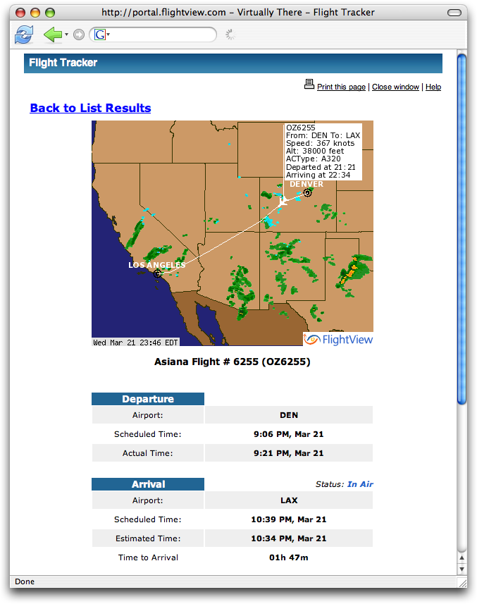
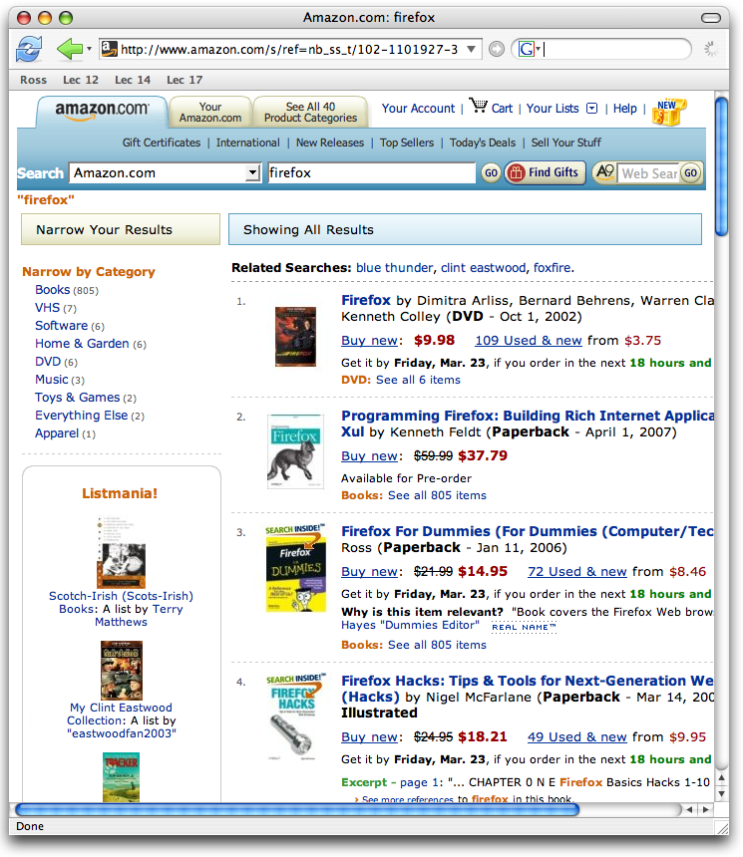
Why a Database?
Consider handling lots of data!

Slide 3
Database Taxonomy - Flat
Hardly a database
Typically …
Row = record.
Column = field.
Common Example
A Spreadsheet.
Upside
Trivial
Downside
Rigid
First Name Frequency from U.S. Census Bureau.

Slide 4
Taxonomy Hierarchical
Root Data Structure is a tree.
May follow a uniform pattern, or …
Highly flexible.

Slide 5
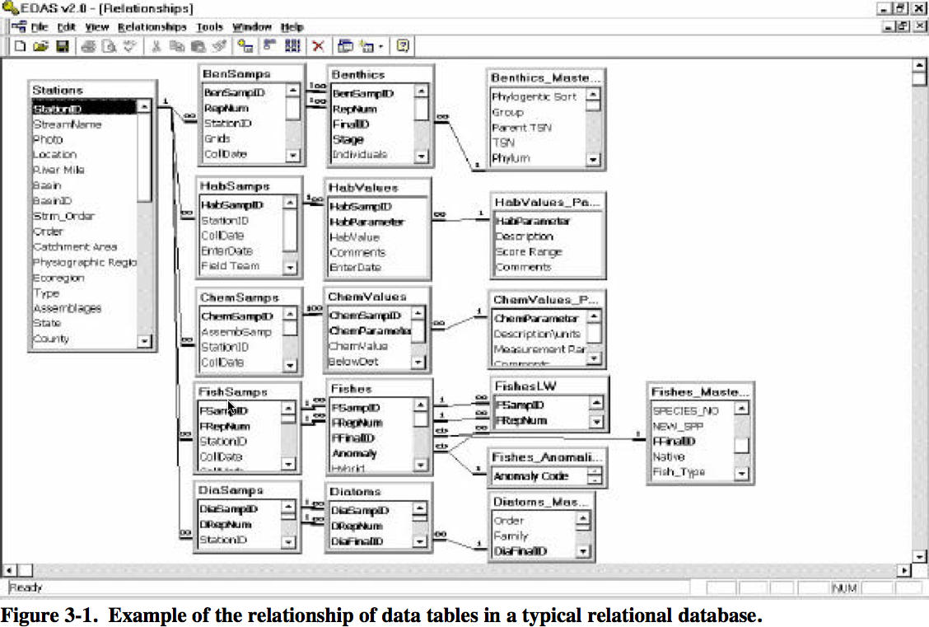
Taxonomy - Relational
Figure from EPA: “Monitoring and Assessing Water Quality”, Chapter 3.
“The relational model for database management is a database model based on predicate logic and set theory. It was first formulated and proposed in 1969 by Edgar Codd with aims that …” (Beginning of Wikipedia entry)
Rather than approach this topic in general, let us proceed with learning MySQL.

Slide 6
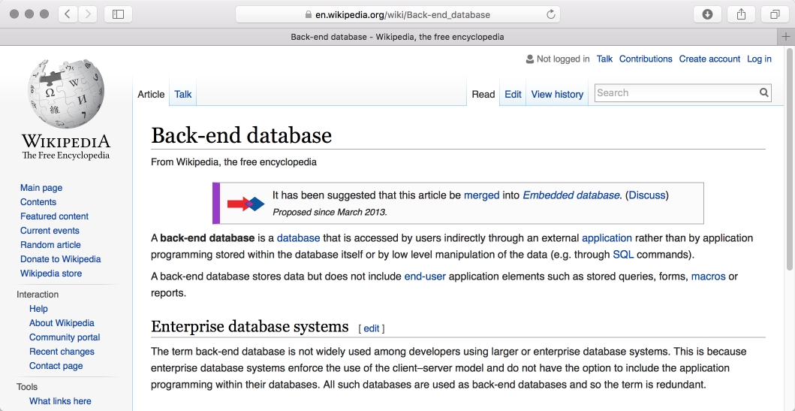
Backend Database Overview
Behind (almost) all good websites stands a loyal database.

Slide 7
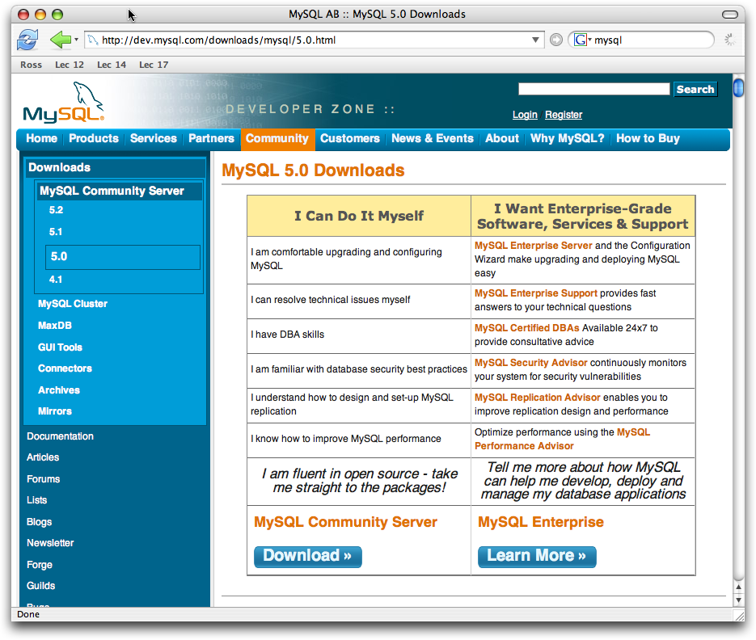
MySQL – By Itself
Open Source
Common Platforms

Slide 8
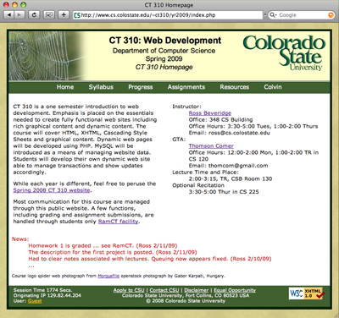
Architecture Review
Where is persistent user specific info?
Client Computer
Web Server (Apache)
Static Files (index.html)

Slide 9
Architecture – Now Where?
Client Computer
Web Server (Apache)
File System /cgi-bin
Server Side cgi, Perl, PHP, …
Native Code (enter.exe)
Client Side
(JavaScript)

Slide 10
Architecture – Data Server
Client Computer
Web Server (Apache)
+
PHP Interpreter
File System (enter.php)
*
MySQL Database

Slide 11
Always Ask – Where?
As in, where is the data?
On a separate machine?
On the same machine?
In a form you can read externally?
Will it move when you move the site?
How do you make copies?
What are the points of failure?

Slide 12
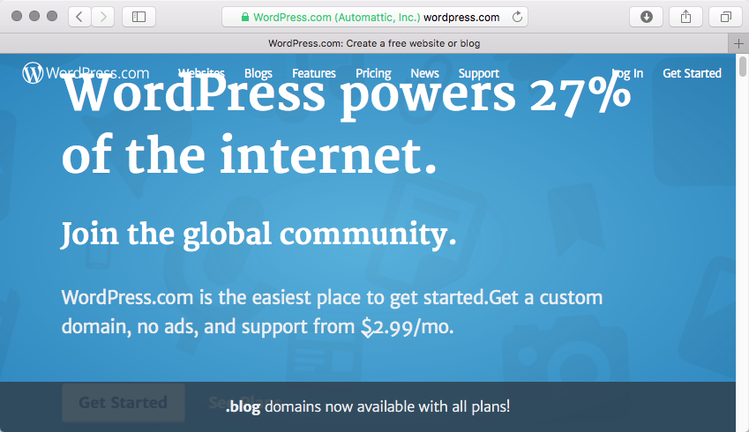
Name a CMS using MySQL

Slide 13
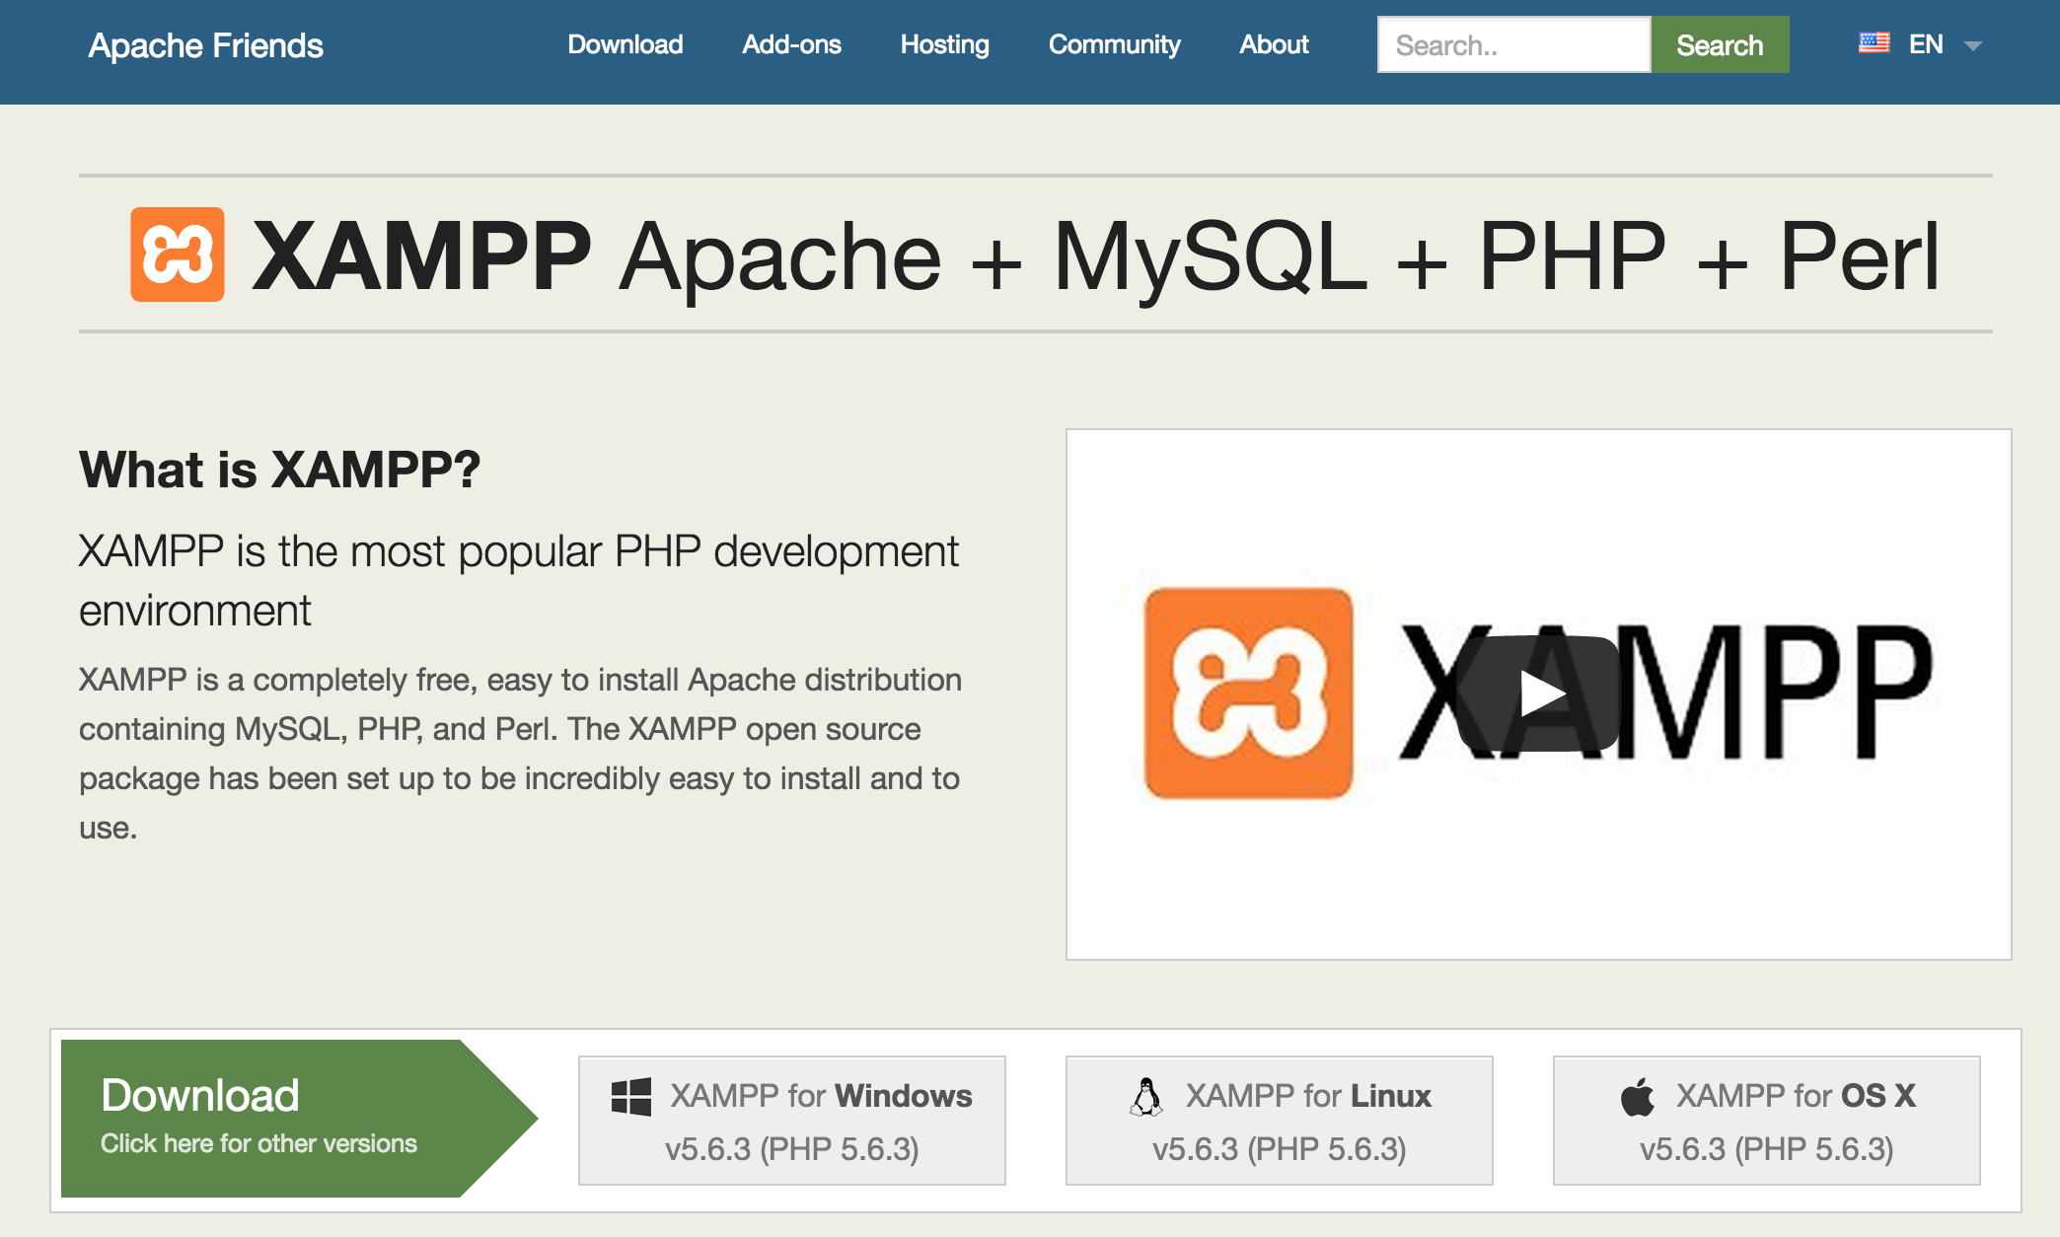
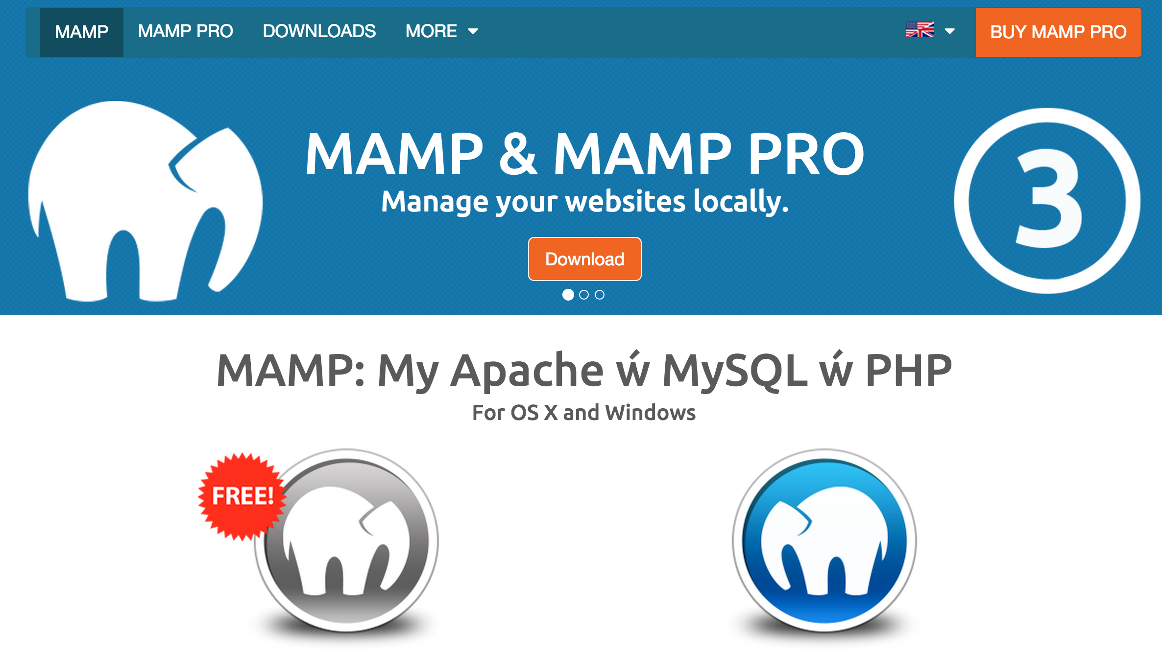
Want to Try at Home

Slide 14
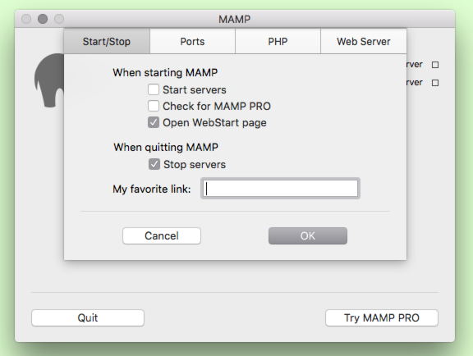
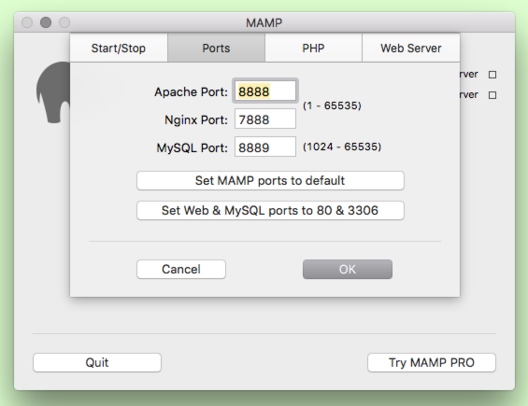
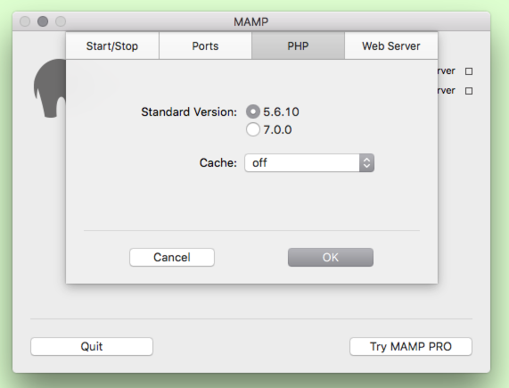
MAMP Preferences Overview

Slide 15
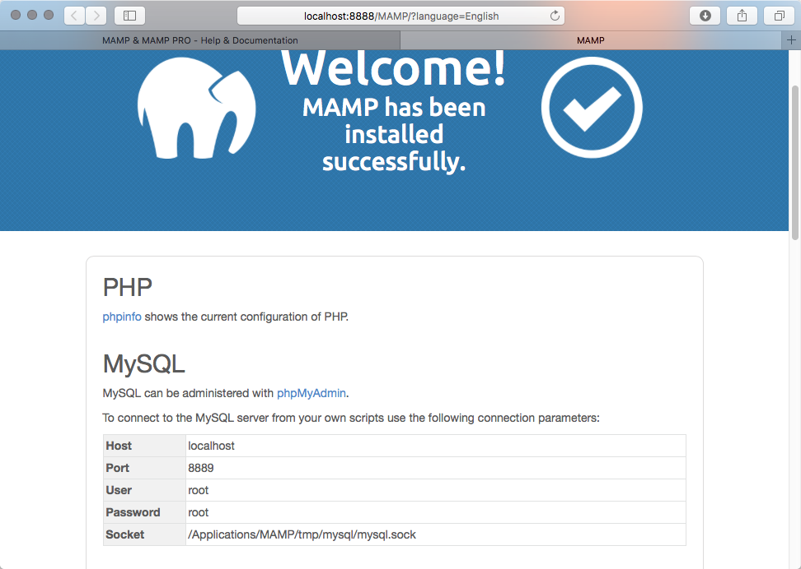
Note port number on URL
Localhost:8888
Also, port number for MySQL server
8889

Slide 16
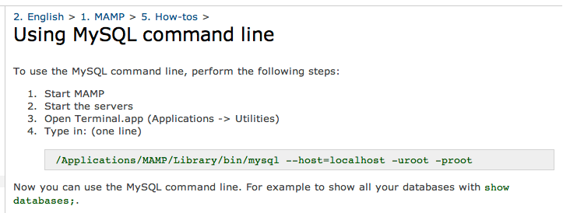
Command Line MySQL
Real Workflows: WYSIG Database Support.
Getting Started: stay close to basics,
understand command line level control.

Slide 17
Danger Danger
Perhaps the most common mistake!
Read the fine print:
… the server does not requre a password at all ...

Slide 18
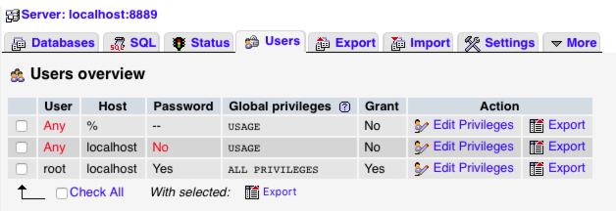
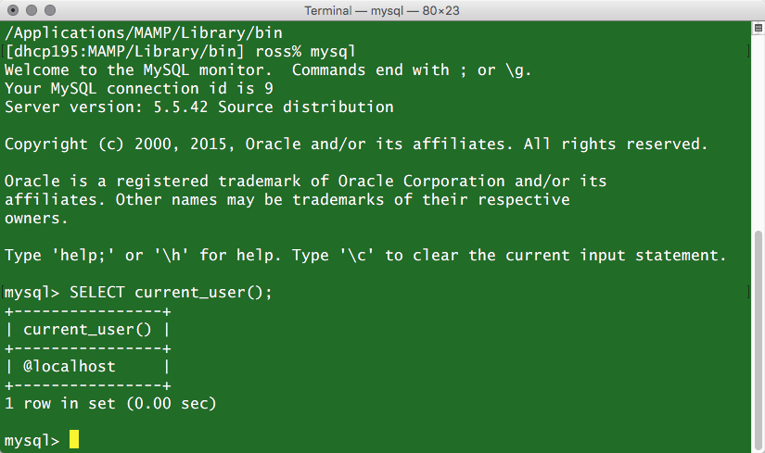
Just How Open is MySQL Out of the Box!
A user with no name!
Remember the password (you saw it!)
Ok – Some Protection

Slide 19
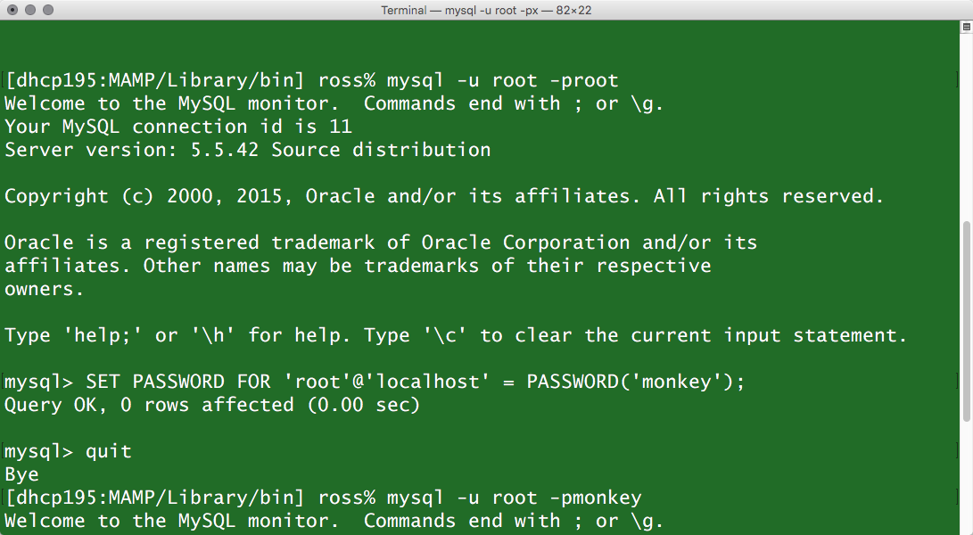
Reset Root Password!
Why am I teaching you this first?!

Slide 20
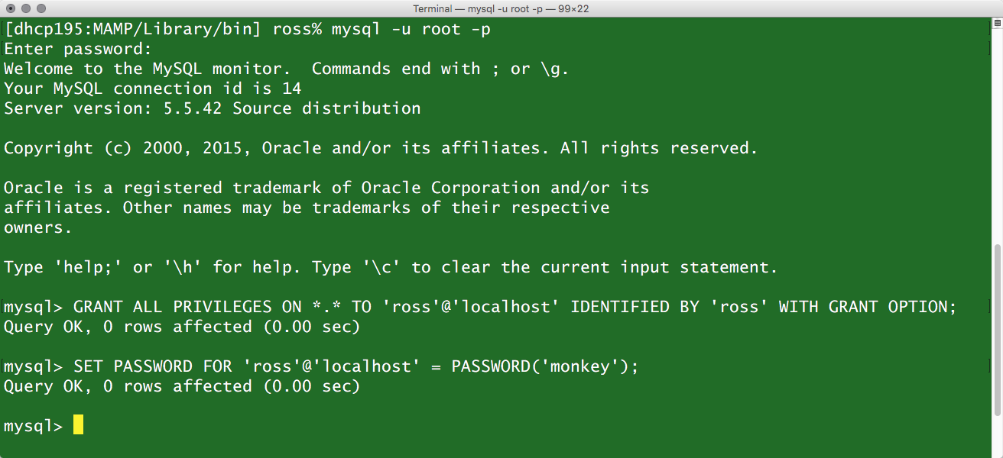
Create A User
Avoid the trap of doing routine work as ‘root’. Build users with purpose.

Slide 21
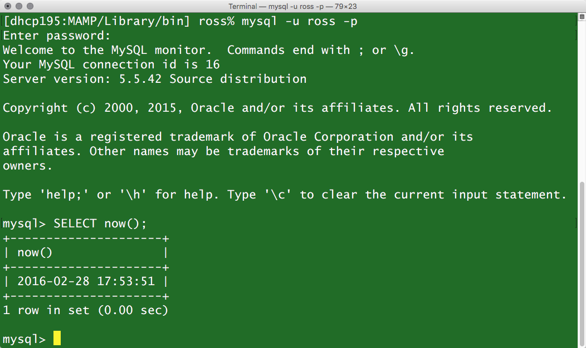
Now Try It Out
Summary
mysql –u ross –p
SELECT NOW();
quit;
Interaction is typically in the form of a query, in this case ‘select’ the function ‘now’ and retrieve the current date and time.

