Slide 1
Lecture 17
*
MySQL
Tables and Relations 101
* Course logo spider web photograph from Morguefile openstock photograph by Gabor Karpati, Hungary.

Slide 2
Data - Tables
Table is, more or less, a flat database.
Contains “things”, objects.
One thing per row.
Columns store attributes.
Primary index unique for each row.
Relations kick in later
How we relate tables to one another.

Slide 3
Exercise Some Commands
use
CREATE
INSERT
SELECT
UPDATE
DROP
id | name | artist
1 | Mudlark | Leo Kottke
2 | My Feet Are Smiling | Leo Kottke
3 | Lucky The Man | Wizz Jones
4 | The Blue Idol | Altan
5 | Return of the Repressed | John Fahey

Slide 4
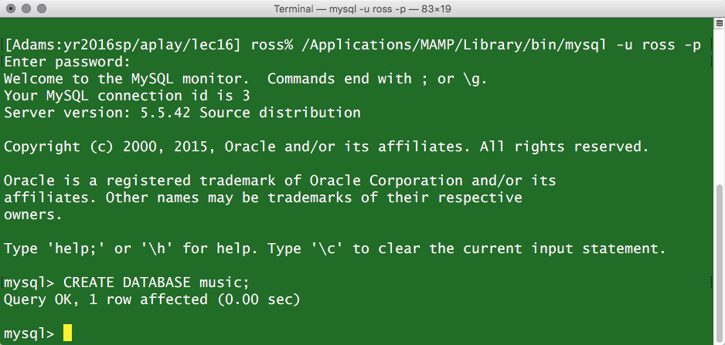
Create Music Database
In general, new databases do not come and go often.

Slide 5
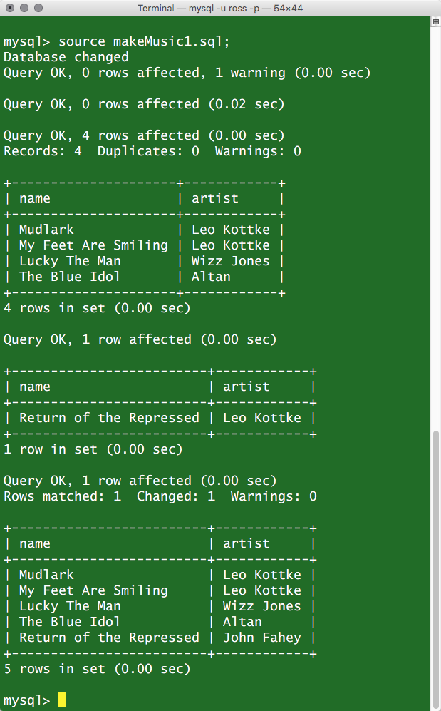
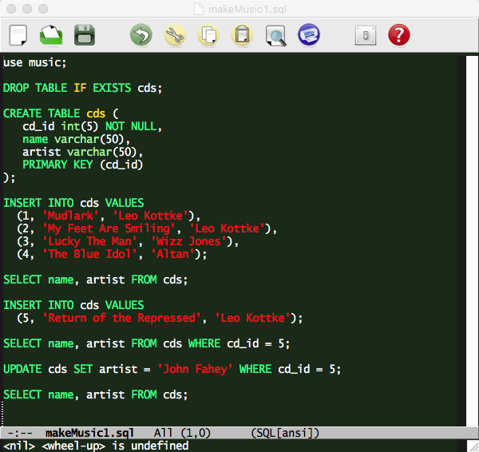
Example 1

Slide 6
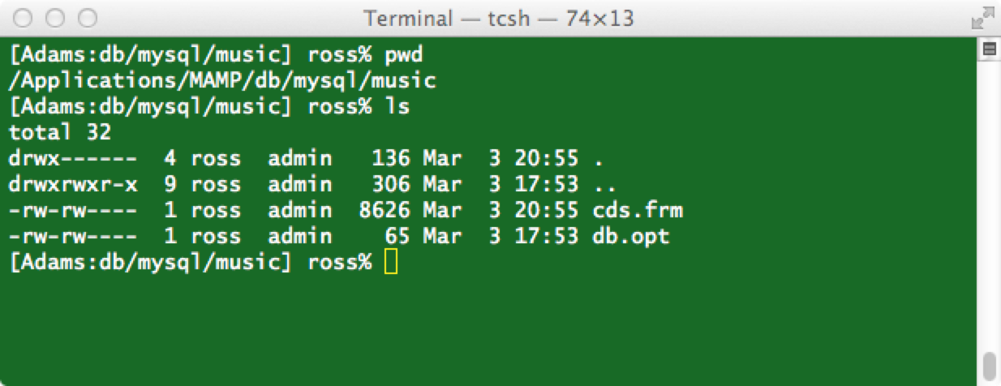
Where’s the Beef, ah … Data.
Data from tables is stored in files.
Case sensitivity comes from host OS.
In case it is not obvious.
NEVER MANIPULATE THESE FILES DIRECTLY.

Slide 7
Relations 101
Leo Kottke appears twice.
Leo Kottke
Wizz Jones
Altan
John Fahey
The Blue Idol
Mudlark
Lucky The Man
My Feet Are Smiling
Return of the Repressed

Slide 8
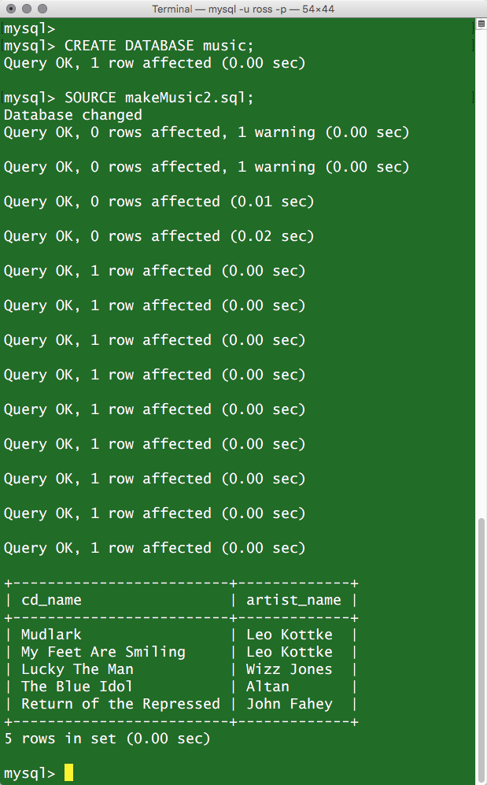
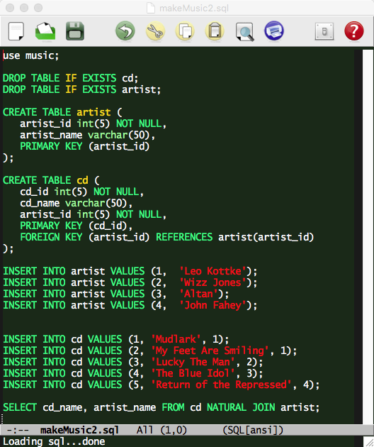
Example 2

Slide 9
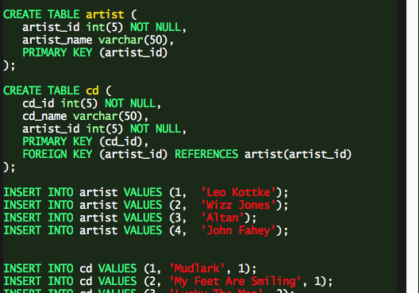
Keys: Primary and Foreign
Primary Key Unique!
Establishes Relation:
Loosely speaking, a ‘pointer’ to the other object.
Two cds related to one artist.

