Slide 1
Lecture 21
*
Handling Files
In particular, uploading files.
* Course logo spider web photograph from Morguefile openstock photograph by Gabor Karpati, Hungary.

Slide 2
Overall Workflow
User Uploads File
Do necessary data validation
Check file type, size, etc.
Move temp file to permanent location.
Two step process provide a level of protection.
Record the transaction in a database
Accurate record of site accessible files.

Slide 3
Setting Up the Form
Set Form Encode Type
<form method='post’ enctype='multipart/form-data'>
Create form element
<input type='file'
name='filename' size='10'>

Slide 4
$_FILES Array
How file information is passed back to PHP on the Server.
Array element
$_FILES['file']['name']
$_FILES['file']['type']
$_FILES['file']['size']
$_FILES['file']['tmp_name']
$_FILES['file']['error']
… The name of the uploaded file (e.g., smiley.jpg)
… The content type of the file (e.g., image/jpeg – More Next)
… ^{The file’s size in bytes}
… The name of the temporary file stored on the server
… The error code resulting from the file upload

Slide 5
Common Media Types
application/pdf image/gif multipart/form-data text/xml application/zip image/jpeg text/css video/mpeg | audio/mpeg image/png text/html video/mp4 audio/x-wav image/tiff text/plain video/quicktime

Slide 6
Types of Validation
File Type
Make sure appropriate type
Make sure file extension matches type
File Size
Check size of file
PHP has a maximum size which is set in php.ini

Slide 7
Saving
Often files are saved to the local disk
move_uploaded_file()
Also possible to save to DB. However, in practice isn’t used very much.
However, we often save a record in the DB referencing the file (see example)

Slide 8
Extended Example Intro
We will demonstrate key features with an extended example: lec21.zip
Note, it will not allow uploads on the CS Server – think about security.
You will download to your own site and experiment.
And then disable if on a public server!

Slide 9
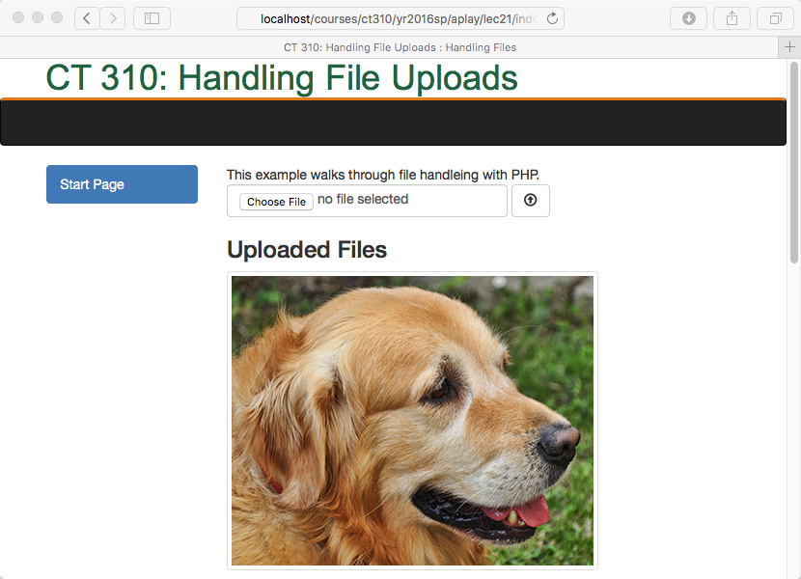
Extended Example Page

Slide 10
Extended Example Roadmap
Similar overall structure as before.

