Slide 1
Lecture 22
*
Images
* Course logo spider web photograph from Morguefile openstock photograph by Gabor Karpati, Hungary.

Slide 2
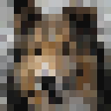
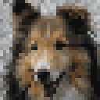
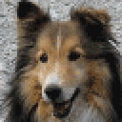
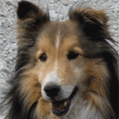
Back to Basics Pixels
Notes:
A Basic Concept is that of an Image Pyramid. Here we see 1x1, 2x2, 4x4, 8x8, 16x16, 32x32, 64x64 and 128x128 versions of the same image.

Slide 3
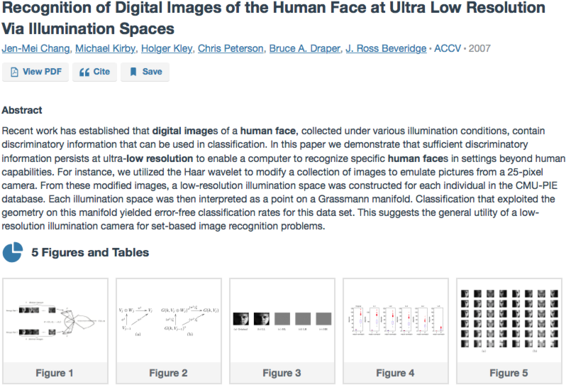
About Low Resolution a total aside comment

Slide 4
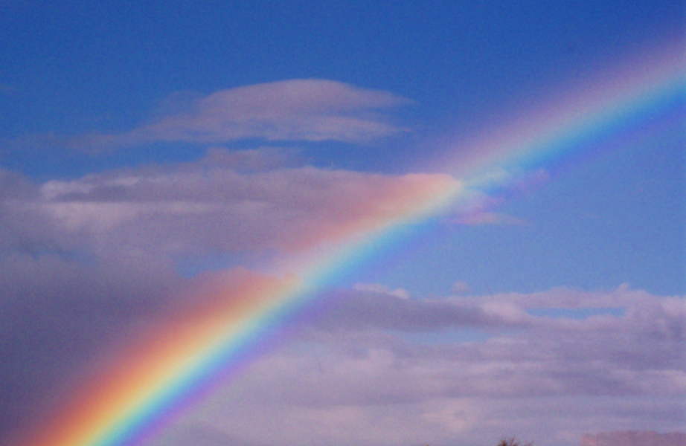
Colors (RGB)
Visual range
red (700 nm) …
to violet (400 nm)
Ever wonder why?
Red, Green & Blue
Physics?
Not really.
Neural Biology?
Much Closer.
energy
400
wavelength
700
Morguefile image by Jane M. Sawyer

Slide 5
Tristimulus Theory of Color
The tristimulus theory says cones in the human eye detect 3 primitive colors:
red, green, and blue.
Energy near red excites response.
Same for green and blue.
All the rest of the “detail” goes away.
RGB Displays therefore cheat.
Might be why dogs don’t like TV ….

Slide 6
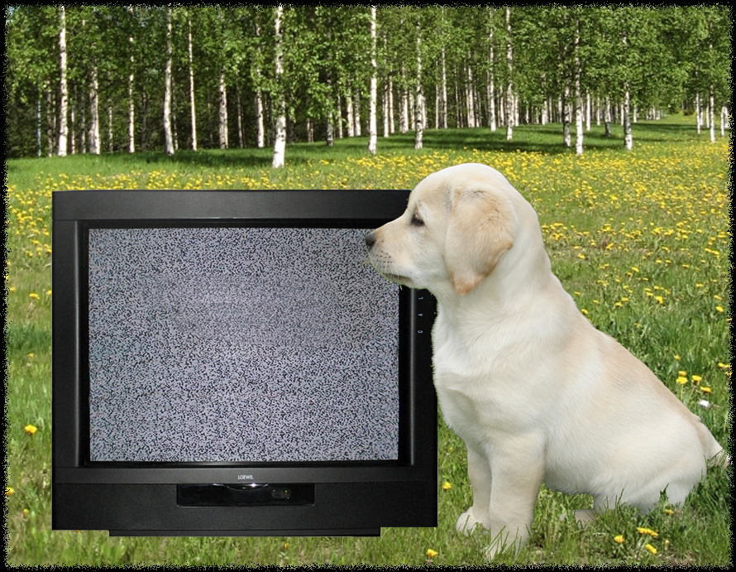
Why Don’t Dogs Watch TV?

Slide 7
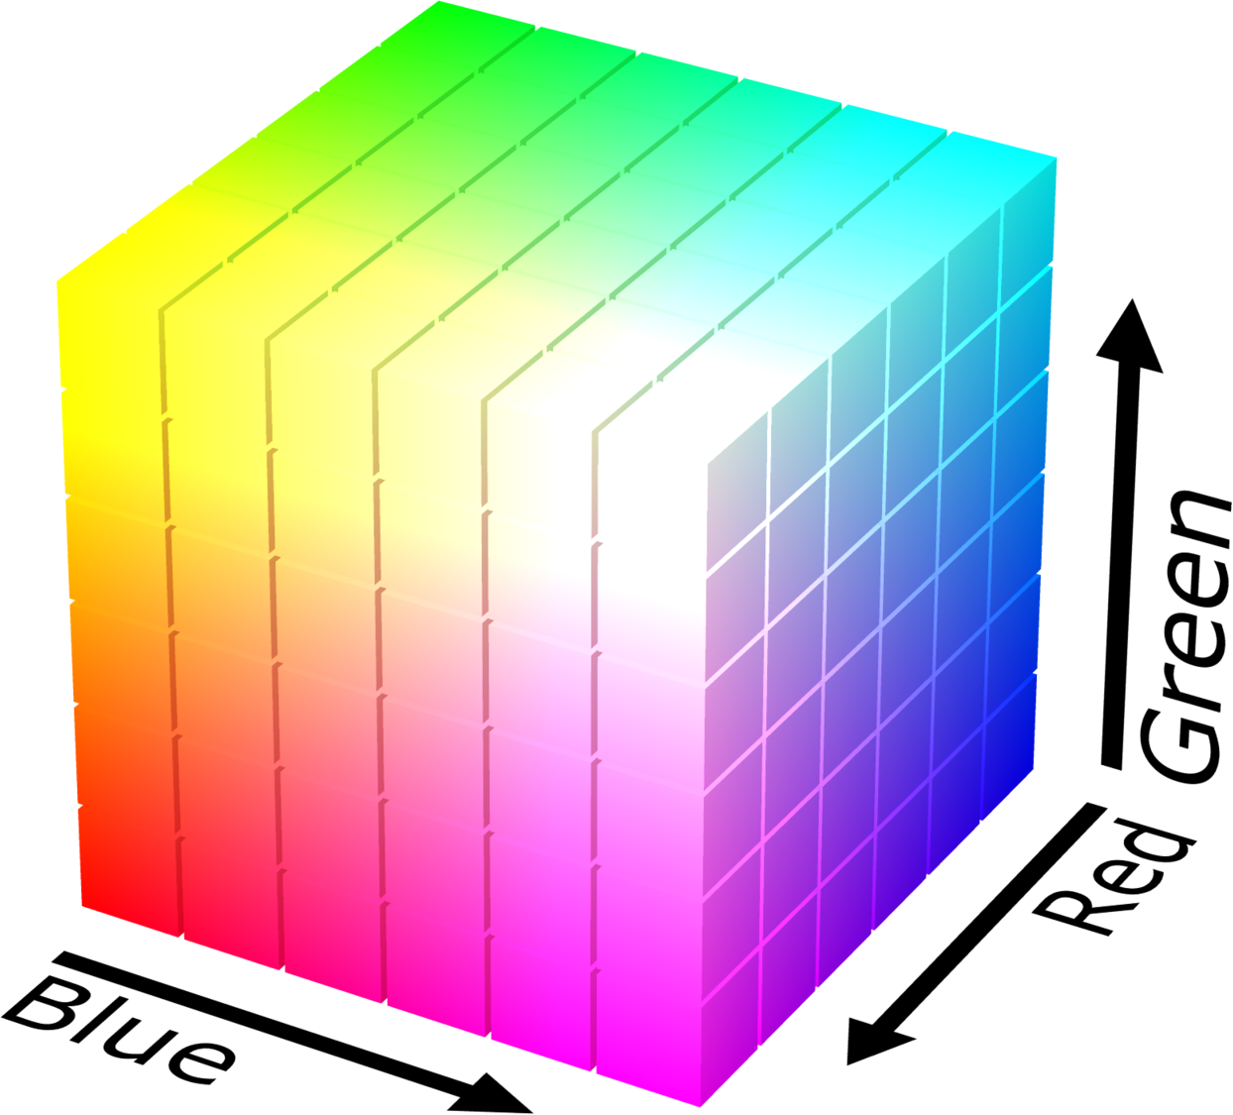
The RGB Cube
3 Dimensions
Move along:
Red
Green
Blue
Direct tie to tristimulus theory.
https://en.wikipedia.org/wiki/RGB_color_model#/media/File:RGB_color_solid_cube.png

Slide 8
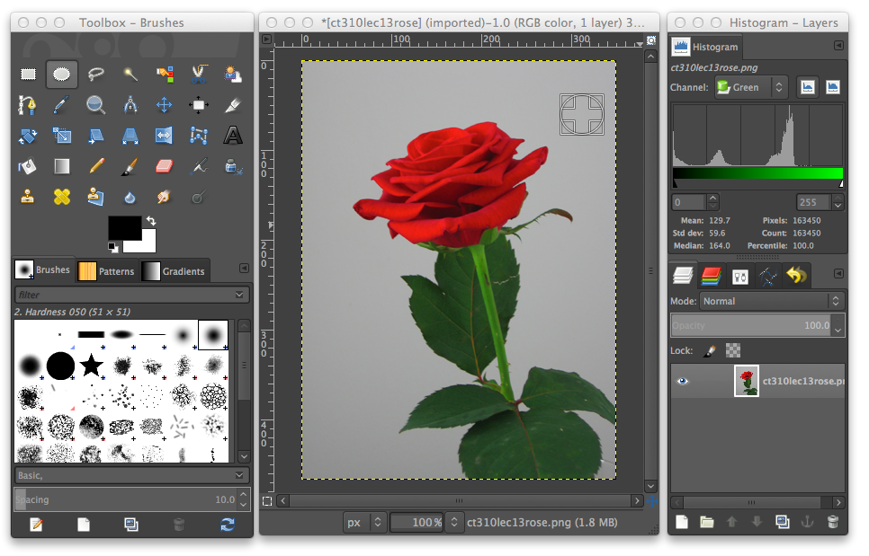
Photo Editing Tools - GIMP
Notes:
GIMP has the great advantage of being on all CS Department Unix Workstations. Just type gimp

Slide 9
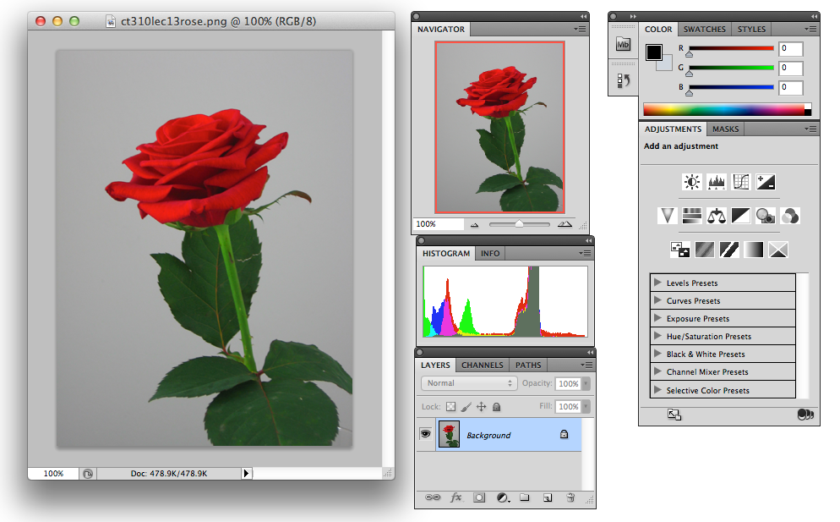
Editing Tools - Photoshop
Notes:
Photoshop has the great advantage, for me, that I’ve spent nearly a decade learning it (and I still only know a small small fraction of what it can do). I will use Photoshop in lectures to illustrate many concepts related to image manipulation.

Slide 10
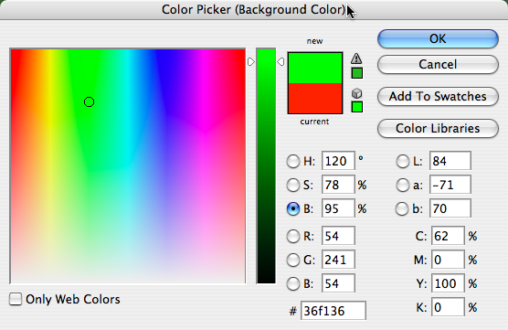
Back to specifying colors
 | Hex | Dec. | Binary
R | 36 | 54 | 00110110
G | f1 | 241 | 11110001
B | 36 | 54 | 00110110
Notes:
The Photoshop color picker gives one nice view of how different means of specifying colors relate to each other.

Slide 11
GIF Image Format
Graphics Interchange Format
Limited to 256 colors
Designed for flat graphics
Not for photographs!
Uses color map, more in a minute.
Superseded by 8 bit PNG
But it certainly is universal …

Slide 12
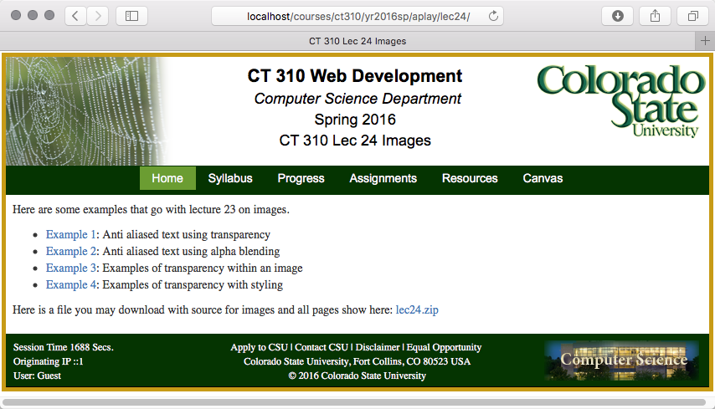
Examples for this Lecture

Slide 13
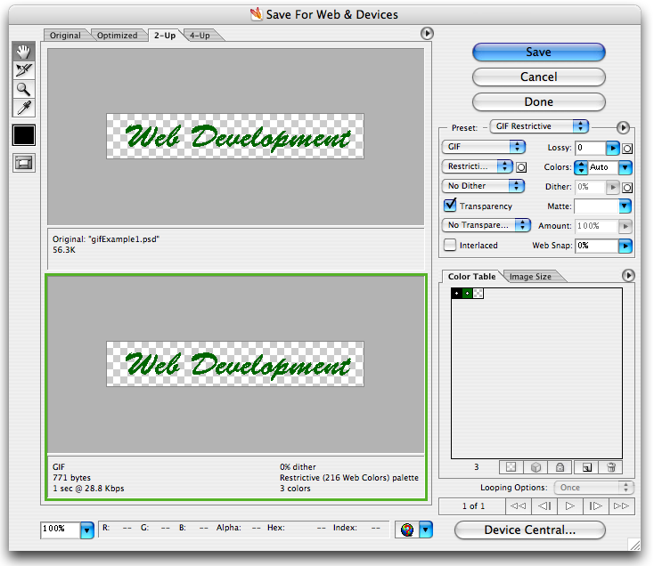
Saving as Gif
Color Table.
Entry 1
000000
Entry 2
006600
Entry 3
Transparent.
Size
56,300 bytes
To 771 bytes.

Slide 14
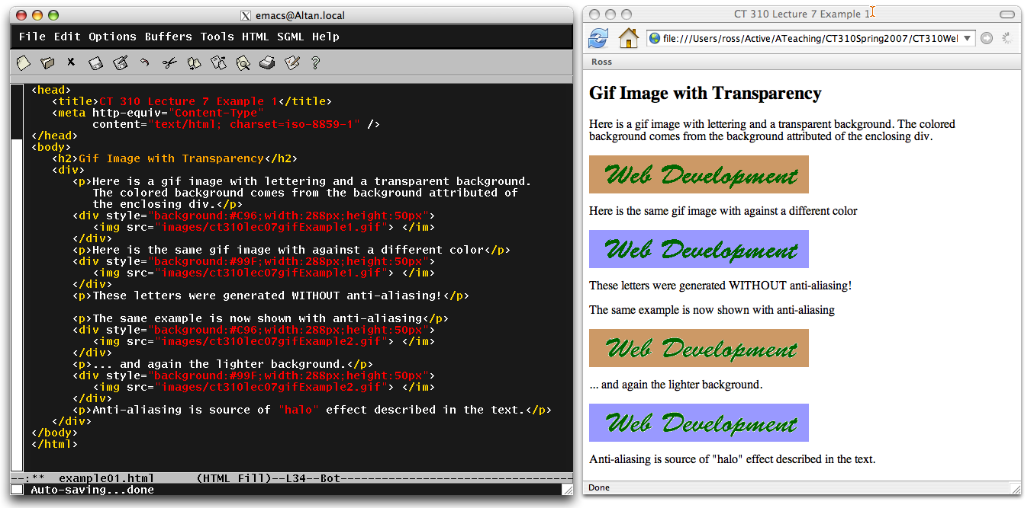
First Example Transparency
Anti-Aliasing is usually a good thing! (But beware).

Slide 15
Gif and Compression
Part 1:
Color Table
Part 2:
Run Length Encoding
Lempel-Ziv-Welch
Consider simple type
Note duplicates
Replace
Lossless!
1 | 1 | 1 | 1 | 1 | 1
1 | 2 | 2 | 2 | 1 | 1
1 | 1 | 2 | 2 | 2 | 1
1 | 1 | 1 | 1 | 1 | 1
111111122211112221111111
(7,1),(3,2),(4,1),(3,2),(7,1)
7132413271

Slide 16
GIF Animations
GIF allows multiple frames in one file.
Browsers sequence through frames.
Result is a simple form of animation.
Leads us to Deidre LaCarte’s famous* …
Now http://www.hamsterdance.org/hamsterdance/
Thanks to Wikipedia for providing an excellent history of hamster dance.
Notes:
Modern tastes in web site design dictate sparing use of animation. That said, used sparingly, it is a powerful accent.

Slide 17
JPEG Image Format
Joint Photographic Export Group.
Full 24 bit color.
But, Some information is lost.
This is why one specifies quality level.
Essence - Discrete Cosine Transform
Wikipedia (again), very nice synopsis.

Slide 18
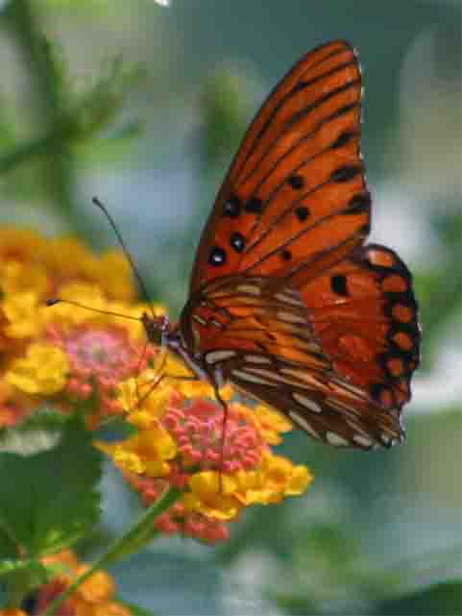
Quality Level Examples
116KB
136KB
324KB
Morguefile image by Nanette Bartet.

Slide 19
JPEG and Plain Text, Note a Good Combination.
Notice artifacts in the white background!

Slide 20
PNG Image Format
Portable Network Graphics
Comes in two flavors
8 bit color mapped, replaces GIF.
24 bit full color, replaces JPEG.
Includes an alpha channel
Practical transparency.

Slide 21
Alpha Channel Review.
A good way to use the last byte :-)
Consider a 32 bit word …
Alpha controls blending
Alpha = 0 (000) - transparent.
Alpha = 1 (255) - completely covers.
Alpha = 0.5 (128) - 50/50 blend.
Alpha
Red
Green
Blue
1 | 0 | 0 | 0 | 0 | 0 | 0 | 0
0 | 0 | 1 | 1 | 0 | 1 | 1 | 0
1 | 1 | 1 | 1 | 0 | 0 | 0 | 1
0 | 0 | 1 | 1 | 0 | 1 | 1 | 0
80 36 F1 36

Slide 22
Modern Operating Systems Support Transparency.

Slide 23
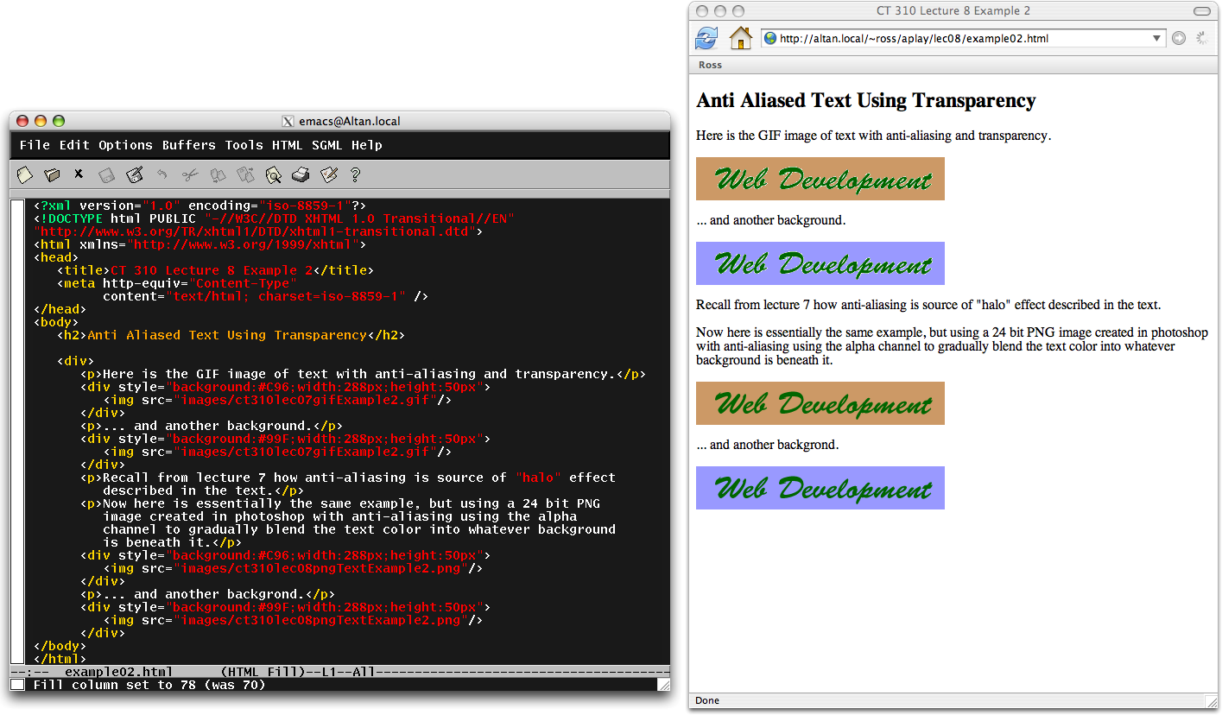
Anti Aliasing Revisited

Slide 24
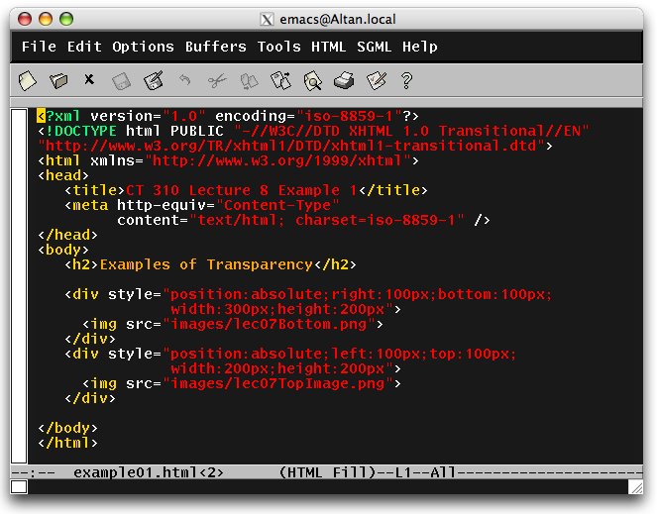
Semitransparent - image
The top image uses the alpha channel to specify opacity.
Photoshop Opacity is 75%

Slide 25
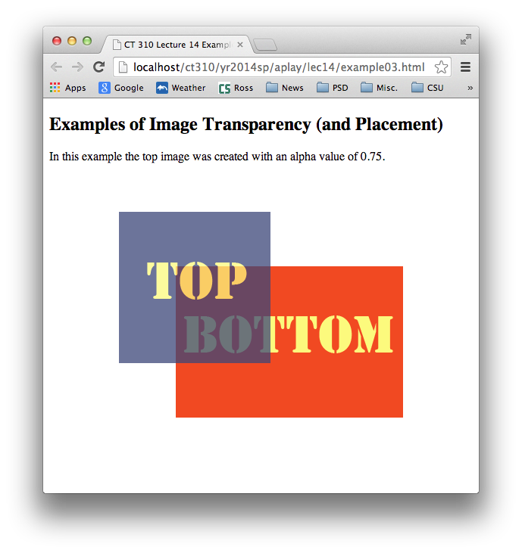
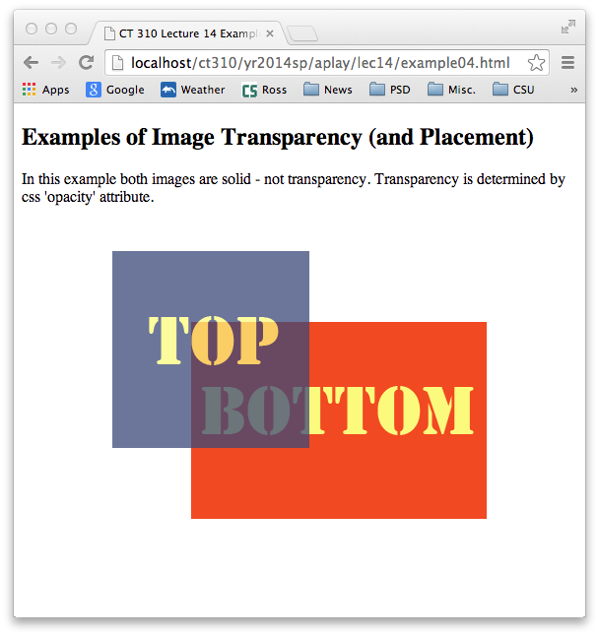
Semitransparent Images
Notes:
We will construct to images in Photoshop and make one 25 transparent.

