Slide 1
Lecture 24
*
Introduction to AJAX
and the migration toward applications
* Course logo spider web photograph from Morguefile openstock photograph by Gabor Karpati, Hungary.

Slide 2
AJAX – Breaking the Promise
Before AJAX
A server serves a page to a client!
After AJAX
Widget level event driven programming.
Server analogous to App backend.
Client analogous to interactive GUI.
AJAX once meant …
Asynchronous JavaScript and XML
The XML part has faded away.

Slide 3
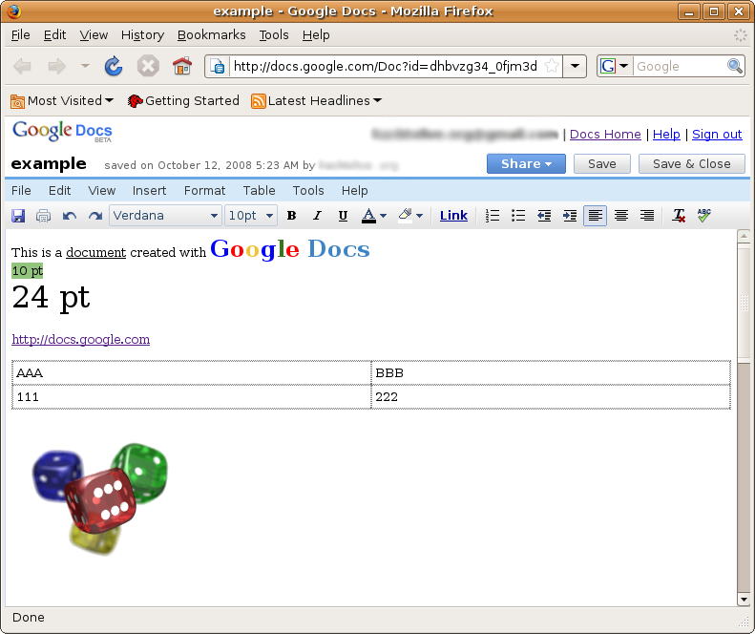
Outward Examples
Google Apps
MapQuest
Facebook
Really, almost all modern complex sites.
An early example of Google Docs
Example from wikipedia

Slide 4
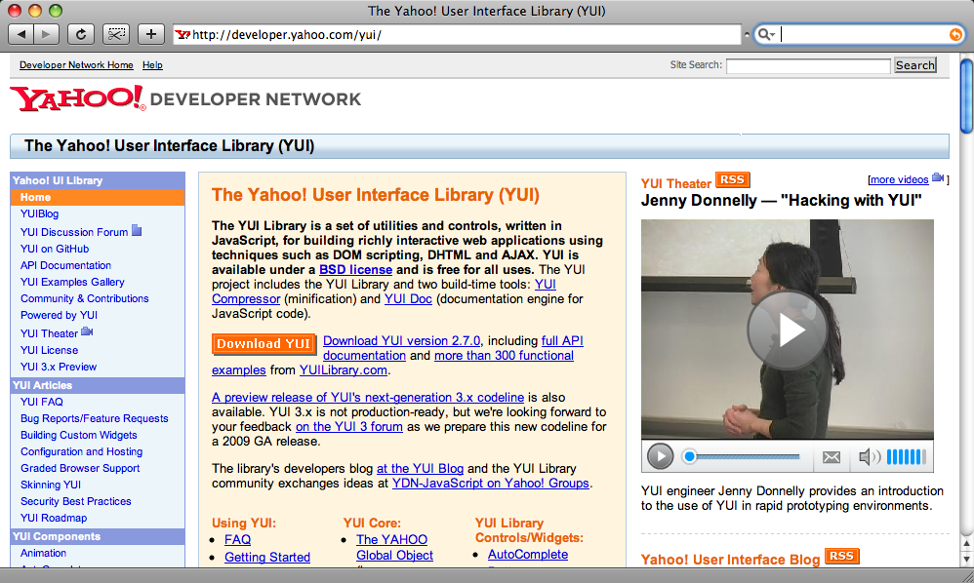
Support Libraries Abound

Slide 5
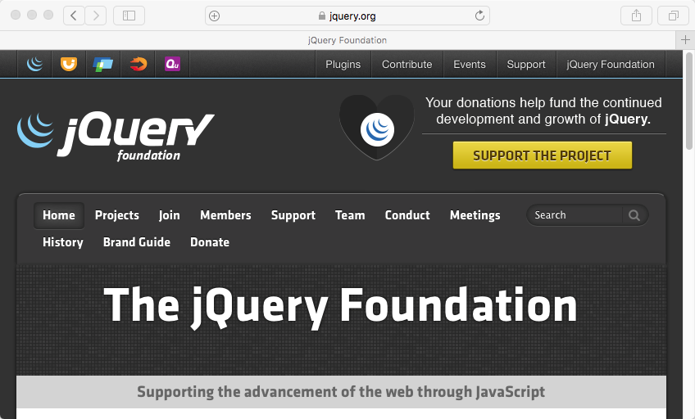
And One is now Dominant
Yes, we are getting closer, but first …

Slide 6
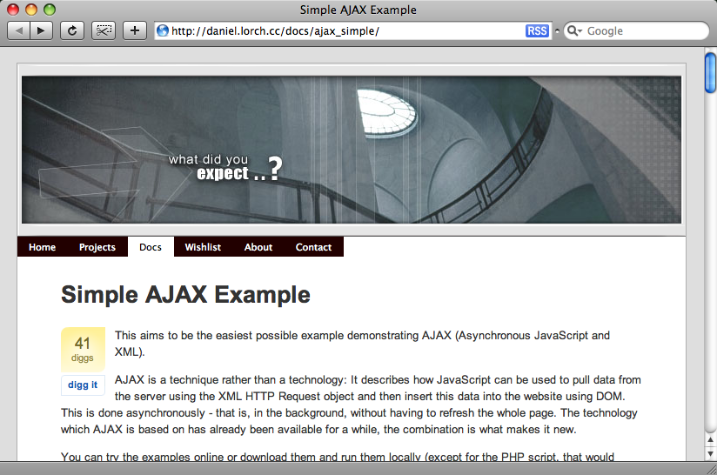

Slide 7
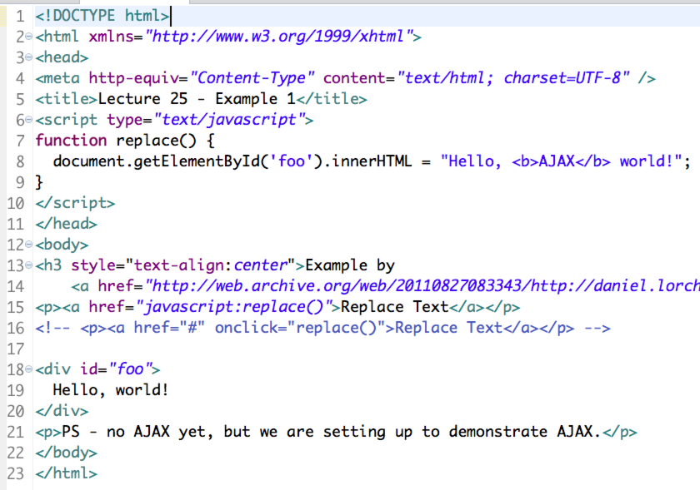

Slide 8
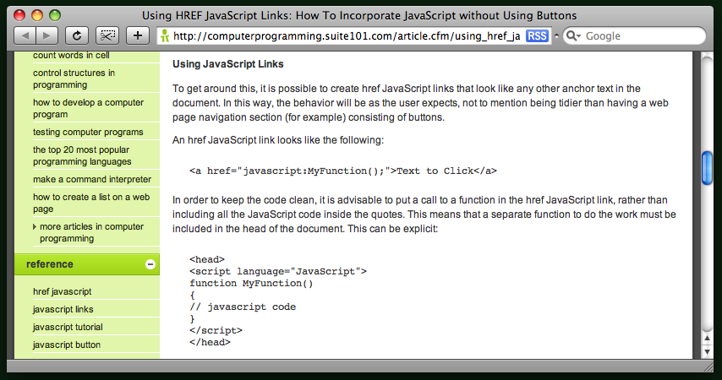
JavaScript as a link

Slide 9
Basic JavaScript Review
The div has a name (id actually)
The document is an object/element
Document contains other elements
Elements have ‘innerHTML’
Not ‘inner peace’
When/where does the html get set?

Slide 10
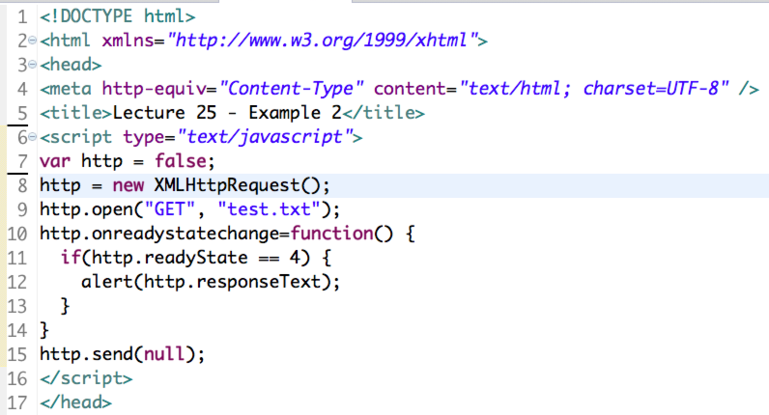
Example 2 -XMLHttpRequest
Important New Object!
Note example does not support antiquated IE6 ActiveX alternative.

Slide 11
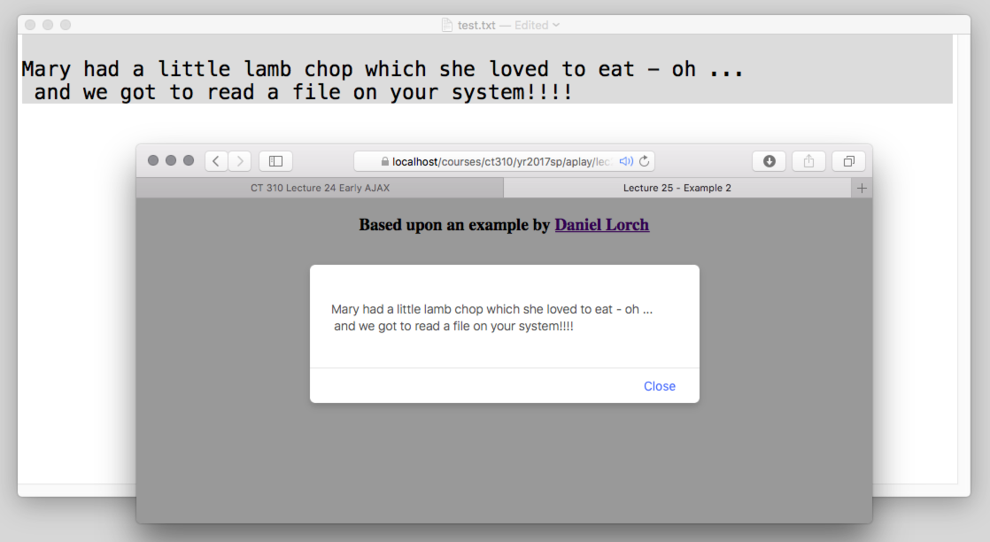
Example 2 – in action

Slide 12
Example 2 - Comments
There is a var/object ‘http’
Establishes a connection to a server.
Notice the use of
Open
‘Get’
Events
Send null - close

Slide 13
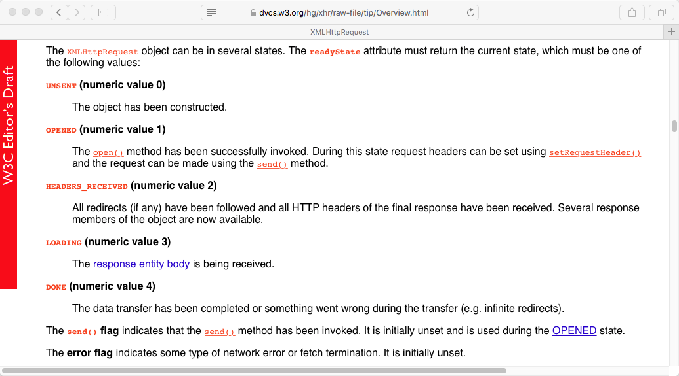
readyState Change

Slide 14
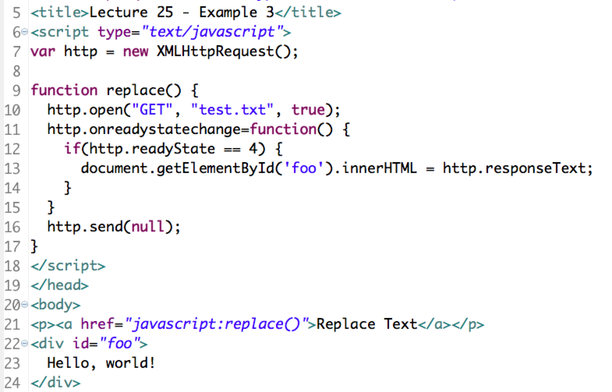
Example 3 code

Slide 15
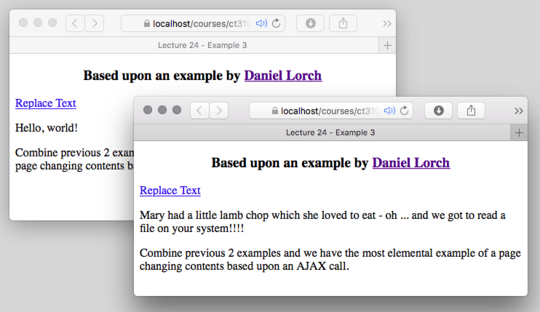
Example 3 in action

Slide 16
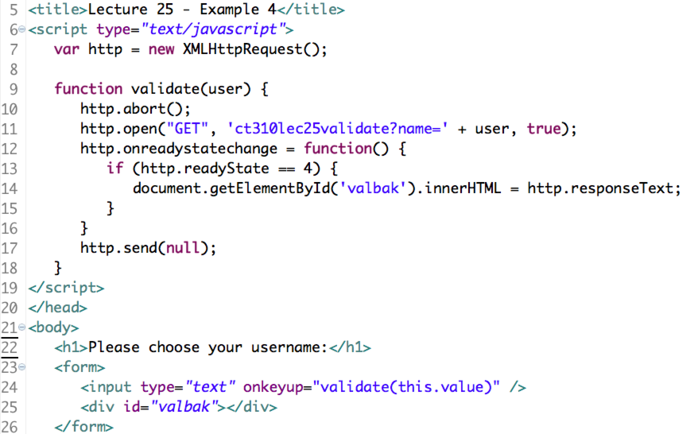
Example 4 – Code 1

Slide 17
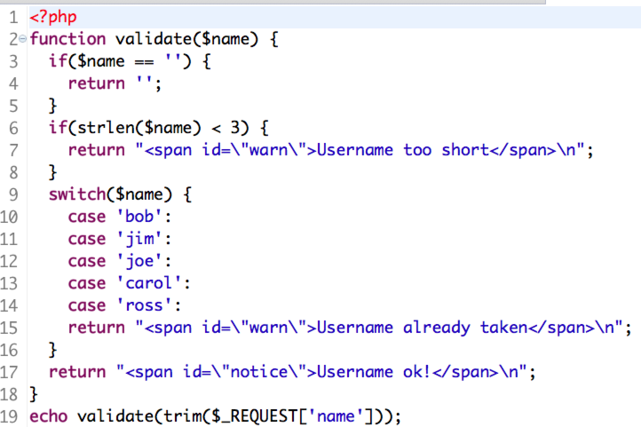
ct310lec25validate.php

Slide 18
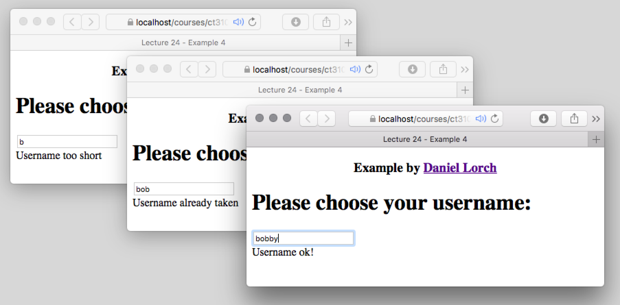
Example 4 in action
Pay attention to character feedback

Slide 19
Cross-Site Scripting!
In class (2012) I walked head long into an illegal use of cross-site scripting.
On my laptop, i.e. localhost, I tried:
http.open("GET",
'http:///www.cs.colostate.edu/' +
'~ct310/yr2013sp/aplay/lec18/' +
'validate.php?name=' +
user, true);
Violates the “Same Origin Policy” !

Slide 20
Background & Summary
Cross-site scripting attacks represent a large fraction of malicious behavior – stolen data/accounts/etc.
In a nutshell, site A gets hacked, hook inserted to load JavaScript from site B, code from B then gains access to what A knows/does etc.

Slide 21
Same Origin Policy
Modern browsers impose strong constraints on AJAX behavior.
Domain serving document must be the same domain used through XMLHttpRequest().
Workarounds include JSONP,
Cross-origin resource sharing.

Slide 22
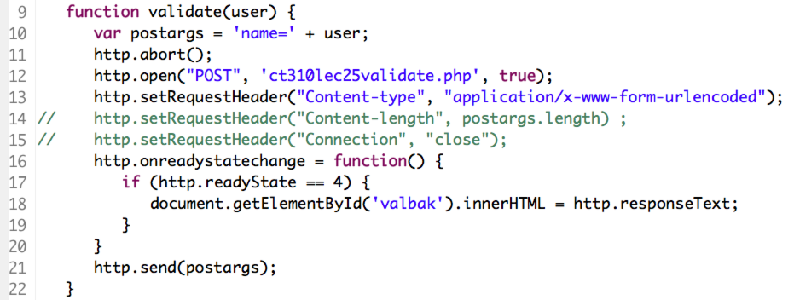
Example 5: Post Not Get
Same as Example 4 but using POST.
Bit more code; bit more secure.

Slide 23
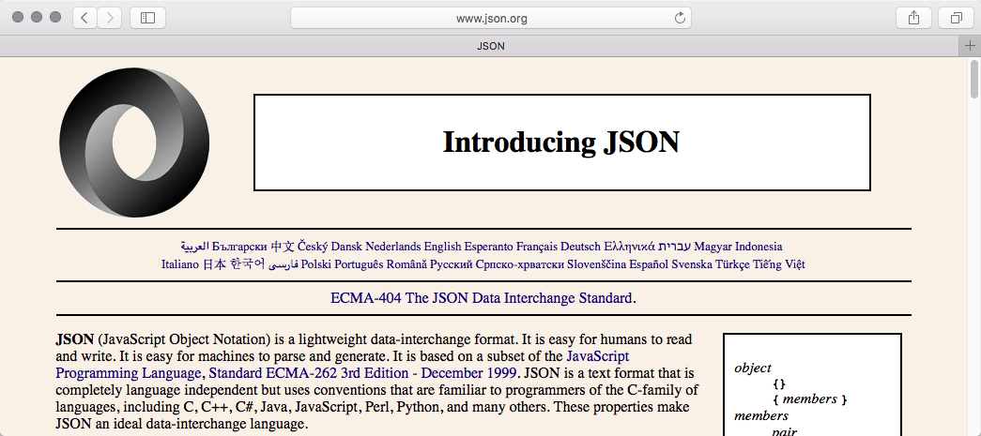
Moving Data - JSON
Moving data from server to client?
We’ve just seen plain text
JSON is common for structured data

Slide 24
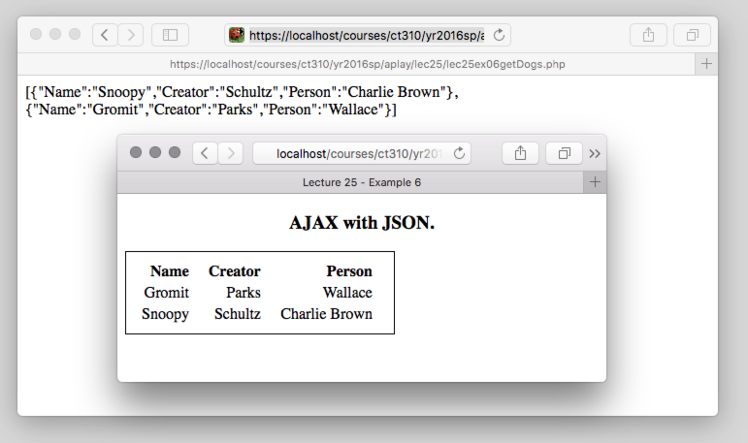
Example 6 – JSON Dogs
json_encode($dogs)
JSON.parse(http.responseText)

Slide 25
Closing thoughts on AJAX The Path Back to Computer Science
In the beginning
HTML is simple and elegant …
Easy to learn and use
Far removed from CS complexities
With AJAX, the circle closes
What do you need to understand?
Just about everything taught in CS

