Slide 1
Lecture 29
*
Content Management and WordPress
* Course logo spider web photograph from Morguefile openstock photograph by Gabor Karpati, Hungary.

Slide 2
Think About Workflow!
Consider domains of expertise:
Design – art, communication, ..
Systems – CS, CIS, ..
Content – writers, photographers, ..
First time up – build a site.
From that moment forward
Maintenance?
Much much more than maintenance!

Slide 3
A Site is Like a …
A Book
Major up front effort then walk away.
A TV Miniseries
Effort over fixed period, then walk away.
A Good Newspaper
What needs to be said today.
A Good Restaurant
Yesterday’s food holds little appeal.

Slide 4
More Newspaper than Book
A website not in need of updating is a rare thing, and probably boring.
How does content get onto a site?
It comes from people, typically without web development skills.
… and they want to contribute that content through a browser.

Slide 5
The Big Change
BCM (Before Content Management)
Content added/modified using files on a server.
No server access, no changing the site.
Content providers need some degree of training.
CT 310 is BCM focused.
ACM(After Content Management)
Content added/modified through a browser.
Web based access control is in place.
Contribution of content through WYSIG tools.
Behind the scenes, content in a database.

Slide 6
The Argument
BCM Pros
Security
No browser updates
Simplicity
No complex superstructure
Often, file<->page match
Escape from WYSIG
Server tools for updating
BCM Cons
Updating is hard !!!
Content changes require server access & expertise
ACM Pros
Updating is easy!
Those responsible for content directly contribute
BCM Cons
Complexity
CMS Superstructure
Obscurity
Pages aren’t files
Security
One mistake and others with a browser own you
For all the ACM Cons, “Updating is easy!” wins. Expect to deploy some form of CMS in any project where real people are responsible for site content.

Slide 7
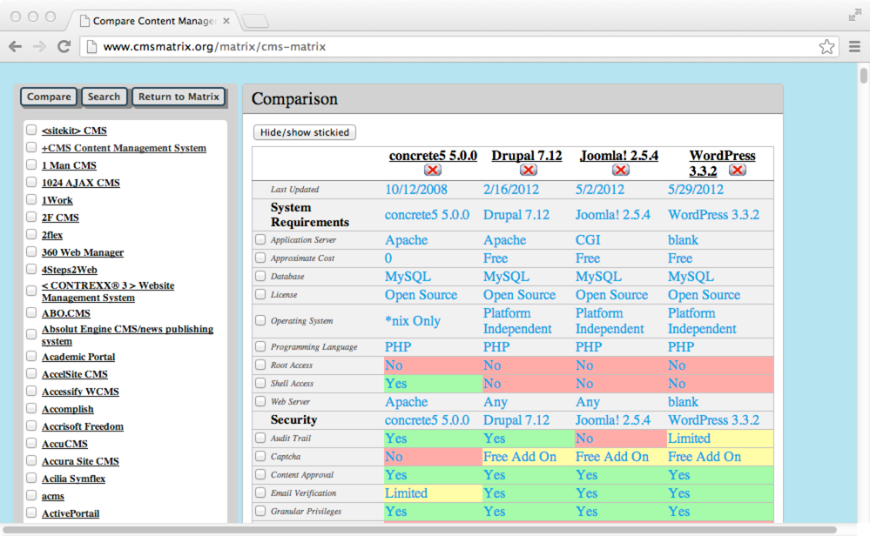
CMS Features
Warning, this site is not being kept up to date
Still useful to glimpse range of CMS features.

Slide 8
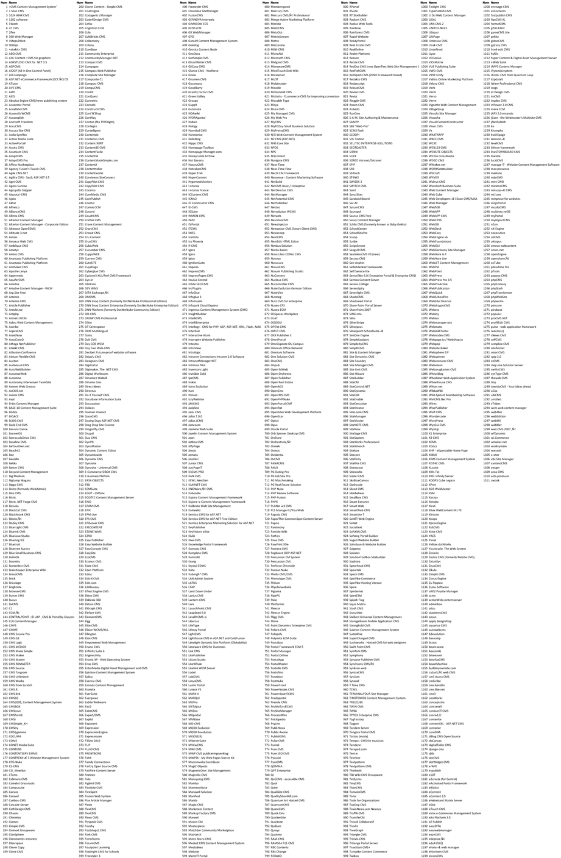
How Many Options
A crowded field!
There are 1311 entries
Problem: Does any platform have critical mass?
2016 CMS
Matrix Listing:
Of course you cannot read this!

Slide 9
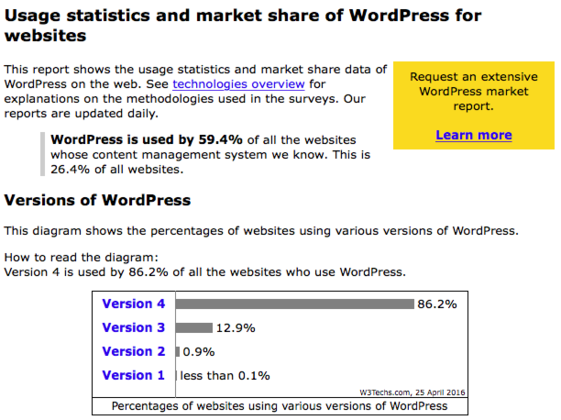
Critical Mass: Yes

Slide 10
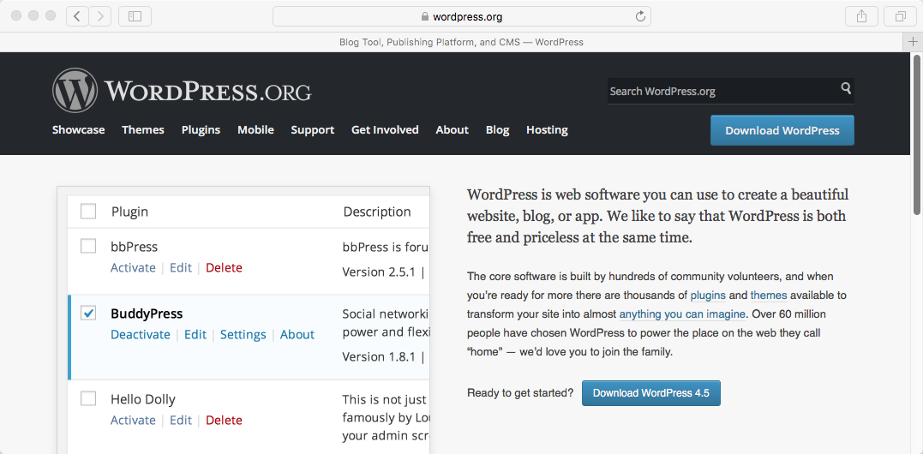
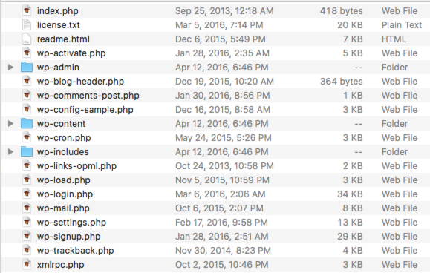
WordPress – Get It

Slide 11
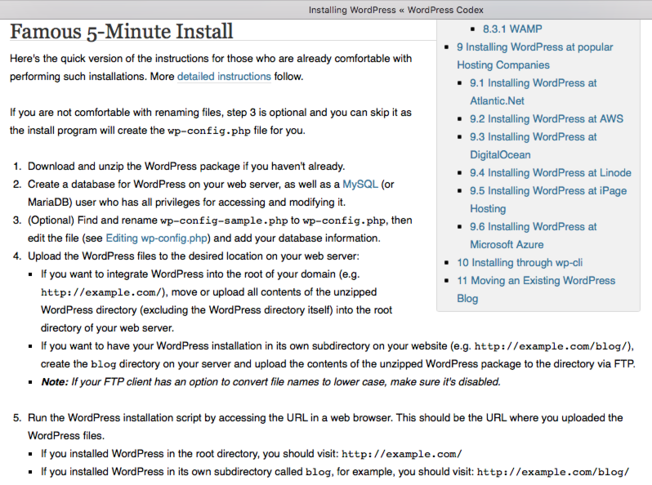
Follow The Handy Guide
Don’t try to read steps here, we will review them briefly today.

Slide 12
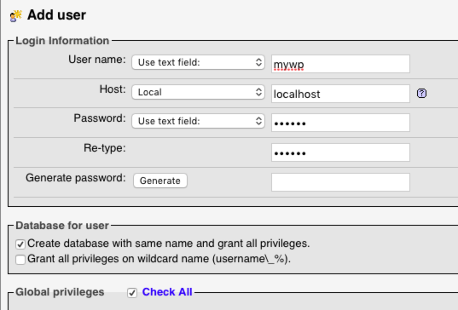
Step 2: New Database
CREATE USER 'mywp'@'localhost' IDENTIFIED BY '***';GRANT ALL PRIVILEGES ON *.* TO 'mywp'@'localhost' IDENTIFIED BY '***' REQUIRE NONE WITH GRANT OPTION MAX_QUERIES_PER_HOUR 0 MAX_CONNECTIONS_PER_HOUR 0 MAX_UPDATES_PER_HOUR 0 MAX_USER_CONNECTIONS 0;
CREATE DATABASE IF NOT EXISTS `mywp`;
GRANT ALL PRIVILEGES ON `mywp`.* TO 'mywp'@'localhost';

Slide 13
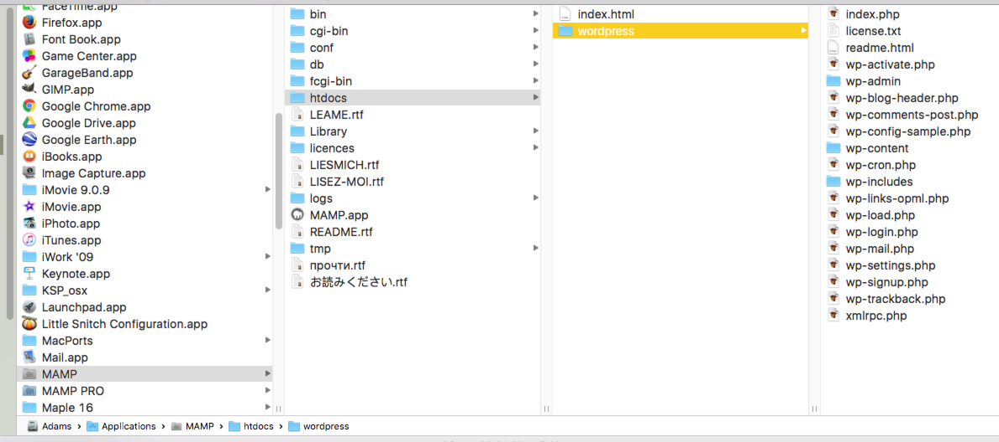
Step 3: Move Download
Place all WordPress files in your server’s root directory.
Think about whether to keep default MAMP location tied to application.

Slide 14
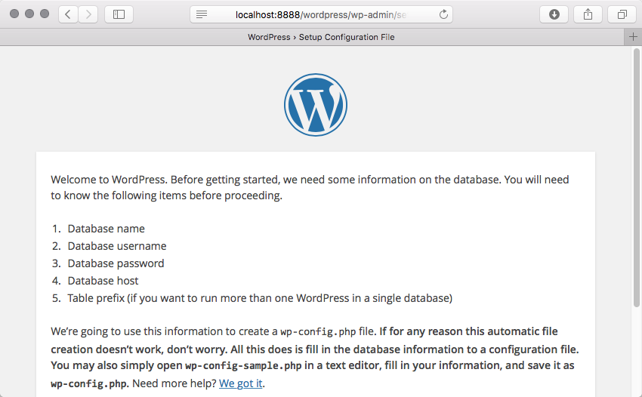
Step 4: Start Setup
Note: I entered only the URL
Localhost:8888/wordpress

Slide 15
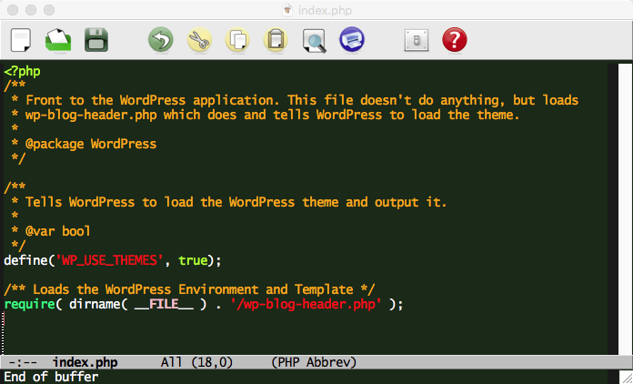
What Happened?
Generally, don’t ask!!!!!!!
WordPress is not written so you can (or should) start messing with the the PHP!
But, in CT 310 you are aware enough of PHP that you should at least think about what is going on.

Slide 16
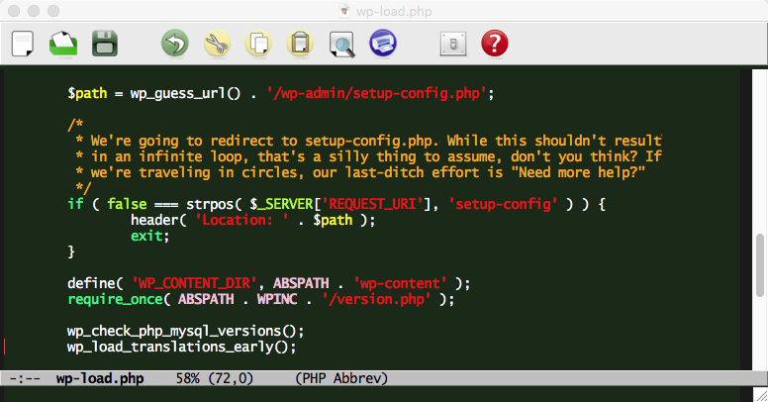
Can’t Help It– On More Peak
Simply speaking, our lack of DataBase setup is detected and we’re going to be asked to fix it.

Slide 17
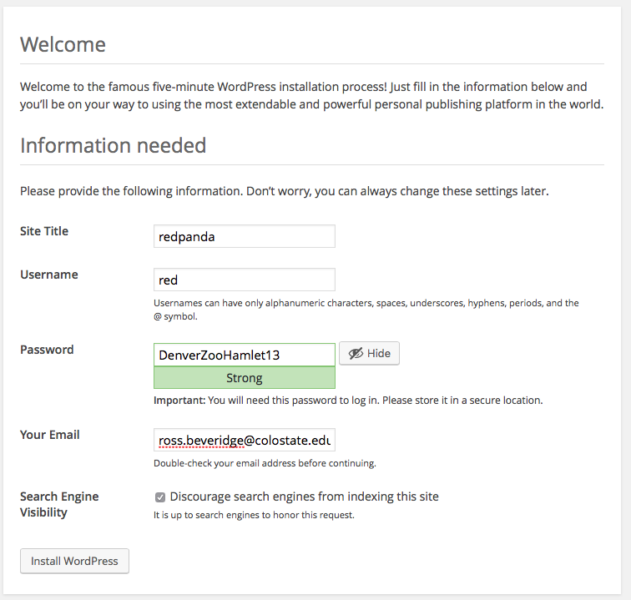

Slide 18
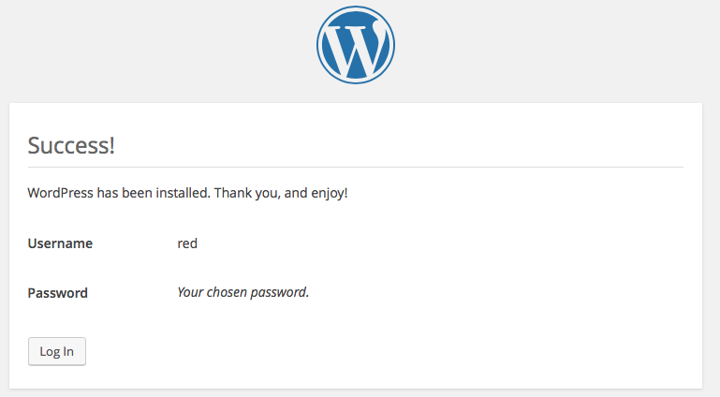
Step 4: Setup Complete
Now connected to your database

Slide 19
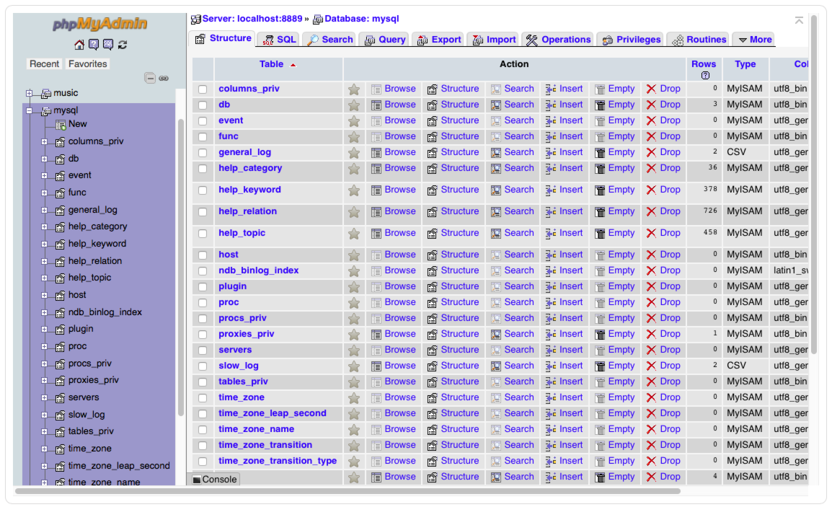
Want Proof

Slide 20
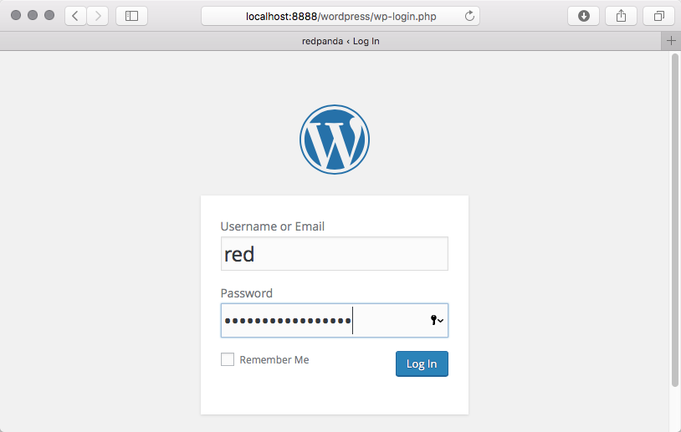
Now Login

Slide 21
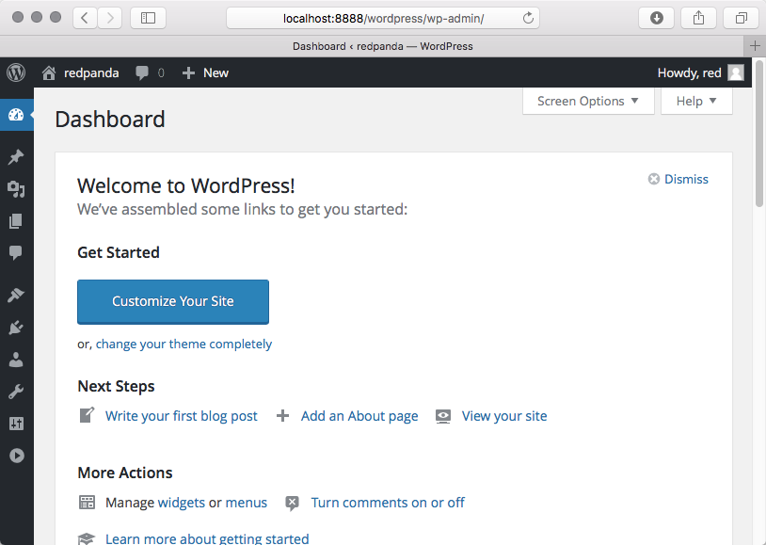
Done? No! Just Started …

Slide 22
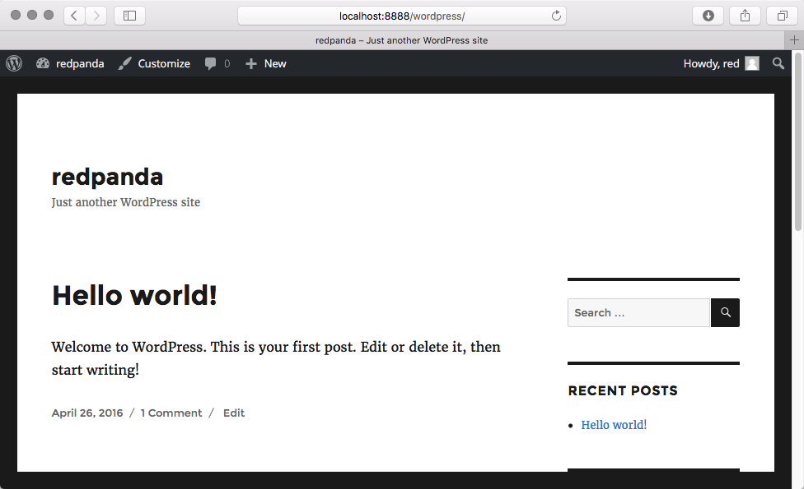
Now Build Your Site

Slide 23
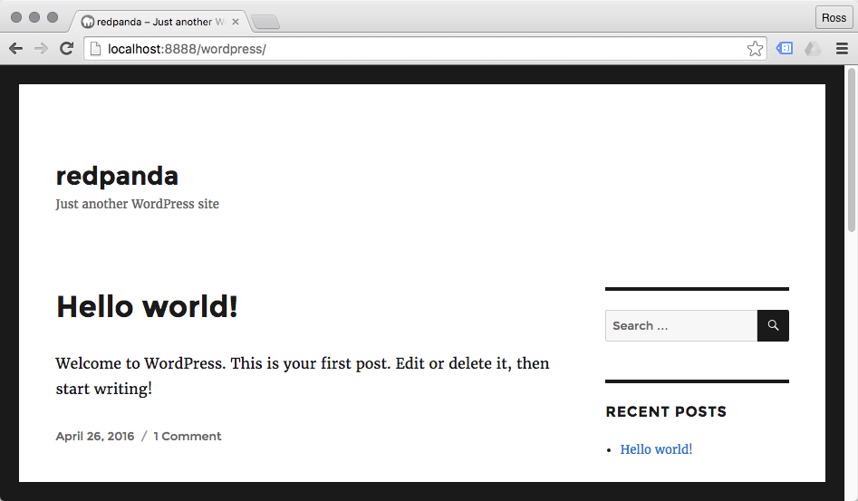
Now You See It – Now …
Notice the absence of editing controls. I am not logged into the site on Chrome. I was in Safari.

Slide 24
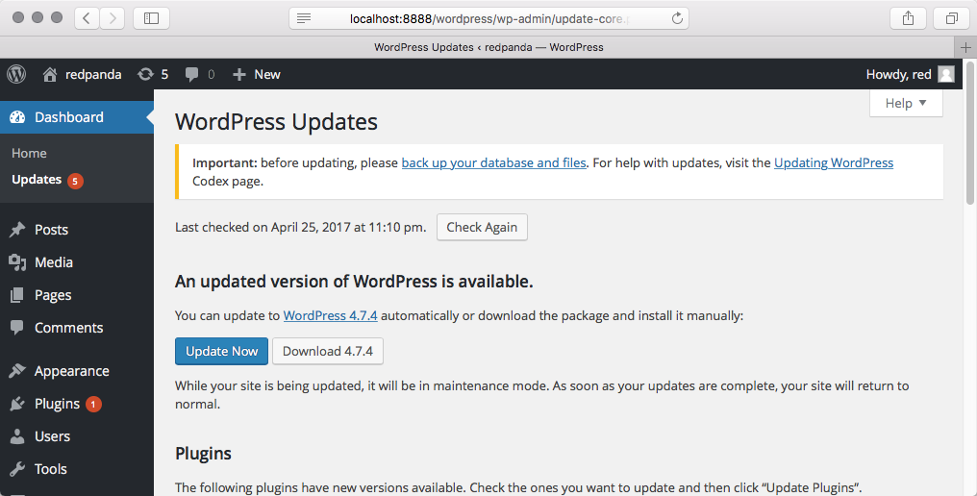
Speaking of Maintenance
This is important!
Keep in mind my test site is ONLY visible on localhost.

Slide 25
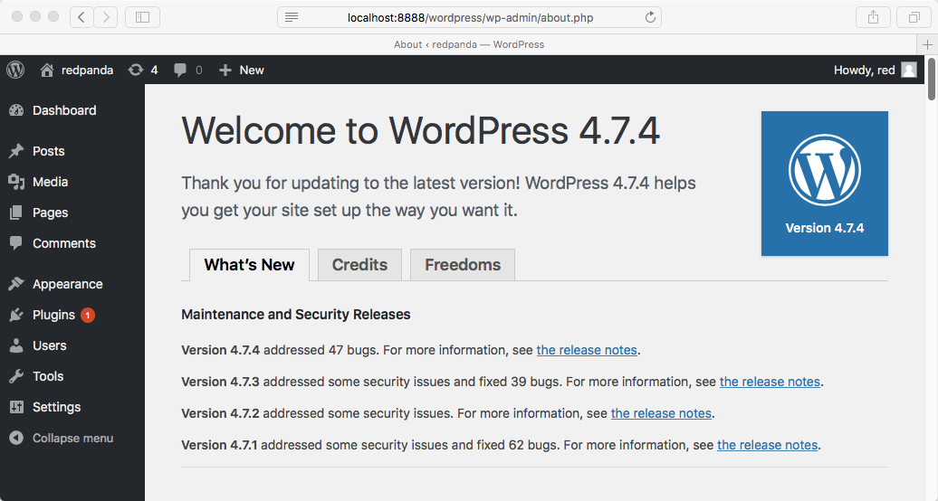
Push a Single Button
Good to know – update succeeded

Slide 26
WordPress: Two Views
How does it work inside?
Overall design
Use of MySQL
Use of PHP
Use of JavaScript
Use of jQuery
As students in CT 310 you could, with sufficient time and motivation, begin to decipher how WordPress is put together.
How do I use it?
Install (easy part)
Build out a site
What about themes
What about features
What about users
Maintenance
As students in CT 310 you have learned nothing about WordPress in particular and the rich ecosystem it supports.

