Slide 1
Dice City Regional Hospital
Introduction to Value Based Purchasing

Slide 2
Agenda
What is the problem?
What do we have?
What do we need?
How can you help?

Slide 3
Hospital Reimbursement
How we get paid by CMS for treating patients

Slide 4
Medicare
An insurance payer
Government sponsored program
Hospitals paid through CMS
Pay is based on patient diagnosis
Not based on procedures that are actually completed

Slide 5
Calculating Hospital Reimbursement
Add reimbursement for patients by diagnosis
Apply adjustments

Slide 6
There are incentives
CMS wants hospitals to perform well
CMS incentivizes (or penalizes) hospitals for their performance
This affects their reimbursement
We, of course, want the maximum reimbursement we can get

Slide 7
The Hospital Value Based Purchasing Program
Is a CMS incentive program
Affects final reimbursement by applying an adjustment
Hospitals don’t get their full reimbursement rate
The rate is adjusted based on measure performance

Slide 8
Value Based Purchasing
Center for Medicare and Medicaid Services (CMS)
Measure-based incentive program
https://www.cms.gov/Outreach-and-Education/Medicare-Learning-Network-MLN/MLNProducts/downloads/Hospital_VBPurchasing_Fact_Sheet_ICN907664.pdf

Slide 9
Introduction
Value-Based Purchasing is a CMS program
“Rewards” hospitals for performance
Goal is to improve care that hospitals provide to Medicare patients

Slide 10
How does it work?
Changes hospital reimbursement based on quality of care
Measures hospitals on:
How well they perform compared to other hospitals
How much they improve the care they provide

Slide 11
How is performance measured?
Performance is measured using metrics across 4 domains:
Safety
Clinical Care
Efficiency and Cost Reduction
Person and Community Engagement

Slide 12
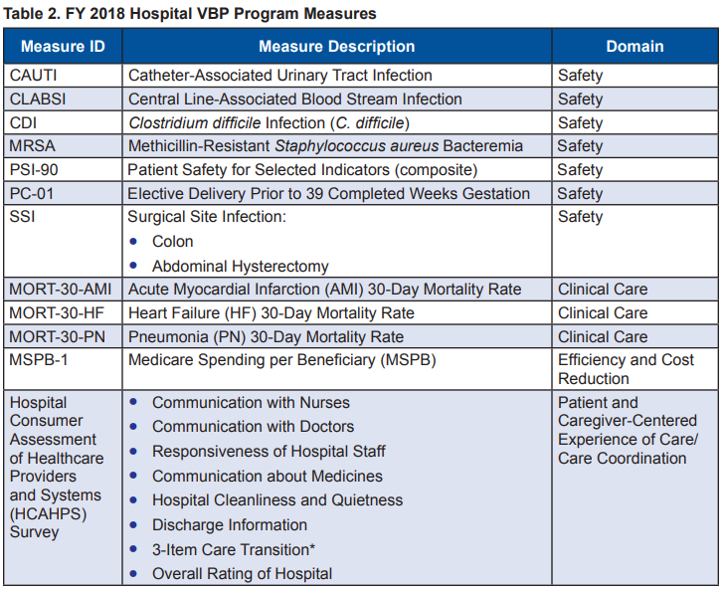
Measures:

Slide 13
Achievement Threshold and Benchmark
Measurements of Achievement and Improvement
Calculation methodology…

Slide 14
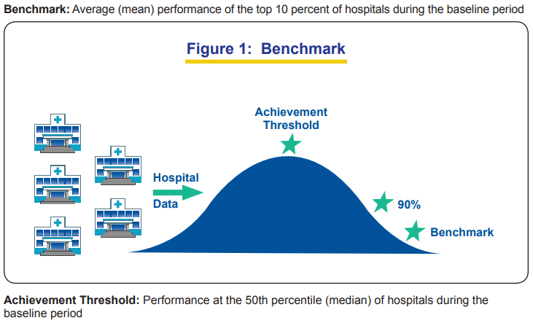

Slide 15
Achievement Points
Achievement points are awarded by comparing an individual hospital’s rates during the performance period to all hospitals’ rates from the baseline period:
Hospital rates at or above benchmark = 10 Achievement points
Hospital rates below the Achievement threshold = 0
Achievement points Hospital’s rate is equal to or greater than the Achievement threshold but less than the benchmark = 1–9 Achievement points

Slide 16
Improvement Points
Improvement points are awarded by comparing an individual hospital’s rates during the performance period to that same individual hospital’s rates from the baseline period:
Hospital rates at or above benchmark = 9 Improvement points
Hospital rates at or below baseline period score = 0
Improvement points Hospital’s rate is greater than its baseline period score but below the benchmark = 0–9 Improvement points

Slide 17
HCAHPS – Consistency Points
The Patient Experience of Care/Person and Community Engagement domain score is the sum of a hospital’s HCAHPS base score and that hospital’s HCAHPS Consistency score.
Consistency points are awarded by comparing an individual hospital’s HCAHPS Survey dimension rates during the performance period to all hospitals’ HCAHPS Survey rates from a baseline period:
If a hospital’s performance on all HCAHPS dimensions is at or above Achievement threshold = 20 Consistency points
If any HCAHPS dimension rate is at or below the worst-performing hospital’s performance on that dimension during the baseline period = 0 Consistency points
If the lowest HCAHPS dimension score is greater than the worst-p

Slide 18
Total Performance Score
CMS calculates a hospital’s Total Performance Score (TPS) by:
Combining the greater of either the hospital’s Achievement or Improvement points for each measure to determine a score for each domain
Multiplying each domain score by a specified weight (percentage)
Adding the weighted domain scores
CMS allows hospitals with sufficient data in at least three out of the four domain scores to receive a TPS. Hospitals that only have scores in three domains will have their scores proportionally reweighted.

Slide 19
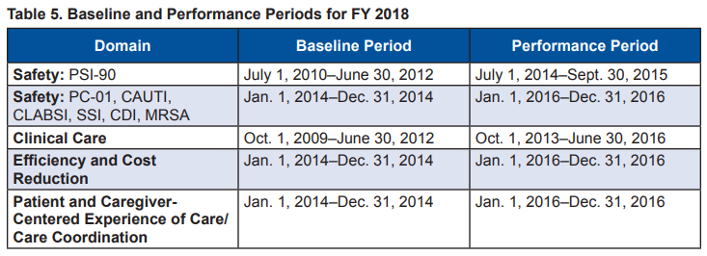
Baseline and Performance Periods

Slide 20
Hospital Performance “Rewards”
The Hospital VBP Program is funded by reducing hospitals’ base operating MS-DRG payments by 2.0 percent.
Any leftover funds are redistributed to hospitals based on their TPS.

Slide 21
What do we have?
CMS Hospital Compare Data Overview

Slide 22
Hospital Compare Data
Hospital Compare Data (public data set)
Will be made available to you next week.

Slide 23
What do we need?

Slide 24
Predictive Budgeting
2.0% of our Medicaid reimbursement is over 500,000
This is a significant budget impact
We want all of this money back!

Slide 25
Modeling
How much of the 2.0% can we expect to get back?
Where can we improve in order to increase this number?

Slide 26
How can you help?

Slide 27
Modeling Software
We need software to model the VBP calculations
We will discuss requirements in our weekly usergroup meetings
The usergroup will meet every friday

Slide 28
Initial Software Needs
We need a static report that shows our VBP Performance
For Fiscal Year 2018
Needs to show all of the numbers, threshold, benchmark, points, etc…

Slide 29
Teams:
Your next steps…

Slide 30
Teams:
Complete the group pairing survey on Canvas.

Slide 31
Make the report
HTML and CSS
Static report
Needs to look professional
Both in the browser…
And “in print” (print the page and select “print to PDF”)

Slide 32
Needs to include
All of the specified items in the online assignment specification

Slide 33
Next usergroup meeting:
Teams will be assigned!
Come with questions!

