Slide 1
Dice City Regional Hospital
Value Based Purchasing Data

Slide 2
Agenda
What data do we have that is relevant to VBP?
Safety
Clinical Care
Efficiency
Experience
How do we find a hospital’s base Medicare reimbursement?

Slide 3
Let’s start simple…
4 Milestones:
1. HTML/CSS VBP report
2. What Iffs using JS
3. Load in any historical data
4. Calculate Current year scores

Slide 4
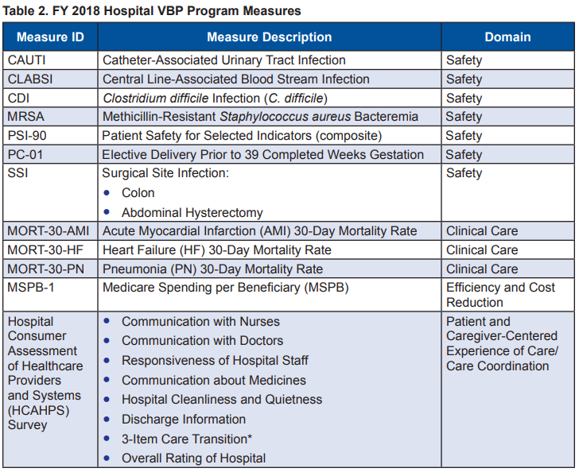
2016
Two different measures
Measures:

Slide 5
Safety Domain
Data locations for Safety Measures

Slide 6
Safety Domain – Final Flat File
Each measure has 7 columns:
[measure] Achievement Threshold – Same for all hospitals
[measure] Benchmark – Same for all hospitals
[measure] Baseline Rate – Specific to this hospital
[measure] Performance Rate – Specific to this hospital
[measure] Achievement Points – To validate your calculations
[measure] Improvement Points – To validate your calculations
[measure] Measure Score – To validate your calculations

Slide 7
CLABSI (HAI-1)
hvbp_safety_11_07_2017.csv
Column HAI-1
Ignore values that are “Not Available”

Slide 8
CAUTI (HAI-2)
hvbp_safety_11_07_2017.csv
Column HAI-2
Ignore values that are “Not Available”

Slide 9
SSI (HAI-3 and HAI-4)
hvbp_safety_11_07_2017.csv
Column HAI-3 and HAI-4
Ignore values that are “Not Available”
Note: 2 columns here, will need to be aggregated

Slide 10
MRSA (HAI-5)
hvbp_safety_11_07_2017.csv
Column HAI-5
Ignore values that are “Not Available”

Slide 11
CDI (HAI-6)
hvbp_safety_11_07_2017.csv
Column HAI-6
Ignore values that are “Not Available”

Slide 12
PSI-90
hvbp_safety_11_07_2017.csv
Column PSI-90
Ignore values that are “Not Available”

Slide 13
PC-01
hvbp_safety_11_07_2017.csv
Column PC-01
Ignore values that are “Not Available”

Slide 14
Clinical Care
Data locations for Clinical Care Measures

Slide 15
Clinical Care – Final Flat File
Each measure has 7 columns:
[measure] Achievement Threshold – Same for all hospitals
[measure] Benchmark – Same for all hospitals
[measure] Baseline Rate – Specific to this hospital
[measure] Performance Rate – Specific to this hospital
[measure] Achievement Points – To validate your calculations
[measure] Improvement Points – To validate your calculations
[measure] Measure Score – To validate your calculations

Slide 16
MORT-30-AMI
hvbp_clinical_care_11_07_2017.csv
Column MORT-30-AMI
Ignore values that are “Not Available”

Slide 17
MORT-30-HF
hvbp_clinical_care_11_07_2017.csv
Column MORT-30-HF
Ignore values that are “Not Available”

Slide 18
MORT-30-PN
hvbp_clinical_care_11_07_2017.csv
Column MORT-30-PN
Ignore values that are “Not Available”

Slide 19
Efficiency Domain
Data locations for Efficiency and Cost Reduction Measures

Slide 20
Efficiency Domain– Final Flat File
Each measure has 7 columns:
[measure] Achievement Threshold – Same for all hospitals
[measure] Benchmark – Same for all hospitals
[measure] Baseline Rate – Specific to this hospital
[measure] Performance Rate – Specific to this hospital
[measure] Achievement Points – To validate your calculations
[measure] Improvement Points – To validate your calculations
[measure] Measure Score – To validate your calculations

Slide 21
MSPB-1
hvbp_efficiency_11_07_2017.csv
Column MSPB-1
Ignore values that are “Not Available”

Slide 22
Experience Domain
Data locations for Person and Community Engagement Measures

Slide 23
Clinical Care – Final Flat File
Each measure has 8 columns:
[measure] Floor – The worst performing hospital’s score
[measure] Achievement Threshold – Same for all hospitals
[measure] Benchmark – Same for all hospitals
[measure] Baseline Rate – Specific to this hospital
[measure] Performance Rate – Specific to this hospital
[measure] Achievement Points – To validate your calculations
[measure] Improvement Points – To validate your calculations
[measure] Measure Score – To validate your calculations

Slide 24
HCAHPS
hvbp_hcahps_11_07_2017.csv
Column for each sub category
Ignore values that are “Not Available”
Weight each of the 8 sub categories evenly

Slide 25
HCAHPS – Consistency Points
The Patient Experience of Care/Person and Community Engagement domain score is the sum of a hospital’s HCAHPS base score and that hospital’s HCAHPS Consistency score.
Consistency points are awarded by comparing an individual hospital’s HCAHPS Survey dimension rates during the performance period to all hospitals’ HCAHPS Survey rates from a baseline period:
If a hospital’s performance on all HCAHPS dimensions is at or above Achievement threshold = 20 Consistency points
If any HCAHPS dimension rate is at or below the worst-performing hospital’s performance on that dimension during the baseline period = 0 Consistency points
If the lowest HCAHPS dimension score is greater than the worst-performing hospital’s rate but less than the Achievement threshold = 0–20 Consistency points

Slide 26
Base Reimbursement
Calculating a rough base reimbursement estimate

Slide 27
File and Methodology
Medicare_Provider_Charge_Inpatient_DRGALL_FY2016.csv
Multiply Total Discharges by Average Medicare Payments
Then, add the results for each DRG
This is the number we’ll use for base reimbursement

Slide 28
Teams:
Your next steps…

Slide 29
Teams have been assigned (also posted on canvas):
Team 1:
Team 2:
Team 3:
Team 4:
Team 5:
Team 6:
Team 7:
Team 8:
Team 9:
Team 10:
Team 11:

Slide 30
Questions?

Slide 31
Team introductions

