Slide 1
Lecture 3
*
Style

Slide 2
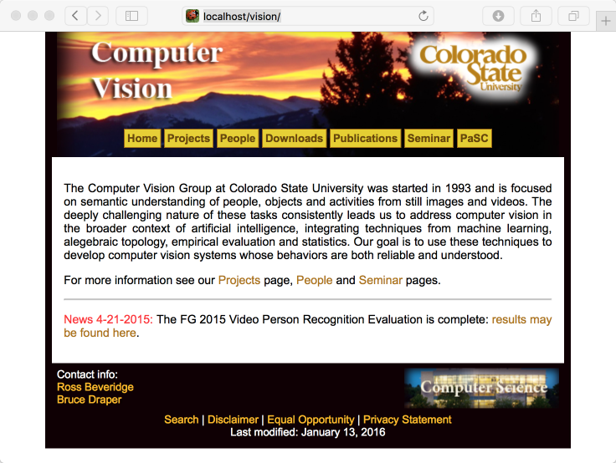

Slide 3
How Powerful is CSS

Slide 4
Example: Skyroots

Slide 5
Glimpse into HTML
[Jorma:~/Downloads] ross% grep 'div id' zengarden-sample.html
<div id="container">
<div id="intro">
<div id="pageHeader">
<div id="quickSummary">
<div id="preamble">
<div id="supportingText">
<div id="explanation">
<div id="participation">
<div id="benefits">
<div id="requirements">
<div id="footer">
<div id="linkList">
<div id="linkList2">
<div id="lselect">
<div id="larchives">
<div id="lresources">
<div id="extraDiv1"><span></span>…

Slide 6
Glimpse into CSS
…
/* specific divs */
#container {
background: url(zen-bg.jpg) no-repeat top left;
padding: 0 175px 0 110px;
padding-left:175px;
padding-top:0px;
margin: 0;
position: relative;
}
#container{
padding-left:300px;
}
#intro {
min-width: 470px;
}
…

Slide 7
Why CSS?
Separate content and appearance
Allows us to do some fancy things
Better designs
Animation
Responsive Websites
Pretty fonts

Slide 8
Extended Example

Slide 9
Sheep Without Style

Slide 10
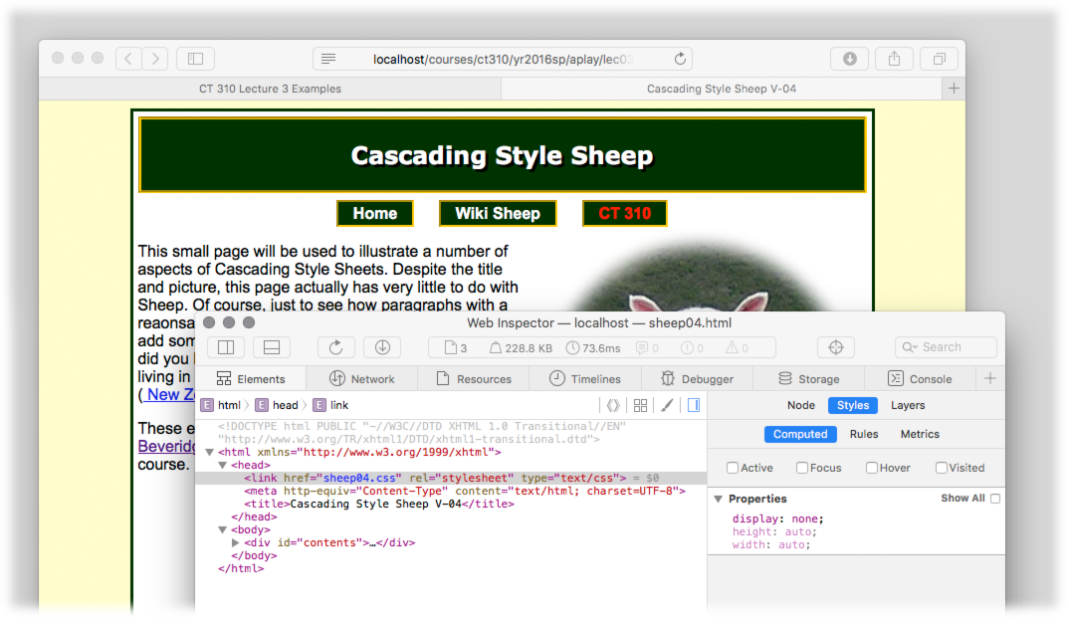
Get Comfortable Inspecting
One of three ways to invoke a style, a link in the head of the page.

Slide 11
CSS Basic Syntax
Note that the format of a style is
selector {
property : value ;
}
Tip: Always use ; even if there is only one element

Slide 12
Where can we use CSS…
In between head tag
See previous example
But, style tag can appear anywhere
Inline
<div style=“width=10px;” ></div>
From the Previous Semester’s Course Progress Page …

Slide 13
Arguably Best Practice
Style Sheets (i.e. external files)
Can Link
<link rel=“stylesheet” type=“text/css” href=“styles.css” />
Can import
<style> #import url(‘styles.css’) </style>

Slide 14
Where do styles come from
Browser
All browsers have built in styles
J Tip: Use something to reset styles
User
User’s can define default styles
Usually found in preferences
Web Page

Slide 15
Selectors
Type
body{
font-family:Verdona;
font-size:12px;
}
IDs
<div id="example"></div>
#example{} or div#example{}

Slide 16
Selectors: Classes
Example:
<div class=“example”></div>
.example{}
Elements can have multiple classes
<div
class=“example round-border”></div>

Slide 17
Selectors
Attribute
[type=“submit”]{}
Universal
*{}
#example * {}

Slide 18
Selector Order
Referencing by ID or attribute
Referencing by class
Referencing by type
Precedence

Slide 19
Last slide before examples
Using Multiple Selectors for Specificity
div.my-div-class a {
font-color : white;
}
Not as complete an example as above, but you may start to see pattern.

Slide 20
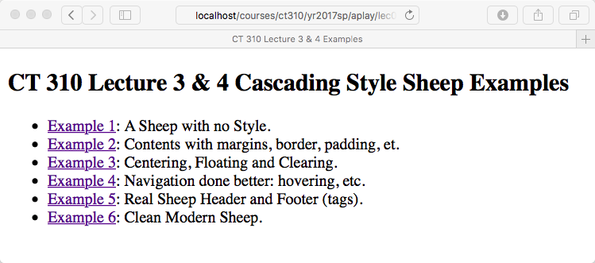
Enough PowerPoint onto to the sheep
On Wednesday, we will largely leave PowerPoint and work our way through the four stages of the Cascading Style Sheep.

Slide 21
For now, let’s explore some CSS

