Slide 1
Authentication
A Broad Overview

Slide 2
Essentials of Authenication
Something you know
Name of high school, …
Password
Something you have
Dongle
Something your are
Biometrics: Fingerprint, Face, Iris, …

Slide 3
Something you Know Often a password
We’re all familiar with passwords
Beyond just webdev, consider ..
How do you manage passwords,
How do ‘most people’ handle them.

Slide 4
HTTP is a stateless protocol
Each request is stand-alone and not related to others
No definitive way to authenticate a source
You can put any return address on an envelope
How does HTTP remember you?

Slide 5
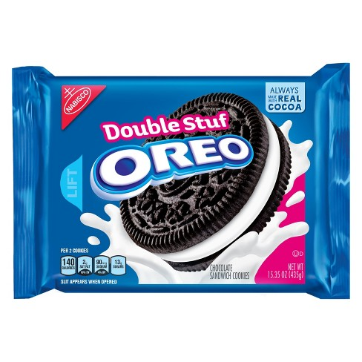
Bribe it with Cookies!

Slide 6
No joking here
The server requests the browser to store a specific “cookie”
Just a plain text piece of information
The browser sends it on subsequent requests
Think like this…
I give you a token
You show it to me later
I know it is you (or someone you trust)
Challenge Coins

Slide 7
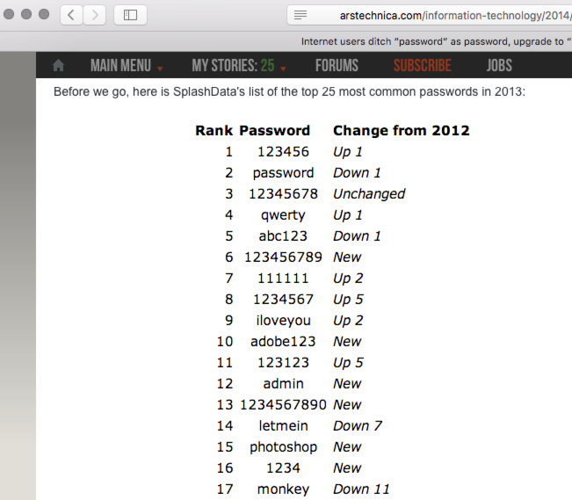
Most Popular Passwords
Arstechnica Story:
Internet users ditch “password” as password, upgrade to “123456
By Jon Brodkin - Jan 20, 2014
Really! Monkey?

Slide 8
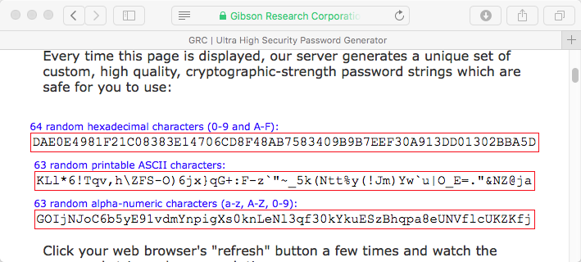
Strategy #1: Entropy
Truly minimize the ‘Odds of guessing’.
But there is a big problem! No human will remember such a password and so it MUST be recorded.

Slide 9
Use a Sentence: Strategy #2
Provided your sentence is not “See Spot Sit” odds are in your favor that others have not gone down the same path.
Summary from: Four Methods to Create a Secure Password You'll Actually Remember, by Kevan Lee.
Original post by Bruce Schneier on BoingBoing: Choosing a Secure Password

Slide 10
PAO, Strategy #3 Beyonce driving a Jello mold at Mount Rushmore
Think of a Person, an Action and an Object. Put them together in a story.
Taps into our innate ability to recall stories, particularly funny or absurd stories.
Summary from: Four Methods to Create a Secure Password You'll Actually Remember, by Kevan Lee.
Original: Memory Trick Increases Password Security, By Larry Greenemeier, 12/26/2013, Scientific American.

Slide 11
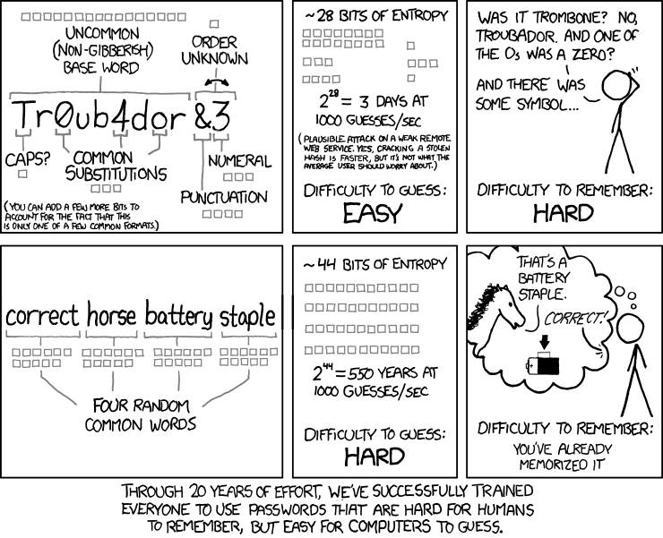

Slide 12
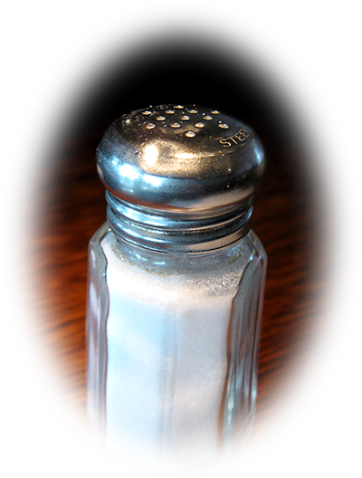
Another Thing: Pass The Salt
Here is a challenge.
Below is the md5 of a salted password.
Email the instructor the original password and/or the salt.
<salt>:<password>
33a27522874215779a0ff1704589e892

Slide 13
FYI – This is Harder
Consider: What if you knew the salt?

Slide 14
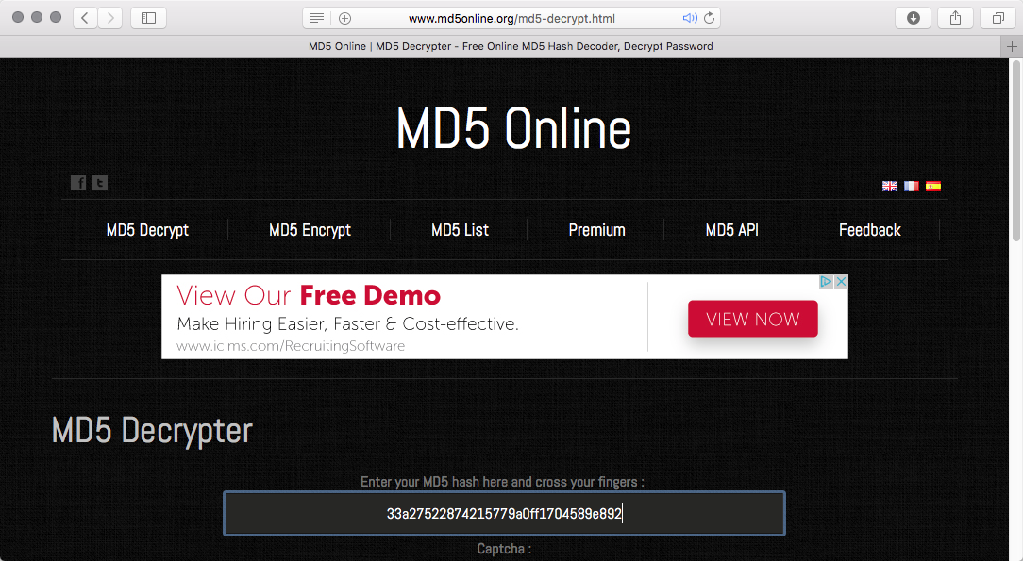
Another Crack at It
FYI – This one also fails (2/26/2017)

Slide 15
Security Questions Mothers Maiden Name?
Another entire class of information
Things you know without effort, and
presumably an attacker does not.
But!
This information leaks
Pervasive use defeats the purpose.
Take-home message for CT 310
Don’t create sites reliant on such info.

Slide 16
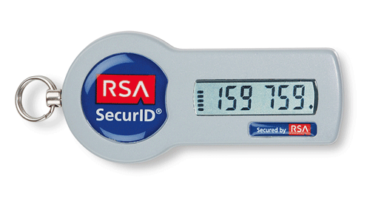
Something you Have
This is not such a new idea …
Do you have a key in your pocket?
It can take on many forms.
Tokens for example …
Image from TokenGuard.com website

Slide 17
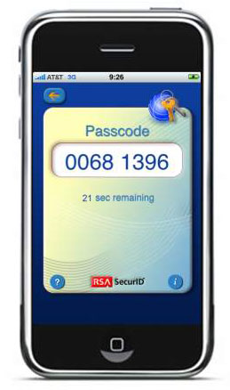
Have a Cell Phone?
No extra equipment – just software.
Major website use increasing.
Example, RSA
Example, Google is now using SMS

Slide 18
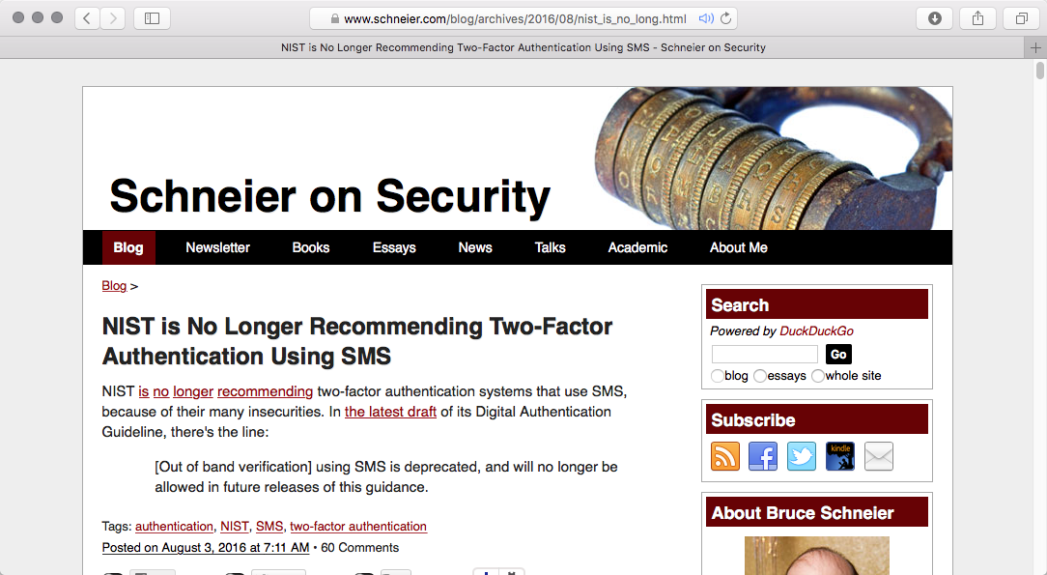
Oops, Things Change Fast
Vulnerable to interception?

Slide 19
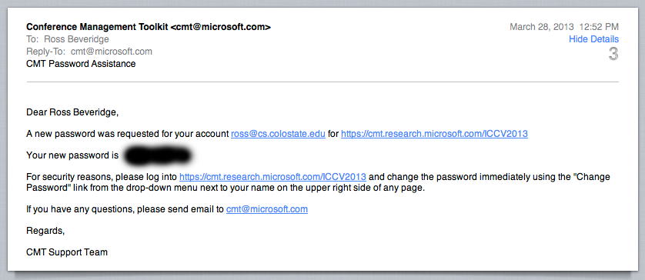
Have Email?
Explosion in use of email accounts as ‘Something that you have’.
Why is this so common …

Slide 20
Something You Are
Some measurable personal trait.
Should be (mostly) unique.
Common Examples:
Fingerprints, Voice, Hand Shape,
Iris, Face, Palm Scan, …
Good, nothing to loose or forget,
But, how reliable!

Slide 21
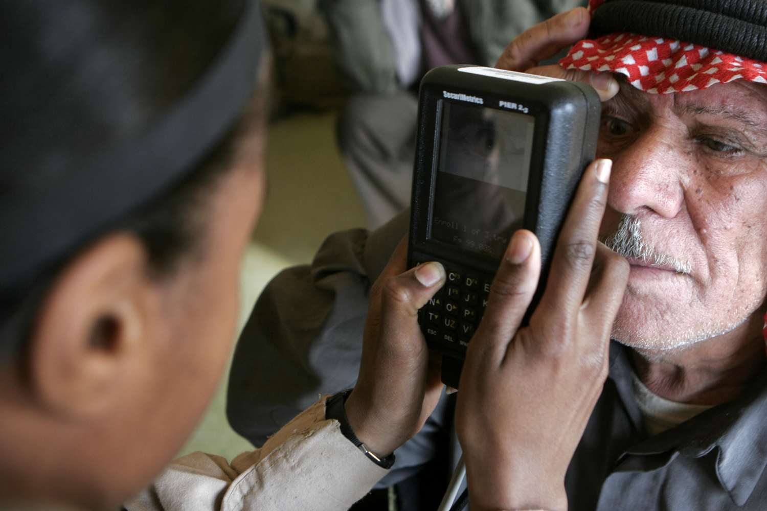
Iris Recognition
Still fairly intrusive, but very useful.
Author:
Gunnery Sergeant Michael Q. Retana, U.S. Marine Corps
Source: Wikimedia

Slide 22
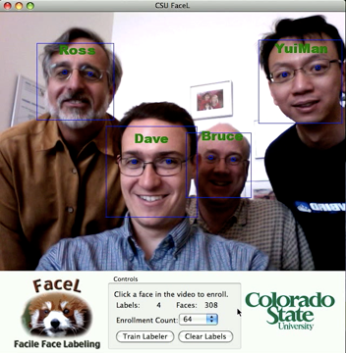
Face Recognition
Our own homegrown example.
Demonstration released in 2009
Face Recognition is Unobtrusive.

Slide 23
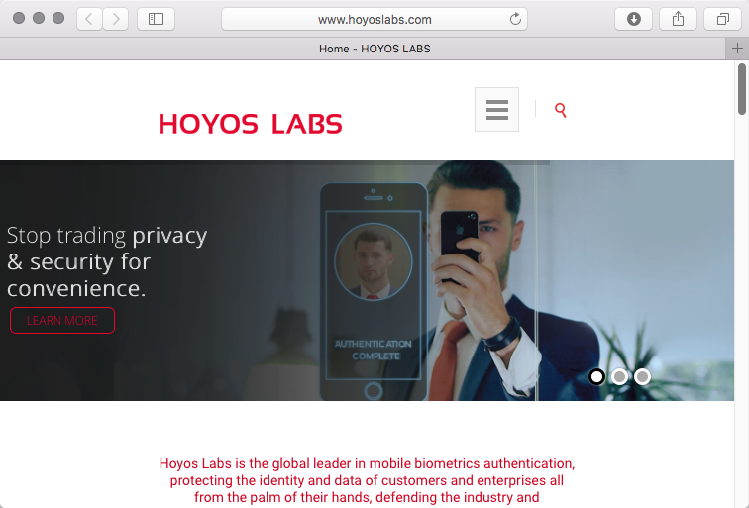
Going to Market
Sponsor: The IEEE Seventh International Conference on Biometrics: Theory, Applications and Systems (BTAS 2015)

Slide 24
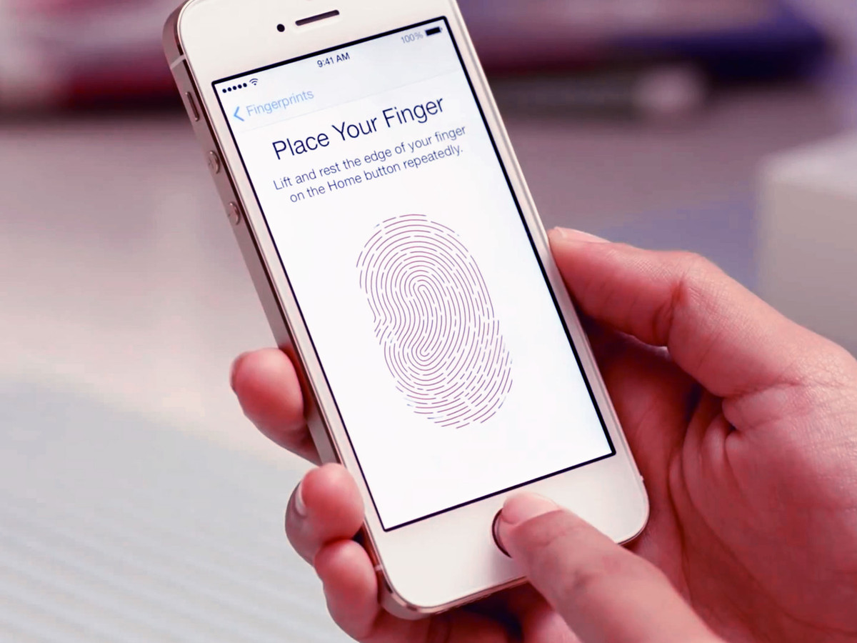
… and of course ...
Image From How Touch ID works: Making sense of Apple's fingerprint identity sensor, Rene Ritchie, iMore, September 14, 2013

Slide 25
Multifactor Authentication
All one’s eggs in one basket:
Passwords can be weak, stolen …
Tokens and keys can be lost,
Not all fingerprints easily read, …
Backups are usually a good idea
Two factor authentication is starting to become common on some areas.
Already common: Bank card and PIN
Now “Chip and PIN”

Slide 26
Proceed with Caution The Weakest Link
Mistakes come in many forms. The following is not to pick on one company, but to highlight how easily security/authentication issues can come off the rails. Quoting Steve Gibson from Security Now 373 on October 10 2012:
Well, a security company, ElcomSoft, just noted back in August that there was a problem with UPEK's (fingerprint) software because, when you're setting it up and giving it the ability to log you into Windows, you need to give it your credentials. Now, the assumption is - and unfortunately that turns out to have been all it is - is that they would do something secure with those credentials. Turns out they're stored in the registry, not very well encrypted.
Here is the link to the transcript
http://www.grc.com/sn/sn-373.txt

Slide 27
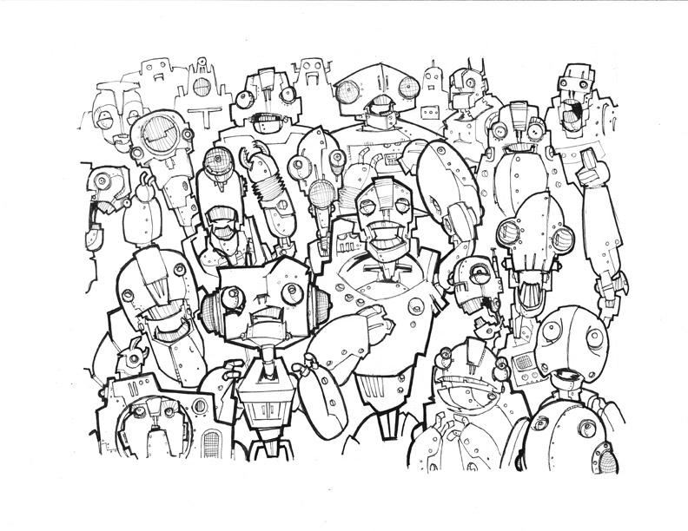
Next Issue: Users
Have requested permission on 2/18/16 from Mike Wagganer http://www.mikewagganer.com
Using according to educational fair use pending reply from artist.

Slide 28
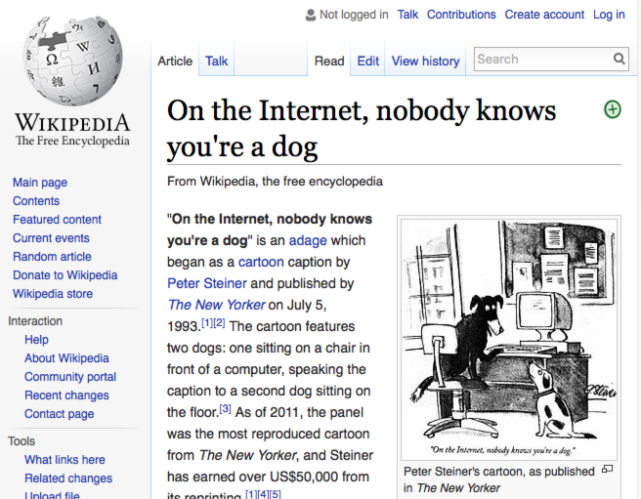

Slide 29
Who Can Have an Account?
Does your site offer accounts to new users without human-in-the-loop screening?
Yes: your site is size limited.
No: does your site include dogs (bots).
You are all therefore familiar with the next technology (Gotcha!)

Slide 30
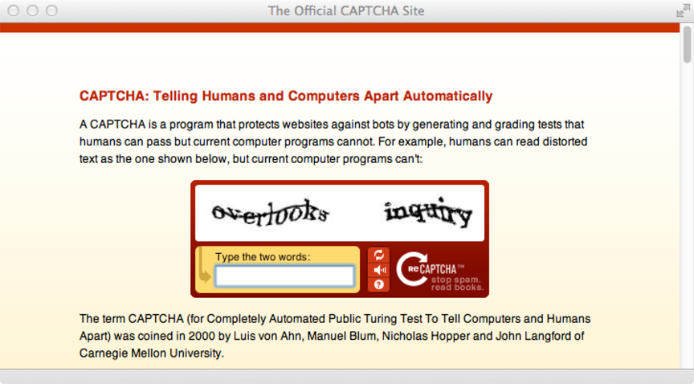
Related Question
Are you a human being (prove it!)

Slide 31
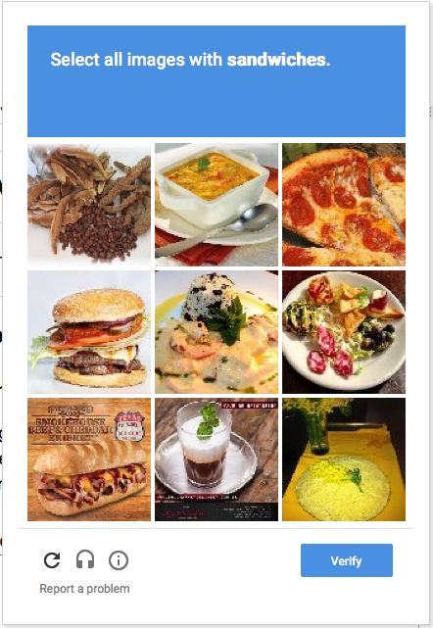
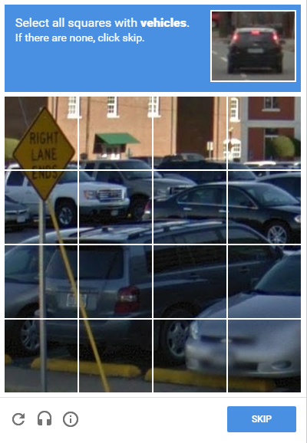
And now…

Slide 32
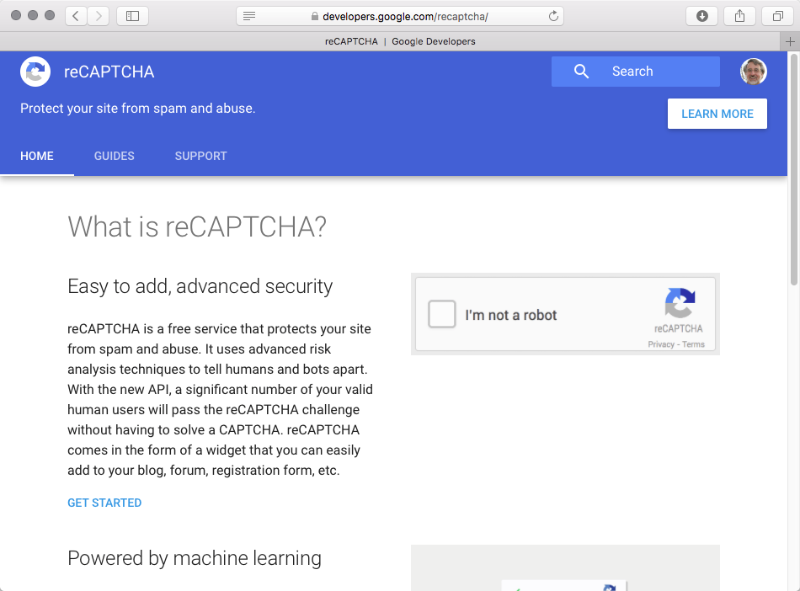
Still Relevant

Slide 33
Key Idea – Chain of Trust
SSL trust certification authority.
Trust user controls cell phone.
Trust user has control of email.
Trust user from known IP address.
Trust person A endorses person B.
…

Slide 34
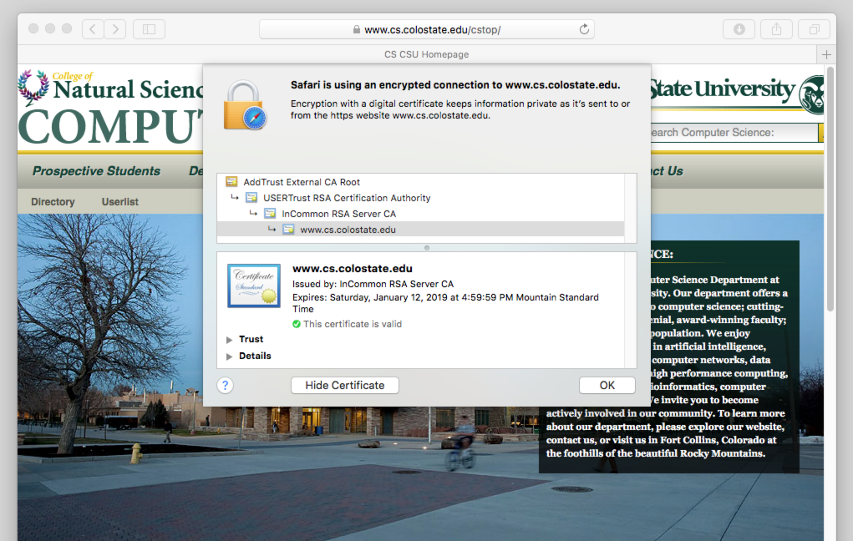
Learn to Inspect Certs

