Slide 1
Lecture 23
*
HTML5 Drawing Canvas and Video
* Course logo spider web photograph from Morguefile openstock photograph by Gabor Karpati, Hungary.

Slide 2
The Canvas
A general purpose drawing canvas
Many of the standard capabilities:
Curves, filled solids, text, effects, …
Learning curve probably depends,
Conventions look standard to one familiar with multiple graphic APIs.
Brief introduction here through an animated spinny.

Slide 4
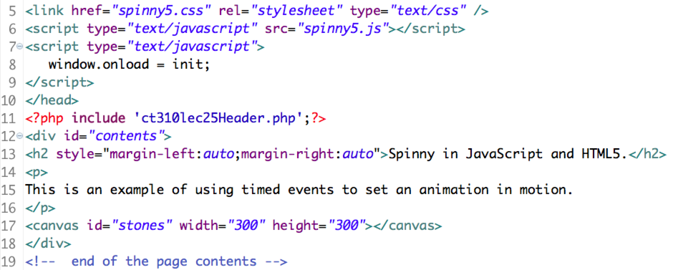
PHP/HTML Code
Not much happening here …
Here is a blank … (what shall we call it? :-) where drawing will later take place.

Slide 5
CSS Code
Not much here either
but see background …
In case we never discussed it before, placing an image into a part of a page using CSS is very different from using an HTML img tag.

Slide 6
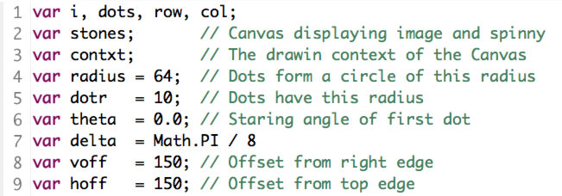
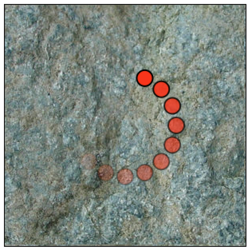
Spinny.js – Setup/Globals.
Note the use of the Math library.
Also think about how theta will be made to vary with time.

Slide 7
Spinny.js – Initialization.
The animation is set in motion using a JavaScript initialization function.
function init() {
stones = document.getElementById("stones");
contxt = stones.getContext('2d');
placeDots();
setTimeout(doStep, 100);
}

Slide 8
Spinny.js – Place Dots.
There are ten dots.
Each drawn by the drawDot function.
function placeDots() {
contxt.clearRect(0, 0, stones.width, stones.height);
for (i = 0; i < 10; i++) {
row = voff + (radius * Math.cos(theta + (i * delta)));
col = hoff + (radius * Math.sin(theta + (i * delta)));
drawDot(row, col, (1.0 - i/10));
}
}

Slide 9
Spinny.js – Draw Dot.
With HTML5 we see a true 2D API.
Drawing contexts.
Paths, arcs, fills & strokes.
function drawDot(xpos, ypos, alpha) {
contxt.beginPath();
contxt.globalAlpha = alpha;
contxt.arc(xpos, ypos, dotr, 0, 2 * Math.PI, false);
contxt.fillStyle = '#ff3f04';
contxt.fill();
contxt.strokeStyle = '#000000';;
contxt.lineWidth = 2;
contxt.stroke();
}

Slide 10
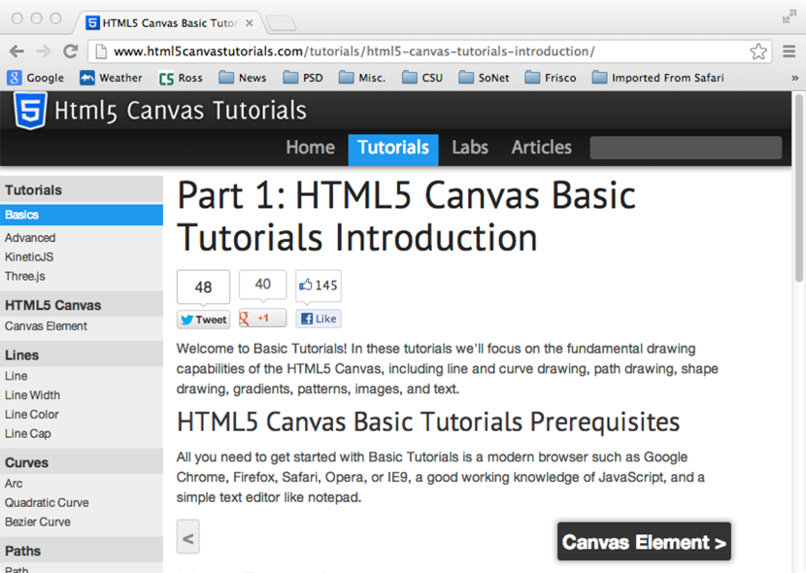
More on HTML5 Drawing

Slide 11
Change of Topic: Video

Slide 12
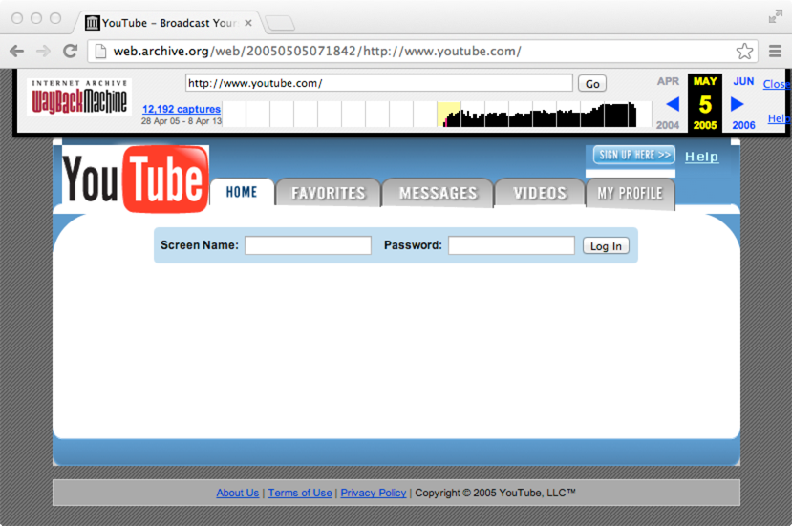
Web Video – Ancient History
May 2005
Managing video formats was nightmarishly complex, often leading to Flash!

Slide 13
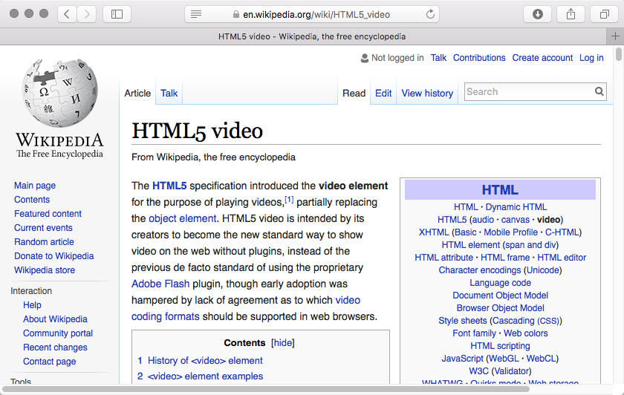
HTML5 Video – Better!

Slide 14
Two Formats Emerging
Webm
Unencumbered by I.P. claims, hence
OpenSource Compatible
Backed by Google
H2.64 (MPEG4)
Good quality, well supported, but …
Users are expected to pay license/royalty

Slide 15
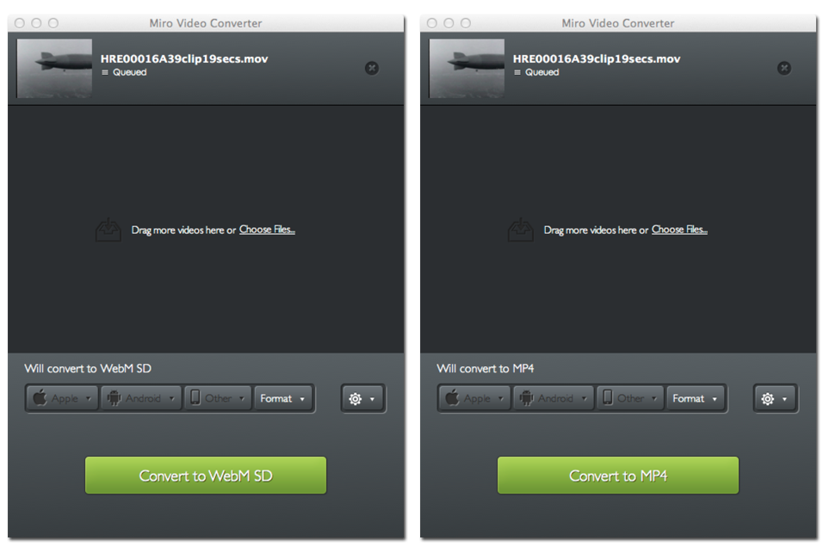
So, encode with both …

Slide 16
Plays on Firefox, Safari, …

Slide 17
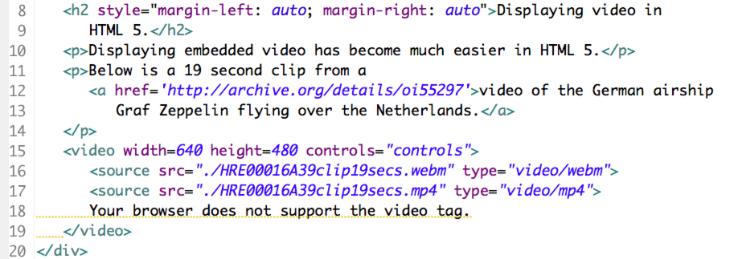
The HTML (5) Code.
Think about a list of options and then the browser moves down the list until it finds a suitable option.

