Slide 1
HTML
*
HTML Basics & Context &
IDEs & Server Basics & Online Notes

Slide 2
Metaphor: Learning HTML
Start naming tools:
Start building a house:
Today we will review a few houses and name a few tools.

Slide 3
Basics: Where is a Site?
Client view
At the other end of a URL
Server view
At a designated root directory
Whose server?
CS Department
Your laptop

Slide 4
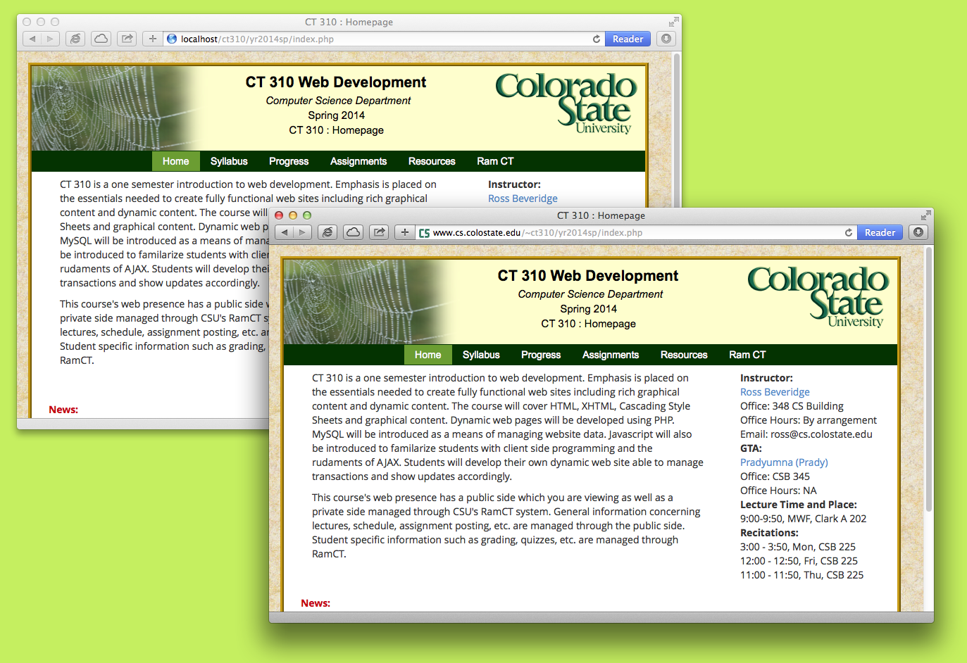
Development / Published

Slide 5
In CT 310 – CS Dept. Hosts
Publish sites built for CT 310 under your account in CS department.
Develop in place, or
develop on your own platform
CSB 120 Machines for instance, or
remote login with X11, or
Test locally then deploy
… if you do this, test what you move!
We are using local_html for this course
Nothing on public_html will be graded!

Slide 6
Tools for Writing Pages
There are many choices
Editors: emacs, vi, notepad, gedit, bluefish, atom, notpad++ …
Dreamweaver,
NetBeans,
Eclipse
Komodo Edit
Cloud based tools coming on fast

Slide 7
Tools for Writing Pages
We will use Komodo Edit in lecture
Light weight
Code Completion
Test on the browser anyways…
Developer tools are also very useful
Firebug, Chrome, IE, etc.

Slide 8
HTML Standards
Ongoing Issue
Browser Compatibility.
The World Wide Web Consortium
(W3C) drafts public standards.
There is a W3C validation site.
Good news, compatibility is improving.
But, problems do still arise …

Slide 9
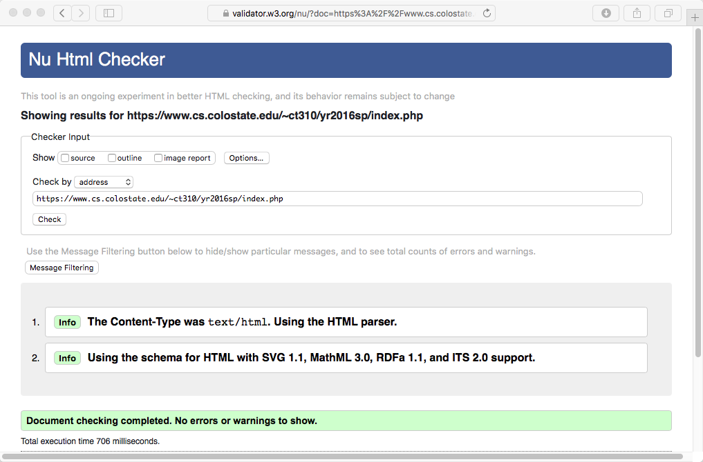
W3C Validation

Slide 10
HTML Specification
Learn More http://dev.w3.org/html5/html-author/ and http://www.w3.org/TR/2014/REC-html5-20141028/syntax.html

Slide 11
HISTORY: HTML ->XHTML
HTML, while great, runs into problems
Very loose and incomplete definitions
“Ignore unintelligible bits” - A. Browser.
Intended for text and graphics on still pages.
XHTML, based upon XML
Much tighter syntactic constraints
Promises more uniformity
Room to grow the specification
Warning: XHTML was an important stage in the web and you should be aware of it! But … HTML5!

Slide 12
HISTORY: HTML ->XHTML
XHTML intentionally similar on the surface.
But, xml must be well formed
based on document type definition (DTD)
tags almost always come in pairs
many tags must not be empty
XML documents always begin with a directive.
Warning: XHTML was an important stage in the web and you should be aware of it! But … HTML5!

Slide 13
HTML5 – Hurray!
Moves to simplify HTML but takes notes from XHTML
Adds semantic tags
Enforces more separation of content and display
More about this when we talk about CSS
Enough with plugins – Native functionality for video/animation/etc.
We, like essentially everyone else have moved to HTML5, and this is largely a great improvement.

Slide 14
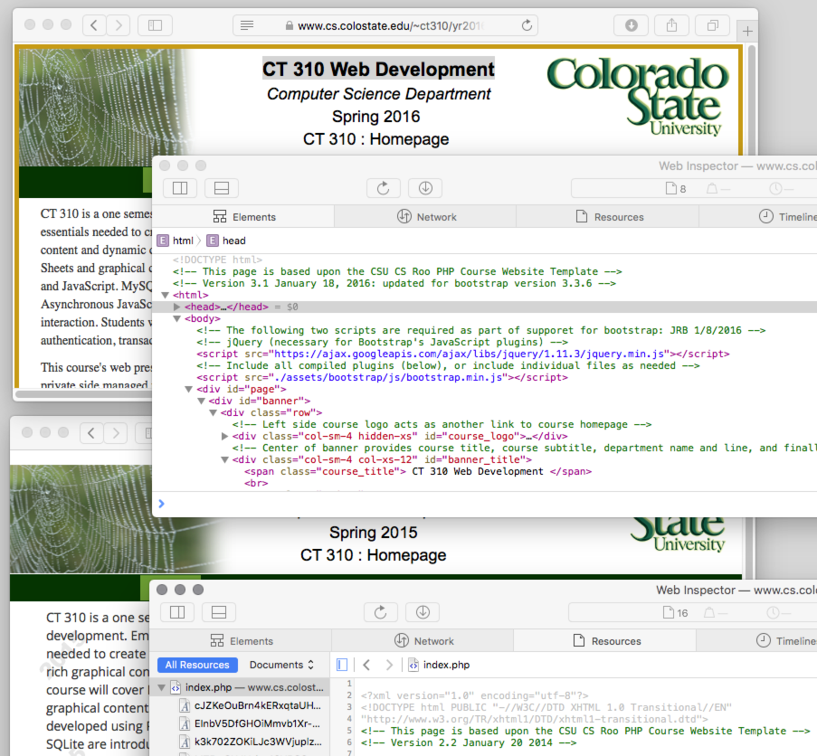
Telling Which is Which
<!DOCTYPE html>
<?xml version=“1.0” …

Slide 15
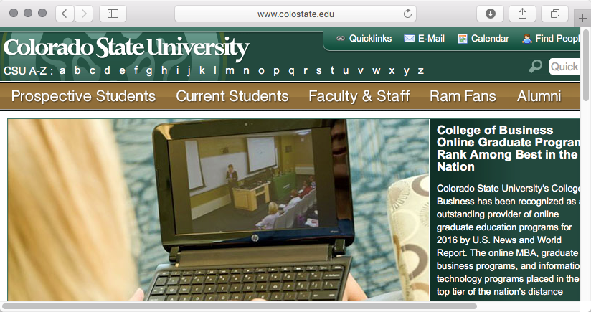
Into The Deep End Fast

Slide 16
On the Importance of Meta
Metatags - information to crawlers
Http-equiv and name
Description
Keywords
Author
Language
Start
Robots
For more information
http://www.seoconsultants.com/meta-tags/
http://code.google.com/webstats/2005-12/metadata.ht/ml/
Notes:
<meta name=“robots” content=“noindex”/> <meta andmore/> - used for things like semantics Keywords useless according to google
Alt tags and external and internal referral links seem to be the most important

Slide 17
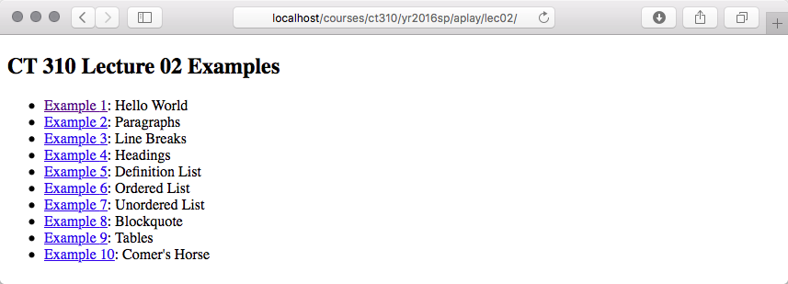
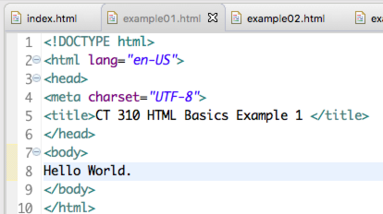
Now Into the Shallow End
Start to Step Through Basic Examples

