Slide 1
GTC 2019
Steve Kommrusch

Slide 2
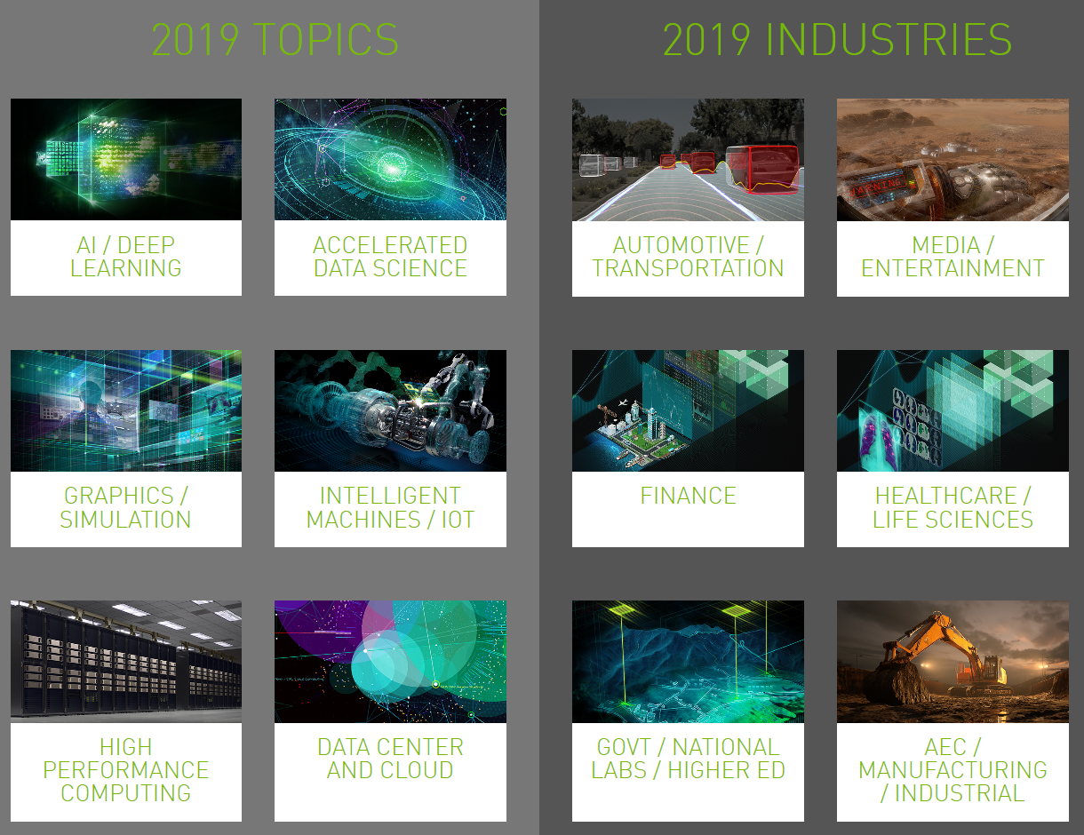

Slide 3
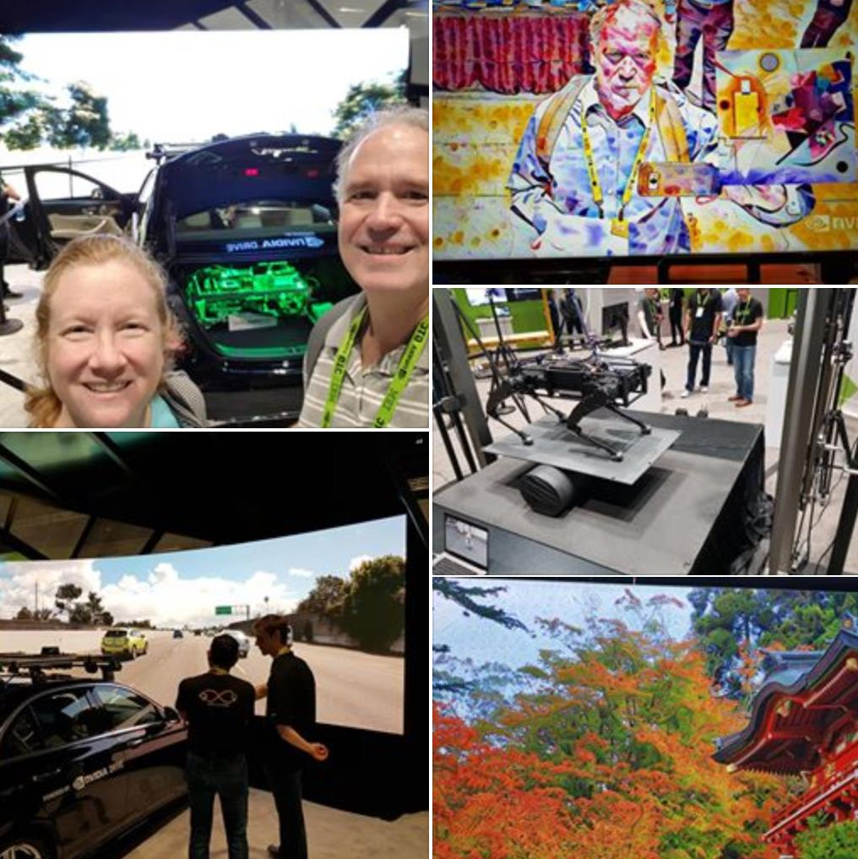

Slide 4
Meta-Optimization on a Distributed System for Deep Reinforcement Learning
Session Speakers
Iuri Frosio - Senior Research Scientist, NVIDIA
Gregory Heinrich - Deep Learning Engineer, NVIDIA
Session Description
Training intelligent agents with reinforcement learning is a notoriously unstable process. Although massive parallelization on GPUs and distributed systems can reduce instabilities, the success of training remains strongly influenced by the choice of hyperparameters. We'll describe a novel meta-optimization algorithm for distributed systems that solves a set of optimization problems in parallel while looking for the optimal hyperparameters. We'll also show how it applies to deep reinforcement learning. We'll demonstrate how the algorithm can fine-tune hyperparameters while learning to play different Atari games. Compared with existing approaches, our algorithm releases more computational resources during training by means of a stochastic scheduling procedure. Our algorithm has been implemented on top of MagLev, the NVIDIA AI training and inference infrastructure.

Slide 5
Reconstruction of 3D Building Models from Aerial LiDAR with AI
Session Speakers
Dmitry Kudinov - Sr. Data Scientist, Esri
Session Description
We'll discuss our work at Esri to reconstruct 3D building models from aerial LiDAR data with the help of deep neural networks. The value of accurate 3D building models for cities is hard to overestimate, but collecting and maintaining this data is labor-intensive, error-prone, and expensive. We teamed up with Miami-Dade County and NVIDIA to see if we could streamline this data-acquisition workflow or at least, make it more cost-effective. We used a Mask R-CNN model trained to detect and report instances of roof segments of various types. Our talk will cover data preparation and Mask R-CNN training and achieved precision. We'll also outline the inference architecture, the integration of TensorFlow and ArcGIS Pro 2.3, and the steps we used to reconstruct 3D building models from the predictions.

Slide 6
Artificial Intelligence in Search for Extra-Terrestrial Intelligence
Session Speakers
Yunfan (Gerry) Zhang - Graduate Student Researcher in Machine Learning, UC Berkeley
Session Description
We'll provide an overview of the Breakthrough Listen Initiative launched in 2015 by the Royal Society in London to conduct the most comprehensive and sensitive search for extraterrestrial intelligence in history. The search, characterized by high data volume and complex interference environments, needs advanced methods of artificial intelligence. We will discuss the project's NVIDIA GPU-Powered digital backend, with a focus on data analysis techniques and deep learning applications. Highlights include applications of predictive anomaly detections, supervised and semi-supervised signal classifications, and detections of fast radio bursts, mysterious signals of unclear origin from billions of light years away.

Slide 7
Deep Learning for Automated Defect Detection in Semiconductors
Session Speakers
Seokhyung Lee - Project Leader, SK Hynix
Session Description
We'll discuss deep learning practices used in semiconductor processes. Semiconductor processes produce a wide variety of data, including image data produced during inspection that can be used to verify if the process was normal. We explain why the problem isn't one of simple image classification, and how it's essential to consider the characteristics of the semiconductor process for accurate results. We'll also describe challenges we faced and how have we solved these problems.

Slide 8
Deep Learning to Predict Regime Changes in Financial Markets Using Constrained Time Delay and Recurrent Neural Networks
Session Speakers
Yigal Jhirad - Head of Quantitative and Derivatives Strategies, Cohen & Steers
Blay Tarnoff - Senior Application Developer and Database Architect, Cohen & Steers
Session Description
We'll discuss how applying deep learning to identifying market regimes can be valuable in helping anticipate and position a portfolio for significant structural shifts in the market. We will explain how we develop deep neural networks, including time delay and recurrent neural networks, and train them to identify and target intervals that delineate market state changes such as factor-based trends (e.g. growth vs. value), volatility regimes, and economic cycles. We'll also cover how the optimization algorithm used to drive the training relies on CUDA for high-performance computations on the GPU.

Slide 9
Doing More with More: Recent Achievements in Large-Scale Deep Reinforcement Learning
Session Speakers
Adam Stooke - PhD Student, UC Berkeley
Session Description
Learn about recent achievements in deep reinforcement learning (RL) with a focus on using large-scale compute resources. We'll cover basic algorithms, discuss development of RL agents for playing Atari games, and provide a chronology of implementations leveraging increasing amounts of hardware to achieve better results faster. We will describe large-scale RL projects in which learned agents surpassed human-level performance in the challenging games of Go, Quake III, and Dota2. For each project, we'll discuss the distinct hardware used and the techniques we developed to scale up the algorithm. These projects demonstrate a range of strategies for harnessing many CPUs and GPUs. We'll outline continued research in this area and explore the potential for more exciting results around the corner.

Slide 10
Deep Learning for Autonomous Driving at BMW
Session Speakers
Alexander Frickenstein - PhD Candidate, BMW Group
Session Description
This session will discuss the process of training deep neural networks using NVIDIA DGX servers at BMW Group. We will describe our research work in four application areas: fine-grained vehicle representations for autonomous driving, panoptic segmentation, self-supervised learning of the drivable area for autonomous vehicles and neural network optimization. All of these projects require high-performance compute and demand a scalable, agile and adaptive learning infrastructure, leveraging Kubernetes on NVIDIA DGX servers.

Slide 11
Refactoring the Unreal Engine Rendering Code Base
Session Speakers
Marcus Wassmer - Lead Rendering Programmer, Epic Games
Session Description
We'll provide an inside look into how Epic Games engineers managed major refactoring in the render engine to prepare it for future challenges. We will explain how the renderer shifted from an immediate mode to a retained one in which only entities that have effectively changed at a given frame are updated. This change produced a remarkable performance boost for the UE4 renderer and opened up the possibility of accommodating ray tracing inside the engine in an efficient way.

