Slide 1
ArrayLists

Slide 2
Using arrays to store data
Arrays: store multiple values of the same type.
Conveniently refer to items by their index
Need to know the size before declaring them:
int[] numbers = new int[100];
We often need to store an unknown number of values.
Need to either count the values or resize as additional storage space is needed.

Slide 3
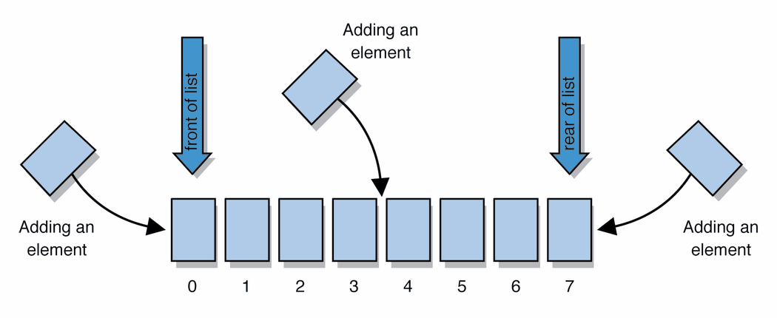
Lists
list: a collection storing an ordered sequence of elements, each accessible by a 0-based index
a list has a size (number of elements that have been added)
elements can be added at any position
Notes:
Let’s take a more abstract view at things

Slide 4
ArrayIntList
Let's consider the methods of a class called ArrayIntList that represents a list using int[]
behavior:
add(value), add(index, value)
get(index), set(index, value)
size()
remove(index)
indexOf(value)
…
The list's size will be the number of elements added to it so far

Slide 5
ArrayIntList
construction
int[] numbers = new int[5];
ArrayIntList list = new ArrayIntList();
storing a given value: retrieving a value
numbers[0] = 42; int val = numbers[0];
list.add(42); int val = list.get(0);
searching for a given value
for (int i = 0; i < numbers.length; i++) {
if (numbers[i] == 27) { ... }
}
if (list.indexOf(27) >= 0) { ... }

Slide 6
Pros/cons of ArrayIntList
pro (benefits)
simple syntax
don't have to keep track of array size and capacity
has powerful methods (indexOf, add, remove, toString)
con (drawbacks)
ArrayIntList only works for ints (arrays can be any type)
Need to learn how to use the class

Slide 7
Java Collections and ArrayLists
Java includes a large set of powerful classes that provide functionality for storing and accessing collections of objects
The most basic, ArrayList, can store any type of Object.
All collections are in the java.util package.
import java.util.ArrayList;

Slide 8
Type Parameters (Generics)
ArrayList<Type> name = new ArrayList<Type>();
When constructing an ArrayList, you can specify the type of elements it will contain between < and >.
We say that the ArrayList class accepts a type parameter, or that it is a generic class.
ArrayList<String> names = new ArrayList<String>();
names.add(”Asa");
names.add(”Nathan");

Slide 9
ArrayList methods
add(value) | appends value at end of list
add(index, value) | inserts given value at given index, shifting subsequent values right
clear() | removes all elements of the list
indexOf(value) | returns first index where given value is found in list (-1 if not found)
get(index) | returns the value at given index
remove(index) | removes/returns value at given index, shifting subsequent values left
set(index, value) | replaces value at given index with given value
size() | returns the number of elements in list
toString() | returns a string representation of the list such as "[3, 42, -7, 15]"

Slide 10
ArrayList methods 2
addAll(list) addAll(index, list) | adds all elements from the given list at the end of this list inserts the list at the given index of this list
contains(value) | returns true if given value is found somewhere in this list
containsAll(list) | returns true if this list contains every element from given list
equals(list) | returns true if given other list contains the same elements
remove(value) | finds and removes the given value from this list
removeAll(list) | removes any elements found in the given list from this list
retainAll(list) | removes any elements not found in given list from this list
subList(from, to) | returns the sub-portion of the list between indexes from (inclusive) and to (exclusive)
toArray() | returns an array of the elements in this list
Notes:
two lists are defined to be equal if they contain the same elements in the same order.

Slide 11
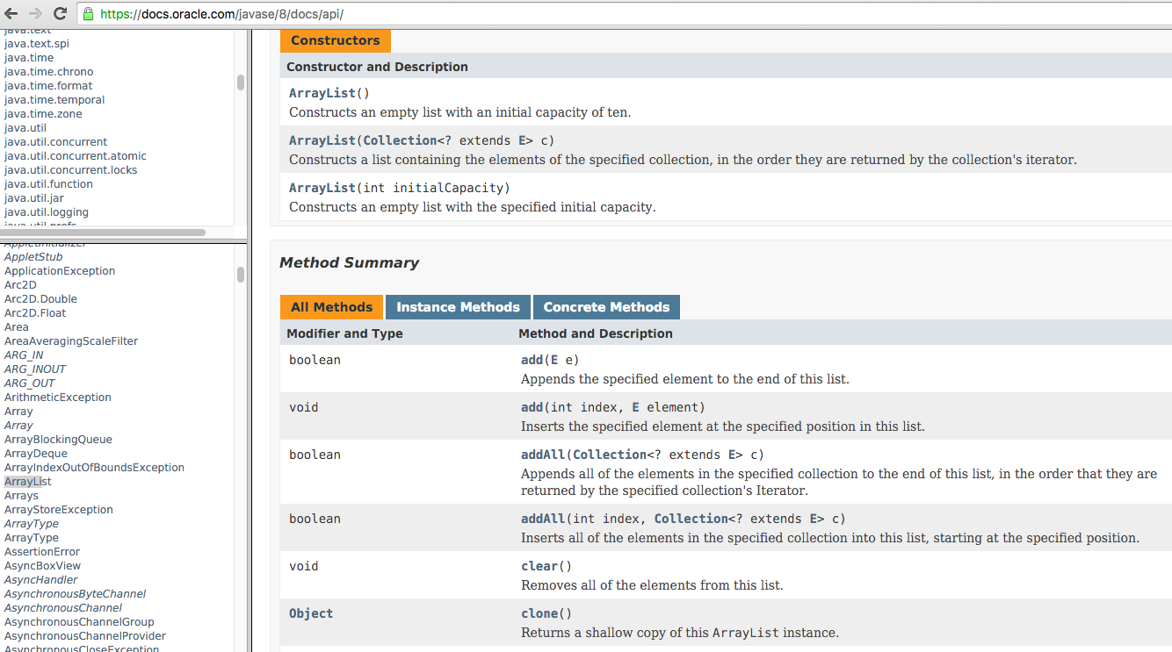
Learning about classes
The Java API specification website contains detailed documentation of every Java class and its methods.
https://docs.oracle.com/javase/8/docs/api/

Slide 12
Iterating through an array list
Suppose we want to look for a value in an ArrayList of Strings.
for (int i = 0; i < list.size(); i++) {
if(value.equals(list.get(i)){
//do something
}
}
Alternative:
for (String s : list) {
if(value.equals(s)){
//do something
}
}

Slide 13
Modifying while looping
Consider the following flawed pseudocode for removing elements that end with ‘s’ from a list:
removeEndS(list) {
for (int i = 0; i < list.size(); i++) {
get element i;
if it ends with an 's', remove it.
}
}
What does the algorithm do wrong?
index | 0 | 1 | 2 | 3 | 4 | 5
value | "she" | "sells" | "seashells" | "by" | "the" | "seashore"
size | 6

Slide 14
ArrayList of primitives?
The type you specify when creating an ArrayList must be an object type; it cannot be a primitive type.
The following is illegal:
// illegal -- int cannot be a type parameter
ArrayList<int> list = new ArrayList<int>();
But we can still use ArrayList with primitive types by using special classes called wrapper classes in their place.
ArrayList<Integer> list = new ArrayList<Integer>();

Slide 15
Wrapper classes: Example
Every java primitive has a class dedicated to it.
Example:
int x = 3;
Integer y = new Integer(5);
int z = x + y;
int z = x + y.intValue(); // convert wrapper to primitive
// can also construct an Integer from a string:
y = new Integer(“5”);

Slide 16
ArrayLists of wrapper type objects
A wrapper is an object whose purpose is to hold a primitive value and to provide more functionality.
Once you construct the list, use it with primitives as normal (autoboxing):
ArrayList<Double> grades = new ArrayList<Double>();
grades.add(3.2);
grades.add(2.7);
Primitive Type | Wrapper Type
int | Integer
double | Double
char | Character
boolean | Boolean
float | Float

Slide 17
ArrayLists of wrapper type objects
Autoboxing:
ArrayList<Double> grades = new ArrayList<Double>();
// Autoboxing: create Double from double 3.2
grades.add(3.2);
grades.add(2.7);
double sum = 0.0;
for (int i = 0; i < grades.size(); i++) {
//AutoUNboxing from Double to double
sum += grades.get(i);
}
...

Slide 18
Java Collections
ArrayList belongs to Java’s Collections framework.
Other classes have a very similar interface, so it will be easier to learn how to use those classes once you’ve learned ArrayList

