Slide 1
Chapter 23 Searching and Sorting
CS1: Java Programming
Colorado State University
Original slides by Daniel Liang
Modified slides by Chris Wilcox

Slide 2
Objectives
To study and analyze time complexity of various sorting algorithms (§§23.2–23.7).
To design, implement, and analyze insertion sort (§23.2).
To design, implement, and analyze bubble sort (§23.3).
To design, implement, and analyze merge sort (§23.4).

Slide 3
Searching Arrays
Searching is the process of looking for a specific element in an array; for example, discovering whether a certain score is included in a list of scores. Searching is a common task in computer programming. There are many algorithms and data structures devoted to searching. In this section, two commonly used approaches are discussed, linear search and binary search.

Slide 4
Linear Search
The linear search approach compares the key element, key, sequentially with each element in the array list. The method continues to do so until the key matches an element in the list or the list is exhausted without a match being found. If a match is made, the linear search returns the index of the element in the array that matches the key. If no match is found, the search returns -1.

Slide 5
Linear Search Animation
animation
Key
List
3
6 | 4 | 1 | 9 | 7 | 3 | 2 | 8
3
6 | 4 | 1 | 9 | 7 | 3 | 2 | 8
3
6 | 4 | 1 | 9 | 7 | 3 | 2 | 8
3
6 | 4 | 1 | 9 | 7 | 3 | 2 | 8
3
6 | 4 | 1 | 9 | 7 | 3 | 2 | 8
3
6 | 4 | 1 | 9 | 7 | 3 | 2 | 8

Slide 6
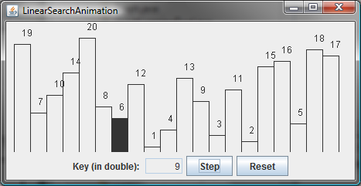
Linear Search Animation
animation
http://www.cs.armstrong.edu/liang/animation/web/LinearSearch.html

Slide 7
From Idea to Solution
/** The method for finding a key in the list */
public static int linearSearch(int[] list, int key) {
for (int i = 0; i < list.length; i++)
if (key == list[i])
return i;
return -1;
}
Trace the method
int[] list = {1, 4, 4, 2, 5, -3, 6, 2};
int i = linearSearch(list, 4); // returns 1
int j = linearSearch(list, -4); // returns -1
int k = linearSearch(list, -3); // returns 5

Slide 8
Binary Search
For binary search to work, the elements in the array must already be ordered. Without loss of generality, assume that the array is in ascending order.
e.g., 2 4 7 10 11 45 50 59 60 66 69 70 79
The binary search first compares the key with the element in the middle of the array.

Slide 9
Binary Search, cont.
Consider the following three cases:
If the key is less than the middle element, you only need to search the key in the first half of the array.
If the key is equal to the middle element, the search ends with a match.
If the key is greater than the middle element, you only need to search the key in the second half of the array.

Slide 10
Binary Search
animation
Key
List
8
1 | 2 | 3 | 4 | 6 | 7 | 8 | 9
8
1 | 2 | 3 | 4 | 6 | 7 | 8 | 9
8
1 | 2 | 3 | 4 | 6 | 7 | 8 | 9

Slide 11
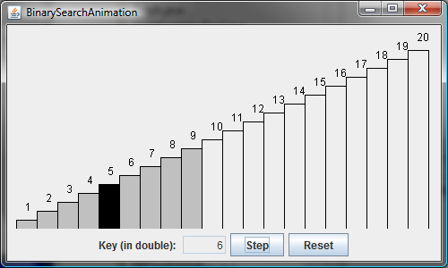
Binary Search Animation
animation
http://www.cs.armstrong.edu/liang/animation/web/BinarySearch.html

Slide 12
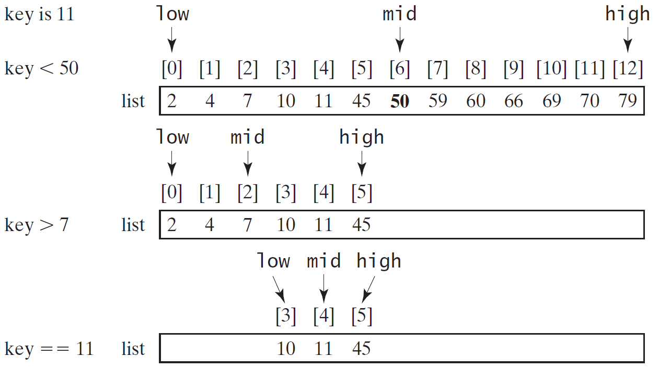
Binary Search, cont.

Slide 13
Binary Search, cont.

Slide 14
Binary Search, cont.
The binarySearch method returns the index of the element in the list that matches the search key if it is contained in the list. Otherwise, it returns
-insertion point - 1.
The insertion point is the point at which the key would be inserted into the list.

Slide 15
Sorting Arrays
Sorting, like searching, is also a common task in computer programming. Many different algorithms have been developed for sorting. This section introduces a simple, intuitive sorting algorithms: selection sort.

Slide 16
Why study sorting?
Sorting is a classic subject in computer science. There are three reasons for studying sorting algorithms.
First, sorting algorithms illustrate many creative approaches to problem solving and these approaches can be applied to solve other problems.
Second, sorting algorithms are good for practicing fundamental programming techniques using selection statements, loops, methods, and arrays.
Third, sorting algorithms are excellent examples to demonstrate algorithm performance.

Slide 17
What data to sort?
The data to be sorted might be integers, doubles, characters, or objects. §7.8, “Sorting Arrays,” presented selection sort and insertion sort for numeric values. The selection sort algorithm was extended to sort an array of objects in §11.5.7, “Example: Sorting an Array of Objects.” The Java API contains several overloaded sort methods for sorting primitive type values and objects in the java.util.Arrays and java.util.Collections class. For simplicity, this section assumes:
data to be sorted are integers,
data are sorted in ascending order, and
data are stored in an array. The programs can be easily modified to sort other types of data, to sort in descending order, or to sort data in an ArrayList or a LinkedList.

Slide 18
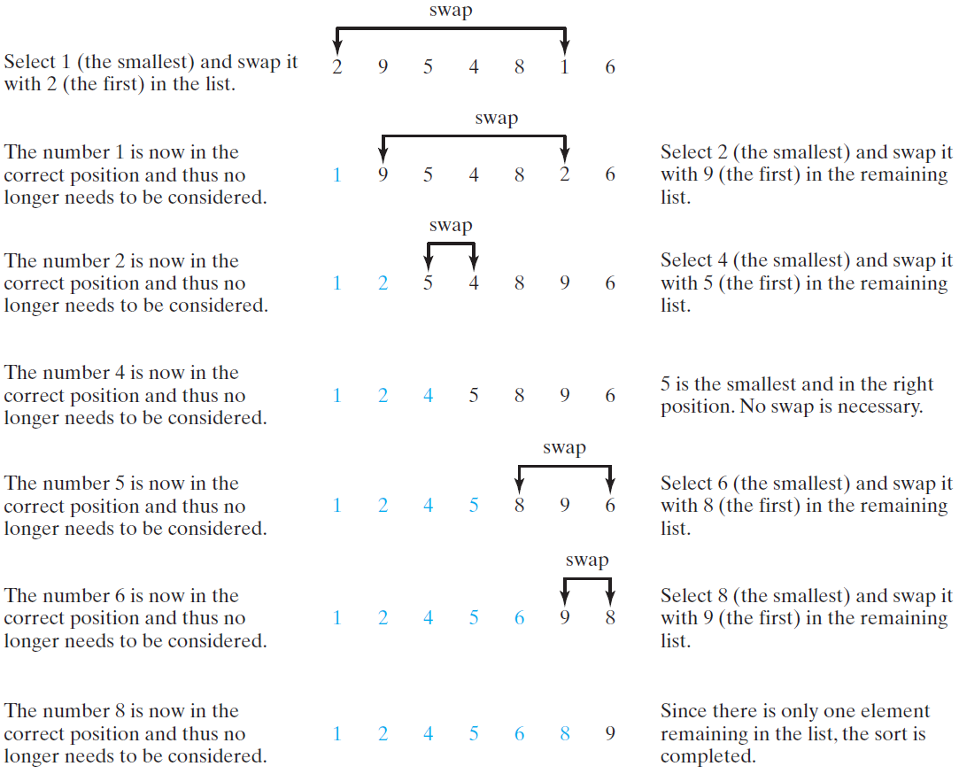
Selection Sort
Selection sort finds the smallest number in the list and places it first. It then finds the smallest number remaining and places it second, and so on until the list contains only a single number.

Slide 19
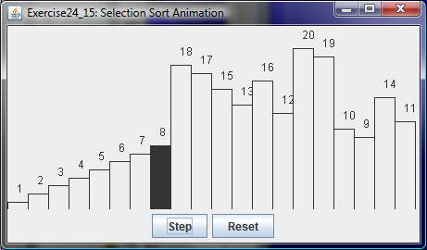
Selection Sort Animation
animation
http://www.cs.armstrong.edu/liang/animation/web/SelectionSort.html

Slide 20
From Idea to Solution
for (int i = 0; i < list.length; i++) {
select the smallest element in list[i..listSize-1];
swap the smallest with list[i], if necessary;
// list[i] is in its correct position.
// The next iteration apply on list[i+1..listSize-1]
}
list[0] list[1] list[2] list[3] ... list[10]
list[0] list[1] list[2] list[3] ... list[10]
list[0] list[1] list[2] list[3] ... list[10]
list[0] list[1] list[2] list[3] ... list[10]
list[0] list[1] list[2] list[3] ... list[10]
...
list[0] list[1] list[2] list[3] ... list[10]

Slide 21
Expand
for (int i = 0; i < listSize; i++) {
select the smallest element in list[i..listSize-1];
swap the smallest with list[i], if necessary;
// list[i] is in its correct position.
// The next iteration apply on list[i..listSize-1]
}
double currentMin = list[i];
int currentMinIndex = i;
for (int j = i+1; j < list.length; j++) {
if (currentMin > list[j]) {
currentMin = list[j];
currentMinIndex = j;
}
}

Slide 22
Expand
for (int i = 0; i < listSize; i++) {
select the smallest element in list[i..listSize-1];
swap the smallest with list[i], if necessary;
// list[i] is in its correct position.
// The next iteration apply on list[i..listSize-1]
}
double currentMin = list[i];
int currentMinIndex = i;
for (int j = i; j < list.length; j++) {
if (currentMin > list[j]) {
currentMin = list[j];
currentMinIndex = j;
}
}

Slide 23
Expand
for (int i = 0; i < listSize; i++) {
select the smallest element in list[i..listSize-1];
swap the smallest with list[i], if necessary;
// list[i] is in its correct position.
// The next iteration apply on list[i..listSize-1]
}
if (currentMinIndex != i) {
list[currentMinIndex] = list[i];
list[i] = currentMin;
}

Slide 24
Wrap it in a Method
/** The method for sorting the numbers */
public static void selectionSort(double[] list) {
for (int i = 0; i < list.length; i++) {
// Find the minimum in the list[i..list.length-1]
double currentMin = list[i];
int currentMinIndex = i;
for (int j = i + 1; j < list.length; j++) {
if (currentMin > list[j]) {
currentMin = list[j];
currentMinIndex = j;
}
}
// Swap list[i] with list[currentMinIndex] if necessary;
if (currentMinIndex != i) {
list[currentMinIndex] = list[i];
list[i] = currentMin;
}
}
}
Invoke it
selectionSort(yourList)

Slide 25
Insertion Sort
int[] myList = {2, 9, 5, 4, 8, 1, 6}; // Unsorted
The insertion sort algorithm sorts a list of values by repeatedly inserting an unsorted element into a sorted sublist until the whole list is sorted.

Slide 26
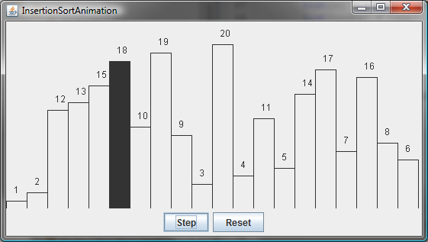
Insertion Sort Animation
animation
http://www.cs.armstrong.edu/liang/animation/web/InsertionSort.html

Slide 27
Insertion Sort
animation
int[] myList = {2, 9, 5, 4, 8, 1, 6}; // Unsorted
2 | 9 | 5 | 4 | 8 | 1 | 6
2 | 9 | 5 | 4 | 8 | 1 | 6
2 | 5 | 9 | 4 | 8 | 1 | 6
2 | 4 | 5 | 9 | 8 | 1 | 6
2 | 4 | 5 | 8 | 9 | 1 | 6
1 | 2 | 4 | 5 | 8 | 9 | 6
1 | 2 | 4 | 5 | 6 | 8 | 9

Slide 28
How to Insert?
The insertion sort algorithm sorts a list of values by repeatedly inserting an unsorted element into a sorted sublist until the whole list is sorted.

Slide 29
From Idea to Solution
for (int i = 1; i < list.length; i++) {
insert list[i] into a sorted sublist list[0..i-1] so that
list[0..i] is sorted
}
list[0]
list[0] list[1]
list[0] list[1] list[2]
list[0] list[1] list[2] list[3]
list[0] list[1] list[2] list[3] ...

Slide 30
From Idea to Solution
for (int i = 1; i < list.length; i++) {
insert list[i] into a sorted sublist list[0..i-1] so that
list[0..i] is sorted
}
Expand
double currentElement = list[i];
int k;
for (k = i - 1; k >= 0 && list[k] > currentElement; k--) {
list[k + 1] = list[k];
}
// Insert the current element into list[k + 1]
list[k + 1] = currentElement;
InsertSort
Run

Slide 31
Bubble Sort
Bubble sort time: O(n²)
BubbleSort
Run

Slide 32
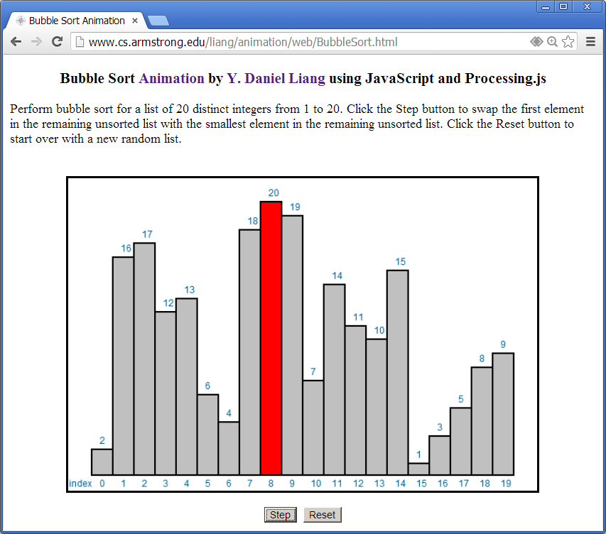
Bubble Sort Animation
http://www.cs.armstrong.edu/liang/animation/web/BubbleSort.html

Slide 33
Merge Sort
MergeSort
Run

Slide 34
Merge Sort
mergeSort(list):
firstHalf = mergeSort(firstHalf);
secondHalf = mergeSort(secondHalf);
list = merge(firstHalf, secondHalf);

Slide 35
Merge Two Sorted Lists
Animation for Merging Two Sorted Lists

Slide 36
Merge Sort Time
Let T(n) denote the time required for sorting an array of n elements using merge sort. Without loss of generality, assume n is a power of 2. The merge sort algorithm splits the array into two subarrays, sorts the subarrays using the same algorithm recursively, and then merges the subarrays. So,

Slide 37
Merge Sort Time
The first T(n/2) is the time for sorting the first half of the array and the second T(n/2) is the time for sorting the second half. To merge two subarrays, it takes at most n-1 comparisons to compare the elements from the two subarrays and n moves to move elements to the temporary array. So, the total time is 2n-1. Therefore,

Slide 38
Quick Sort
Quick sort, developed by C. A. R. Hoare (1962), works as follows: The algorithm selects an element, called the pivot, in the array. Divide the array into two parts such that all the elements in the first part are less than or equal to the pivot and all the elements in the second part are greater than the pivot. Recursively apply the quick sort algorithm to the first part and then the second part.

Slide 39
Quick Sort

Slide 40
Partition
Animation for partition
QuickSort
Run

Slide 41
Quick Sort Time
To partition an array of n elements, it takes n-1 comparisons and n moves in the worst case. So, the time required for partition is O(n).

Slide 42
Worst-Case Time
In the worst case, each time the pivot divides the array into one big subarray with the other empty. The size of the big subarray is one less than the one before divided. The algorithm requires time:

Slide 43
Best-Case Time
In the best case, each time the pivot divides the array into two parts of about the same size. Let T(n) denote the time required for sorting an array of elements using quick sort. So,

Slide 44
Average-Case Time
On the average, each time the pivot will not divide the array into two parts of the same size nor one empty part. Statistically, the sizes of the two parts are very close. So the average time is O(nlogn). The exact average-case analysis is beyond the scope of this book.

Slide 45
Computational Complexity (Big O)
T(n)=O(1) // constant time
T(n)=O(log n) // logarithmic
T(n)=O(n) // linear
T(n)=O(nlog n) // linearithmic
T(n)=O(n²) // quadratic
T(n)=O(n³) // cubic

Slide 46
Complexity Examples
http://bigocheatsheet.com/

Slide 47
Complexity Examples
http://bigocheatsheet.com/

Slide 48
Why does it matter?
Algorithm | 10 | 20 | 50 | 100 | 1,000 | 10,000 | 100,000
O(1) | <1 s | <1 s | <1 s | <1 s | <1 s | <1 s | <1 s
O(log(n)) | <1 s | <1 s | <1 s | <1 s | <1 s | <1 s | <1 s
O(n) | <1 s | <1 s | <1 s | <1 s | <1 s | <1 s | <1 s
O(n*log(n)) | <1 s | <1 s | <1 s | <1 s | <1 s | <1 s | <1 s
O(n²) | <1 s | <1 s | <1 s | <1 s | <1 s | 2 s | 3 m
O(n³) | <1 s | <1 s | <1 s | <1 s | 20 s | 6 h | 232 d
O(2^{n}) | <1 s | <1 s | 260 d | ∞ | ∞ | ∞ | ∞
O(n!) | <1 s | ∞ | ∞ | ∞ | ∞ | ∞ | ∞
O(n^{n}) | 3 m | ∞ | ∞ | ∞ | ∞ | ∞ | ∞
Notes:
Go over some of these numbers:
Execution time varies on processor, but even so the message is the same.
Anything linear, logarithmic, including n(log n) is wonderful!
log(n) where n = 10,000 is 4
n where n = 10,000 is 10,000
n(log n), where n = 10,000 is 40,000
10,000² = 100,000,000 = 100 million
10,000³ = 1,000,000,000,000 = 1 trillion
2⁵⁰ = ~1,000,000,000,000,000 = ~1 quadrillion
factorial and n^{n} are ridiculous, 10¹⁰ = 10,000,000,000 = 10 billion

