Slide 1
Security and Privacy
CS110
Personal Computing

Slide 2
Definitions
What is security?
Protection of information and property from theft, corruption, or natural disaster
Allowing the information and property to remain accessible and productive to its intended users.
What is privacy?
The desire of personal privacy concerning the storing, repurposing, providing to third-parties
Displaying of information via the Internet.

Slide 3
Why do we need security?
To protect money
Banks, Financial transactions
To protect information
Government agencies
To ensure personal safety
Airlines, trains, bridges
To keep the bad guys out
Or just the nosy…

Slide 4
What is the price of security?

Slide 5
Ease of use
With more security comes:
More checks
Is what you are doing is legit ?
More chances for error
Entering wrong password
Differing rules
One site wants letters and numbers
Another wants a special character
More frustration

Slide 6
Performance
The more security you have in place
The more activities your computer is doing to check things
These activities take resources
And your computer slows down…
You are entering more information to authorize
And your performance slows down…

Slide 7
Inability to act
Sometimes you just can’t do what you are entitled to do,
Forgotten password
System imposed restrictions
3 times enter incorrect password
Security servers are often different than content servers
Differing point of failure

Slide 8
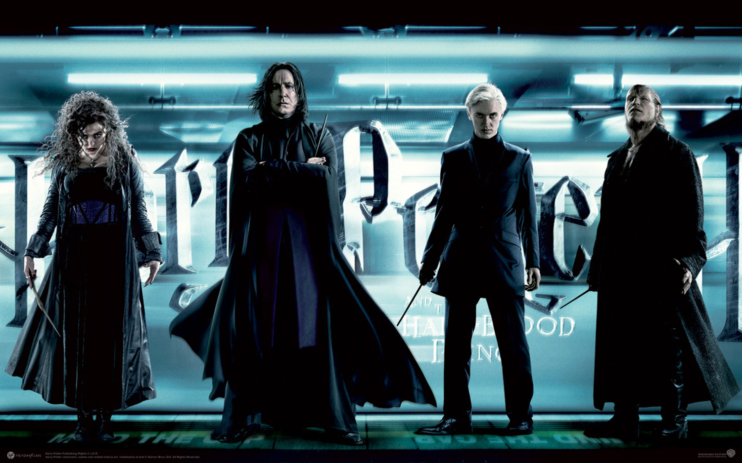
Who are the bad guys?

Slide 9
Malware
Short for malicious software
Programs designed to
Disrupt or deny operation
Gather information
Gain unauthorized access
Software is considered malware based on the intent of the programmer

Slide 10
Virus
A computer virus attaches itself to a program or file
Enables it to spread from one computer to another, leaving infections as it travels.
Viruses can increase their chances of spreading to other computers by infecting files on a network file system or a file system that is accessed by another computer

Slide 11
Worm
Similar to a virus by design and is considered to be a sub-class of a virus.
Worms spread from computer to computer, but unlike a virus, it has the capability to travel without any human action.
A worm takes advantage of file or information transport features on your system, which is what allows it to travel unaided.

Slide 12
Trojan Horse
At first glance will appear to be useful software
Do damage once installed or run on your computer.
Results vary
From the merely annoying to causing serious damage
Can also create a backdoor on your system
Backdoors used to create botnets
Unlike viruses and worms, Trojans do not reproduce by infecting other files nor do they self-replicate.

Slide 13
Spyware
Collects small pieces of information about users without their knowledge.
Surfing habits
Can install additional software
Keyloggers
Change web browser activity
Home page
SLOWS DOWN YOUR SYSTEM
Additional activity
Change computer settings

Slide 14
Adware
Software which displays advertisements
User-consented
Alternative to registration fees.
The other kind…
Displays advertisements related to what it finds from spying on users.
Example is Gator from Claria Systems.
Visited Web sites frequently install Gator on clients
It directs revenue to the installing site and to Claria by displaying advertisements to the user.
You get pop-up advertisements

Slide 15
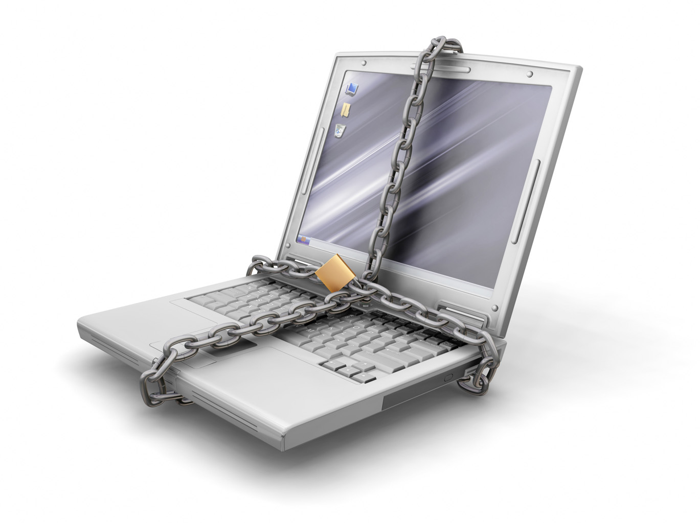
Back to security..

Slide 16
How do we achieve security?
Physical
Lock it down
Authentication
Are you who you say you are?
Authorization
Are you allowed to do what you are trying to do?

Slide 17
Physical security
Armed guards, gates, etc.
Not so good
Possession
Adequate for most of us
Lock and keys, badges
Good for large things
Computer lab

Slide 18
Authentication
Badges, passports
Physical possession
Passwords
Differing degrees of difficulty
Biometrics
Fingerprints, retinal scans
Captcha keys
Are you a bot?
Digital certificates
Am I talking to the real site?

Slide 19
Authorization
Access control
Tying an object to permissions
Can be done individually or to a role
Can be logical or physical
Role-based access control
Person is assigned “roles”
The roles are assigned permissions
Much easier to administer

Slide 20
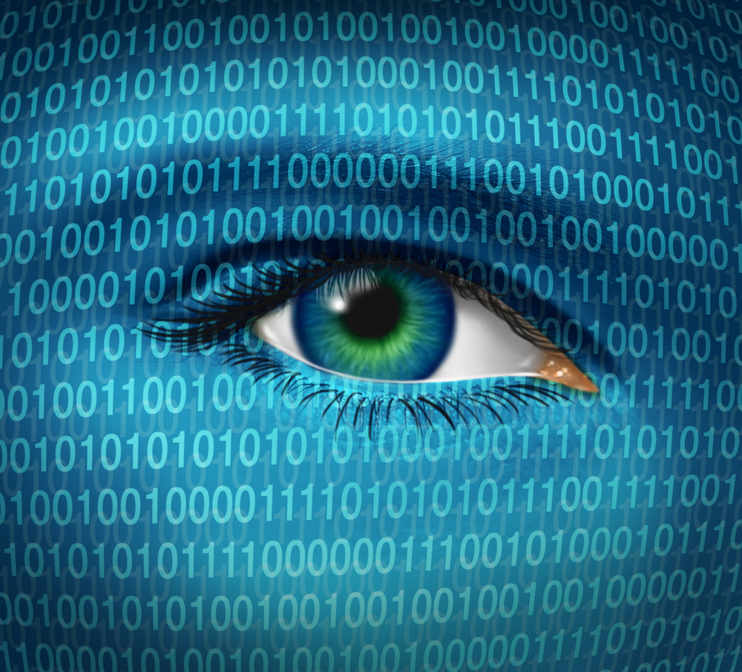
Privacy

Slide 21
What is privacy?
The ability to keeping information from being shared without your approval
Personally Identifying Information (PII)
Name
Social Security number
Bank account number
Non-PII information
Surfing habits
Purchasing habits

Slide 22
What type of info?
Healthcare records
Criminal justice investigations and proceedings
Financial institutions and transactions
Biological traits, such as genetic material
Residence and geographic records
Ethnicity, gender, sexual preference
Many, many more

Slide 23
Does privacy exist anymore?
Unfortunately, the horses have left
We can close the barn door, but…
We were in such a rush to make the data available, privacy was short-circuited
A lot of factors are not under your control
Other people’s data
Significant number of experts believe that privacy no longer exists

Slide 24
Why has privacy disappeared?
On-line shopping, surfing
Habits are recorded
Identifying information
IP addresses, PIP
Public surveillance
Cameras, facial recognition software
Legislation
Terrorism, public right to know

Slide 25
Is it hopeless?
Small subset of people with access
Like to believe those people require authorization
Keep that subset small
Keep your info out of the bad guys hands
Guard your personal information
Don’t be afraid to question someone’s right to know
Information on the net is permanent

Slide 26
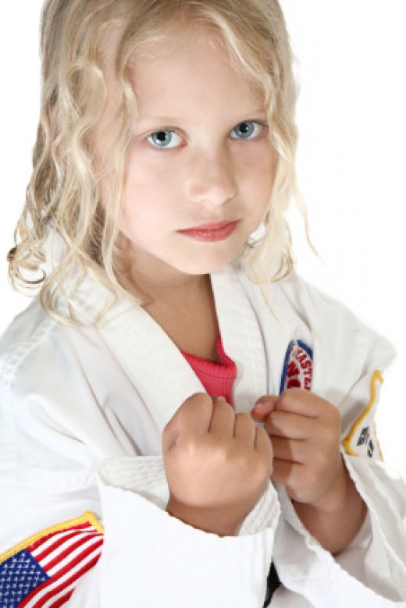
How to fight back…

Slide 27
Passwords
Social engineering
Have differing degrees of passwords
Don’t share your important passwords
Passwords guessers
Combine numbers, letters, special characters
Use the phrase method
Michelle Took Bobby Out For 4 Beers
MTBOF4B

Slide 28
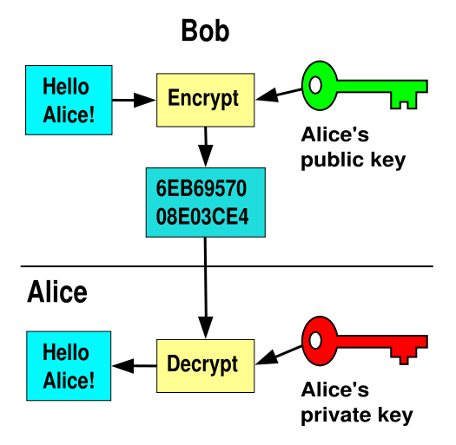
Encryption

Slide 29
Backups
Back your systems up regularly
Automated software
Built into Macs, Windows
Can backup to portable hard drive
Very inexpensive these days
If a virus attacks you, you can recover
Reload from backups

Slide 30
Personal habits
Be careful about posting PII
Who can see it?
What is their privacy policy?
Use differing levels of e-mail addresses
Keep one for shopping, surveys
Keep one for professional
Keep one for personal

Slide 31
Personal habits
Change your passwords regularly
Every 90 days or so
Do NOT use your birthday…
Watch your bank accounts
Easy to log in and verify transactions
Programs like Quicken will download
Use encryption
https://

Slide 32
Personal habits
Verify on-line sites
Don’t give your CC# unnecessarily
Ensure it is a legitimate business
NEVER respond to phishing
They will clean out your account in seconds
Run virus checkers
Norton, MacAfee, ClamXav
Backup your system regularly

Slide 33
References
http://en.wikipedia.org/wiki/Computer_security
http://www.webopedia.com/DidYouKnow/Internet/2004/virus.asp
http://en.wikipedia.org/wiki/Internet_privacy
http://en.wikipedia.org/wiki/Malware
http://en.wikipedia.org/wiki/Spyware
http://www.buzzle.com/articles/computer-security-authentication.html

