Slide 1
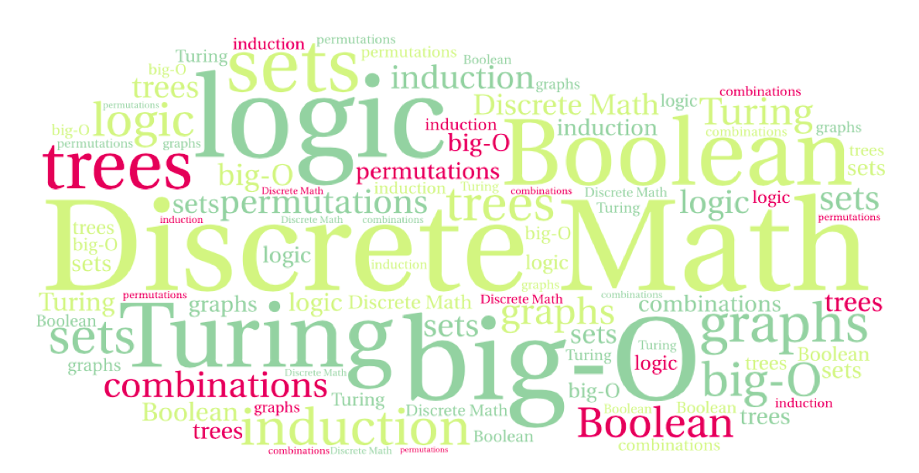
CS 220: Discrete Structures and their Applications
Predicate Logic
Section 1.6-1.10 in zybooks

Slide 2
From propositional to predicate logic
A predicate is a parameterized proposition.
Let’s consider the statement “x is an odd number”
Its truth value depends on the the value of the variable x.
Once we assign x a value, it becomes a proposition.
Predicate logic will allow us to reason about statements with variables without having to assign values to them.

Slide 3
Predicates
Predicate: A logical statement whose truth value is a function of one or more variables.
Examples:
x is an odd number
Computer x is under attack
The distance between cities x and y is less than z
When the variables are assigned a value, the predicate becomes a proposition and can be assigned a truth value.

Slide 4
Predicates
The truth value of a predicate can be expressed as a function of the variables, for example:
“x is an odd number”
can be expressed as P(x).
So, the statement P(5) is the same as "5 is an odd number”.
“The distance between cities x and y is less than z miles”
Represented by a predicate function D(x, y, z)
D(fort-collins, denver, 100) is true.

Slide 5
The domain of a predicate
The domain of a variable in a predicate is the set of all possible values for the variable.
Examples:
The domain of the predicate "x is an odd number" is the set of all integers.
In general, the domain of a predicate should be defined with the predicate.
Compare domain to type. Compare predicate to a java method declaration.
What about the predicate:
The distance between cities x and y is less than z miles?
Notes:
Typed parameters
x,y points (x1,x2) (y1,y2) on a map
z real number

Slide 6
Predicates
Consider the predicate S(x, y, z) which is the statement that
“x + y = z”
What is the domain of the variables in the predicate?
What is the truth value of:
S(1, -1, 0)
S(1, 2, 5)

Slide 7
Uses of predicate logic
Verifying program correctness
Consider the following snippet of code:
if (x < 0) x = -x;
What is true before? (called precondition)
x has some value, its type determines which values are allowed
What is true after? (called postcondition)
greaterEqual(x, 0)

Slide 8
Quantifiers
Assigning values to variables is one way to provide them with a truth value.
Alternative: Say that a predicate is satisfied for every value (universal quantification), or that it holds for some value (existential quantification)
Example:
Let P(x) be the statement x + 1 > x.
This holds regardless of the value of x
We express this as: ∀x P(x)

Slide 9
Universal quantification
Universal quantification is the statement
“P(x) for all values of x in the domain of P”
Notation: ∀x P(x)
∀ is called the universal quantifier
If the domain of P contains a finite number of elements
a₁, a₂,..., a_{k}:
∀x P(x) ≡ P(a₁) ∧ P(a₂) ∧ ,..., ∧ P(a_{k})

Slide 10
Universal quantification
Universal quantification is the statement
“P(x) for all values of x in the domain of P”
Notation: ∀x P(x)
∀ is called the universal quantifier
An element x for which P(x) is false is called a counterexample.
Example: Let P be the predicate “x² > x” with the domain of real numbers. Give a counterexample.
What does the existence of a counterexample tell us about the truth value of ∀x P(x) ?

Slide 11
Existential quantification
Existential quantification of P(x) is the statement
There exists an element x in the domain of P such that P(x)
Notation: ∃x P(x)
∃ is called the existential quantifier
Example:
M(x) - “x is a mammal” and
E(x) - “x lays eggs”
(both with the domain of “animals”).
What is the truth value of ∃x (M(x) ∧ E(x))?
True (Platipus)
Notes:
Platipus, 4 species of echidna (spiny anteaters) from Australia, New Guinea

Slide 12
Existential quantification
Existential quantification of P(x) is the statement
There exists an element x in the domain of P such that P(x)
Notation: ∃x P(x)
∃ is called the existential quantifier
If the domain of P contains a finite number of elements
a₁, a₂,..., a_{k}:
∃x P(x) ≡ P(a₁) ∨ P(a₂) ∨,..., ∨ P(a_{k})

Slide 13
Quantified statements
Consider the following predicates:
P(x): x is prime
O(x): x is odd
The proposition ∃x (P(x) ∧ ¬O(x)) states that there exists a positive number that is prime and not odd.
Is this true?
What about ∀x (P(x) → O(x)) ?
Notes:
Yes! 2 is a prime number that is not odd.

Slide 14
Precedence of quantifiers
The quantifiers : ∃ and ∀ have higher precedence than the logical operators from propositional logic.
Therefore:
∀x P(x) ∧ Q(x) means:
(∀x P(x)) ∧ Q(x) rather than:
∀x (P(x) ∧ Q(x))
Image from:
http://mrthinkyt.tumblr.com/

Slide 15
Binding variables
When a quantifier is used on a variable x, we say that this occurrence of x is bound
All variables that occur in a predicate must be bound or assigned a value to turn it into a proposition
Example: ∃x D(x, Denver, 60)
Notes:
Start here w2 lec 2
Bound: you can NOT give a value anymore, it is bound to the quantifier.
D is the predicate that states that the distance between cities x and y is less than z

Slide 16
Examples
In the statement ∃x (x + y = 1) x is bound
In the statement ∃x P(x) ∨ ∀x R(x) all variables are bound
Can also be written as: ∃x P(x) ∨ ∀y R(y)
What about ∀x P(x) ∧ Q(x) ?
Better to express this as ∀x P(x) ∧ Q(y)

Slide 17
Negating quantified statements
Suppose we want to negate the statement:
“Every student in CS220 has taken Math160”
Translation into logic:
∀x P(x) where P is the predicate “x has taken Math160”, with the domain of CS220 students.
The negation: “not every student in CS220 has taken Math160”, or “there exists a student in CS220 who hasn’t taken Math160” i.e.:
∃x ¬P(x)

Slide 18
Note
Alternative way of expressing the statement
“Every student in CS220 has taken Math160”
∀x (takes(x, CS220) → hasTaken(x, math160))
or
∀x (takesCS220(x) → hasTakenMath160(x))

Slide 19
De Morgan’s laws for quantifiers
We have illustrated the logical equivalence:
¬∀x P(x) ≡ ∃x ¬P(x)
A similar equivalence holds for the existential quantifier:
¬∃x P(x) ≡ ∀x ¬P(x).
Example: There does not exist someone who likes to go to the dentist. Same as: everyone does not like to go to the dentist

Slide 20
De Morgan’s laws for quantifiers
Example:
Each quantifier be expressed using the other
∀x Likes(x,IceCream) ¬∃x ¬Likes(x,IceCream)
∃x Likes(x,Broccoli) ¬∀x ¬Likes(x,Broccoli)

Slide 21
English to Logic
Express these statements in an alternative way:
No one in this class is wearing shorts and a ski parka.
Everyone in the class
either doesn’t wear a parka or doesn’t wear shorts
Some lions do not drink coffee
Not all lions drink coffee
Notes:
show that there are several ways to express these statements
the parka statement: equivalent to everyone in the class either doesn’t wear a park or doesn’t wear shorts
Not all lions drink coffee

Slide 22
Nested quantifiers
If a predicate has more than one variable, each variable must be bound by a separate quantifier.
The logical expression is a proposition if all the variables are bound.

Slide 23
Nested quantifiers of the same type
Example:
M(x, y): x sent an email to y, with the domain of people.
Consider the statement
∀x ∀y M(x, y)
In English: Every person sent an email to everyone.
This is a statement on all pairs x,y:
For every pair of people, x,y it is true that x sent y a mail.

Slide 24
Nested quantifiers
Example:
M(x, y): x sent an email to y, with the domain of people.
Consider the statement
∀x ∀y M(x, y)
In English: Every person sent an email to everyone – including themselves.
But what if we would like to exclude the self emails?
∀x ∀y ((x ≠ y) → M(x, y))

Slide 25
Nested quantifiers of the same type
Example:
M(x, y): x sent an email to y, with the domain of people.
Express the following in English:
∃x ∃y M(x, y)
Order does not matter:
∀x ∀y is the same as ∀y ∀x
∃x ∃y is the same as ∃y ∃x

Slide 26
Alternating nested quantifiers
∃x ∀y is not the same as ∀y ∃x:
∃x ∀y Likes(x, y)
There is a person who likes everyone
∀y ∃x Likes(x, y)
Everyone is liked by at least one person

Slide 27
Expressing uniqueness
L(x): x was late
How do we express the statement that exactly one person was late?
What’s wrong with ∃x L(x) ?

Slide 28
Expressing uniqueness
L(x): x was late
How do we express the statement that exactly one person was late?
What’s wrong with ∃x L(x) ?
Instead:
∃x (L(x) ∧ ∀y((x ≠ y) → ¬L(y) )

Slide 29
Moving quantifiers
L(x): x was late
How do we express the statement that exactly one person was late?
∃x (L(x) ∧ ∀y((x ≠ y) → ¬L(y))
Equivalent to:
∃x ∀y (L(x) ∧ ((x ≠ y) → ¬L(y))

Slide 30
De Morgan’s laws with nested quantifiers
¬∀x ∀y P(x, y) ≡ ∃x ∃y ¬P(x, y)
¬∀x ∃y P(x, y) ≡ ∃x ∀y ¬P(x, y)
¬∃x ∀y P(x, y) ≡ ∀x ∃y ¬P(x, y)
¬∃x ∃y P(x, y) ≡ ∀x ∀y ¬P(x, y)
Example:
∃x ∀y Likes(x, y ) : There is a person who likes everyone
Its negation:
¬∃x ∀y Likes(x, y ) : There is no person who likes everyone.
¬∃x ∀y Likes(x, y ) ≡ ∀x ∃y ¬Likes(x, y ) : Every person has someone that they do not like.
Notes:
Each time the negation sign moves past a quantifier, the quantifier changes type from universal to existential or from existential to universal:

